Slide 1
Concurrency: Deadlock and Starvation
Chapter 6

Slide 2
Deadlock
Permanent blocking of a set of processes that either compete for system resources or communicate with each other
No efficient solution
Involve conflicting needs for resources by two or more processes

Slide 3
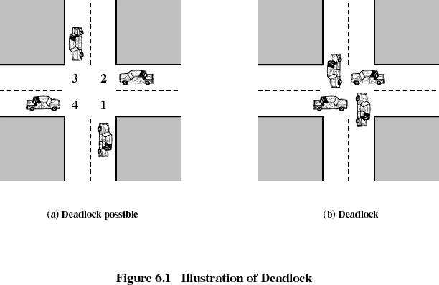

Slide 4
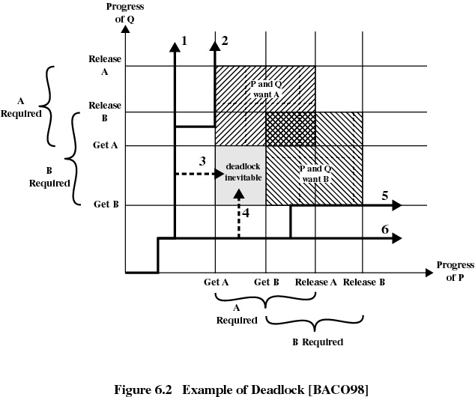

Slide 5
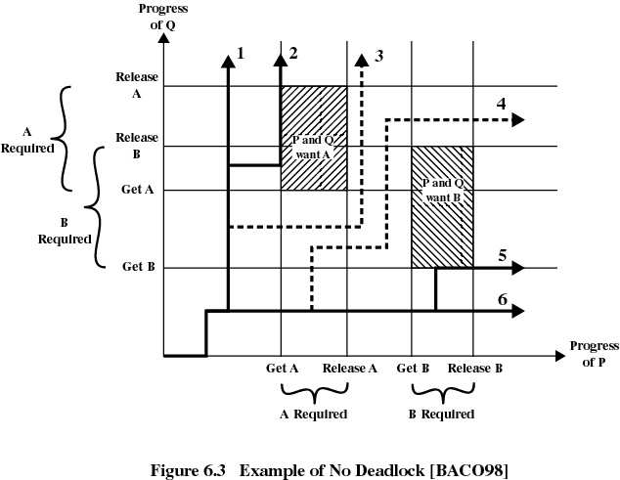

Slide 6
Reusable Resources
Used by one process at a time and not depleted by that use
Processes obtain resources that they later release for reuse by other processes
Processors, I/O channels, main and secondary memory, files, databases, and semaphores
Deadlock occurs if each process holds one resource and requests the other

Slide 7
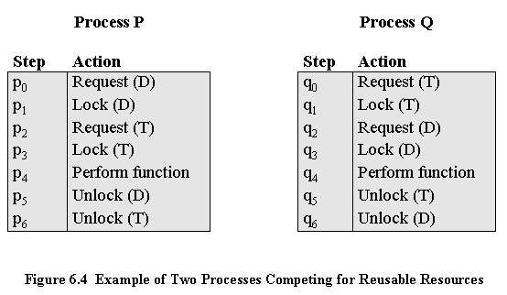
Example of Deadlock

Slide 8
Another Example of Deadlock
Space is available for allocation of 200K bytes, and the following sequence of events occur
Deadlock occurs if both processes progress to their second request
P1
P2
. . .
. . .
Request 80K bytes;
Request 70K bytes;
. . .
. . .
Request 60K bytes;
Request 80K bytes;

Slide 9
Consumable Resources
Created (produced) and destroyed (consumed) by a process
Interrupts, signals, messages, and information in I/O buffers
Deadlock may occur if a Receive message is blocking
May take a rare combination of events to cause deadlock

Slide 10
Example of Deadlock
Deadlock occurs if receive is blocking
P1
P2
. . .
. . .
Receive(P2);
Receive(P1);
. . .
. . .
Send(P2, M1);
Send(P1, M2);

Slide 11
Conditions for Deadlock
Mutual exclusion
  only one process may use a resource at a time
Hold-and-wait
  A process request all of its required resources at one time

Slide 12
Conditions for Deadlock
No preemption
  If a process holding certain resources is denied a further request, that process must release its original resources
  If a process requests a resource that is currently held by another process, the operating system may preempt the second process and require it to release its resources

Slide 13
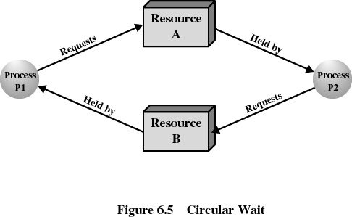
Conditions for Deadlock
Circular wait
  Prevented by defining a linear ordering of resource types

Slide 14
Deadlock Avoidance
A decision is made dynamically whether the current resource allocation request will, if granted, potentially lead to a deadlock
Requires knowledge of future process request

Slide 15
Two Approaches to
Deadlock Avoidance
Do not start a process if its demands might lead to deadlock
Do not grant an incremental resource request to a process if this allocation might lead to deadlock

Slide 16
Resource Allocation Denial
Referred to as the banker’s algorithm
State of the system is the current allocation of resources to process
Safe state is where there is at least one sequence that does not result in deadlock
Unsafe state is a state that is not safe

Slide 17
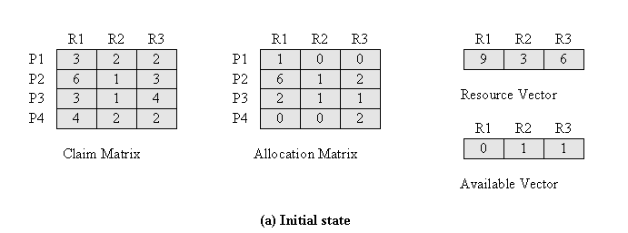
Determination of a Safe State
Initial State

Slide 18
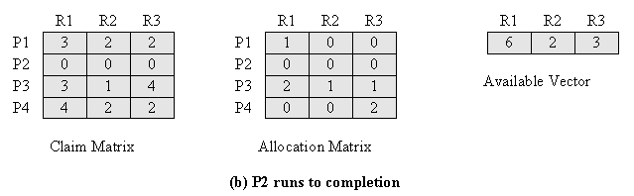
Determination of a Safe State
P2 Runs to Completion

Slide 19
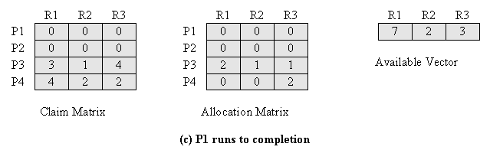
Determination of a Safe State
P1 Runs to Completion

Slide 20
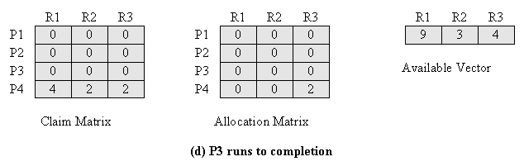
Determination of a Safe State
P3 Runs to Completion

Slide 21
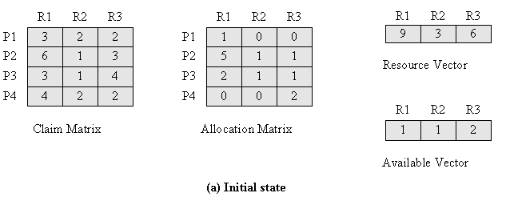
Determination of an
Unsafe State

Slide 22
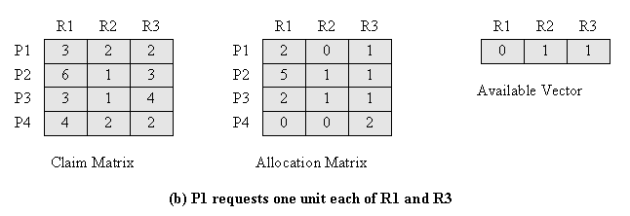
Determination of an
Unsafe State

Slide 23
Deadlock Avoidance
Maximum resource requirement must be stated in advance
Processes under consideration must be independent; no synchronization requirements
There must be a fixed number of resources to allocate
No process may exit while holding resources

Slide 24
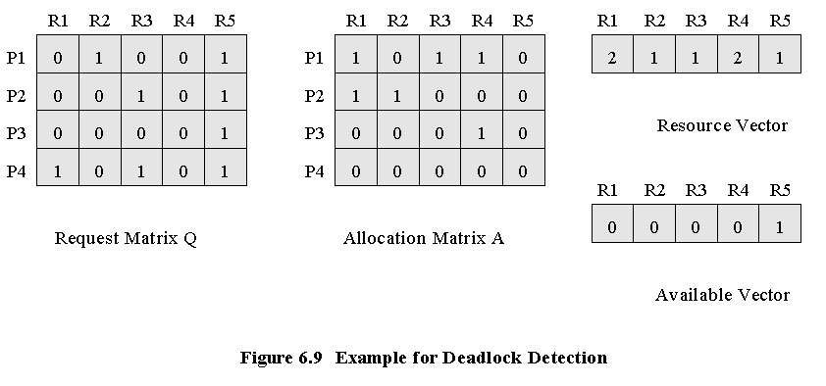
Deadlock Detection

Slide 25
Strategies once Deadlock Detected
Abort all deadlocked processes
Back up each deadlocked process to some previously defined checkpoint, and restart all process
  original deadlock may occur
Successively abort deadlocked processes until deadlock no longer exists
Successively preempt resources until deadlock no longer exists

Slide 26
Selection Criteria Deadlocked Processes
Least amount of processor time consumed so far
Least number of lines of output produced so far
Most estimated time remaining
Least total resources allocated so far
Lowest priority

Slide 27
Dining Philosophers Problem

Slide 28
UNIX Concurrency Mechanisms
Pipes
Messages
Shared memory
Semaphores
Signals

Slide 29
Solaris Thread Synchronization Primitives
Mutual exclusion (mutex) locks
Semaphores
Multiple readers, single writer (readers/writer) locks
Condition variables

Slide 30
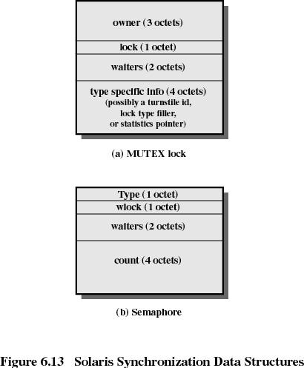

Slide 31
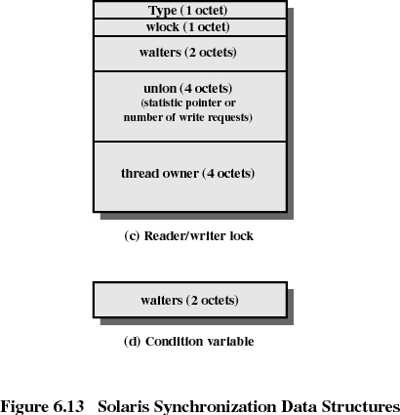

Slide 32
Windows 2000 Concurrency Mechanisms
Process
Thread
File
Console input
File change notification
Mutex
Semaphore
Event
Waitable timer

