Slide 1
G8-9
A Long Walk to Water
Session 1 — Two Lives, One Land
LEARNING GOAL
The student can describe Nya's and Salva's worlds, explain why the author tells their stories in parallel, and use at least two new vocabulary words.
Session Date: ____Sept 18th____ · Full class session
Notes:
Share screen in Zoom before the student joins. Fill in the session date before presenting.

Slide 2
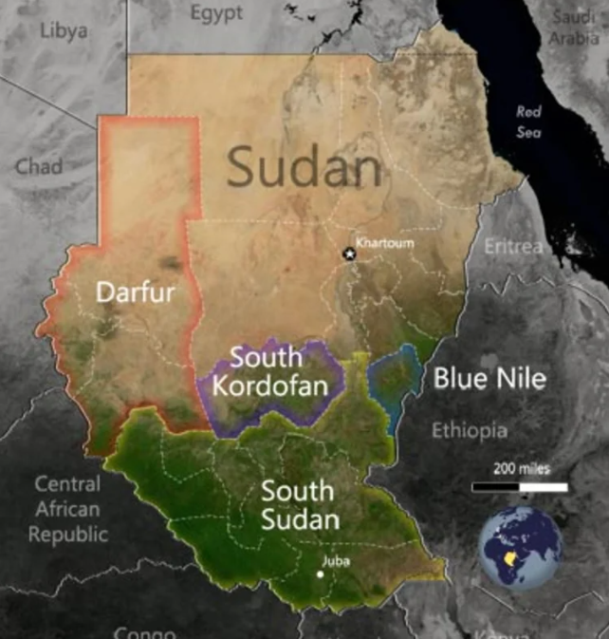
SETTING
Where in the World?
1
2
3
SOUTH SUDAN
ETHIOPIA
KENYA
Home village for
both Nya and Salva
Refugee camp on
Salva's journey
Kakuma refugee camp,
later in Salva's story
Schematic route — not drawn to scale
FAST FACTS
At the time of the story, Sudan was the largest country in Africa.
A civil war (1983–2005) forced huge numbers of people — including many children known as “Lost Boys” — to flee on foot.
Nya's family moves between two homes during the year to be near water and grazing land.
Session 1 · Slide 2 of 15

Slide 3
ROADMAP
Today's Session, Start to Finish
1
~5 min
2
~15 min
3
~10 min
Warm-Up
Read
Solve
Connect the story to your own life.
Read four key passages from Chapters 1–2 together.
Discuss and interpret what you just read.
4
~10 min
5
~10 min
6
~5 min
Memorize
Test
Wrap-Up
Learn five new vocabulary words.
Quick check: vocabulary and comprehension.
Write, reflect, and plan the next session.
Total ≈ 55 minutes — adjust the pace to fit your class length.
Session 1 · Slide 3 of 15

Slide 4
1 · WARM-UP
~5 min
Opening Conversation
?
Warm-Up Question
TIP
The book alternates between two narrators. Before reading, make sure the student can keep Nya (2008) and Salva (1985) straight — who they are, where they are, and what each is doing.
“If you had to walk a long way every day to get something your family needed, what would make that walk easier?”
Follow-up: Is there anything your own family has to work hard to get?
Listen for:
Today you will:
A specific reason, not just “a car.”
A connection to the student's own life.
Read four key passages from Chapters 1–2, discuss them, learn new words, and take a short check.
Session 1 · Slide 4 of 15

Slide 5
2 · READ (1 of 4)
Nya's Walk
SCENE — Southern Sudan, 2008 · opening of Chapter One
PDF page 7 — starts with: “Going was easy…”
Going, the big plastic container held only air. Tall for her eleven years, Nya could switch the handle from one hand to the other, swing the container by her side, or cradle it in both arms. She could even drag it behind her, bumping it against the ground and raising a tiny cloud of dust with each step.
There was little weight, going. There was only heat, the sun already baking the air, even though it was long before noon. It would take her half the morning if she didn't stop on the way.
Heat. Time. And thorns.
Describing Nya's walk to fetch water — the heat, the distance, and the empty container she carries.
While reading, ask:
What does this passage show about what Nya's body and day go through?
Session 1 · Slide 5 of 15

Slide 6
2 · READ (2 of 4)
Salva's Classroom & Family
SCENE — Southern Sudan, 1985 · Chapter One
PDF pages 7–9 — starts with: “Salva sat cross-legged…”
Salva sat cross-legged on the bench. He kept his head turned toward the front, hands folded, back perfectly straight. Everything about him was paying attention to the teacher—everything except his eyes and his mind.
His eyes kept flicking toward the window, through which he could see the road. The road home. Just a little while longer—a few minutes more— and he would be walking on that road.
… Salva's father was a successful man. He owned many head of cattle and worked as their village's judge—an honored, respected position. Salva had three brothers and two sisters. As each boy reached the age of about ten years, he was sent off to school.
Describing Salva in class, his father's position in the village, or his brothers' and sisters' roles.
While reading, ask:
What does this passage reveal about Salva's family's place in the community?
Session 1 · Slide 6 of 15

Slide 7
2 · READ (3 of 4)
Gunfire and Flight
SCENE — Southern Sudan, 1985 · end of Chapter One
PDF pages 10–11 — starts with: “CRACK! The noise had come from outside…”
Was it a gunshot? Or just a car backfiring? The teacher stopped talking for a moment. Every head in the room turned toward the window.
Nothing. Silence.
The teacher cleared his throat, which drew the boys' attention to the front of the room again. He continued the lesson from
where he had left off.
Then—
CRACK! POP-POP-CRACK!
From the moment gunfire interrupts class and the teacher tells the students what to do.
While reading, ask:
Why does the teacher tell the boys to run into the bush instead of home?
Session 1 · Slide 7 of 15

Slide 8
2 · READ (4 of 4)
Alone in the Barn
SCENE — Southern Sudan, 1985 · end of Chapter Two
PDF page 16 — starts with: “Even before he was fully awake…”
,,,Salva could feel that something was wrong. He lay very still with his eyes closed, trying to sense what it might be.
Finally, he sat up and opened his eyes. No one else was in the barn.
Salva stood so quickly that for a moment he felt dizzy. He rushed to the door and looked out. Nobody. Nothing. They had left him. He was alone.
From the moment Salva wakes up in the barn and realizes what has happened.
While reading, ask:
Why is this moment such a turning point for Salva?
Session 1 · Slide 8 of 15

Slide 9
3 · SOLVE
~10 min
From Reading to Interpretation
1
How are Nya's day and Salva's day similar? How are they different?
2
What do we learn about Salva's family and community in Chapter One?
3
What does Nya's daily task suggest about what her family needs?
4
Why might the author choose to alternate between 1985 and 2008?
Teacher follow-up for every answer: “What in the text makes you think that?” — have the student locate the passage and explain it in their own words.
Session 1 · Slide 9 of 15

Slide 10
4 · MEMORIZE
~10 min
New Words: Part 1
Scarce
Not easily found; in short supply
PRACTICE
S
“Something that is scarce at my house is …”
Displaced
Forced to leave one's home
PRACTICE
D
How might it feel to be displaced from your home?
Routine
A fixed, regular way of doing something
PRACTICE
R
What is part of your morning routine?
Session 1 · Slide 10 of 15

Slide 11
4 · MEMORIZE
~10 min
New Words: Part 2
Resilient
Able to recover quickly from difficulty
PRACTICE
R
Describe a time you had to be resilient.
Parallel
Happening at the same time, alongside something else
PRACTICE
P
Why might an author tell two stories in parallel?
Session 1 · Slide 11 of 15

Slide 12
5 · TEST
~10 min
Quick Check
PART A — Vocabulary (say the best answer)
PART C — Short Answer (2–3 sentences each)
1. Scarce means — (a) not easily found (b) delicious (c) heavy
2. Displaced means — (a) proud (b) forced to leave home (c) tired
3. Resilient means — (a) able to recover from difficulty (b) angry (c) slow
4. Parallel means — (a) happening at the same time (b) far away (c) broken
7. Why does the teacher tell the boys to run into the bush instead of going home?
8. What does Salva realize when he wakes up in the barn at the end of Chapter Two?
PART B — Fill in the blank
5. Nya's family follows a strict daily __________ to fetch water.
9. Why does the author tell Nya's and Salva's stories in parallel instead of one after the other?
6. After the attack, Salva and his neighbors were __________ from their village.
Session 1 · Slide 12 of 15
Notes:
Answer key (for teacher, not shown to student): 1-a, 2-b, 3-a, 4-a, 5-routine, 6-displaced. Q7-9 are open-ended — grade for text-based reasoning, not one right answer.

Slide 13
6 · WRAP-UP
~5 min
Short Writing
Prompt
How are Nya's world and Salva's world alike, and how are they different?
Nya's world and Salva's world are __________ because __________.
1
For example, __________.
2
This suggests __________.
3
Session 1 · Slide 13 of 15

Slide 14
6 · WRAP-UP
Exit Ticket
E
Describe one difference between Nya's life and Salva's life using one new vocabulary word, and share one question about how their stories might connect.
HOMEWORK
Read Chapter 3 (through the next Nya section)
Write three original sentences using today's vocabulary
Bring one discussion question to next session
Session 1 · Slide 14 of 15

Slide 15
SEE YOU NEXT SESSION
Chapter 3 — What happens next for Nya and Salva?
Bring your three sentences and your discussion question.
Session 1 · Slide 15 of 15

