Slide 1
Analyzing COVID-19 Data For New York City Boroughs
Notes:
[Notes to trainer:
For detailed help in customizing this template, see the very last slide. Also, look for additional lesson text in the notes pane of some slides.
Adobe Flash animations: This template contains Flash animations. These will play in PowerPoint 2000 and later. However: If you want to save this template in PowerPoint 2007, save it in the earlier PowerPoint file format: PowerPoint 97-2003 Presentation (*.ppt) or PowerPoint 97-2003 Template (*.pot) (you’ll see the file types in the Save As dialog box, next to Save as type). Warning: If you save it in a PowerPoint 2007 file format, such as PowerPoint Presentation (*.pptx) or PowerPoint Template (*.potx), the animations won’t be retained in the saved file.
Also: Because this presentation contains Flash animations, saving the template may cause a warning message to appear regarding personal information. Unless you add information to the properties of the Flash file itself, this warning does not apply to this presentation. Click OK on the message.]

Slide 2
Analyzing COVID-19 Data For New York City Boroughs
Problem Statement
The goal of this project is to analyze the COVID-19 data for New York City and identify potential correlations between number of COVID cases and other variables including gender, age, demographics, availability of hospital/medical cities, across various Boroughs of New York City
[Queens, Brooklyn, Bronx, Manhattan, Staten Island]
Also, given the availability of data for number of COVID cases for each calendar day since the beginning of this pandemic, would like to predict the curve for modeling number of COVID cases

Slide 3
Data Acquisition & Cleansing
Data Sources
Most of the data sets are available at COVID-19 NY website which is updated on a daily basis.
For choropleth Data Visualization, the latitude and longitudes of various New York City Boroughs would be needed. This geojson dataset is available at New York City Boroughs.
Foursquare location API would be used to search/explore and to get the points of interest such as medical facilities, within each New York City Borough.
NY City Borough latest Census data

Slide 4
Data Acquisition & Cleansing
Data Cleansing
Date format scrubbing
Defaulting index columns for Pandas data Frame
Conversion of Dates to float data types for modeling using sigmoid functions for Logistic Regression

Slide 5
Exploratory Data Analysis
Target Variable : Number of COVID cases across various boroughs of NY city
Total Number of COVID cases across various NY city boroughs
Number of COVID cases distribution for patient Age
Number of COVID cases distribution for patient Gender
Number of COVID cases based on Age 65 +
Correlation between [Number of COVID cases, Age 65 +]
Total Number of COVID cases progression starting 3/7 thru 4/18

Slide 6
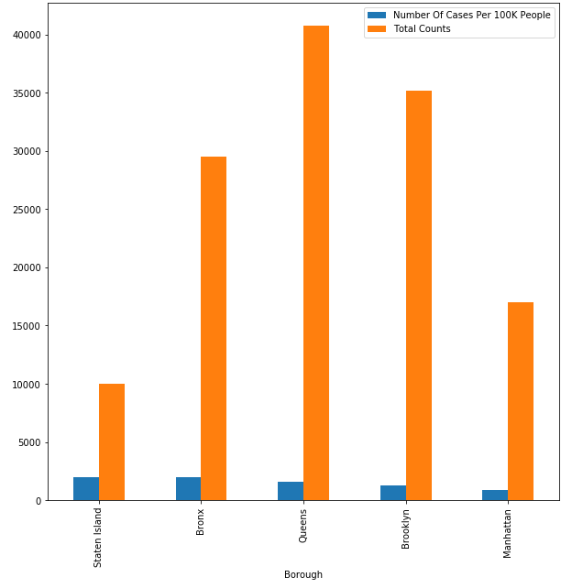
Distribution Of COVID cases across NY City Boroughs
Queen & Brooklyn Boroughs with highest Number of Cases

Slide 7
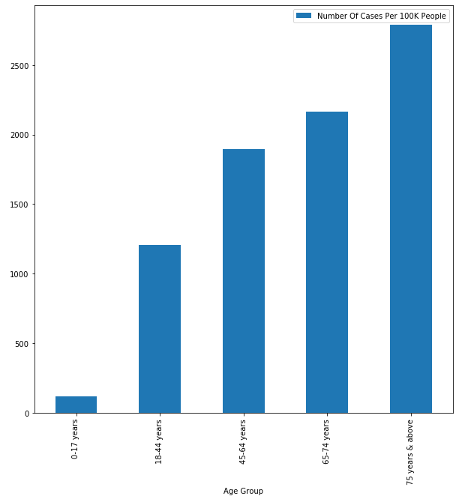
Relationship between COVID cases and patient age
Highest Number of cases for patients aged 65 & older

Slide 8
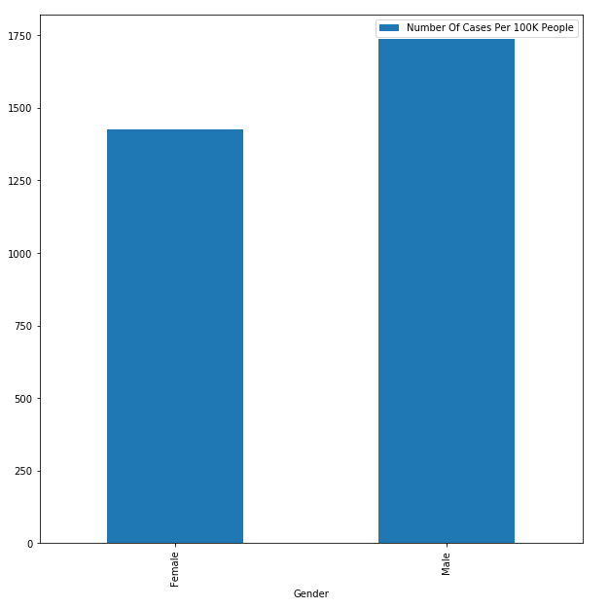
Relationship between COVID cases and patient gender
Higher Number of cases for Males. Only marginally higher

Slide 9
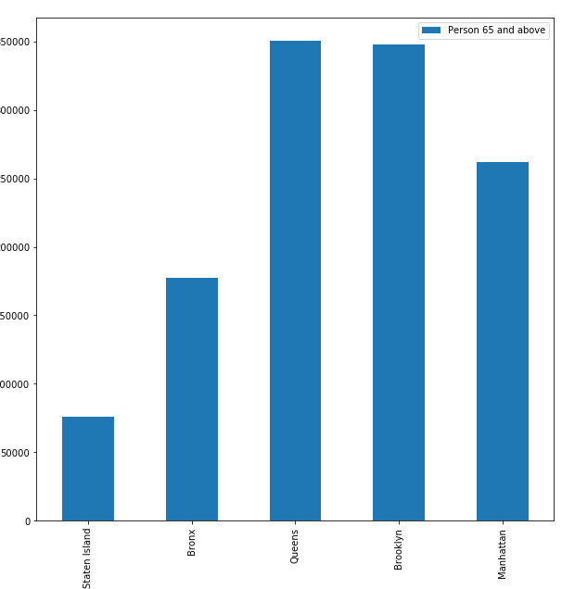
Relationship between COVID cases for patients 65 + across various Boroughs
Queens & Brooklyn have highest number of people aged 65 + [based on census data]

Slide 10
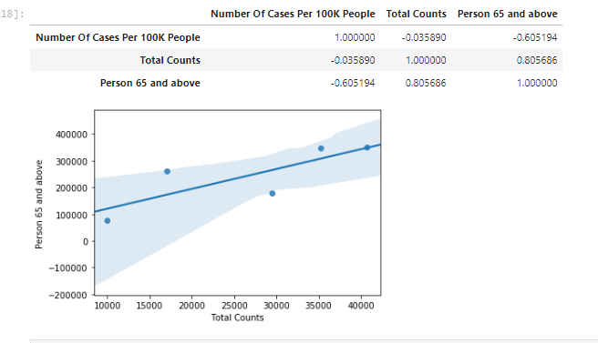
Correlation : Number of people over 65 + across various Boroughs & Number COVID cases in that Borough
Queens & Brooklyn have highest number of people aged 65 +
Age 65 + strongly correlated with number of COVID cases
Hence, Queens & Brooklyn also have the highest # of COVID cases

Slide 11
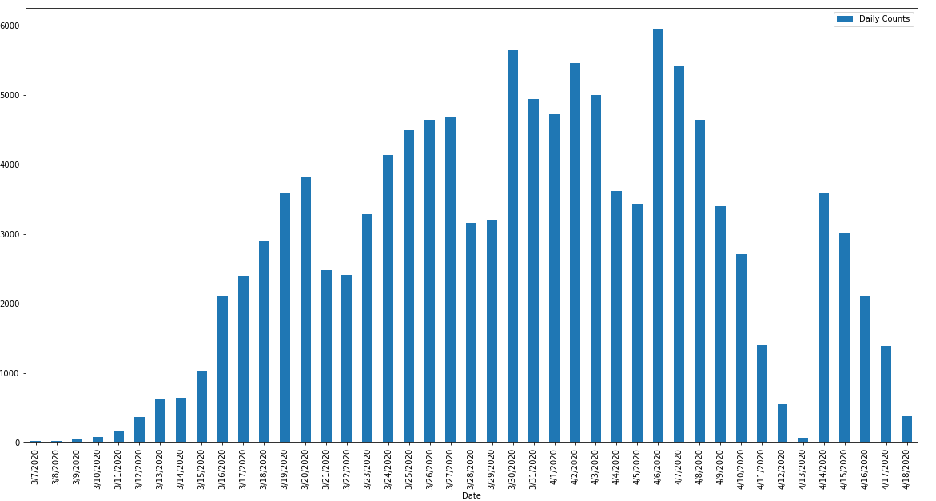
Total COVID cases in NY : 3/7/20 – 4/18/20
Cases gradually increasing, flattening, before decreasing

Slide 12
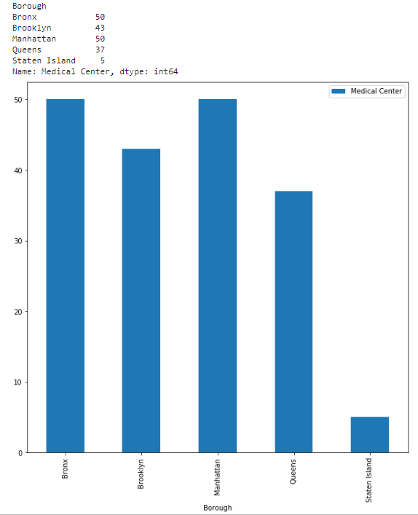
Foursquare API : Medical Centers in NY City Boroughs
Foursquare API used to determine, “Emergency Medical centers” across various NY city boroughs
Queens & Brooklyn have less Medical Centers compared to other boroughs

Slide 13
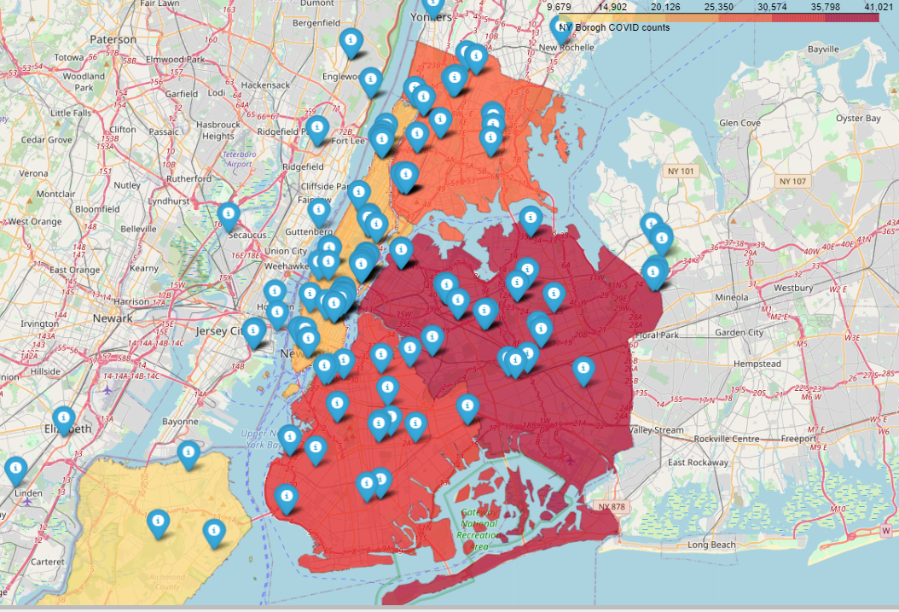
Foursquare API & Folium choropleth : Mapping Medical Centers in NY City Boroughs
Choropleth Map for NY city Boroughs based on Number of cases
Folium Markers highlight Medical Centers

Slide 14
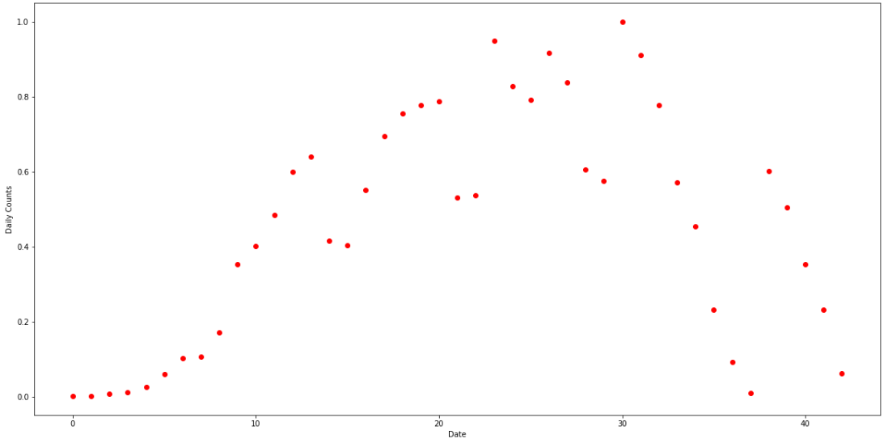
Machine Learning Models : Predictive Modeling
Number of Cases over time, follows non-linear distribution
# of cases progressively increasing, flattening before decreasing
Fits Logistic Regression Model

Slide 15
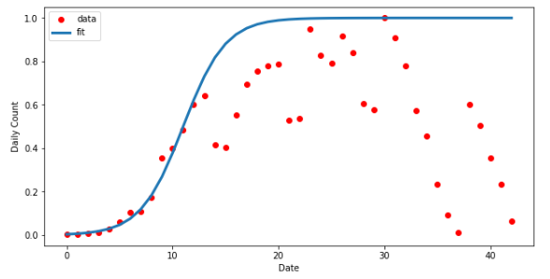

Machine Learning Models : Logistic Regression
Sigmoid Function For Logistic Regression
Model Accuracy :

Slide 16
Conclusion
Conclusion
Queens & Brooklyn Boroughs had the highest number of COVID cases, since they also had the highest number of elderly people [65 + years] [based on the latest census data]
Based on the data, there is a strong correlation between the number of COVID cases and patient age. Higher the patient age [65 +] in a given Borough, higher the case count in that Borough
Distribution of COVID cases over a period of time, follows a Logistic Regression model [i.e. slow growth initially, gradual growth, flattening, followed by a decrease]
Based on the Foursquare API, the number of venues [Emergency Hospitals] were relatively lesser in Queens & Brooklyn.

