Slide 1
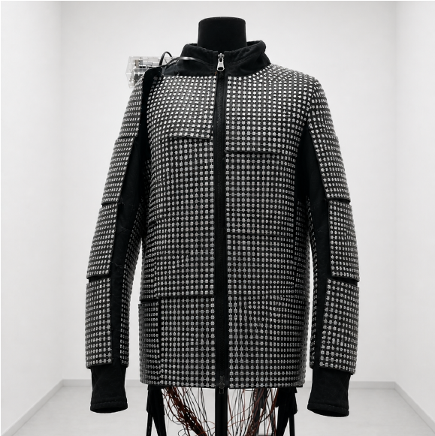
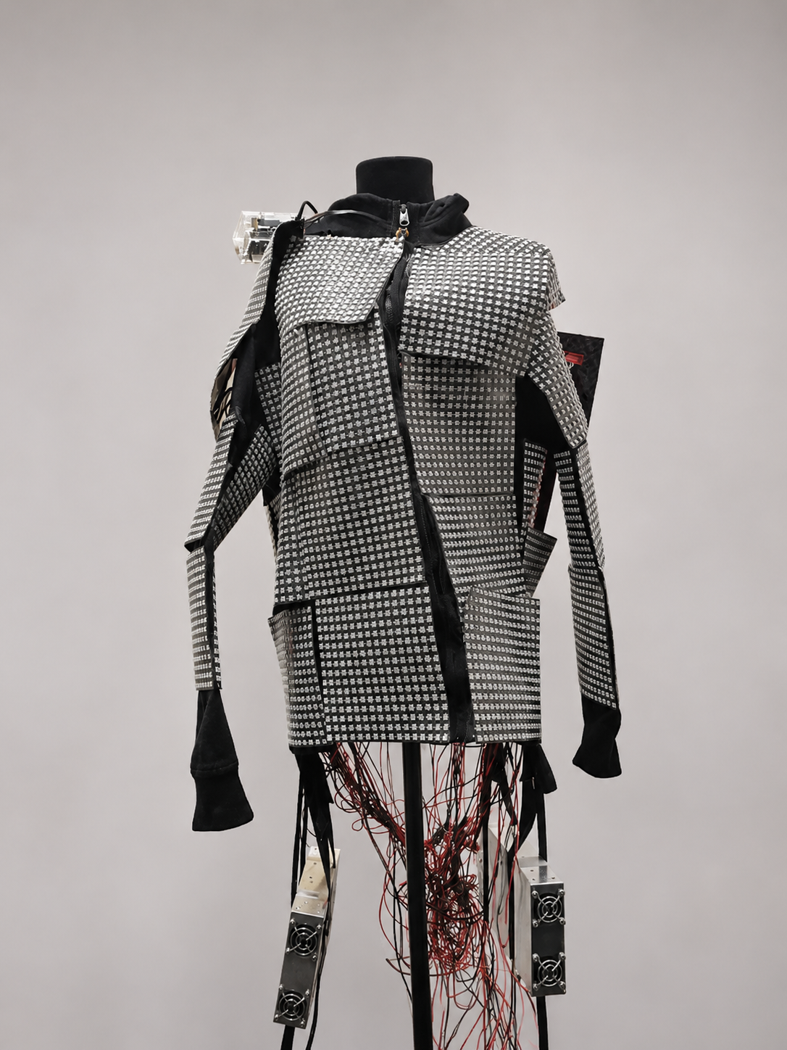
Dynamic Physical Adversarial LED Patterns via Reinforcement Learning
NEURIPS 2026
Closed-loop control of a wearable LED array to evade person detectors
Konstantin Zyryanov · Nikita Lotts
Lomonosov Moscow State University · HSE University
zyryanov.konstantin.sergeevich@gmail.com · nklotts@edu.hse.ru
Notes:
Hi, I’m [presenter name]. This is joint work with [co-author]. Our question is simple: physical adversarial attacks are usually a fixed printed pattern — what happens if the pattern can change in response to the scene? On the right is our testbed: a jacket covered with almost ten thousand individually controllable RGB LEDs.

Slide 2
Physical adversarial attacks today are static
MOTIVATION
Printed patches
Adversarial T-shirts
Camouflage textures
Thys et al., 2019
Xu et al., 2020
Hu et al., 2022
All are optimized once and printed. Light, distance and viewing angle keep changing — the pattern doesn’t.
OUR QUESTION
Can an emissive pattern that adapts to the scene, using only black-box detector feedback, beat a fixed one?
Zyryanov & Lotts · Dynamic Physical Adversarial LED Patterns · NeurIPS 2026
2
Notes:
Most physical attacks — patches, T-shirts, camouflage textures — are optimized once and then printed. But the real scene is not fixed: lighting, distance and viewing angle change all the time, and the pattern cannot react. So we ask: if the pattern is emissive and programmable, and a policy can change it based on what it sees, does that beat the best fixed pattern? And we want to do this in a black-box setting, with only the detector’s confidence as feedback.

Slide 3
The paper in three lines
STUDY OVERVIEW
Closed-loop physical adversarial control — a policy changes a wearable LED array based on what its cameras see
Setting
PR-SAC — Physically Regularized Soft Actor-Critic with latent actions and structured upsampling
Approach
89.1 / 84.7 / 86.8 % attack success on YOLOv8 / Faster R-CNN / RetinaNet — +38–42 pp over the best static pattern
Finding
Zyryanov & Lotts · Dynamic Physical Adversarial LED Patterns · NeurIPS 2026
3
Notes:
Here is the whole talk in three lines. The setting is closed-loop physical adversarial control: a policy controls a physical actuator, our LED garment, based on camera observations. The method is PR-SAC, a physically regularized version of Soft Actor-Critic, with a latent action space. And the main finding: the dynamic policy reaches 89, 85 and 87 percent attack success rate on three detectors — about 40 percentage points more than the best fixed pattern.

Slide 4
A wearable array of 9,984 RGB LEDs
TESTBED
39 × 16²
29,952
LED panels
RGB control values (d)
Orange Pi 5 Pro
3 GB GPU
drives the LED matrix
training + detector inference
Onboard front + back cameras → what the policy observes
Separate external camera → what the detector is scored on
Zyryanov & Lotts · Dynamic Physical Adversarial LED Patterns · NeurIPS 2026
4
Notes:
The testbed: 39 panels of 16 by 16 RGB LEDs, almost ten thousand LEDs, so the raw action has about thirty thousand dimensions. An Orange Pi drives the matrix, and a single consumer GPU with 3 GB handles training and detection. One important design choice: the cameras on the garment are only for observation — they tell the policy what the scene looks like. Attack success is measured by a separate external camera, so the policy never sees the evaluation view directly.

Slide 5
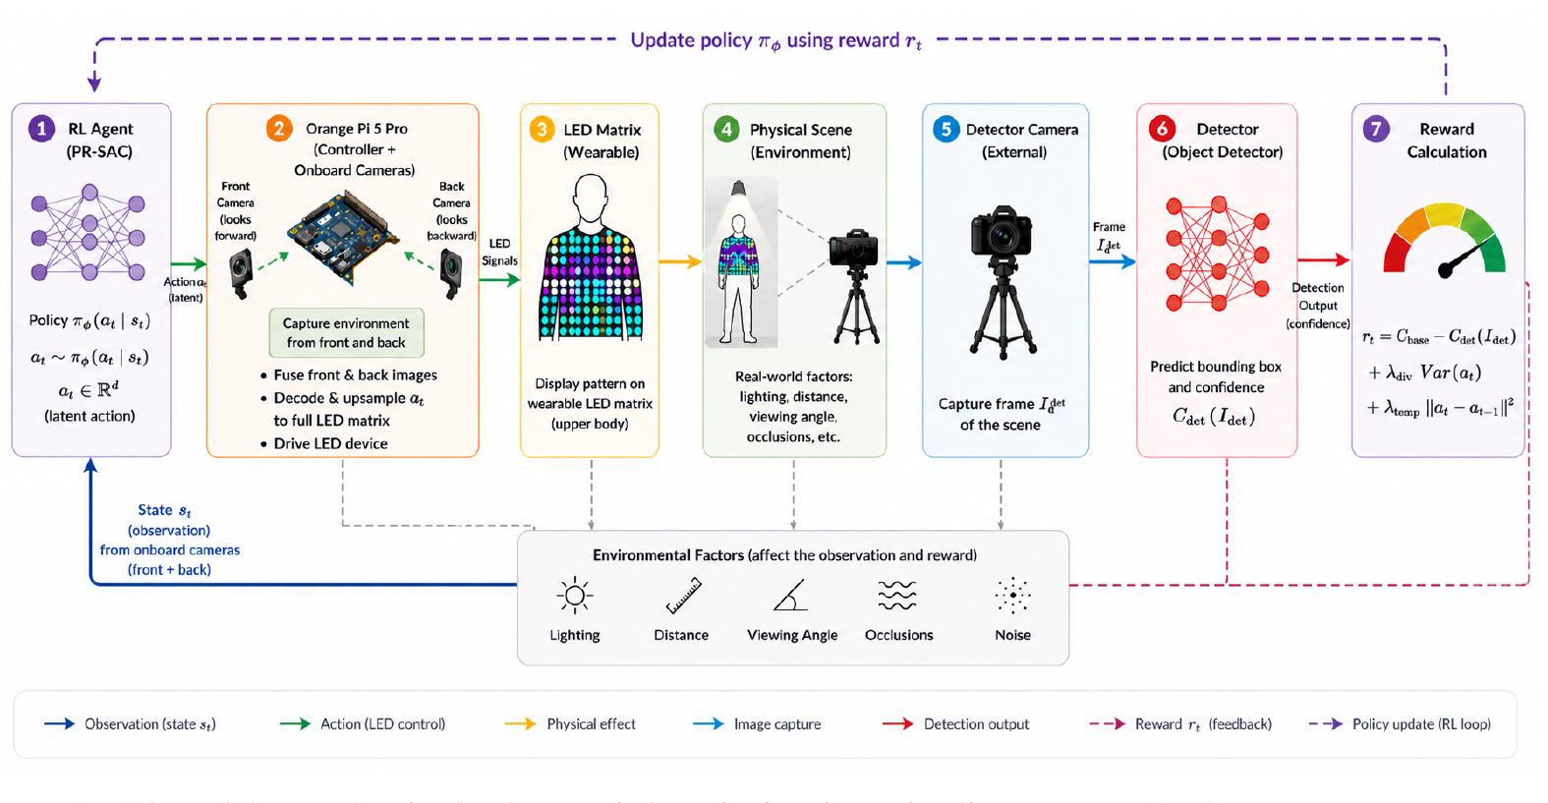
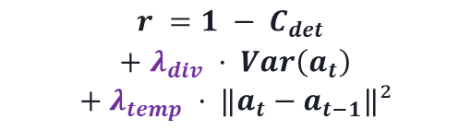
The attack as a closed-loop RL problem
FORMULATION
Reward
$$r =1 − C_{det }$$
$$+ λ_{div} · Var\left(a_{t}\right)$$
$$+ λ_{temp} · ‖a_{t}−a_{t−1}‖²$$
Threat model
Black-box: no gradients, weights or camera access
Training: detector confidence only
Test time: no detector feedback
Zyryanov & Lotts · Dynamic Physical Adversarial LED Patterns · NeurIPS 2026
5
Notes:
Here is the loop. The agent observes the scene through the onboard cameras, outputs an LED pattern, the controller renders it on the garment, the external camera captures the scene, the detector gives a confidence for the person class, and that becomes the reward. The main reward term is one minus the detector confidence, plus small terms for action diversity and temporal variation. The threat model is strictly black-box: we never touch the detector, its weights or the camera; we only see its confidence during training, and at test time the policy runs without any detector feedback.

Slide 6
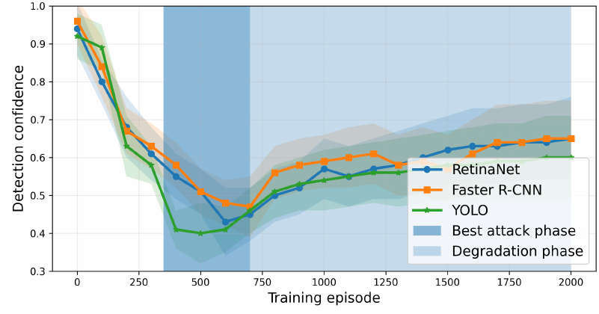
Why RL is unstable in the physical loop
CHALLENGE
Noisy reward
Sensor noise and measurement noise in every detector score
Drifting scene
Pose, light and distance change, so the Bellman operator is time-dependent
Replay mismatch
Old transitions no longer match the current policy or scene
→ Q-drift, entropy collapse, degradation after the peak
Detection confidence over training (mean of 15 runs): best attack around episodes 350–700, then degradation
Zyryanov & Lotts · Dynamic Physical Adversarial LED Patterns · NeurIPS 2026
6
Notes:
Why is this hard? Three reasons. The reward is noisy — every detector score includes sensor and measurement noise. The scene drifts — pose, light and distance change, so the Bellman operator itself changes over time. And replay data goes stale: old transitions no longer reflect the current policy or scene. Together this produces Q-drift, entropy collapse, and the pattern you see on the right: confidence drops nicely until about episode 500, and then it climbs back. PR-SAC is designed to push back against exactly this.

Slide 7
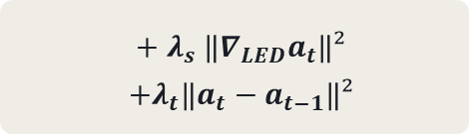
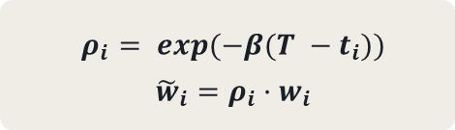
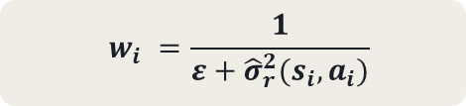
PR-SAC: three fixes on top of SAC
METHOD
1 · SMOOTH
2 · TRUST
3 · RECENT
Regularize the actor
Down-weight noisy transitions
Recency-weighted replay
Penalize jumps between neighboring LEDs and between frames
Stale samples from an older scene count for less
Critic loss weighted by the estimated reward variance
$$+ λ_{s} ‖∇_{LED}a_{t}‖²$$
$$+λ_{t}‖a_{t}−a_{t−1}‖²$$
$$ρ_{i}= exp⁡(−β(T −t_{i}))$$
$${\tilde{w}}_{i}=ρ_{i}·w_{i}$$
$$w_{i} =\frac{1}{ε+{\hat{σ}}_{r}^{2}(s_{i},a_{i})}$$
Improves stability in practice; no formal convergence guarantee.
Zyryanov & Lotts · Dynamic Physical Adversarial LED Patterns · NeurIPS 2026
7
Notes:
PR-SAC adds three things to standard SAC. First, smoothness: the actor is penalized for large differences between neighboring LEDs and between consecutive frames, which keeps patterns physically renderable. Second, trust: each critic update is weighted by the inverse of the estimated reward variance, so noisy physical transitions count less. Third, recency: replay samples are down-weighted exponentially with age, because old samples come from a different scene. This improves stability in practice, but to be clear, we don’t have a convergence guarantee.

Slide 8
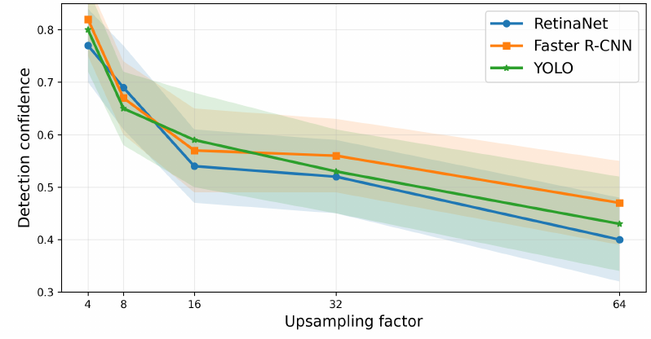
Latent actions tame 29,952 dimensions
METHOD
Latent action
Decode
Structured upsampling
9,984-LED pattern
Final detection confidence (lower = stronger)
Direct LED control
0.71
Latent action
0.60
Latent + structured upsampling
0.43
Degradation after peak also drops: 0.19 → 0.18 → 0.13 (15 runs)
Upsampling factor trades detail for stability: low factors are unstable, high ones over-smooth
Zyryanov & Lotts · Dynamic Physical Adversarial LED Patterns · NeurIPS 2026
8
Notes:
The second ingredient is the action space. Controlling all thirty thousand values directly makes the critic unstable. Instead the policy outputs a small latent action, which is decoded and deterministically upsampled to the full LED pattern. On the left you see the effect: direct control ends at 0.71 confidence, a latent action gets 0.60, and latent plus structured upsampling reaches 0.43, with less degradation after the peak. The upsampling factor is a trade-off between detail and stability, shown on the right.

Slide 9
Adapting beats any fixed pattern
MAIN RESULT
Attack success rate, %
YOLOv8
Faster R-CNN
RetinaNet
Random LED
8.7
10.6
7.9
CMA-ES (static)
43.5
45.1
47.8
PR-SAC, frozen
50.8
42.6
46.8
Vanilla SAC
61.9
55.8
54.6
PR-SAC, dynamic
89.1
84.7
86.8
+38 to +42 pp
over the same policy, frozen to one pattern (+38.3 / +42.1 / +40.0) — the gain comes from adapting, not from the pattern
Mean over 15 independent runs, 300 frames each · Table 2
9
Notes:
This is the key result. Attack success rate is the share of frames where the person is not detected. Random LEDs barely matter, under 11 percent. A static pattern optimized with CMA-ES reaches 44 to 48. Vanilla SAC gets 55 to 62. Dynamic PR-SAC reaches 89, 85 and 87 percent. The most important control is the dark bar: the same trained PR-SAC policy, but frozen to a single pattern. It drops to 43–51 percent. So about 40 percentage points come from adapting the pattern to the scene, not from the pattern itself.

Slide 10
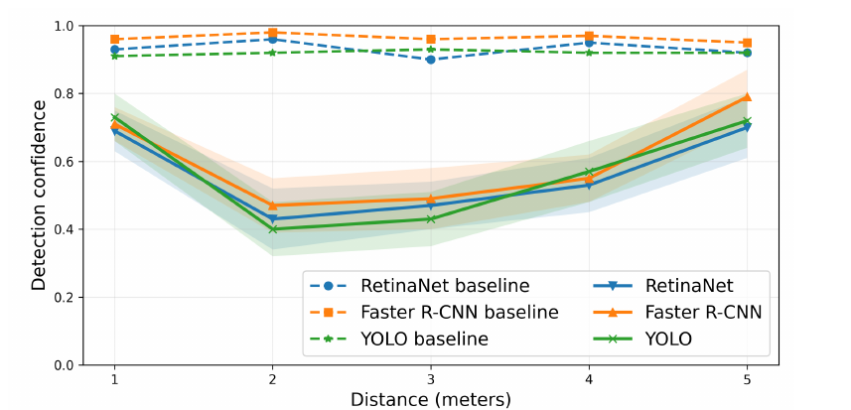
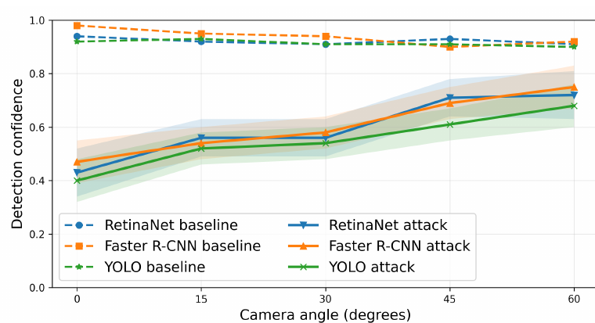
New locations: weaker, but still strong
GENERALIZATION
YOLOv8
Faster R-CNN
RetinaNet
89.1 → 77.3%
84.7 → 69.8%
86.8 → 74.5%
Unseen locations, no fine-tuning — still above every static baseline in familiar ones (≤ 50.8%)
Confidence vs. distance (1–5 m)
Confidence vs. viewing angle (0–60°)
Mean over 15 runs · Table 2, Figure 5
10
Notes:
Does it work outside the training locations? We tested trained policies in new locations with a different background, geometry and lighting, with no fine-tuning. Attack success drops by 12 to 15 points — to 77, 70 and 75 percent — but it is still higher than any static baseline achieves in the familiar locations. Below: the attack weakens with distance and with viewing angle, because the garment covers less of the image and the pattern is more distorted. So this is partial generalization, not robustness to arbitrary conditions.

Slide 11
Patterns partially transfer across detectors
TRANSFERABILITY
Train ↓ · Test →
YOLO
Faster R-CNN
RetinaNet
0.40
0.48
0.51
Strongest on the training detector
YOLO
Diagonal: 0.40 / 0.47 / 0.43
0.52
0.47
0.56
Still effective elsewhere
Faster R-CNN
Off-diagonal 0.48–0.56, vs. 0.92–0.96 with no attack
0.54
0.55
0.43
Cells: mean detection confidence; darker = lower = stronger attack
RetinaNet
Mean over 15 runs · Tables 3, 5
11
Notes:
We also trained on one detector and tested on the others. The diagonal — same detector for training and testing — is strongest, as expected. Off the diagonal, confidence is 0.48 to 0.56. That is weaker, but far below the 0.92 to 0.96 the detectors give without any attack, so the learned patterns partially transfer across architectures.

Slide 12
Dedicated defenses help; none removes the attack
DEFENSES
ASR under defense, %
YOLOv8
Faster R-CNN
RetinaNet
No defense
89.1
84.7
86.8
Gaussian blur
61.2
56.8
69.4
JPEG compression
63.6
58.9
71.0
Morphological
39.8
30.9
46.5
UDFilter
35.7
27.8
41.2
RAPID
24.6
17.6
29.8
LIMITATIONS
One LED platform, three detectors · adversarial training and certified defenses not tested · training remains unstable (~5–6 h per run)
Same PR-SAC evaluation frames · Table 8
12
Notes:
How do defenses react? Generic input processing — blur and JPEG compression — only reduces attack success to roughly 57 to 71 percent. Defenses designed for physical attacks do much better: our earlier morphological defense, UDFilter, and especially RAPID, which brings attack success down to 18 to 30 percent. But none of them removes the attack completely. Limitations: we tested one hardware platform and three detectors, we did not evaluate adversarial training or certified defenses, and training is still unstable and takes five to six hours per run.

Slide 13
Adaptive physical attacks are much stronger than static ones — robustness evaluations should include them, along with generalization and training stability.
TAKEAWAY
Konstantin Zyryanov · Nikita Lotts
Thank you
Responsible release: no real-time deployment tools or optimized policies for specific targets are released.
Notes:
To conclude: adapting the pattern to the scene is worth about 40 points of attack success over the best fixed pattern, on all three detectors. That means robustness evaluations of person detectors should include adaptive physical attacks, and should report generalization to new environments and training stability, not just a single best number. To limit misuse, we don’t release deployment tools or trained policies. Thank you — come talk to us at the poster.

Slide 14
Detection confidence and mAP@0.5
BACKUP · FULL RESULTS
Lower = stronger attack
Detection confidence (Table 5)
mAP@0.5, person (Table 6)
Method | YOLOv8 | F. R-CNN | RetinaNet | YOLOv8 | F. R-CNN | RetinaNet
Clean baseline | 0.92 ± 0.04 | 0.96 ± 0.03 | 0.94 ± 0.03 | 0.88 ± 0.03 | 0.85 ± 0.03 | 0.83 ± 0.03
Random search | 0.81 ± 0.04 | 0.79 ± 0.04 | 0.82 ± 0.05 | 0.74 ± 0.04 | 0.72 ± 0.04 | 0.73 ± 0.04
CMA-ES | 0.71 ± 0.05 | 0.70 ± 0.05 | 0.68 ± 0.06 | 0.64 ± 0.05 | 0.63 ± 0.05 | 0.62 ± 0.05
Vanilla SAC | 0.59 ± 0.08 | 0.66 ± 0.07 | 0.67 ± 0.08 | 0.54 ± 0.06 | 0.58 ± 0.06 | 0.57 ± 0.06
PR-SAC | 0.40 ± 0.08 | 0.47 ± 0.08 | 0.43 ± 0.09 | 0.42 ± 0.06 | 0.47 ± 0.05 | 0.45 ± 0.05
Mean ± std over 15 independent runs; 95% Student-t confidence intervals in the paper.
Zyryanov & Lotts · Backup
B1
Notes:
Backup for Q&A. Full confidence and mAP@0.5 numbers. PR-SAC gives the lowest confidence and lowest mAP on all three detectors; vanilla SAC is second but with higher variance.

Slide 15
Reward design: regularization terms matter
BACKUP · ABLATION
Reward | YOLO | F. R-CNN | RetinaNet
−C | 0.62 ± 0.06 | 0.64 ± 0.08 | 0.67 ± 0.06
1 − C | 0.59 ± 0.07 | 0.60 ± 0.08 | 0.63 ± 0.08
−log C | 0.56 ± 0.05 | 0.54 ± 0.06 | 0.57 ± 0.06
(1 − C)² | 0.55 ± 0.06 | 0.53 ± 0.09 | 0.61 ± 0.07
+ variance | 0.43 ± 0.09 | 0.51 ± 0.07 | 0.50 ± 0.09
+ temporal diff | 0.40 ± 0.08 | 0.47 ± 0.08 | 0.43 ± 0.09
Detection confidence after training; lower = stronger attack.
Default reward: 1 − C plus diversity and temporal terms. Excessive shaping can reduce stability.
Mean ± std over 15 runs · Table 4
B2
Notes:
Backup: reward ablation. Plain confidence-based rewards end around 0.55 to 0.67. Adding the action-variance term and then the temporal-difference term brings confidence down to 0.40, 0.47 and 0.43.

Slide 16
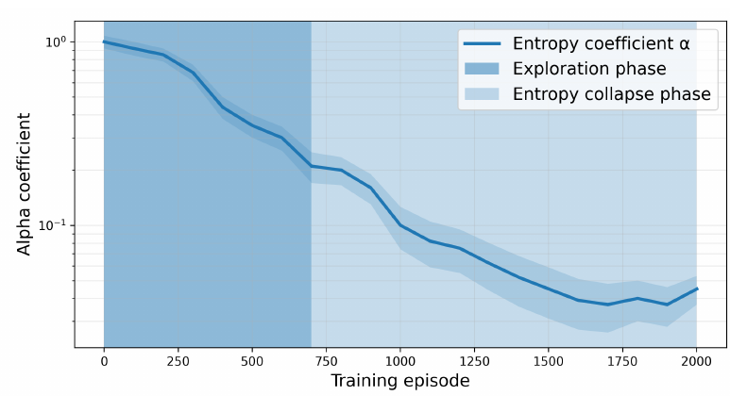
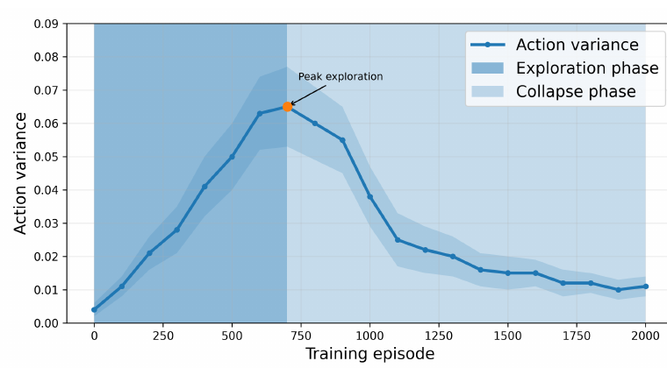
Entropy collapse is delayed, not removed
BACKUP · STABILITY
Entropy coefficient α over training
Action variance over training (peak exploration ≈ episode 700)
Diversity collapse coincides with the degradation phase; checkpoints are chosen on held-out validation confidence.
Mean over 15 runs · Figure 6
B3
Notes:
Backup: training stability. The entropy coefficient keeps falling, and action variance peaks around episode 700 and then collapses. This lines up with the degradation phase in the training curve. PR-SAC delays this collapse but does not prevent it, which is why we select checkpoints on a held-out validation sequence.

Slide 17
Evaluation protocol
BACKUP · PROTOCOL
Attack success rate
Statistics
% of frames with no person detection matching ground truth at IoU ≥ 0.5 and confidence ≥ 0.6
15 independent seeds × 300 evaluation frames; run-level mean, std, 95% Student-t CI
Training
Checkpoint selection
2,000 episodes of ~10–12 s each, ~5–6 h per run
Minimum mean confidence on a held-out validation sequence
Baselines
Scene variation
Random LED, vanilla SAC, CMA-ES static pattern in the same latent space with the same reward and query budget
Operator varies pose, viewpoint, distance, light on a shared schedule; unseen locations without fine-tuning
Section 4.5
B4
Notes:
Backup: evaluation details. Every number in the talk is a mean over 15 independent training runs, 300 evaluation frames each. The CMA-ES baseline optimizes a static pattern in the same latent space, with the same reward and the same query budget as PR-SAC, so the comparison is fair.

