Slide 1

Fire Breathing Rubber Duckies
RUBBER DUCKY TRADER
Public Demonstration

Slide 2
Fulfilled Requirements (ATTP)
Reading a correctly formatted Sirca orders file (1 Day only)
Sirca files can be easily chosen with the help of the GUI’s file-browser.
Contents of input Sirca file can be viewed in the GUI’s spreadsheet viewer.
Choosing an appropriate algorithmic trading strategy and setting its different parameters
We provide the choice of using our (Fire-breathing) MSM or another group’s (Actuators) MSM
Customisable parameters include Window and Threshold values
Generating Algorithmic orders for 1 particular day
Module order outputs can be viewed in the GUI’s spreadsheet viewer
Evaluating algorithmic orders and providing feedback to user
We provide line-by-line calculation of returns of each Buy/Sell pair and provide an overall returns value to determine profit or loss.
GUI functions to visualise market data (Spread, volume and depth) as well as when orders are made
Currently, our GUI displays all data as represented in a spreadsheet format.
We aspire to create intuitive graphs and visualisations in later releases.

Slide 3
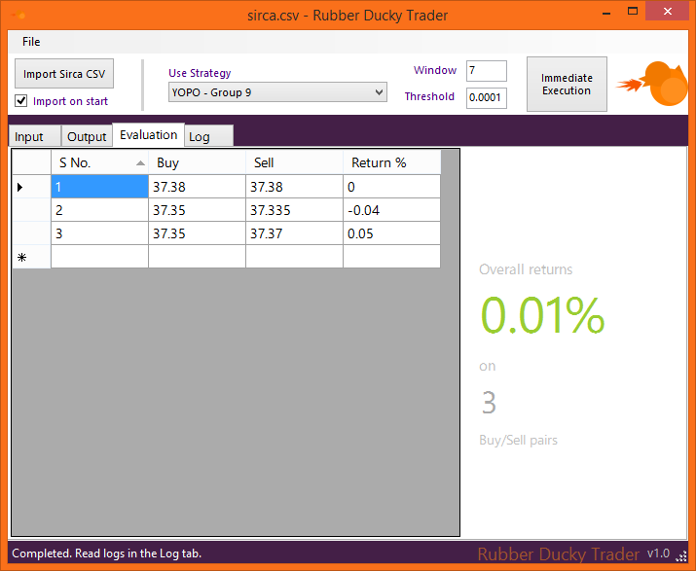
Which modules are being used?
We have chosen to use our Momentum Strategy Module, and modules from 2 other teams:
Actuators (Group 1)
YOPO (Group 9)
Window and Threshold values are fully customisable in the GUI, as well as Strategy
An Evaluator module performs the final evaluation stage of the process:
Takes the Order Book as input
Creates a text file with a list of Buy/Sell pairs
Finally, the GUI displays this in simple format
Large sidebar with overall returns
Buy/Sell pairs represented in table format, with in-built sorting available
A Log tab that displays logs from each Strategy module, including time taken.

Slide 4
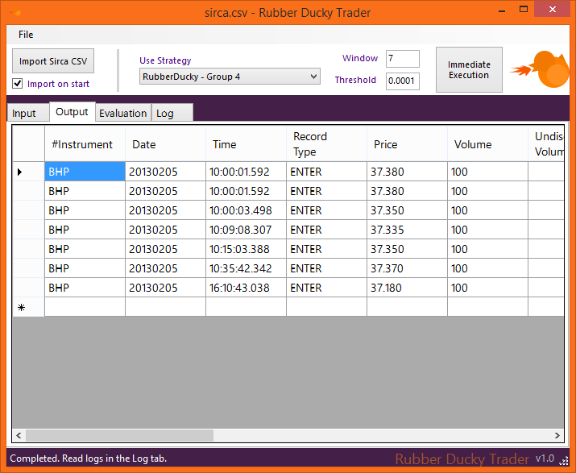
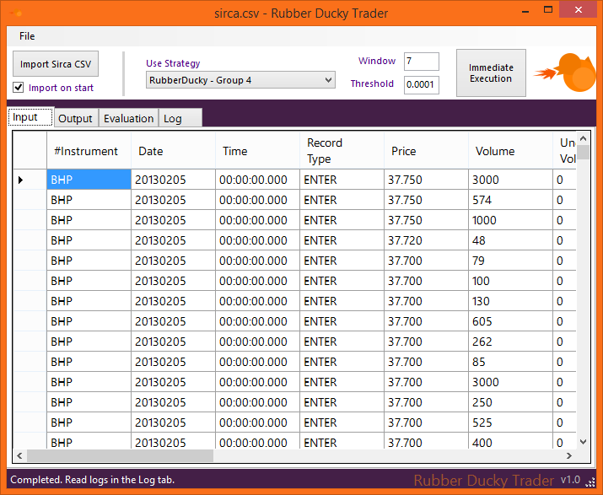
Demonstration

