Slide 1
Project-01
Pokemon Data analysis using HIVE,HDFS,MAPREDUCE

Slide 2
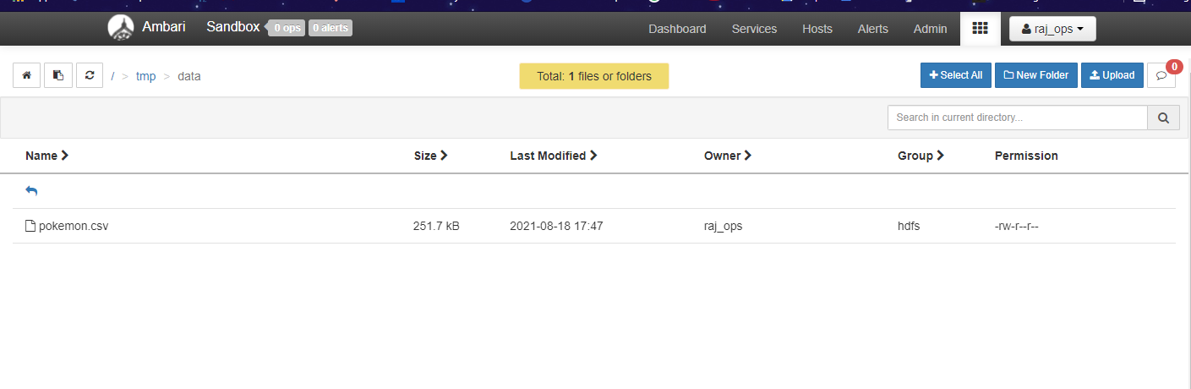
INPUT DATA LOCATION IN HDFS

Slide 3
Copy Data to local using HDFS
Copy the data to local using hdfs through hdfs terminal and then load the data from local.
Syntax :hdfs dfs –copyToLocal /path/to/file/on/hdfs root
go to hive shell and from there load the data from local
Syntax:load data inpath ‘/root/pokemon.csv’ into table table_name;

Slide 4
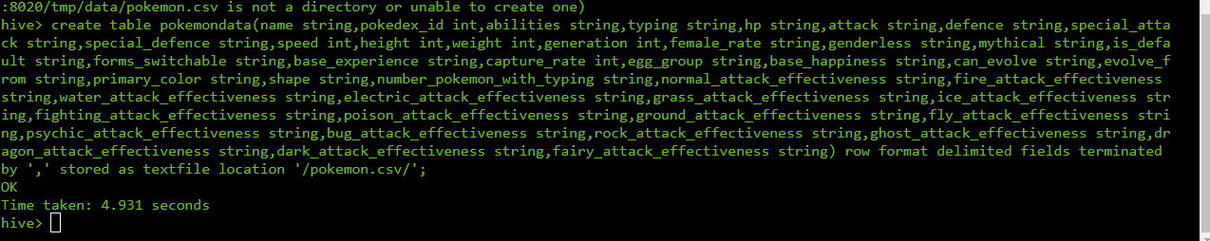
Creating table in hive

Slide 5
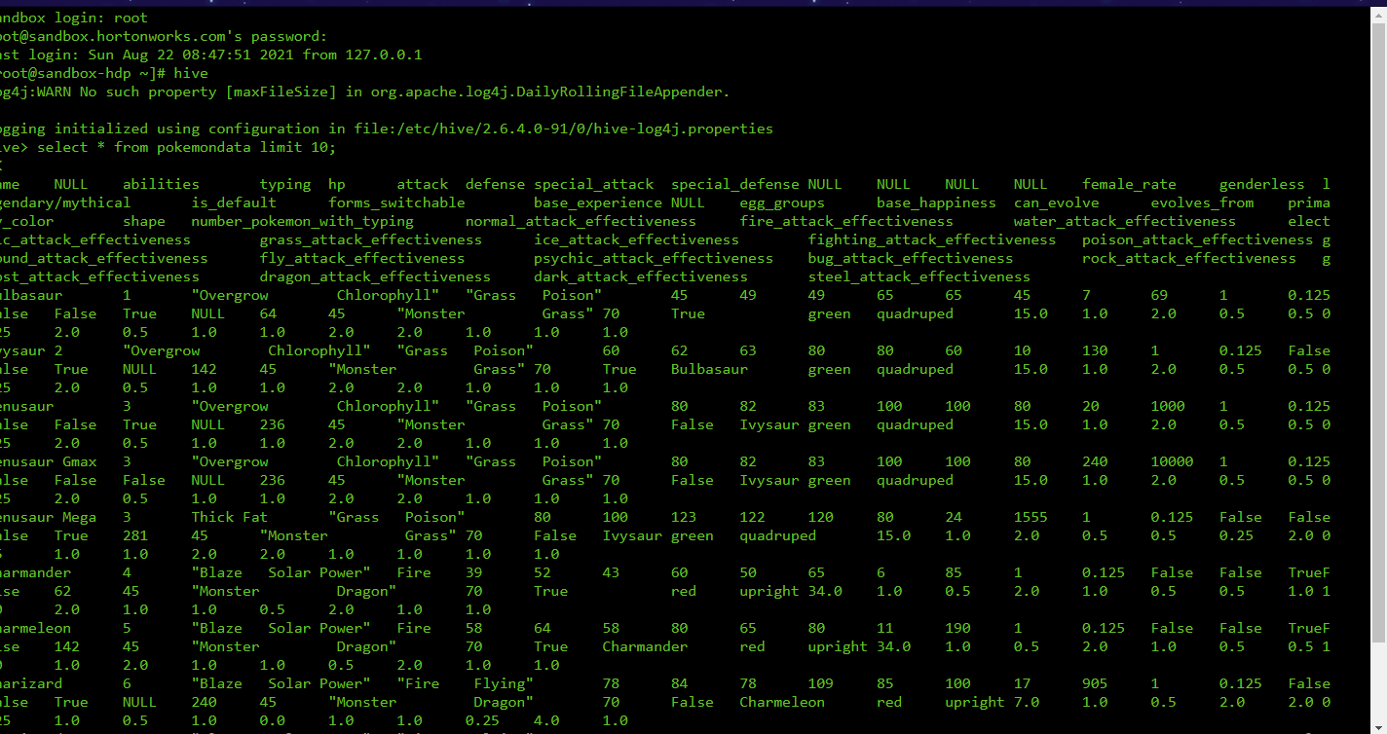
Select * from pokemondata limit 100;

Slide 6
Questions:
Questions:
1. Finding total number of pokemons in dataset.
2. Select name from pokemondata limit 10.
3. Selecting name,pokedex_id,ability,special_attack from pokemondata limit 20.
4. Describe pokemondata.
5.Select name,abilities,typing,hp,attack,defence,special_attack from pokemondata where attack>50 and defence=65 limit 15.
6. Select name,height,weight,speed,generation from pokemondata where height>100 and speed between 50 and 88 and height not in(50,55) limit 30.
7.Select avg(hp) from pokemondata.
8.Create table pokemon1 as select * ,if(hp>75.98, ‘powerful’,if(hp<75.98,’moderate’,’powerless’)) as power_rate from pokemondata;.
9.Select count(name),power_rate from pokemon1 group by power_rate. (Find out powerful and moderate hp pokemon present.)
10.Select name,hp from pokemon1 order by hp desc limit 10. (Find out the top 10 pokemons according to their hp’s using the below query.)
11.Select name,attack from pokemon1 order by attack desc limit 10. (Find out the top 10 pokemons based on their Attack stat,using below query.)

Slide 7

1. Find total number of pokemon in pokemon dataset

Slide 8

2.Select name from pokemondata limit 10;

Slide 9

3.Selecting name,pokedex_id,ability,special_attack from pokemondata limit 20;

Slide 10

4.Describe pokemondata;

Slide 11

5.Select name,abilities,typing,hp,attack,defence,special_attack from pokemondata where attack>50 and defence=65 limit 15

Slide 12
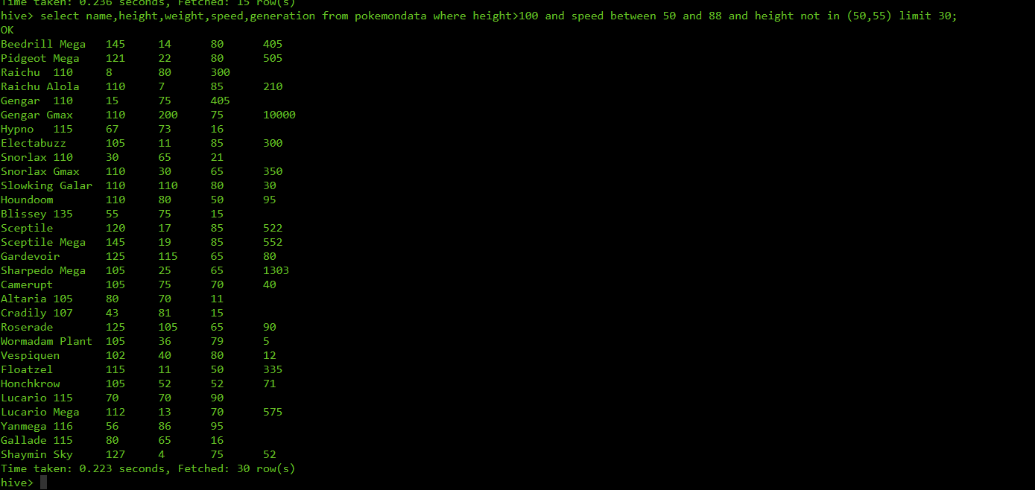
6. Select name,height,weight,speed,generation from pokemondata where height>100 and speed between 50 and 88 and height not in(50,55) limit 30;

Slide 13

7.Select avg(hp) from pokemondata;

Slide 14

8.Create table pokemon1 as select * ,if(hp>75.98, ‘powerful’,if(hp<75.98,’moderate’,’powerless’)) as power_rate from pokemondata;

Slide 15

9.Select count(name),power_rate from pokemon1 group by power_rate; We will find out powerful and moderate hp pokemon present ,using this query;

Slide 16

10.Select name,hp from pokemon1 order by hp desc limit 10; find out the top 10 pokemons according to their hp’s using the below query.

Slide 17

11.Select name,attack from pokemon1 order by attack desc limit 10; find out the top 10 pokemons based on their Attack stat,using below query;

