Slide 1
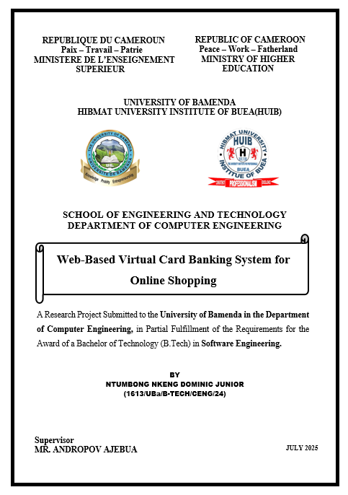

Slide 2
OUTLINE
Introduction
Problem Statement
Objective
Methodology
Limitation and Recommendation
conclusion

Slide 3
INTRODUCTION
This project focuses on simulation a virtual card banking system. The platform enable creation of digital cards that can be used for online shopping and online bills payment. It was also developed to address the safeness of virtual cars over physical cards.

Slide 4
PROBLEM STATEMENT
Students cannot afford to use real online banking tools.
Many fear fraud when using online payment platform.
Real banking platform are not made for learning.

Slide 5
OBJECTIVE
To show users how virtual cards are generated and used.
To allow students and beginners to practice digital banking without using real money
To design a simple system that shows how virtual cards work.
To reduce fear of online payment through hands on learning

Slide 6
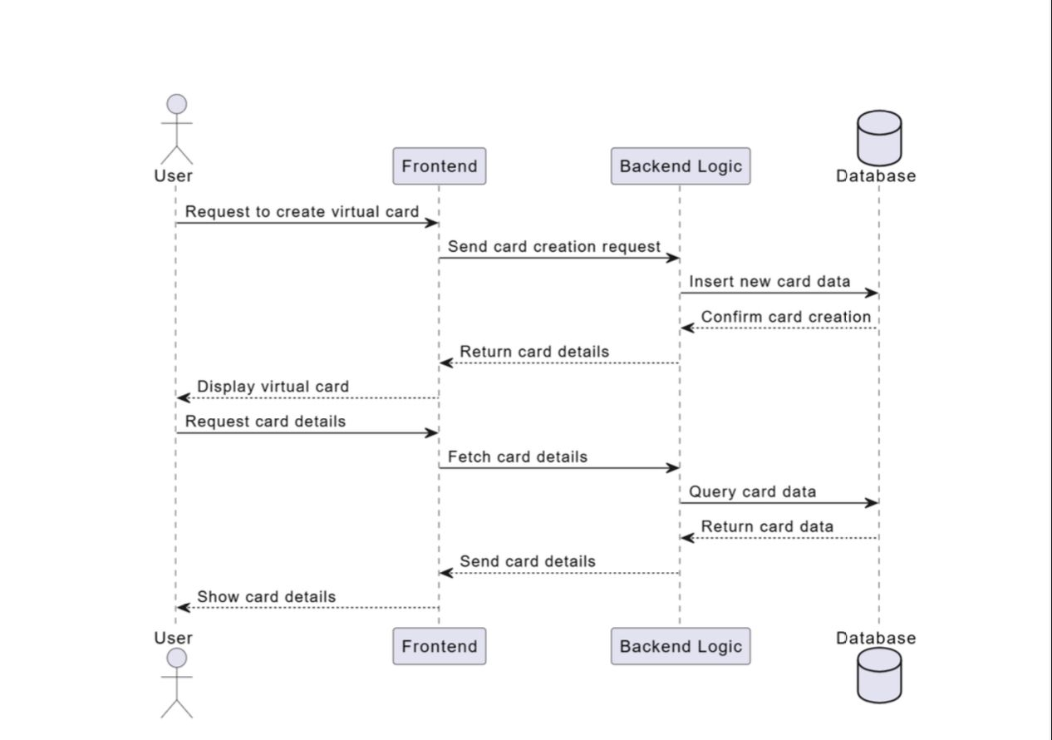
METHODOLOGY
The sequence diagram here, shows the message flow between the user, frontend, backend logic, and database system.
This UML diagram plans roles and interactions.

Slide 7
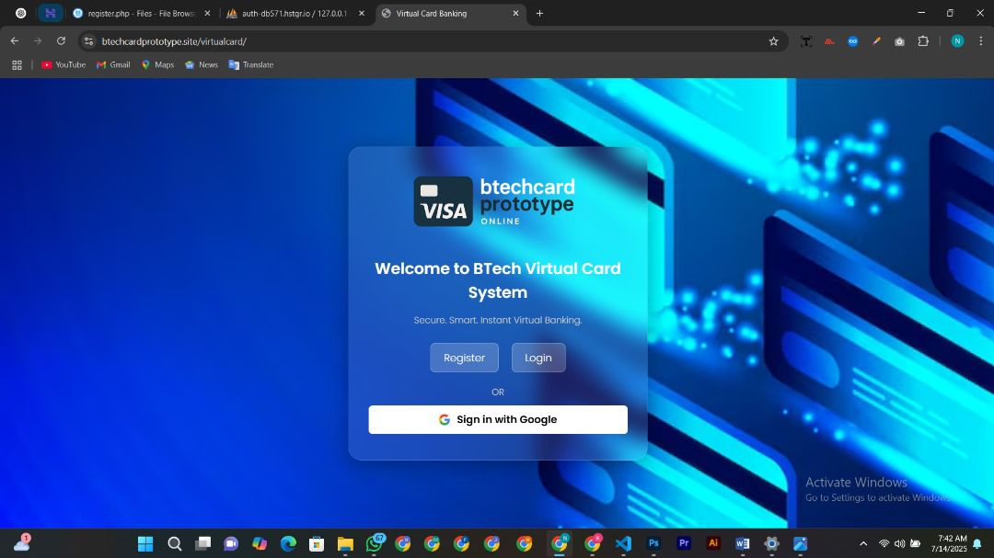
SYSTEM MODULES
User interface of the homepage (login/Register)

Slide 8
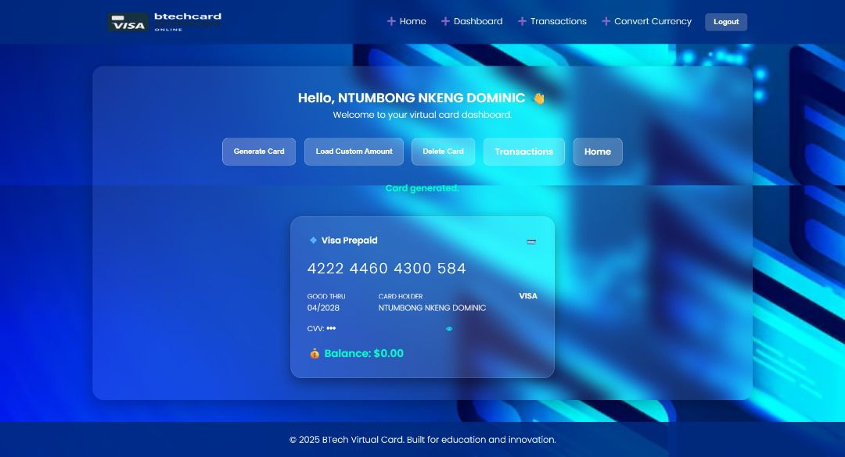
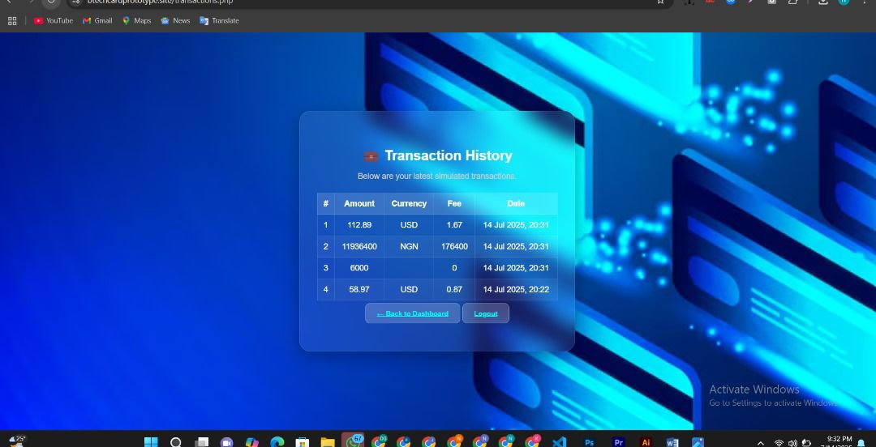
Card Generator Dashboard
Transaction History

Slide 9
LIMITATION
No real time APIs
Web only platform (No mobile App)
Small user sample to test the platform

Slide 10
RECOMMENDATIONS
Add real APIs
Develop mobile version
Broaden user testing across different areas
Open source the project for collaboration.

Slide 11
CONCLUSION
The project achieved its goals:
Simulated online banking functions.
Promoted financial literacy
Provided safe, hands on fintech experience.

Slide 12
THANK YOU FOR YOUR TIME AND ATTENTION

