Slide 1



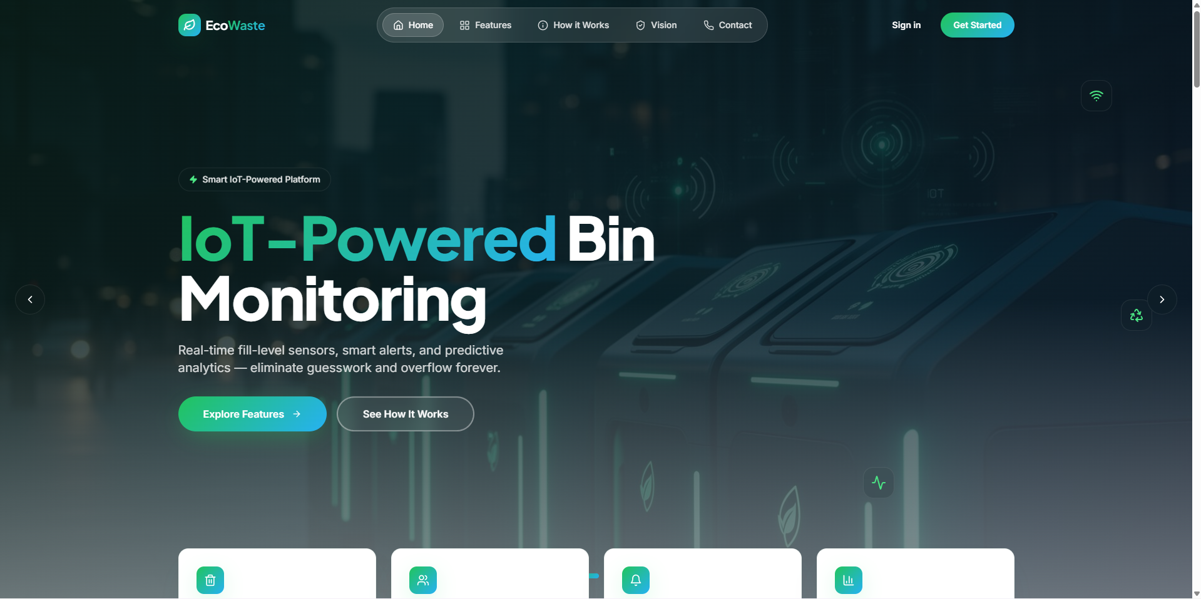
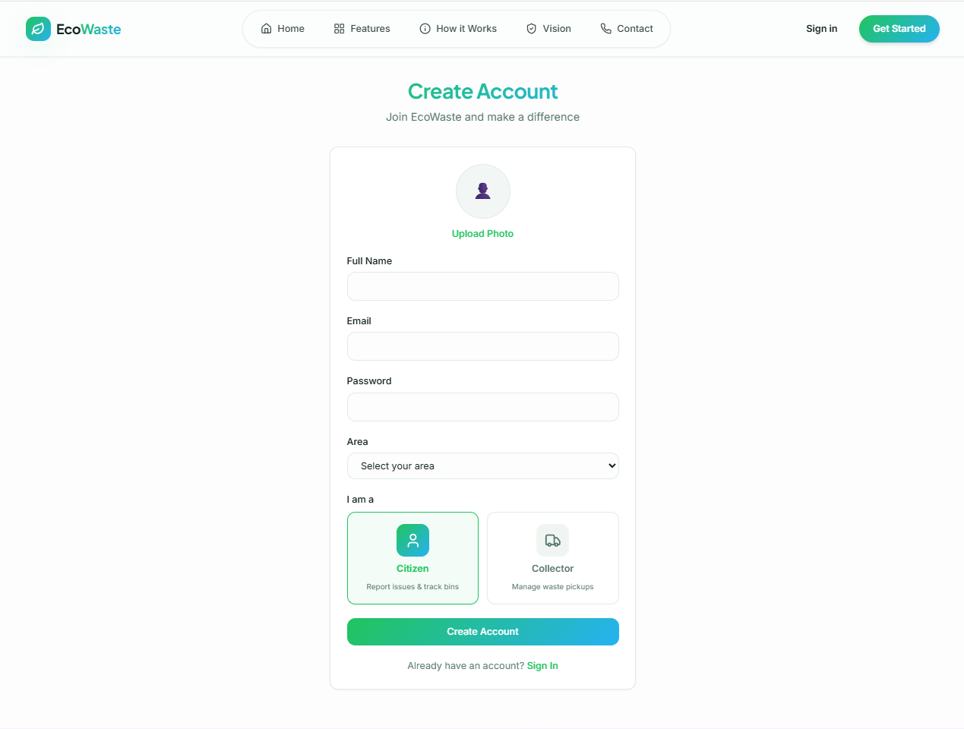
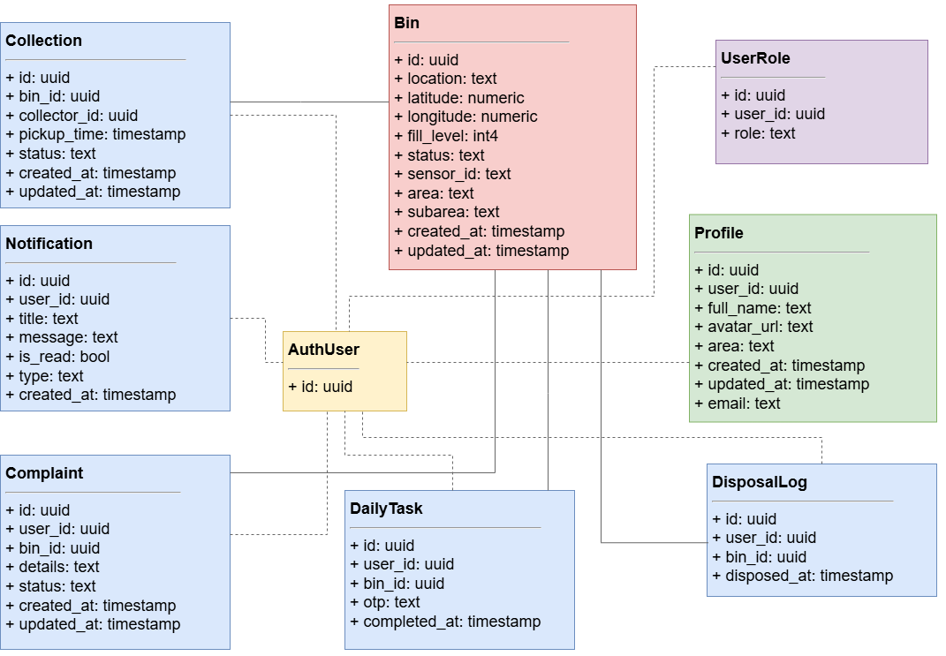
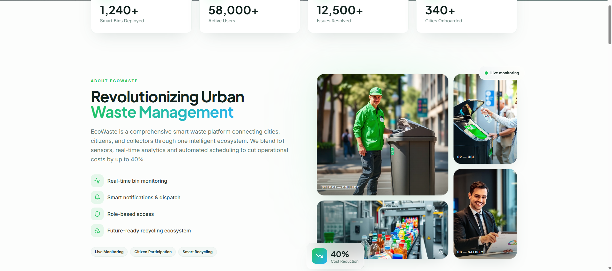
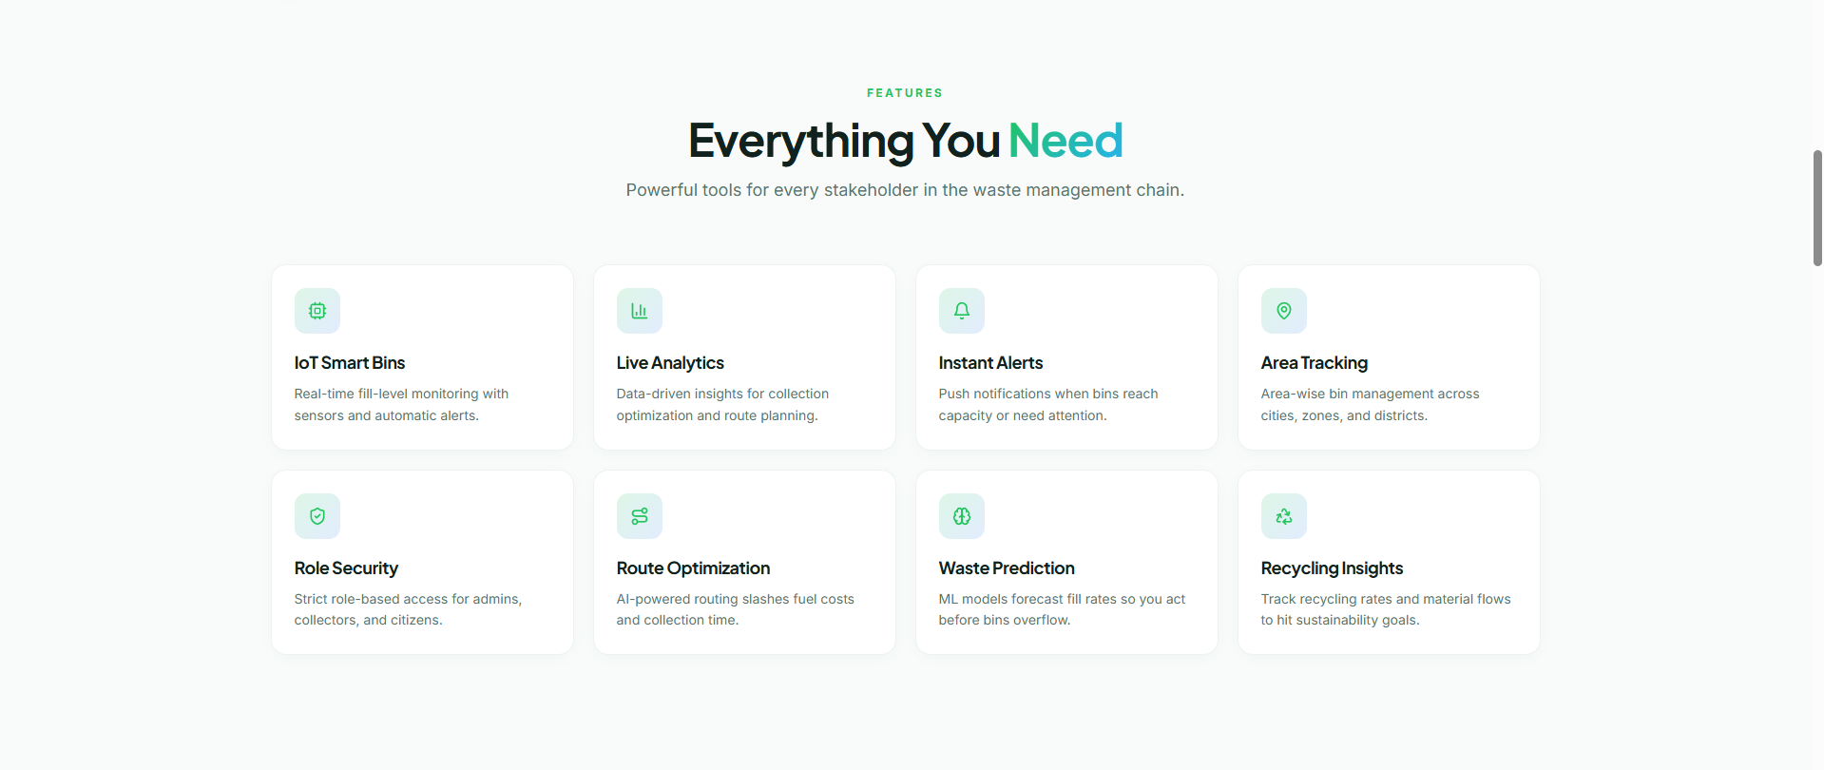
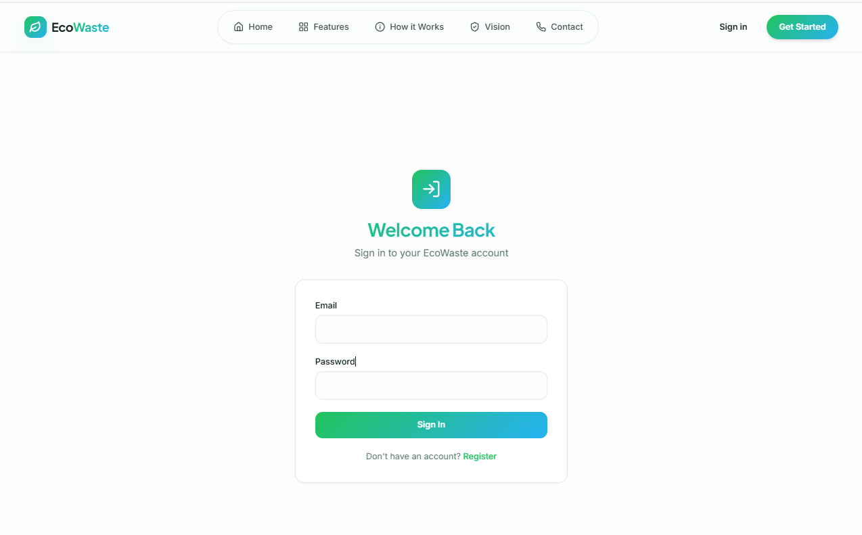
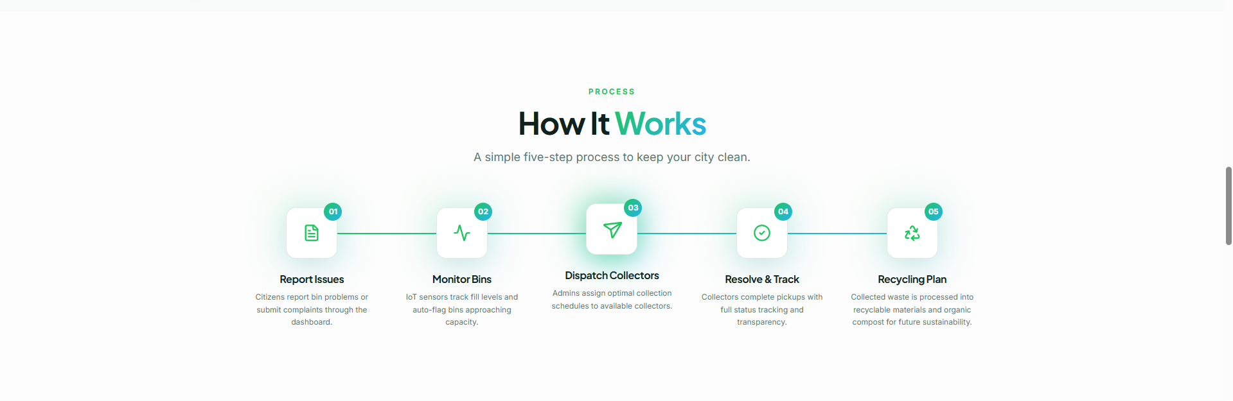
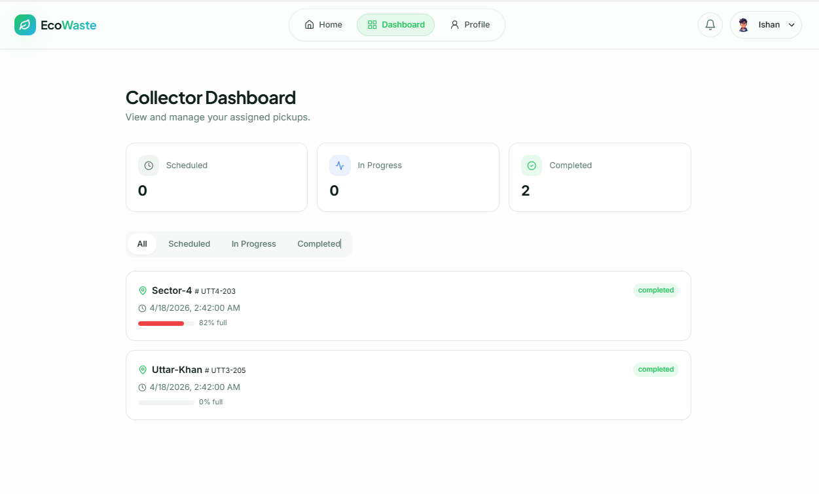
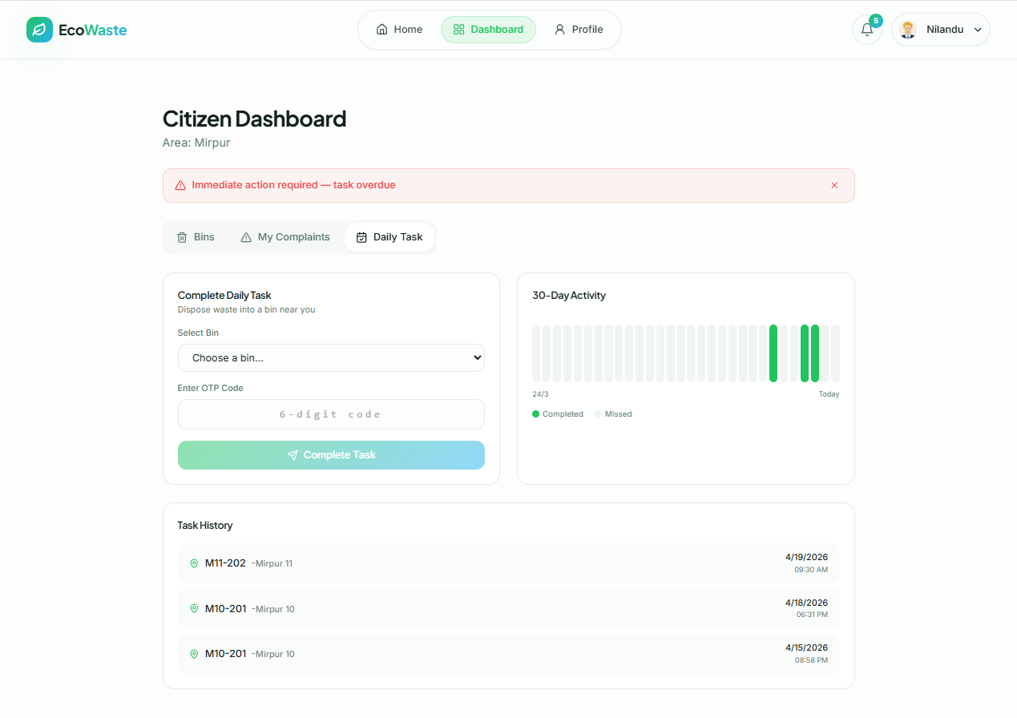
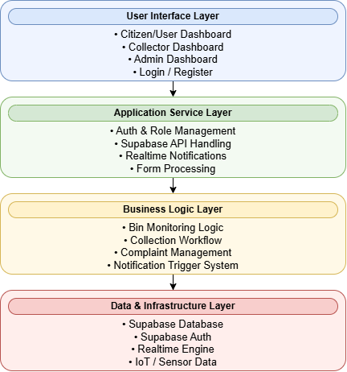
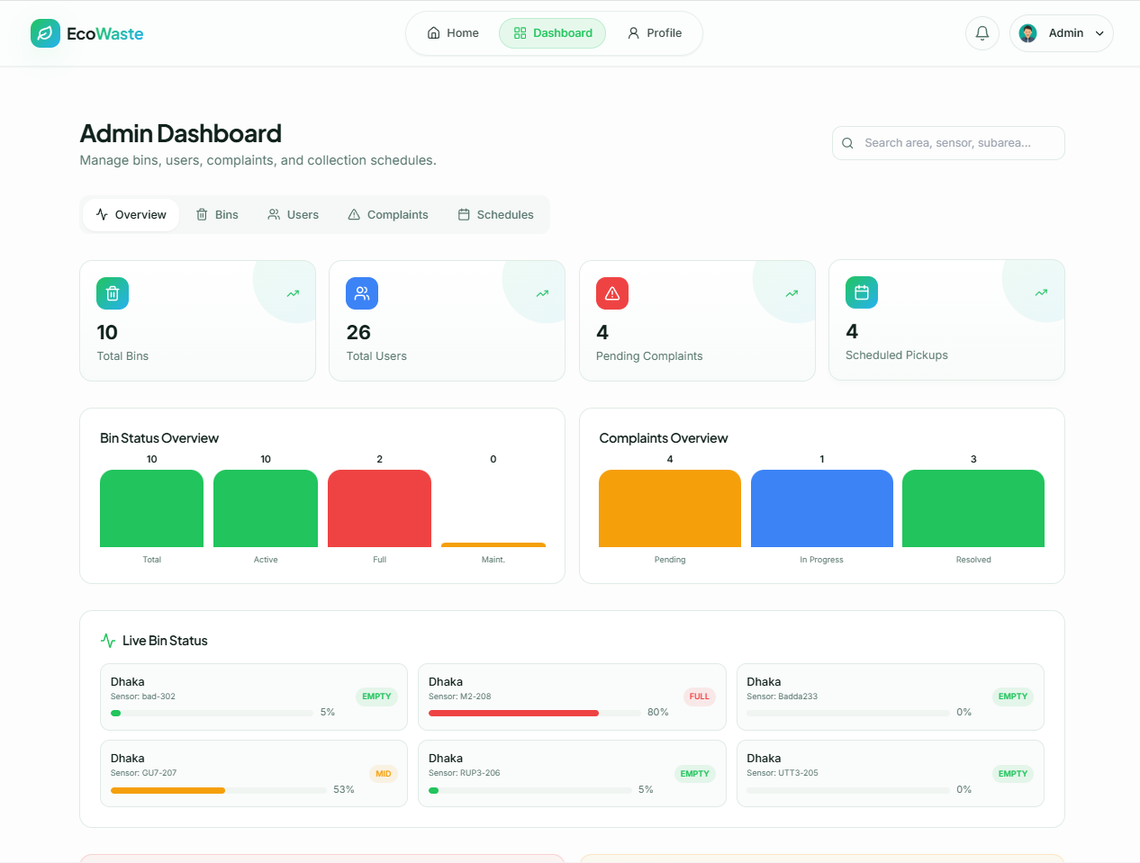
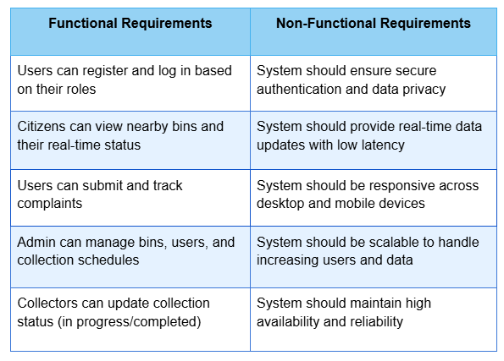
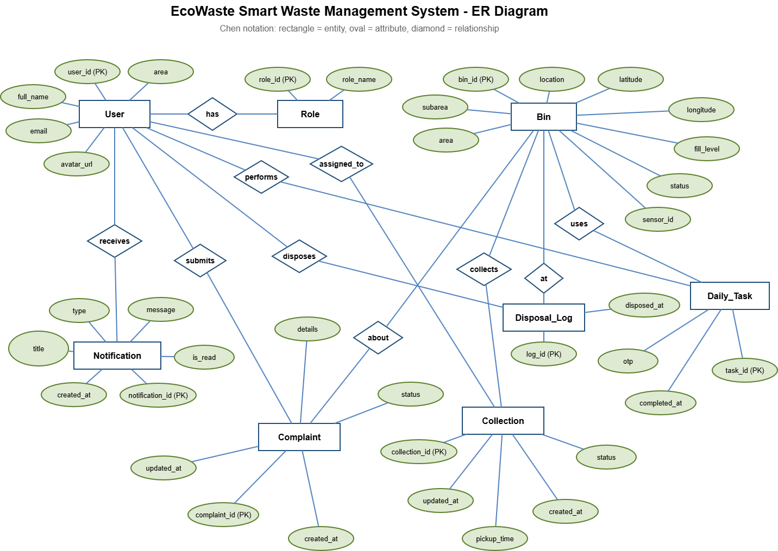
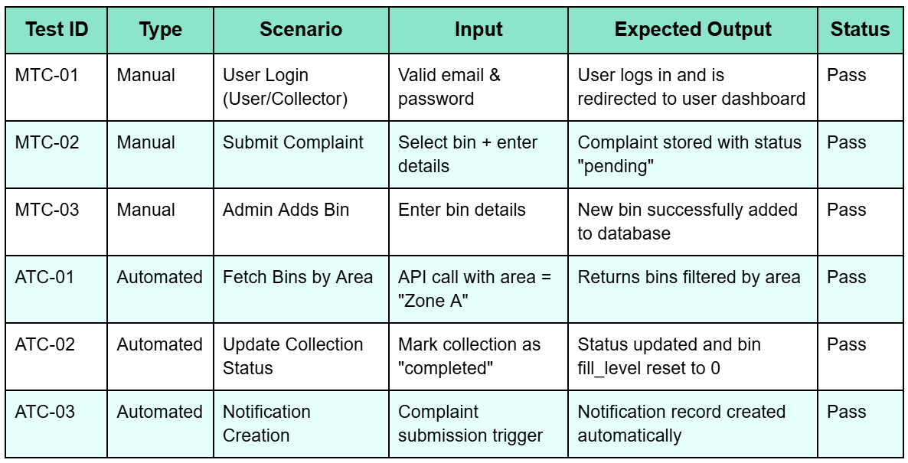
EcoWaste - Smart Waste Management System
Nilandu Kumar Das Vapon - 231902031
Asfiqul Alam Emran - 23190249
Rahat Perves Rahi - 231002043
Saiful Islam - 231902065
Abstract
UI & UX
Class Diagram
Integrates IoT sensors and a web platform to monitor waste bins in real time.
Enables optimized collection scheduling and reduces overflow and manual effort.
Provides a scalable, data-driven solution for efficient urban waste management.
Problem Domain
Traditional systems rely on fixed schedules, causing inefficient waste collection.
Lack of real-time monitoring leads to bin overflow and resource wastage.
Limited citizen involvement in reporting and tracking waste-related issues.
High Level Diagram
User Dashboard
Motivation & Objective
Develop a smart system to improve efficiency using real-time data.
Enable optimized scheduling and better communication between users and collectors.
Enhance transparency, reduce environmental impact, and improve service quality.
Functional & Non-functional
Tools And Technology
Frontend: React, TypeScript, Tailwind CSS for responsive UI design.
Backend: Supabase for authentication, database, and real-time services.
Modular architecture for scalability, maintainability, and future upgrades.
ER Diagram
Features
Test Case
Real-time monitoring of waste bins with fill-level and status updates.
Role-based dashboards for citizens, collectors, and administrators.
Complaint submission, tracking, and resolution workflow.
Smart collection scheduling with task management and notifications.
Social Impact
Conclusion
Reference
Improves urban cleanliness by reducing bin overflow and delays.
Encourages active citizen participation in waste reporting.
Minimizes environmental pollution through efficient collection.
Supports sustainable and smart city development initiatives.
Improves efficiency through automation and real-time data integration.
Reduces operational cost and prevents waste overflow.
Supports sustainable and smart city waste management practices.
[1] M. Faccio, A. Persona, and F. Zanin, “Waste collection multi objective model with real time traceability data,” Waste Management, vol. 31, no. 12, pp. 2391–2405, 2011.
[2] S. Longhi et al., “Solid waste management architecture using wireless sensor network technology,” Proc. IEEE ICINCO, pp. 1–5, 2012.
[3] A. Medvedev et al., “Waste management as an IoT-enabled service in smart cities,” Proc. IoT Conf., pp. 1–7, 2015.

