Slide 1
A MINI - PROJECT ON STRING TOKENIZER
By NITESH KUMAR

Slide 2
CONTENTS
INTRODUCTION
ARRAYS
ACCESSING FILE
COMPARING CHARACTERS
FREQUENCIES
SORTING
STORING TO FILE
RESULTS
CONCLUSION AND FUTURE SCOPE
REFERENCES AND BIBLIOGRAPHY

Slide 3
INTRODUCTION
In this modern world of technologies, the major tech giants like Google acquired Wavii and Yahoo! acquired Summly, there is no doubt auto summarization technologies have become a hot topic.
To develop such a demanding technology, “String Tokenizer” can act as catalyst for the future scope.
“String-Tokenizer” is a modern tool which make use of text analysis to calculate the frequencies of the tokens.
It uses the concepts of arrays, strings, finite automata, searching and sorting and file input-output.

Slide 4
ARRAYS
Arrays are a kind of data structure that can store a fixed-size sequential collection of elements of the same type.
“String Tokenizer” consists of three 1-dimensional character arrays each containing set of alphabets, numbers and symbols.
There is a 2-dimensional character array to store tokens and a 1-dimensional integer array to store frequencies.
Apart from all these arrays, there are four temporary arrays : three character arrays and an integer array to be used at various positions in the code.

Slide 5
ACCESSING FILE
A file represents a sequence of bytes, regardless of it being a text file or a binary file.
The function fopen ( ) can be used in read mode (“r”) to open an existing file.
This call initializes an object of the type FILE, which contains all the information necessary to control the stream.
The codes checks if the file is present at the provided address.
If the provided path does not contain the file, the program returns with an error “File not found!”.
If the file is found at the provided path, the file opens successfully and characters starts getting copied to buffer until EOF is reached.

Slide 6
COMPARING CHARACTERS
The input character is tested if it is an alphabet or a number or a symbol.
If it is alphabet, it is passed as an argument to alpha () function for further execution of the codes.
Similarly, when a number or a symbol is encountered, it is passed as argument to num () or sym () functions respectively.
Functions alpha () and num () at first check if the previous character is also an alphabet or number respectively and then stores the current character at proper index in the array.
Function sym () on the other hand simply increments the row number of the array aand stores current character there.

Slide 7
FREQUENCIES
All the elements of the array of frequencies is initialized with -1.
Two nested loops are used to access the rows of the array of tokens, to pivot a token at a time and the other to find the pivoted token in the rest of the content in the array.
Whenever a duplicate is encountered, the frequency of second token is set to 0 and the counter is incremented.
In the outer loop, Frequencies are assigned the integer value of counter before changing the pivot token if and only if the frequencies are not equal to 0.
This stores the frequencies of each token in the array of tokens at the corresponding index in the array of frequencies.

Slide 8
SORTING
Sorting refers to arranging data in a particular format.
After getting the frequencies, the tokens and their frequencies are to be sorted in descending order of frequencies for which “Bubble Sort” is being used here.
In Pass 1, first and second elements are compared, then second element is compared with third, and so on. It places the biggest element at the lowest index of the array
Similarly in pass 2, second element is compared with third, third element is compared with fourth, and so on. It places second biggest element at second lowest index of array.
This process repeats until all the tokens of the array are accessed.
This rearranges the tokens and their frequencies in the descending order.

Slide 9
STORING TO FILE
The function fopen ( ) can be used in read mode (“w”) to create a new file.
This call initializes an object of the type FILE, which contains all the information necessary to control the stream.
The codes checks if the file is already present at the provided address.
If the provided path already contain the file, the program opens the file and clears the contents of that file and then starts storing new data from starting of the file.
If the file is not found at the provided path, then it is created with the name specified in the code and starts storing the data from start of the file.

Slide 10
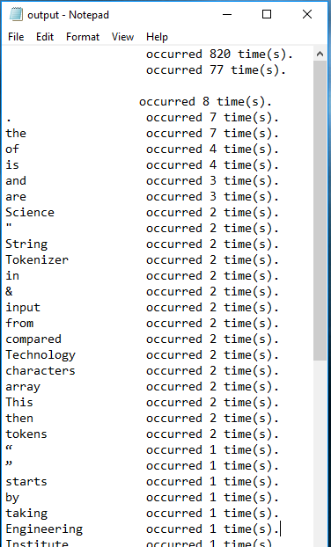
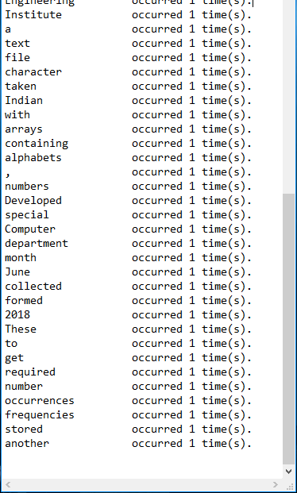
RESULTS

Slide 11
CONCLUSION AND FUTURE SCOPE
The test run of the code shows that the “String Tokenizer” stands up totally on the expectations and does the work as explained earlier.
This shows the successful completion of the project with positive outcomes.
The future of the “String Tokenizer” is the “Summarization Technology”.
The “String Tokenizer” can be used to develop an even larger project which is used for summarizing the larger paragraph into a smaller one.
The “Summarization Technology” has a vast future in the field of Artificial Intelligence.

Slide 12
REFERENCES AND BIBLIOGRAPHY
The C Programming Language - 2nd Edition – Brian W. Kernighan and Dennis M. Ritchie.
Introduction to Automata Theory, Languages, and Computations (2006, Prentice Hall) - John E. Hopcroft, Rajeev Motwani, Jeffrey D. Ullman.
https://www.tutorialspoint.com/cprogramming/c_arrays.htm
https://www.youtube.com/watch?v=csEv5ZRMvpQ
http://www.techcrashcourse.com/2015/11/c-program-to-find-frequency-each-arrayelements.html
https://www.tutorialspoint.com/data_structures_algorithms/sorting_algorithms.htm

Slide 13

THANK YOU

