Slide 1

Smart Doorbell
Raspberry Pi + Machine Learning

Slide 2
The Challenge: Traditional doorbells only alert homeowners of visitors but provide no identification or context about who is at the door.
Current Issues & Our Solution
• No visitor identification >> Real-time face recognition
• Security concerns >> Edge processing (privacy)
• Cloud dependency >> Instant identification

Slide 3
Primary Goal: Deploying a lightweight ML-based (YuNet+Sface recognition system) on Raspberry Pi that can identify known household members and detect unknown visitors in real-time.
Edge Deployment
Run ML inference directly on Raspberry Pi
Face Recognition
Identify known vs unknown visitors
Real-Time
Instant detection and classification

Slide 4
System Architecture
Face Capture (capture.py)
Collect and align user faces using webcam → Save as dataset images
Output: Aligned JPG face images per user
Feature Extraction (feature.py)
Convert face images → 128-D numerical embeddings using Sface
Output: User database of embeddings (.npy files)
Real-Time Recognition (recognition.py)
Detect faces → Extract embeddings → Compare → Identify
Output: Real-time identification with name + confidence

Slide 5
Real-Time Recognition Pipeline
Camera Captures Frame
Raspberry Pi camera module captures live video
YuNet Detects Faces
Identifies face bounding boxes and landmarks
Face Alignment & Cropping
SFace aligns and normalizes detected faces
Feature Extraction
Generates 128-D embedding vector
Cosine Similarity Comparison
Compares with all stored embeddings in database
Decision: Known vs Unknown
If similarity > 0.363 → Recognized (green box + name)
If similarity ≤ 0.363 → Unknown (red box)

Slide 6
Why Yunet
Property | What It Means | YuNet | Compared to Other Detectors (e.g., RetinaFace-ResNet50 / SCRFD-0.5g)
Model Size | Number of learnable parameters → affects memory use + loading speed | 75K parameters → extremely tiny | RetinaFace-ResNet50 ≈ 27M params, SCRFD-0.5g ≈ 631K params → 10×–350× larger
FLOPs | Total operations per inference → determines compute cost | 149M FLOPs @320×320 → very low | RetinaFace-ResNet50 ≈ 11 GFLOPs, SCRFD-10g ≈ 3.3 GFLOPs → YuNet is 20×–70× lighter
Inference Speed (CPU) | Time taken per frame → critical for real-time performance | 2–11 ms depending on resolution | RetinaFace on CPU: 50–230 ms; SCRFD-0.5g: 3–18 ms → YuNet is much faster, especially at higher resolutions
Backbone | Feature extraction network determining accuracy + weight | Custom DWConv-based tiny backbone(12layers) | RetinaFace uses ResNet50 (50+ layers); SCRFD uses heavier CNN blocks → YuNet is far simpler and lighter
Multi-Scale Feature Fusion | How the network handles large vs small faces | TFPN (Tiny Feature Pyramid Network); DWConv-based | RetinaFace FPN uses full convolutions → heavy; YOLO5Face uses PAN → even heavier
Detection Type | Strategy used to predict boxes | Anchor-free, direct regression | RetinaFace, SCRFD, YOLO → anchor-based → require anchor tuning & more post-processing
Small-Face Accuracy | Ability to detect <20 px faces (critical in WIDER FACE Hard) | Strong performance (AP Hard ≈ 0.81) due to emphasis on shallow layers | RetinaFace-R50 ≈ 0.85 AP Hard but much larger and slower; SCRFD-0.5g ≈ 0.68 (smaller version)
Memory Footprint | RAM usage during inference | < 1.5 MB total | RetinaFace-ResNet50 uses 100–200 MB models + activations
Deployment | Usability on edge hardware | Fits easily on Raspberry Pi / IoT / CPU-only devices | RetinaFace/SCRFD often require GPU/optimized CPU kernels for real-time performance
Training Sensitivity | Sensitivity to data scaling, augmentation, distribution | Uses distribution-aware scale augmentation → stable | Large models require massive datasets + careful augmentation to stay stable

Slide 7
Why SFace
Property | Meaning / Why It Matters | SFace | Compared to RetinaFace (Anchor-based) / UnitBox (Anchor-free)
Scale Handling | Ability to detect tiny → extremely large faces | Hybrid: anchor-based + anchor-free → full-scale coverage | RetinaFace: good small/medium, weak on huge faces; UnitBox: handles huge faces but weaker precision
Architecture Type | How faces are detected | Two-branch system (anchor-based + anchor-free) | RetinaFace: anchor-only; UnitBox: anchor-free only
Backbone Efficiency | Computation needed | Xception-39 → 39M FLOPs (very lightweight) | RetinaFace uses ResNet50 (~7.6 GFLOPs) → ~200× heavier
Bounding Box Regression | Quality of localization | IOU Loss → scale-invariant, robust | RetinaFace uses Smooth L1 → less stable for large-scale variation
Confidence Score Meaning | How reliable the detection score is | Score = predicted IOU → directly tied to box accuracy | RetinaFace score = class probability → not linked to localization
Speed | Real-time capability | ~50 FPS | RetinaFace ~5–8 FPS; UnitBox ~10–15 FPS
Accuracy (WIDER FACE) | Detection performance | Easy 89.1, Medium 87.9, Hard 80.4 | Comparable to RetinaFace; much faster
4K Face Performance | Real-world high-resolution detection | 65.4% AP on 4K-Face | RetinaFace & UnitBox significantly drop on extreme scales

Slide 8
Hardware and software details
Hardware
Raspberry Pi 4
Main computing unit
Pi Camera Module V2
8MP video capture
Power Supply
5V/3A USB-C adapter
Storage
32GB microSD card
Software
Raspberry Pi OS
Debian-Bookworm
Python 3.8+
Programming language
OpenCV 4.5+
Computer vision library
YuNet + SFace Models
Pre-trained ML models

Slide 9
Key Features
Real-Time Processing Instant face detection and recognition with 15fps
Edge Computing All processing done locally on Raspberry Pi - no cloud dependency
Privacy Focused Face data never leaves the device - complete privacy protection
Scalable Database Easy to add new users - just capture & extract features
Multi-Face Support Detects and recognizes multiple faces simultaneously
Confidence Scoring Displays similarity score for each recognition

Slide 10
Challenge’s Faced
Challenge 1: Limited Computing
Raspberry Pi has limited CPU/RAM compared to cloud servers
Solution 1
Used lightweight models (YuNet + SFace) optimized for edge devices. Xception-39 is 200× lighter than traditional models.
Challenge 2: Varying Face Scales
Faces can appear from 10px to 2000px depending on distance
Solution 2
SFace's dual-branch architecture (anchor-based + anchor-free) handles all scales effectively.
Challenge 3: Real-Time Performance
Need to process video frames fast enough for smooth operation
Solution 3
Optimized pipeline with efficient FPN backbone achieves ~20 FPS on edge hardware.
Challenge 4: False Positives
Risk of incorrectly identifying strangers as known users
Solution 4
Carefully tuned similarity threshold (0.363) balances accuracy and false positive rate.

Slide 11
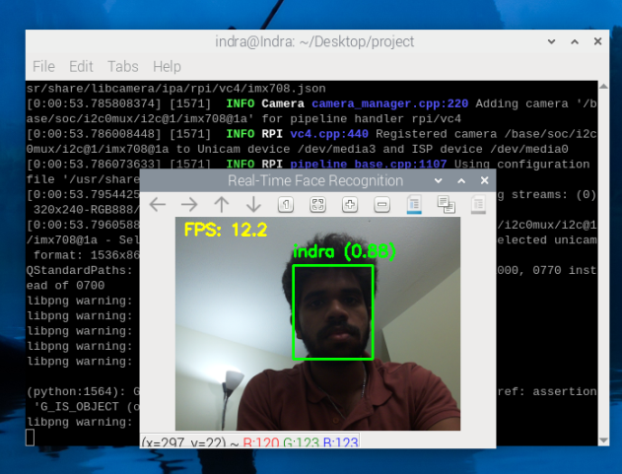
Results & Demo

Slide 12
Future Enhancements
Mobile Notifications Push alerts to smartphone when visitor detected (MQTT/Firebase)
Voice Announcements Text-to-speech to announce visitor names via speaker
Delivery Person Detection Train classifier to identify pizza/package delivery uniforms
Event Logging & Database Store timestamps, images, and visitor history in SQLite
Night Vision Support Add IR camera module for low-light/nighttime operation
Two-Way Audio Enable communication between homeowner and visitor
Web Dashboard Remote monitoring interface with live feed and visitor logs
Smart Home Integration Connect with Home Assistant, Google Home, or Alexa

Slide 13

Thank You!
Any Questions?

