Slide 1
How accurate is HyperLogLog?
We tested its error, and where it stops being accurate
Ibrahim and Nika · Advanced Algorithms & Data Structures · Fall 2026

Slide 2
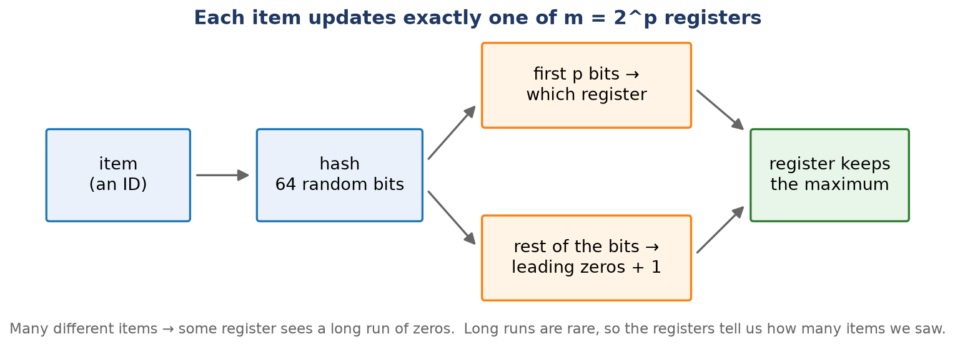
The idea: count different items without storing them
• Keep only m small counters (registers). Memory stays tiny, however long the stream is.
• A long run of zeros in a hash is rare, so a long run means many different items.
2

Slide 3
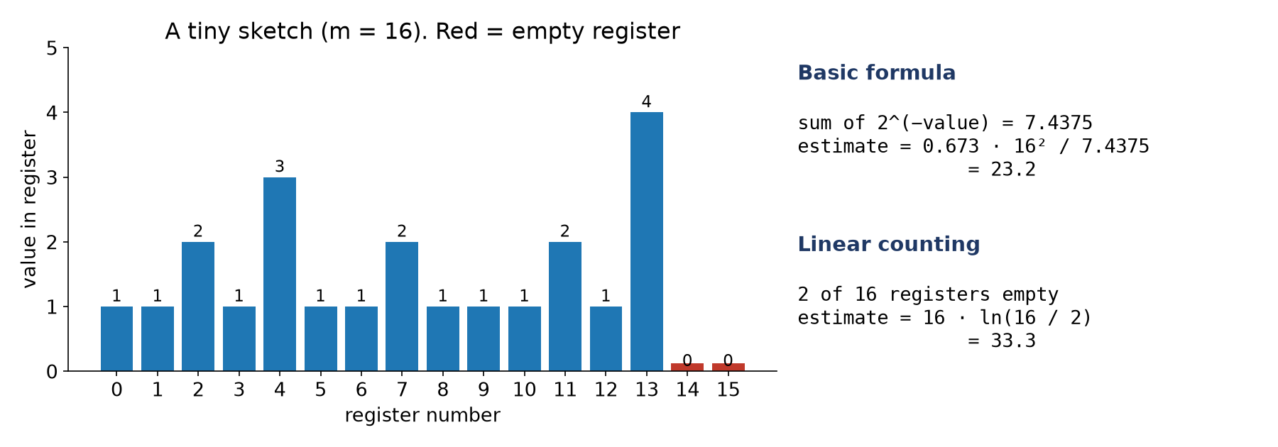
Example: from registers to an estimate
• Basic formula: 23.2. Linear counting (uses the 2 empty registers): 33.3.
• Linear counting is the fix for small counts: it looks at how many registers are still empty.
3

Slide 4
What we wanted to know
• Question 1: how does the error change with the real count n? Does linear counting fix small counts?
• Question 2: how does the number of registers change the error? Theory says 1.04/√m.
• m = number of registers = 2^p. We use p = 14, so m = 16,384.
• Error = (estimate − real count) / real count.
4

Slide 5
How we tested
• We wrote HyperLogLog ourselves in C++.
• Two versions: basic, and basic + linear counting.
• Input: random IDs with repeats. We know the real count exactly.
• Every point: 20 random runs (seeds).
• Tests cover 100% of the code. Hash checked for uniformity.
5

Slide 6
What we expected
• Large counts: error about 0.81% (16,384 registers), whatever n is.
• 1,000 items: basic about 12 times too big; linear counting within about 1%.
• Linear counting should not slow things down.
• Not sure: what happens where the two formulas hand over (40,000 to 80,000 items).
6

Slide 7
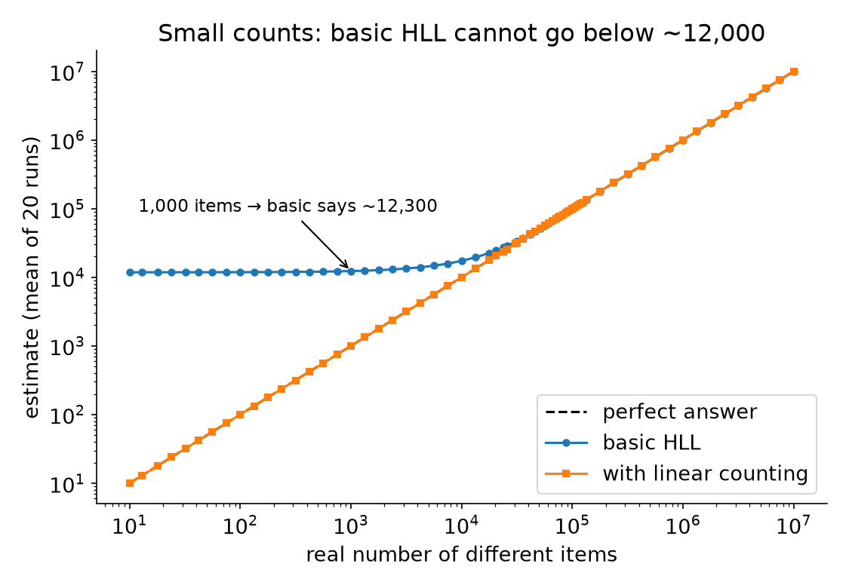
Small counts: basic HLL cannot go below ~12,000
Even for 10 items, basic HLL says about 12,000.
Linear counting follows the real count.
7

Slide 8
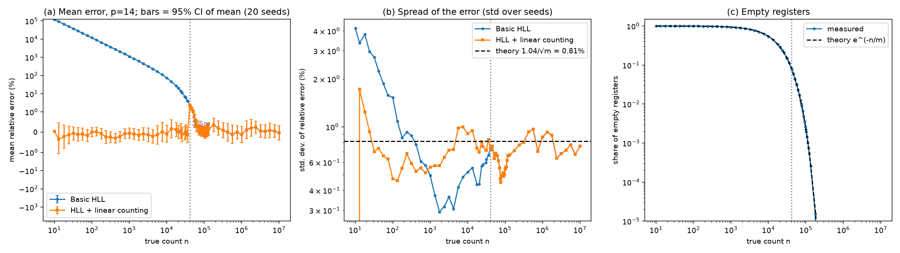
Experiment 1: error vs real count (p = 14)
Blue = basic. Orange = with linear counting. Left: mean error. Middle: spread of the error (dashed line = theory 0.81%). Right: share of empty registers.
8

Slide 9
Experiment 1: results
1,000 items, basic HLL
• Basic HLL: 12 times too big for small counts, as expected.
• Linear counting fixes it.
• From 10^6 items the error is about 0.8%, whatever n is. This matches the theory.
+1130%
1,000 items, with linear counting
−0.05%
9

Slide 10
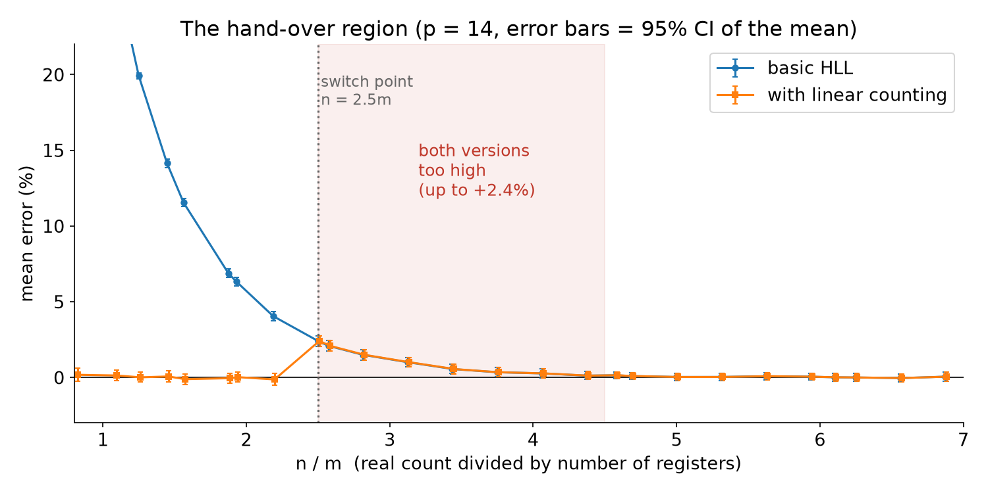
The surprise: both versions are too high around 2.5m
Between 41,000 and 74,000 items the error is up to +2.4%.
That is about 3 times the normal noise.
10

Slide 11
Why does this happen?
• 1. Near 2.5m items, the basic formula is a little too high (+2.4%).
• 2. We switch to linear counting when the estimate is at most 2.5m.
• 3. The estimate is too high, so it passes 2.5m a bit early.
• 4. Linear counting is turned off while the bias is still there.
• HLL++ fixes this with a correction table. We only report it.
• Our tests also check that this bias is real.
11

Slide 12
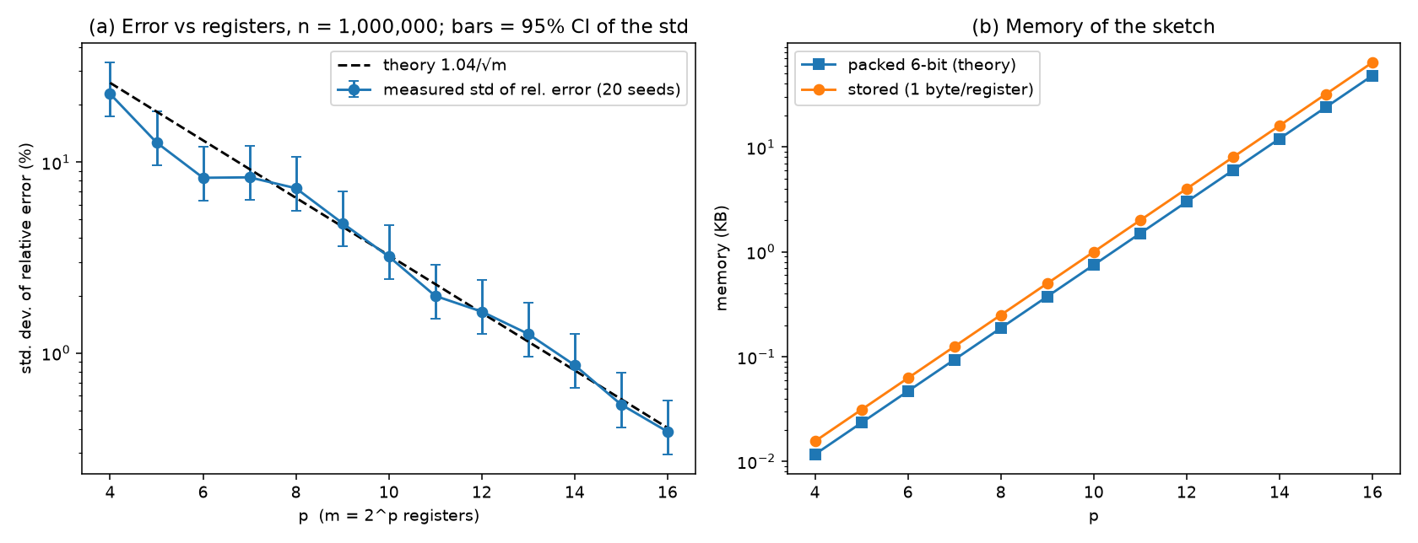
Experiment 2: error vs number of registers
• Real count 10^6. The measured error follows 1.04/√m for every p from 4 to 16.
• p = 14: 0.87% measured, 0.81% theory.
12

Slide 13
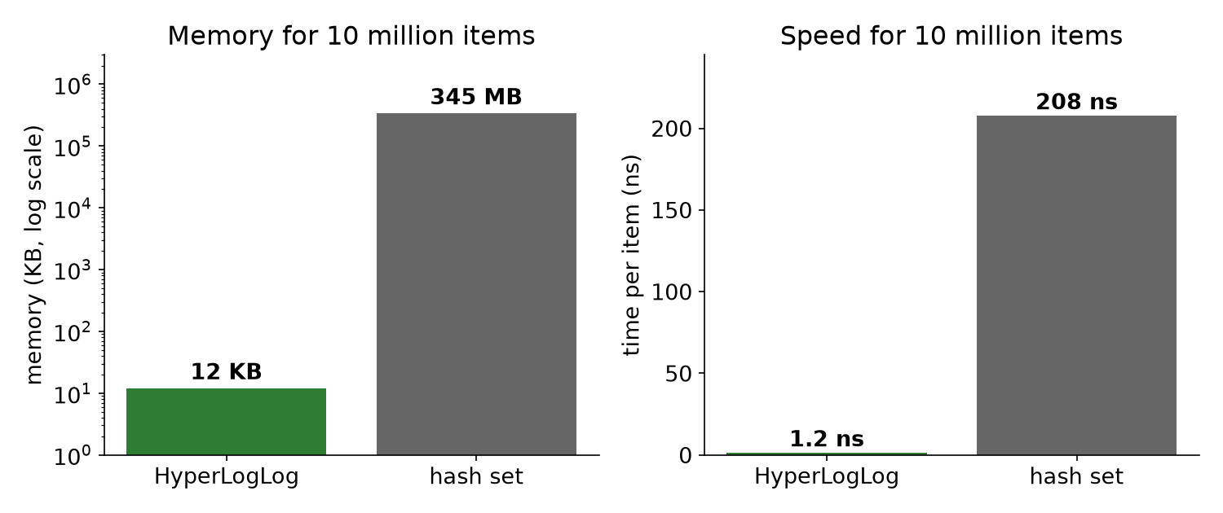
Experiment 3: speed and memory
10 million items, p = 14.
HLL: 12 KB, 1.2 ns per item.
Hash set: 345 MB, 208 ns per item.
• HLL is 8 to 170 times faster. Its memory does not grow with n.
• Linear counting does not slow the updates (same code).
13

Slide 14
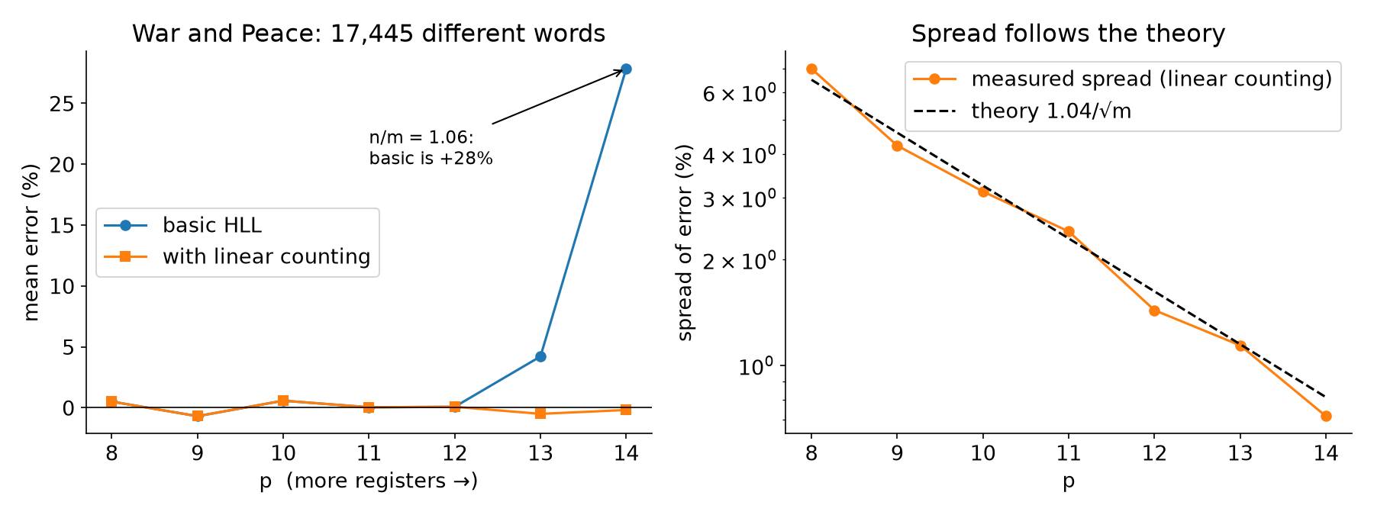
Real data: words in War and Peace
• 583,368 words, 17,445 different (counted exactly).
• Same result: basic is too high when n/m is small (+28%), linear counting fixes it.
14

Slide 15
Answers to our questions
• Q1: the error is about 0.8% once n is above about 4.5m. Below 2.5m basic HLL is far off, and linear counting fixes it.
• Small catch: a bump of up to 2.4% between 2.5m and 4.5m.
• Q2: the error follows 1.04/√m for all p from 4 to 16.
• Linear counting costs no time per item.
15

Slide 16
Corrections to our seminar slides
• Memory: 16,384 registers × 6 bits = 12 KB. The 1.5 KB on the slide would be only 2,048 registers.
• Typical error: 0.81% for p = 14, not about 2%. (2% matches p = 11.)
• Our code stores 1 byte per register (16 KB). Packing to 6 bits gives 12 KB.
16

Slide 17
Limits
• 20 runs per point: spread values are uncertain by about ±16%.
• Timings: one laptop, plugged in. Ratios matter more than exact ns.
• No HLL++ correction table and no sparse mode.
• All code, data and plots are in the project folder; the README shows how to rerun them.
17

