Slide 1
Quiz Lottery DAPP
Michael Narine, Farnoosh Sharifian Esfahani, Nikhita Kokkirala

Slide 2
Basic Overview
An electronic lottery quiz system using Ethereum
Entrance Fee required to start the quiz & participate
The fee is is submitted into an accruing pool
A score will be allocated based on accuracy of answers
The Winner will be given the reward.
Who is the winner?

Slide 3
Starting the Quiz.
User needs to pay an entrance fee in order to start the quiz.
The user must not have attempted this quiz before.
The quiz must be available to play
If user has paid and not attempted, they can take the quiz
After all conditions are met, the user will be granted access to the quiz.

Slide 4
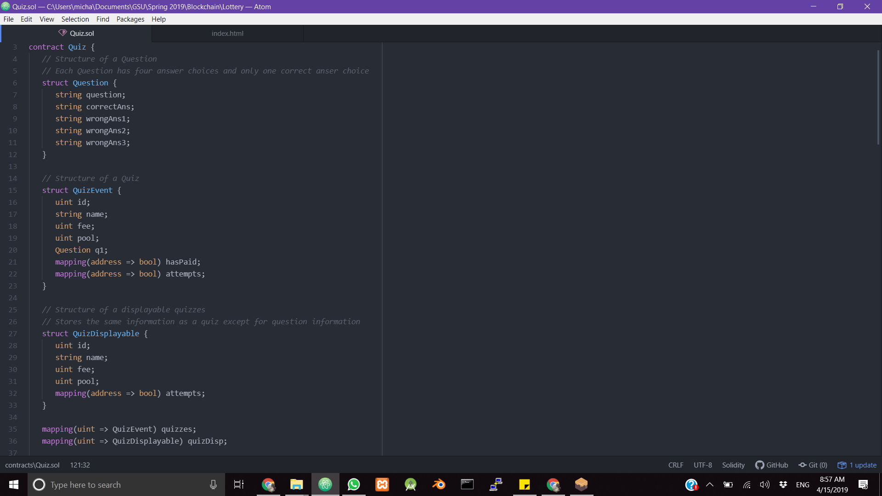
Structure of Quiz and Quiz Questions

Slide 5
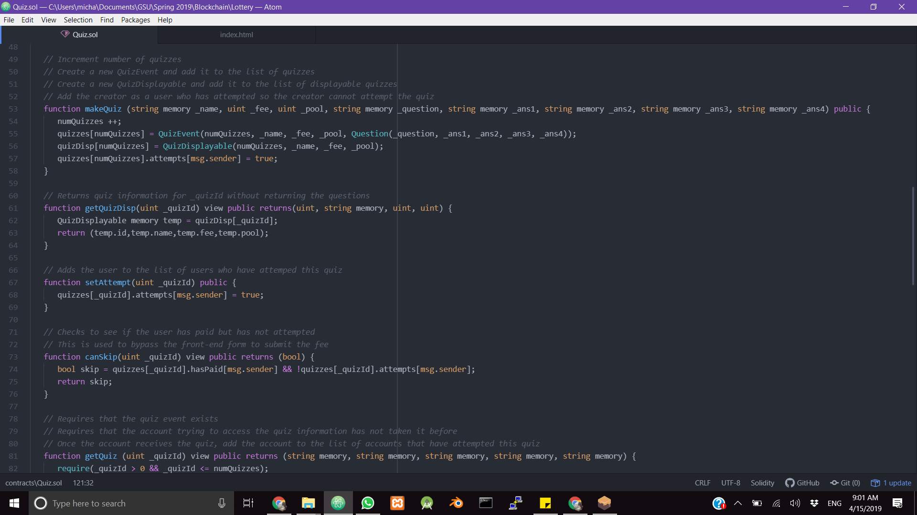
Making and Displaying Quiz

Slide 6
Accruing Pool
Current pool amount is based on:
The Quiz itself
Number of participants
The fees submitted by the participants is what creates the pool.

Slide 7
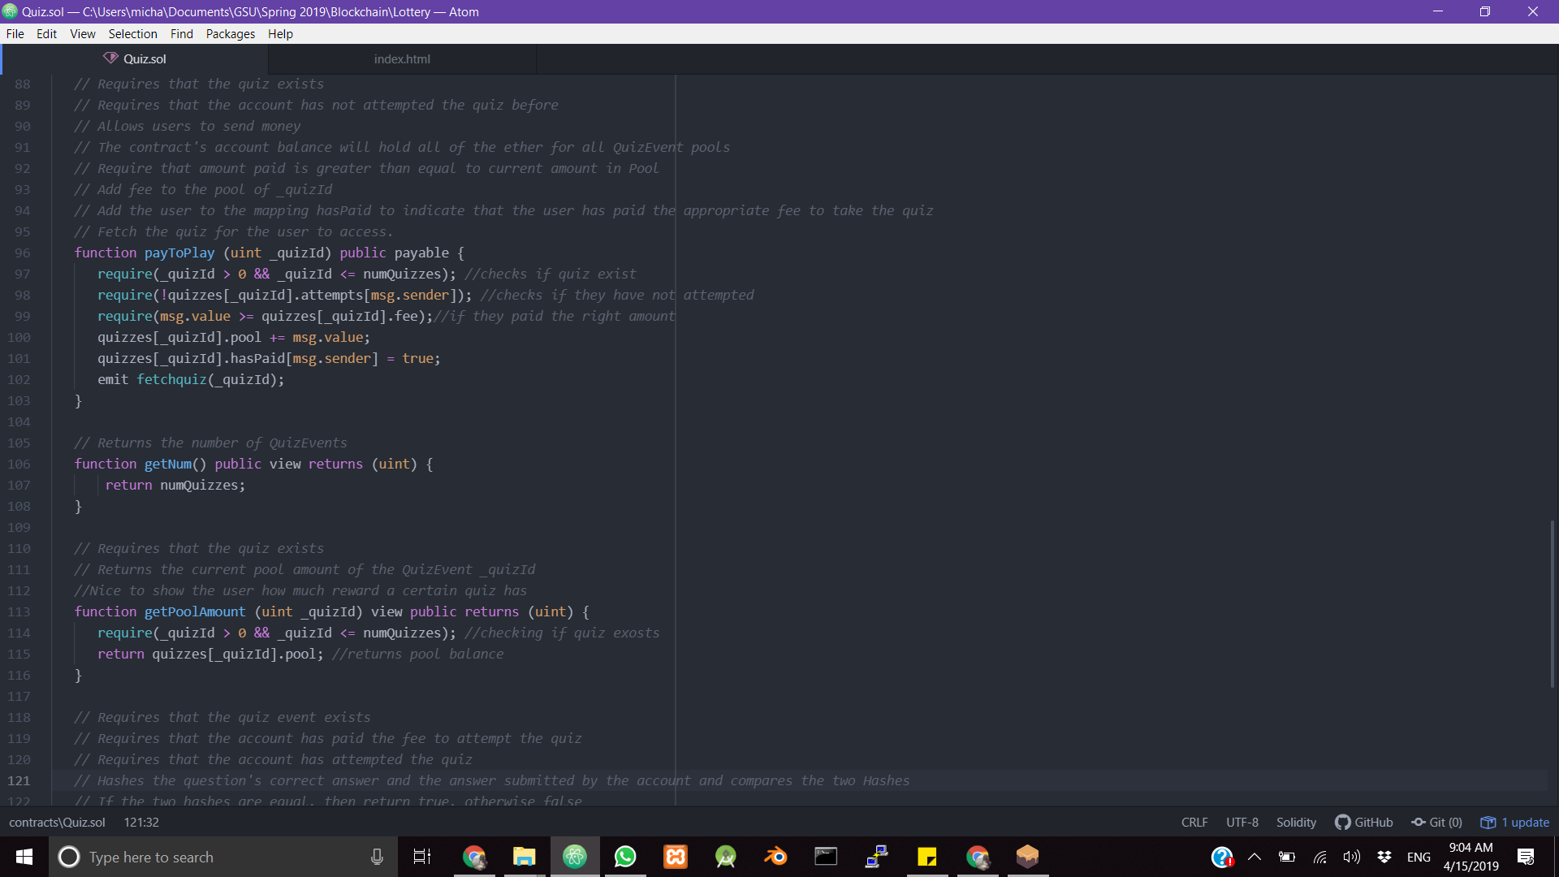
Paying and Pool

Slide 8
Scoring
Hash of the correct answer and hash of submitted answers are compared
If the two hashes match, then a positive score will be allocated.
The number of correct answers for a certain answer is totalled
The user with a perfect score first is the winner of this round.

Slide 9
Reward Pool
The amount of ether in the pool is transferred to the winner.
The pool amount is reset to 0

Slide 10
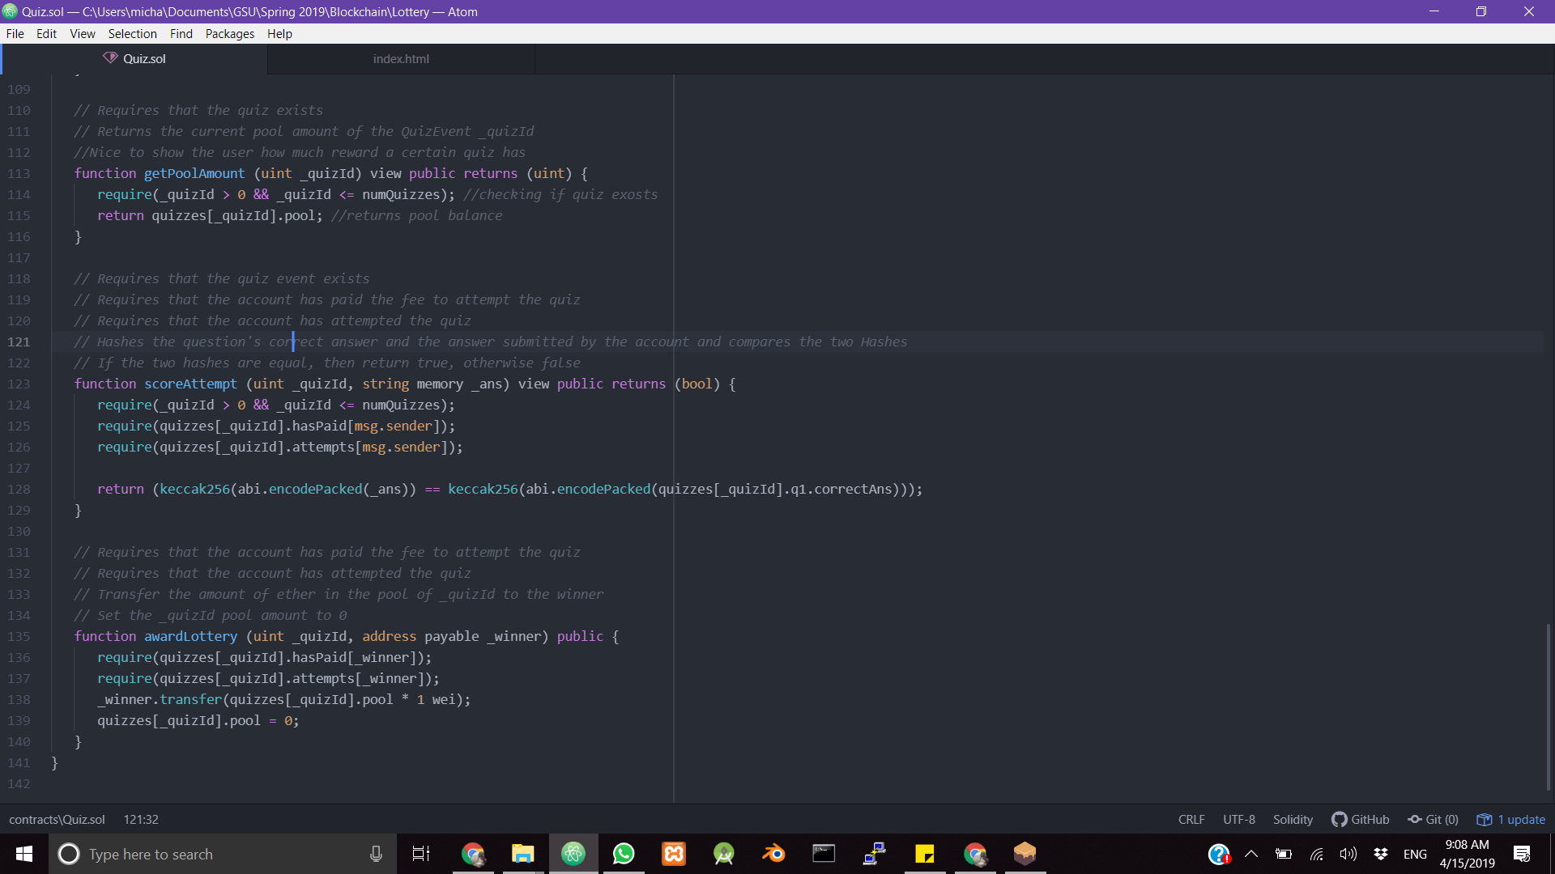
Scoring and Awarding

Slide 11
Front End

Slide 12
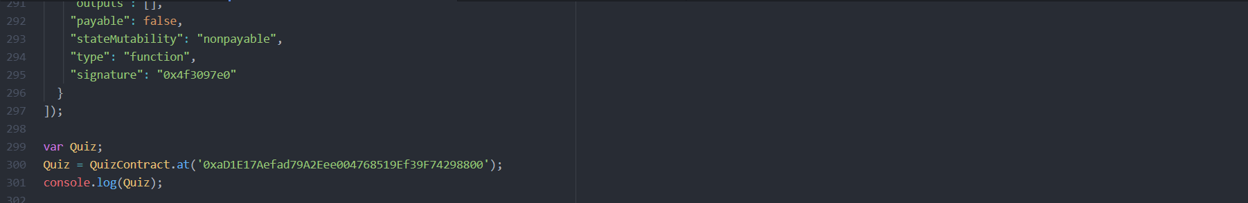
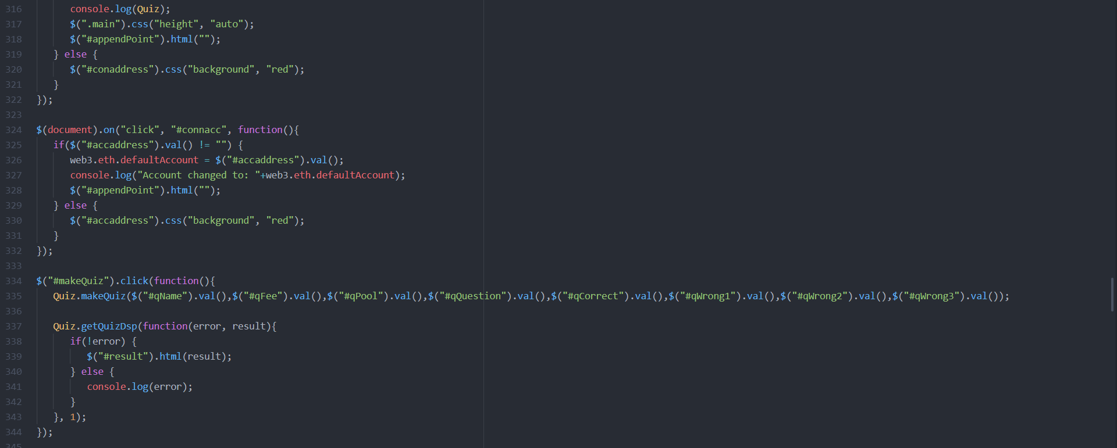
Setting Up Connection To Contract

Slide 13
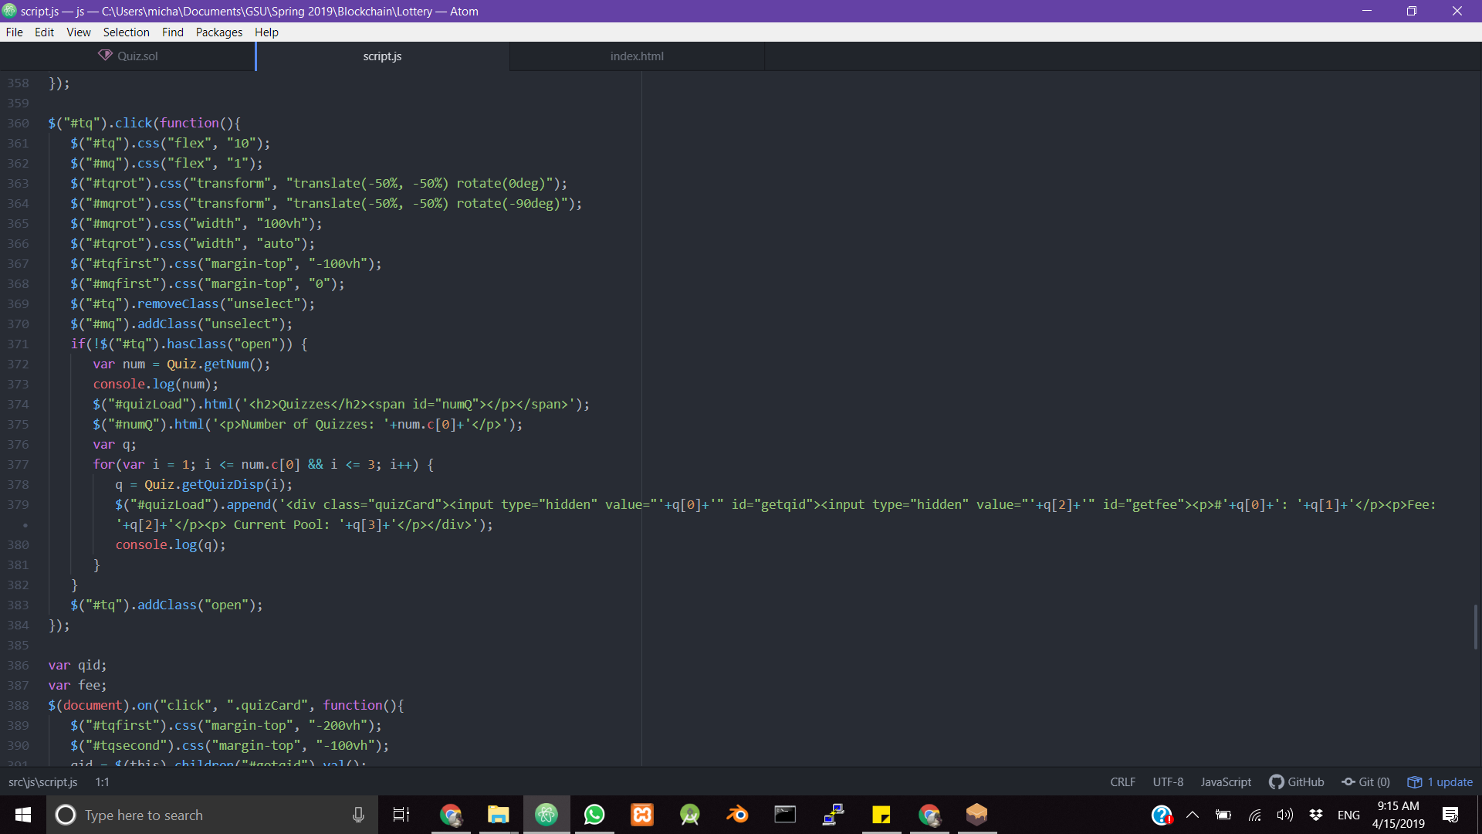
Loading and Retrieving a Quiz

Slide 14
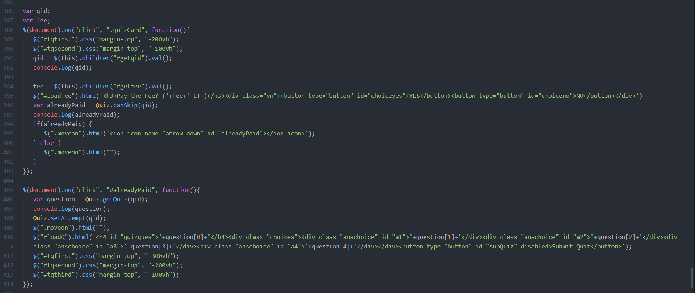
Allowing a User to Pay for a Quiz and Confirming Payment

Slide 15
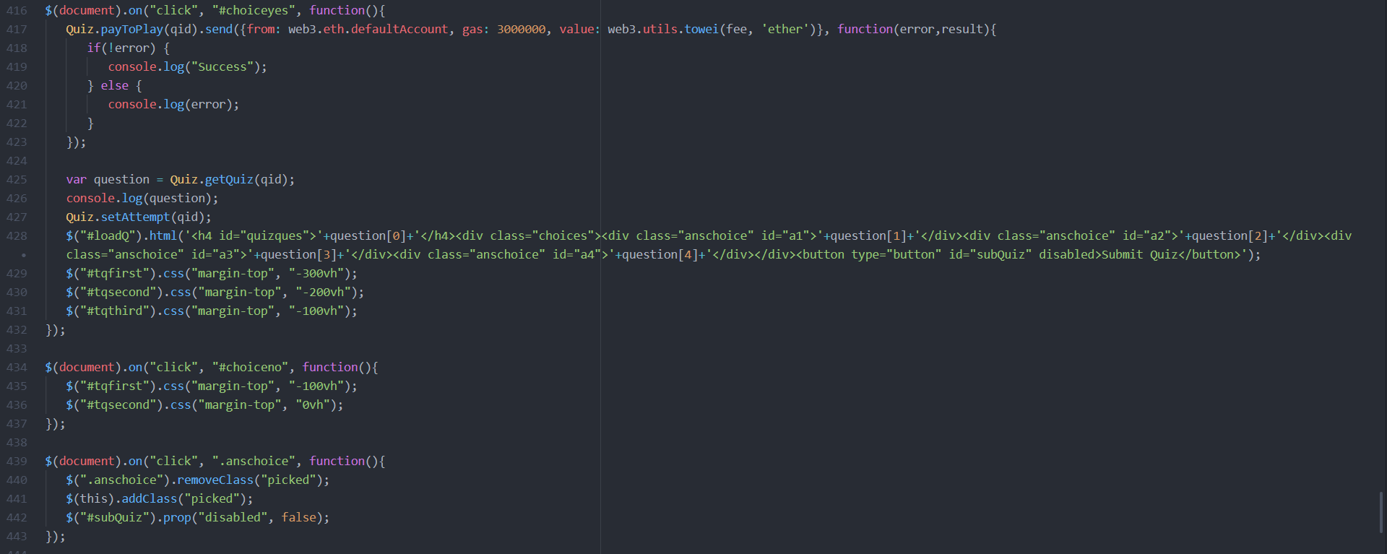
Loading Quiz Contents and Allowing User to Select an Answer

Slide 16
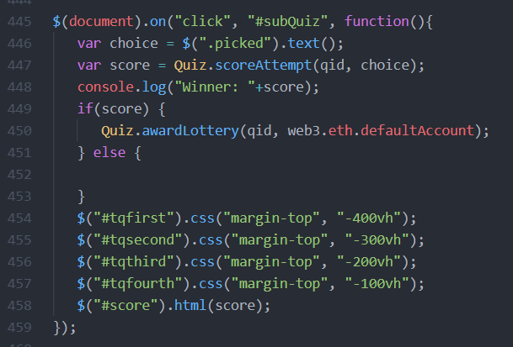
Scoring a Quiz and Rewarding a Winner

