Slide 1

Exercises
Given the file button.psd create a Web page (HTML + CSS + images) that displays two buttons and a hyperlink:
  [OK]
  [Cancel]
  View More Information
  The buttons and the hyperlink should look like in the Photoshop file
1

Slide 2
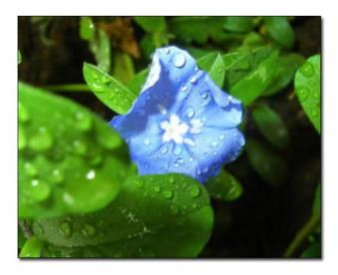

Exercises (2)
Given the file shadow.psd create a Web page (HTML + CSS + images) that displays few images (with different sizes) with a shadow.
Using the file menu-horizontal.psd create a Web page (HTML + CSS + images) that displays a horizontal menu with hyperlinks.
2

