Slide 1
AuroraStay Hotels: AI Policy Assistant
(RAG POC)
Deploying GenAI Solutions | Artificial Intelligence and Machine Learning
October 31, 2026

Slide 2
Contents / Agenda
Executive Summary
Business Problem Overview and Solution Approach
Data Understanding
Retrieval Augmented Generation System
Evaluation
Deployment – Inference
Insights and Recommendations

Slide 3
Executive Summary
What we built: A working POC where hotel staff ask a question in plain English and get an answer grounded only in the four policy PDFs, with the supporting source text shown beside it.
Does it work? Partly. Exactly 50% of queries were confidently answered on both the evaluation set (5/10) and the held-out test set (5/10), which just meets our ≥50% target. Every auto-answered response was faithful (≥0.99).
Where it falls short: Faithfulness 0.89 / 0.73 (eval / test) vs target 0.85; Recall 0.66 / 0.75 vs 0.80; Precision 0.59 / 0.53 vs 0.75; Relevancy 0.61 / 0.71 vs 0.75. Property-specific lookups (fees, times, breakfast) are the weak spot.
Recommendation: Run an internal pilot with a three-way routing rule (auto answer / staff review / manual lookup). In parallel, fix retrieval of property data, enlarge the test set and clean up duplicated policy tables before any guest-facing use.
Status: notebook, evaluation and deployment files are complete. Codespaces deployment and live inference screenshots are pending.

Slide 4
Business Problem Overview and Solution Approach
Problem: 18 hotels, ~1,200 guest queries a week; ~40% are complex and need several documents. Manual lookup takes 8–12 minutes with a 15–20% error rate, and 45% staff turnover keeps eroding know-how.
Goal: An internal-facing POC that answers from policy documents only, shows its sources, and reduces queries needing manual lookup or escalation (target: ≥50% confidently answered).
Approach (RAG): Parse PDFs, chunk, embed, retrieve the most relevant text, and have an LLM answer only from it; then score answers with an LLM judge and deploy as an API plus a web UI.
1. Parse PDFs
(Docling)
2. Chunk
(120 tokens)
3. Embed + index
(FAISS)
4. Retrieve
top-4 chunks
5. Generate
(GPT-4o-mini)
6. Evaluate
(GPT-4o judge)
7. Deploy
(Flask + Streamlit)
Success criteria: Faithfulness ≥0.85 | Contextual Recall ≥0.80 | Contextual Precision ≥0.75 | Answer Relevancy ≥0.75 | ≥50% of queries confidently answered

Slide 5
Data Understanding
Four policy PDFs, 19 pages: Booking terms and cancellation (5), room and property information (5), refunds and additional charges (4), guest conduct, accessibility and resolution (5). About 50,000 characters of text after parsing.
Consistent structure: Each document opens with a metadata table (policy code AS-01 to AS-04, effective Jan 1 2026, review Jan 1 2027) followed by numbered sections, 26 tables in total (rate plans, charges, workflows, escalation matrices, property matrix).
Docling kept headings, lists and tables as markdown, so fees and times stay in rows and columns. Group-wide rules (quiet hours, smoking, service animals) sit alongside property-specific ones (parking, pets, breakfast, check-in).
Gaps and risks found: The property matrix covers only 6 of the 18 properties and is repeated in all four documents with different columns, so retrieval returns near-duplicates and any future edit risks conflicting versions.
| Property | Check-in / out | Parking | Pets | Breakfast |
| ASH-CHI Loop, Chicago IL | 3:00 PM / 12:00 PM | Self parking, $42 per night | $50 per night, $150 stay cap | $22 per person |
| ASH-BOS Harbor, Boston MA | 4:00 PM / 11:00 AM | Valet only, $65 per night | No pets except service animals | Included with room |
(excerpt of the property matrix as exported by Docling)

Slide 6
Data Understanding: EDA – Corpus at a Glance
AuroraStay policy data: exploratory data analysis | prepared October 29, 2026
4
7,970
26
45
20
Policy PDFs, 19 pages
Tokens (~5,500 words)
Tables, 59% of all tokens
Text sections
Benchmark questions (10+10)
The corpus is small, clean and consistently structured, but about 59% of it by tokens sits in tables, and the same property table is repeated across the documents.
All numbers are reproducible from the files in Data/ (scripts and tables in eda/).

Slide 7
Data Understanding: EDA – Key Findings
What the analysis means for retrieval and for how we read the scores
25-29%
56%
16-23%
Table export is padding
Sections over embedding window
Text repeated across files
Spaces and dashes in the Docling output. With a 128-token embedding window, this was the main cause of poor early retrieval.
25 of 45 sections (median 147 tokens, longest 475) must be split, and tables need care.
13-16% is shared boilerplate, the rest is the property table. Topics still separate well (similarity 0.21-0.30).
15 of 27
2 sets
0.03-0.31
Numbered sections tested
Evaluation and test sets differ
LLM judge understates quality
Safety, complaints, the escalation matrix, workflows and tax/deposit rules are never tested.
The test set has no multi-condition scenarios or "not in the documents" question, and leans to property lookups.
In an audit of the 3 lowest-scoring questions, correct, grounded answers still scored this low on some metrics.

Slide 8
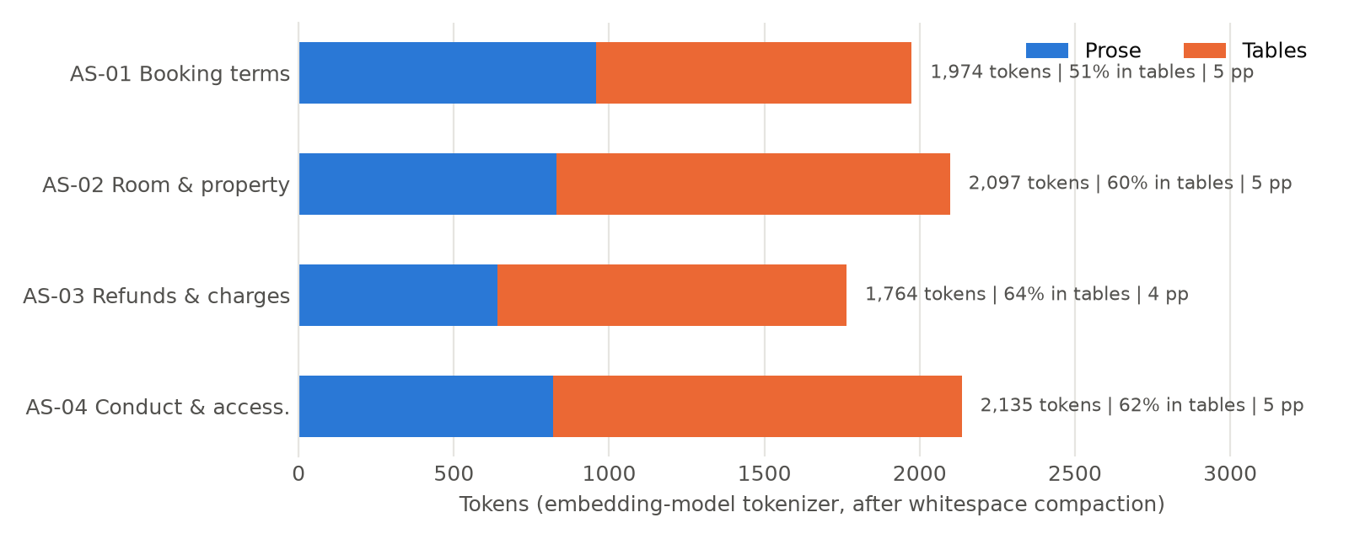
EDA: Corpus Content Details

Slide 9
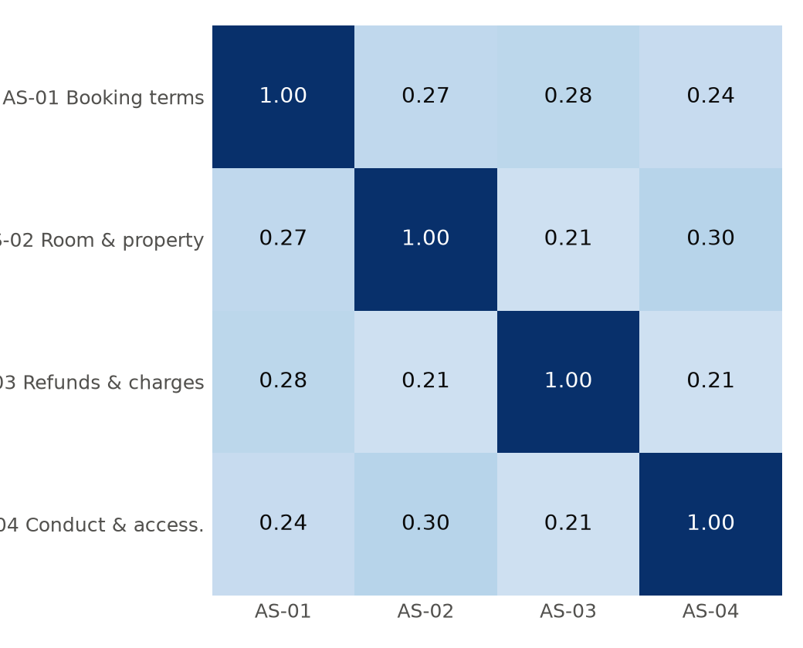
EDA: Cosine Similarity between Documents
Pairwise cosine similarity between documents (1 = identical vocabulary).

Slide 10
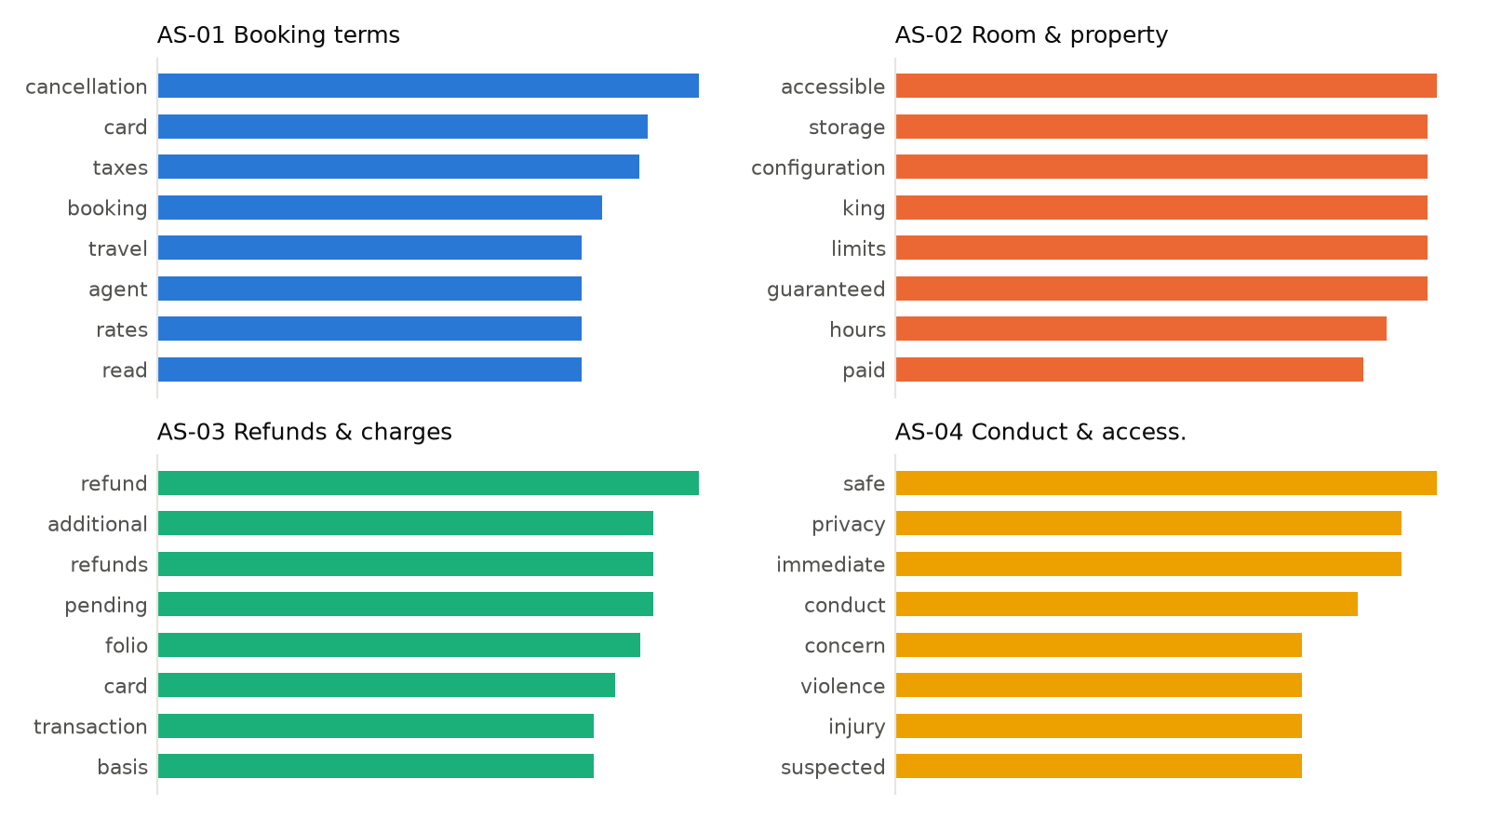
EDA: Distinctive Terms per Document
Most distinctive terms per document

Slide 11
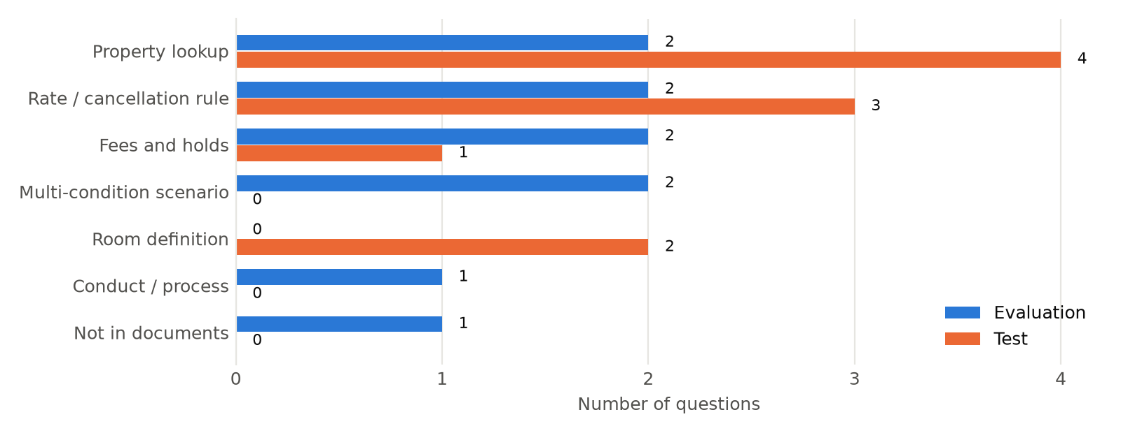
EDA: Questions By Type
Questions by type

Slide 12
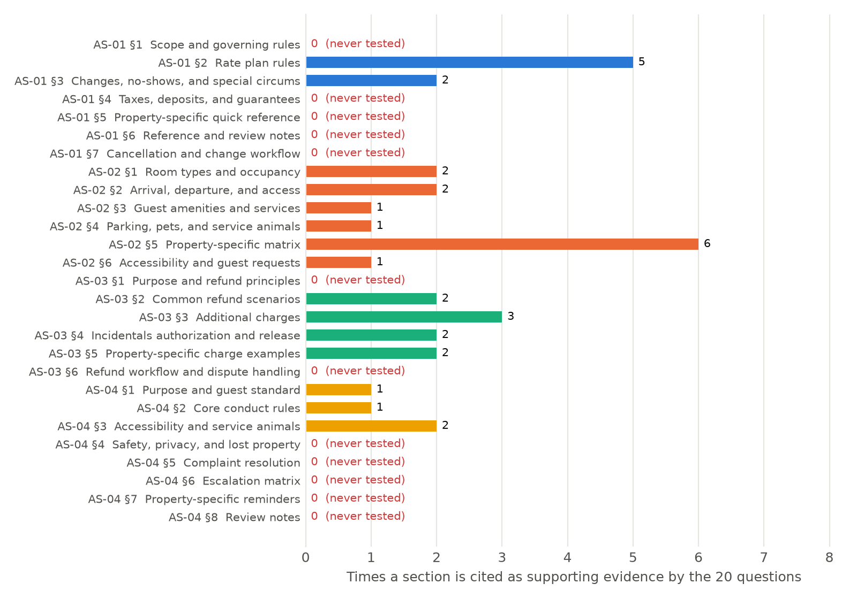
EDA: Test Coverage of Parts of Policy Documents

Slide 13
RAG: Chunking – Embedding Model
First pass (500 / 75) was template guidance, not a choice. The notebook suggested 400–600 tokens with 10–15% overlap; we did not check the embedding model's input limit.
Composite score by chunking setup
Setup | Evaluation set | Test set
500-token chunks | 0.77 | 0.63
120-token chunks | 0.74 | 0.71
120-token + compacted tables (final) | 0.72 | 0.69
Why we changed it. The first run scored poorly and the pet-fee demo returned “not enough information”. The model's max_seq_length is 128, so everything past token 128 is silently dropped: a 500-token chunk was embedded from only its first quarter.
How 120 / 15 were set. Size 120 is the largest round number safely under 128, leaving room for special tokens (final index: max 120, none above 128). Overlap 15 is ~12% of 120, within the 10–15% rule.
Takeaway: on unseen test data the final setup scores 0.69 vs 0.63 for 500-token chunks; evaluation-set score eased from 0.77 to 0.72.
What this does not show: no chunk-size sweep (e.g. 64, 96, 100) and no separate overlap sweep, so 120 is not proven optimal.

Slide 14
RAG: Chunking – Embedding Model
Embedding model: HarishMaths/Hotel-Policy-Embedding, a model fine-tuned on hotel policy text, so it should capture hotel vocabulary better than a general-purpose model.
max_length = 128 tokens. Anything beyond 128 tokens in a chunk is silently ignored when the vector is computed. This is far below the 400–600 tokens suggested in the notebook guidance, and it drove every chunking decision.
Why it matters: Our first run used 500-token chunks, so each vector described only the first quarter of its chunk; the test-set composite score was 0.63
Setup: Runs on CPU, embeddings are normalized so cosine similarity and inner product give the same ranking.

Slide 15
RAG: Chunking – Chunker
Method: LangChain RecursiveCharacterTextSplitter, driven by the embedding model's own tokenizer so chunk sizes are counted in the same tokens the model reads.
Parameters: chunk_size = 120 tokens, chunk_overlap = 15 tokens (about 12%), separators: paragraph, line, "##" heading, sentence, word, character. 120 stays inside the 128-token window.
Table clean-up before splitting: Docling pads wide tables with long runs of spaces and dashes that used up the token budget; some chunks held only table separator lines and table rows were cut away from their column headers. We collapse the padding (content is unchanged), which reduced the chunk count from 172 to 95.
Tried and rejected: 500-token chunks (silently truncated) and one chunk per table row (duplicated rows across documents crowded out the right property). Results in Insights.

Slide 16
RAG: Chunking
Step | Choice | Why
Embedding model | HarishMaths/Hotel-Policy-Embedding (384-dim, CPU, normalized vectors) | Fine-tuned on hotel-policy text; hard limit of 128 tokens per input
Chunker (prose) | LangChain RecursiveCharacterTextSplitter on the model's own tokenizer; chunk_size=120, overlap=15 (~12%) | Sizes are counted in tokens the model reads; 120 is the largest round size under 128. The template's 400-600 guidance would have silently truncated every chunk
Chunker (tables) | Split on row boundaries; each chunk repeats the header row and section title (up to 120 tokens) | A row such as $24 per person must stay tied to its column name; version 1 lost headers and the model refused
Pre-processing | Collapse runs of spaces and dashes in Docling's tables | Padding was 25-29% of each export and used up the token budget
De-duplication and metadata | Identical chunks repeated across PDFs kept once; each chunk stores its source file and section heading | Duplicates filled the top results; section metadata supports citations
124
final chunks (172 with the first plain split)
12
duplicate chunks removed (136 before)
83
median tokens per chunk (mean 74)
4-120
tokens per chunk (min 4, max 120)

Slide 17
RAG: Vector Database & Retrieval
Step | Choice | Detail
Load embedding model | HuggingFaceEmbeddings, CPU, normalize_embeddings=True | Same model at index time and query time (also loaded in the Flask backend).
Create vector DB | FAISS IndexFlatL2 (exact search), 124 vectors x 384 dimensions | Normalized vectors make L2 ranking identical to cosine ranking. At this size an approximate index is unnecessary.
Serialize | backend_files/faiss_index/ = index.faiss (190 KB) + index.pkl (55 KB, chunk text and metadata) | The API loads it at start-up instead of re-embedding.
Retrieval system | Hybrid search. Top 20 from the vector search and top 20 from a BM25 keyword | Meaning-based search misses exact terms; keyword search misses everyday wording. Together they cover both. Median 17 ms (max 23 ms) per query.
124 x 384
vectors x dimensions in the FAISS index (exact search)
20 + 20
top results from vector search and BM25 keyword search
17 ms
median retrieval time per query (max 23 ms)
245 KB
index on disk: 190 KB vectors + 55 KB text and metadata

Slide 18
RAG: Measured Behavior – version1 vs version2
Measure | Version 1 (120-token chunks, vector only, k=4) | Version 2 (final)
Judge composite, evaluation / test | 0.72 / 0.69 | 0.84 / 0.90
Confidently answered (target: at least 50%) | 5 of 10 / 5 of 10 | 8 of 10 / 9 of 10
Faithfulness / Recall / Precision / Relevancy (evaluation) | 0.89 / 0.66 / 0.59 / 0.61 | 0.95 / 0.84 / 0.68 / 0.82
Faithfulness / Recall / Precision / Relevancy (test) | 0.73 / 0.75 / 0.53 / 0.71 | 0.99 / 0.92 / 0.69 / 0.92
Judge-free: needed facts present in the retrieved chunks | 10 of 20 | 17 of 20
Judge-free: key facts correct in the generated answer | 10 of 20 | 17 of 20
Wrongly refused answerable questions | 8 | 1
Retrieval latency (median) / end-to-end (median) | 7 ms / 1.4 s | 17 ms / 1.1 s
Targets met in version 2: Faithfulness, Recall and Relevancy (both sets).
Still open: Precision (0.68 / 0.69) is still below 0.75.

Slide 19
RAG: Chunking – Chunk Documents
Total chunks: 95 across the four documents (172 before table clean-up). Every chunk carries its source PDF as metadata so answers can cite where they came from.
Example chunk (from the refunds and charges guide; the table now fits in one chunk with its header):
| Property | Parking | Pet fee | Breakfast |
|---|---|---|---|
| ASH-ATL Midtown | $28 self parking per night | $75 per stay | $19 adult, $10 child |
| ASH-BOS Harbor | $65 valet per night | No pets except service animals | Included |
| ASH-CHI Loop | $42 self parking per night | $50 per night, $150 stay cap | $22 per person |
metadata: {'source': 'Data/aurorastay_refunds_and_additional_charges_guide.pdf'}

Slide 20
RAG: Vector Database
Vector database: FAISS (in-memory index, built from LangChain documents).
Total vectors created: 95, one per chunk, so every chunk was embedded and stored.
Search: The query is embedded with the same model and compared with all chunk vectors; the closest chunks are returned. With only 95 vectors an exact search is instant.
Scale note: At 3–4 new properties a year the index stays small; the real scaling issue is document quality and property-level filtering, not vector search speed.

Slide 21
RAG: Vector Database – Retrieval Function
Query: "What is the pet fee at ASH-CHI Loop?" | k = 3 chunks retrieved
Result: The Chicago row is retrieved (pet fee $50 per night, $150 stay cap). Results 2 and 3 are the same property rows repeated from two other PDFs, which wastes retrieval slots.
--- Result 0 --- source: aurorastay_refunds_and_additional_charges_guide.pdf
| Property | Parking | Pet fee | Breakfast |
| ASH-ATL Midtown | $28 self parking per night | $75 per stay | $19 adult, $10 child |
| ASH-BOS Harbor | $65 valet per night | No pets except service animals | Included |
| ASH-CHI Loop | $42 self parking per night | $50 per night, $150 stay cap | $22 per person |
--- Result 1 --- source: aurorastay_room_and_property_information.pdf
| ASH-CHI Loop, Chicago IL | 3:00 PM / 12:00 PM | Self parking, $42 per night | $50 per night, $150 stay cap | $22 per person |
| ASH-DEN Union, Denver CO | 4:00 PM / 11:00 AM | Garage, $35 per night | $75 per stay; 2 pets max | $18 per person |
--- Result 2 --- source: aurorastay_guest_conduct_accessibility_and_resolution_guidelines.pdf
| (same two rows as Result 1) |

Slide 22
RAG: Generation System – Load the LLM
LLM: gpt-4o-mini, accessed through an OpenAI-compatible API (credentials kept in config.json, never in the notebook).
temperature = 0 for consistent, repeatable answers: staff asking the same question should get the same answer.
top_p = 1 (full probability distribution; temperature already makes output near-deterministic).
max_tokens = 512 keeps answers short enough to read while a guest waits.
Why a small model: Lower cost and latency for ~1,200 queries a week. A different, stronger model (GPT-4o) is used only as the judge.

Slide 23
RAG: Generation System – Generation Prompt
Role: Assistant answering AuroraStay Hotels policy questions (booking, cancellation, rooms, refunds, charges, guest conduct). The template said "medical insurance policies"; we corrected it, since the wrong domain would invite unsupported answers.
Ten rules: Use only the retrieved text; no outside knowledge; include all conditions, exceptions, fees and deadlines; stay on the question asked; be concise; never invent fees, deadlines or property details; flag conflicting sources.
Safe fallback: If the information is insufficient, reply exactly: "The available policy documents do not contain enough information to answer this question." This lets staff see a clear "go look it up" signal instead of a guess.
Rules:
1. Use only information explicitly supported by the retrieved policy information.
2. Do not use outside knowledge, assumptions, or information not present in the retrieved policy information.
...
9. Do not invent fees, deadlines, limits, conditions, or property-specific details.
10. If the information is insufficient, say: "The available policy documents do not contain enough information to answer this question."

Slide 24
RAG: Generation System – RAG Function
rag(query, k) = retrieve top-k chunks, then generate. Returns the answer and the chunks used, so sources are always shown.
Query: "What is the pet fee at ASH-CHI Loop?"
Response: "The pet fee at ASH-CHI Loop is $50 per night, with a maximum cap of $150 per stay." This matches the policy table.
Context: Before the table clean-up this same question was refused ("not enough information"), and in one experiment it returned another property's fee ($75 per stay). Retrieval quality, not the LLM, decides answer quality here.

Slide 25
Evaluation: Load the Evaluation Data
evaluation.csv: 10 benchmark questions with an expected answer and the policy passages (relevant context) a correct answer should be based on; multi-document questions list several passages. Example record (row 3):
question: I am staying at ASH-MIA Brickell with a dog on an Advance Purchase rate. What will the dog cost, and can I cancel for a refund?
expected_answer: ASH-MIA Brickell lists a $100 pet fee per stay for a non-service animal, subject to the property's pet limits. An Advance Purchase rate is generally non-refundable and non-changeable, so a refund is not normally available unless the confirmation, law, a documented system error, or an approved service recovery creates an exception.
relevant_context (3 passages, separated by "<>"): Room and Property Information Guide, Section 5 | Booking Terms, Section 2 | Refunds and Additional Charges Guide, Section 2

Slide 26
Evaluation: Define the Evaluation Model
Judge model: GPT-4o, loaded through DeepEval's OpenAIModel wrapper using the same API gateway.
Why a different, stronger model: The answers are written by gpt-4o-mini; having the same model grade its own work would flatter the results.
Method: LLM-as-a-judge (DeepEval GEval) with explicit scoring steps for each metric. Scores are 0–1.
Caution: Judge scores are not perfectly repeatable. In our runs the same system varied by a few points on aggregates and much more on individual questions, so with 10 questions per set we treat differences under ~0.05 as noise.

Slide 27
Evaluation: Define the Evaluation Metrics
Four metrics, each tied to a business risk. Composite = 0.35 × Faithfulness + 0.25 × Recall + 0.20 × Precision + 0.20 × Relevancy (weights reflect the priority on avoiding unsupported answers).
Metric | Target | What the judge checks
Faithfulness | ≥ 0.85 | Splits the answer into claims; checks each against the retrieved text; penalizes unsupported or contradicted claims.
Contextual Recall | ≥ 0.80 | Splits the expected answer into key facts; checks the retrieved text contains each; penalizes missing information.
Contextual Precision | ≥ 0.75 | Finds the retrieved text relevant to the question; penalizes retrievals padded with unrelated content.
Answer Relevancy | ≥ 0.75 | Checks the answer directly addresses the question; penalizes off-topic or unnecessary content.
Routing: Composite > 0.75 = auto answer; 0.50–0.75 = assisted review (staff check the sources); < 0.50 = manual lookup.

Slide 28
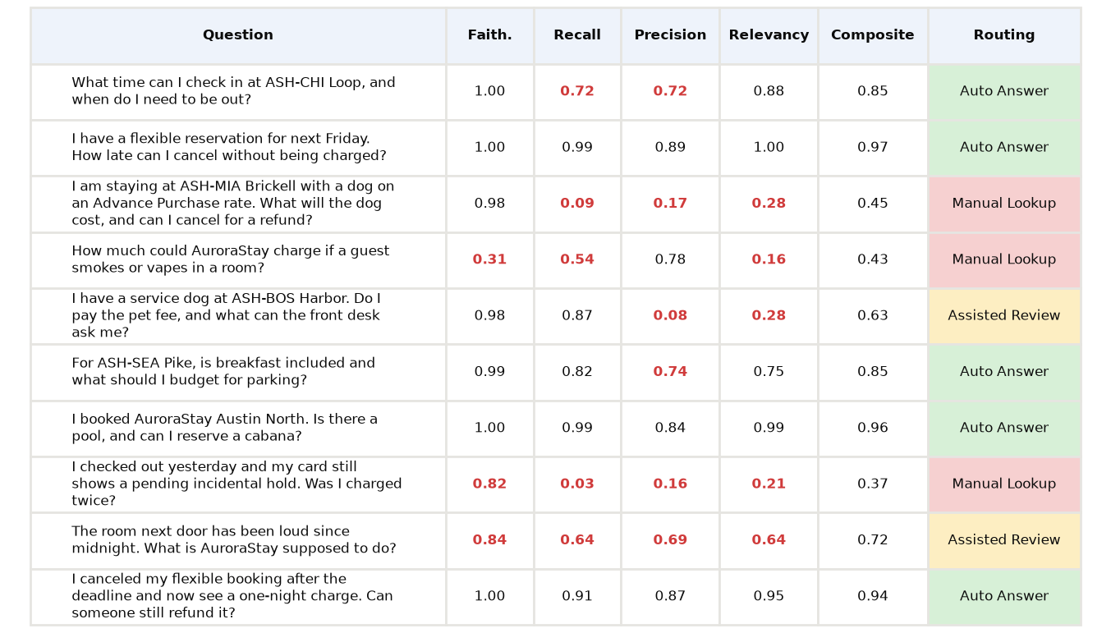
Evaluation: Build and Run the Evaluation
Evaluation set (10 questions): Faithfulness 0.89, Recall 0.66, Precision 0.59, Relevancy 0.61, composite 0.72. 5 auto answer, 2 assisted review, 3 manual lookup. Red = below target.

Slide 29
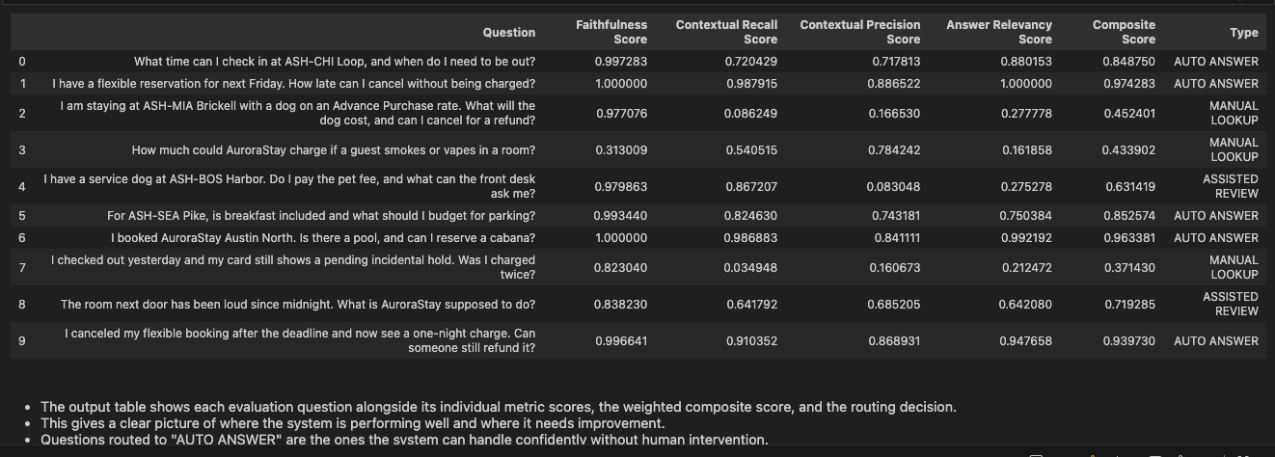
Run the Evaluation - Test data Set

Slide 30
Evaluation: Load the Test Data
test.xlsx: 10 further questions in the same format, never used while choosing settings (booking, property, conduct and refund scenarios). Example record (row 9):
question: My dog is not a service animal. What is the pet charge at ASH-CHI Loop?
expected_answer: ASH-CHI Loop lists a pet fee of $50 per night, capped at $150 per stay, for a non-service animal. Other pet limits and room restrictions may apply, so verify the live property profile.
relevant_context (2 passages): Room and Property Information Guide, Section 5 (ASH-CHI Loop: $50 per night pet fee with a $150 stay cap) <> Guest Conduct Guidelines, Section 3 (non-service animals follow the property's pet policy)
Note: The notebook loads Data/test.csv; the supplied file is test.xlsx, so it is read with pd.read_excel.

Slide 31
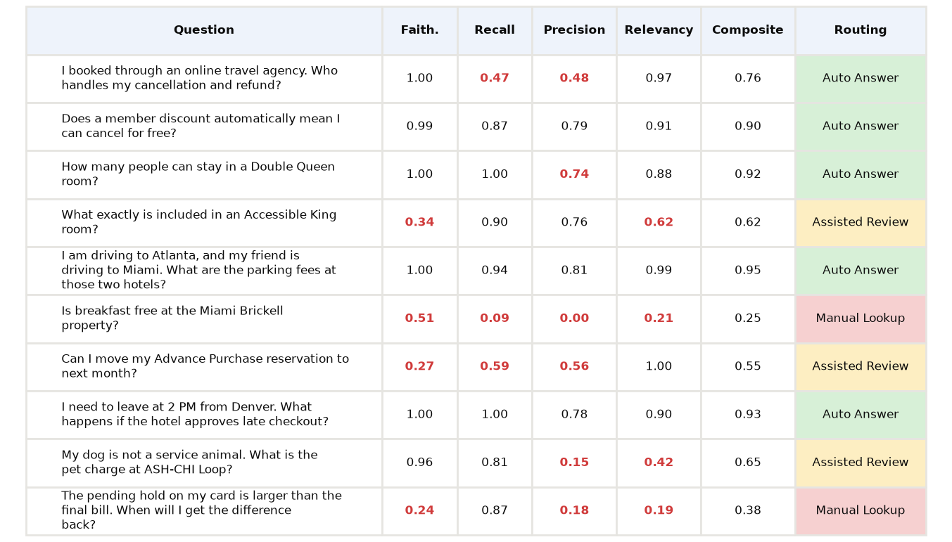
Evaluation: Build and Run the Evaluation
Test set (held out): Faithfulness 0.73, Recall 0.75, Precision 0.53, Relevancy 0.71, composite 0.69. 5 auto answer, 3 assisted review, 2 manual lookup. Same settings as the evaluation set.

Slide 32
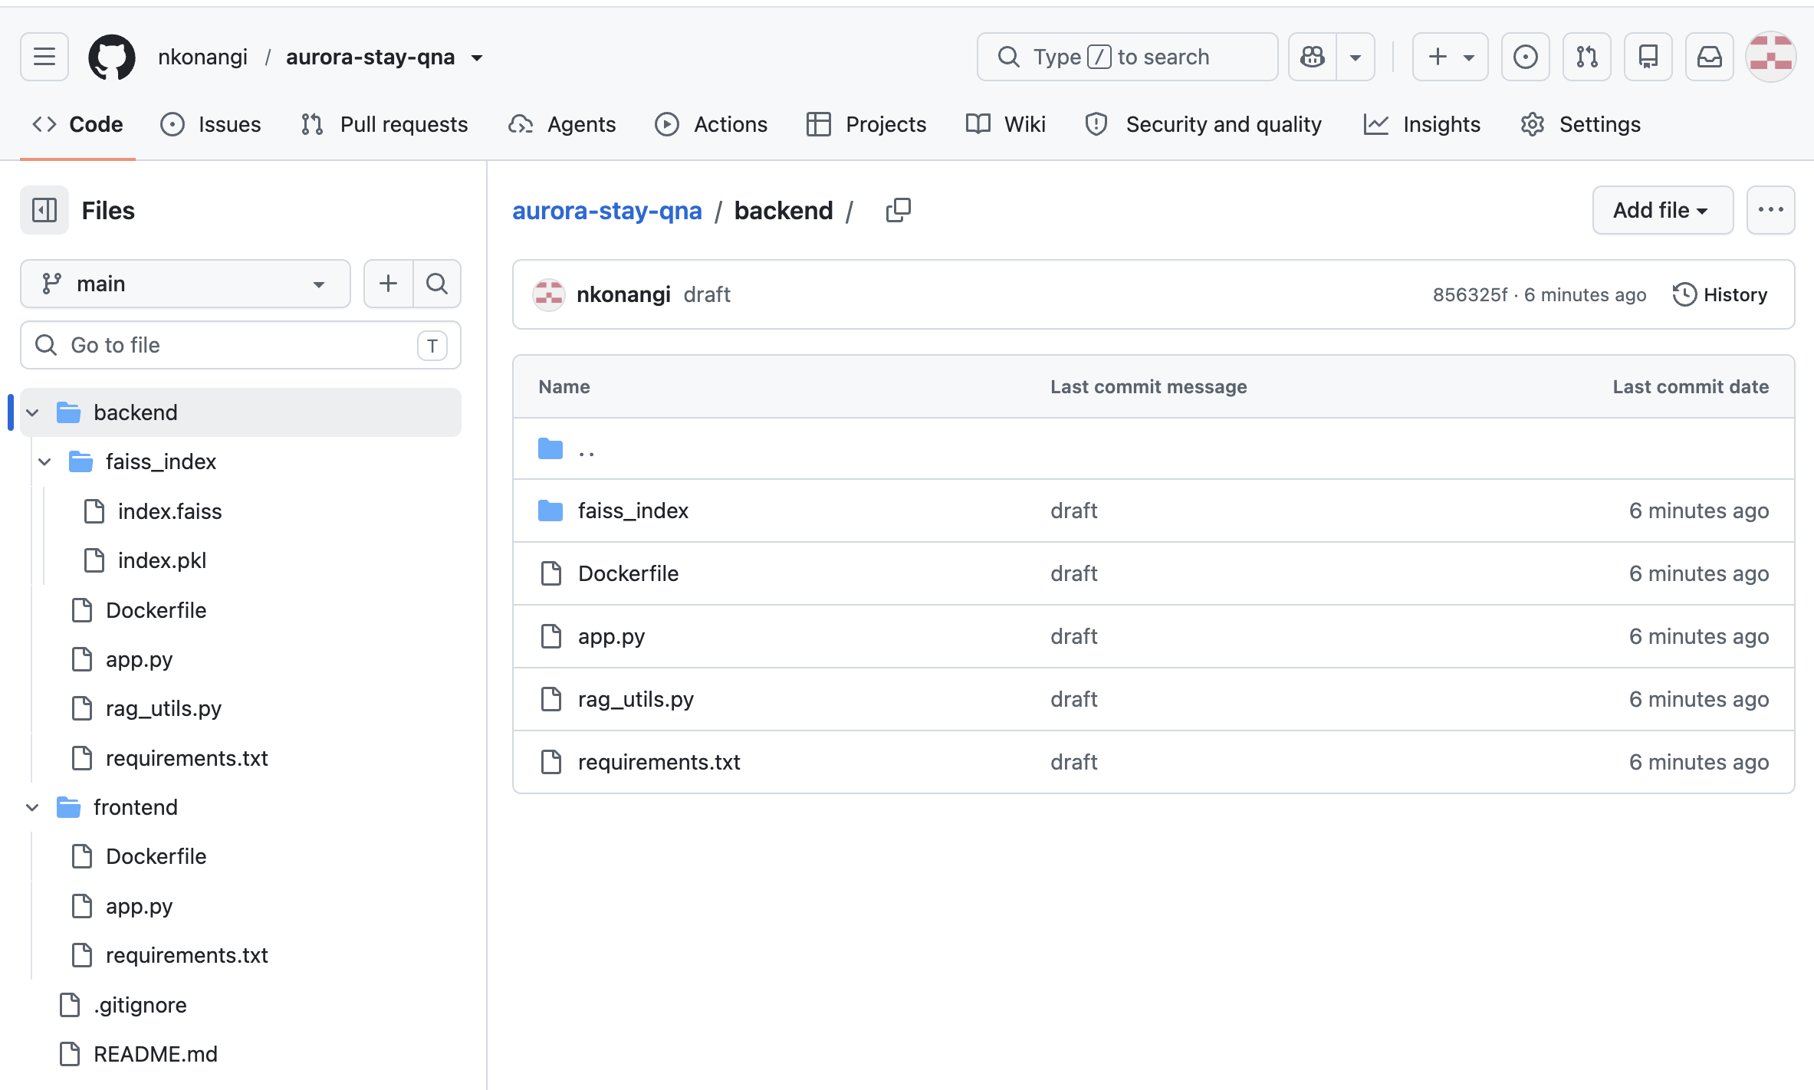
Source Code: Github Repository

Slide 33
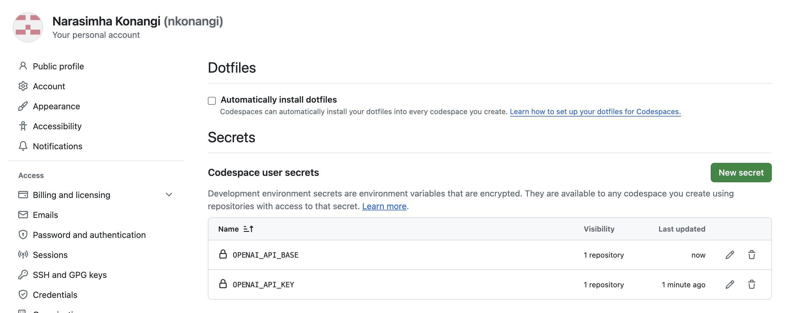
Github Codespaces : Secrets

Slide 34
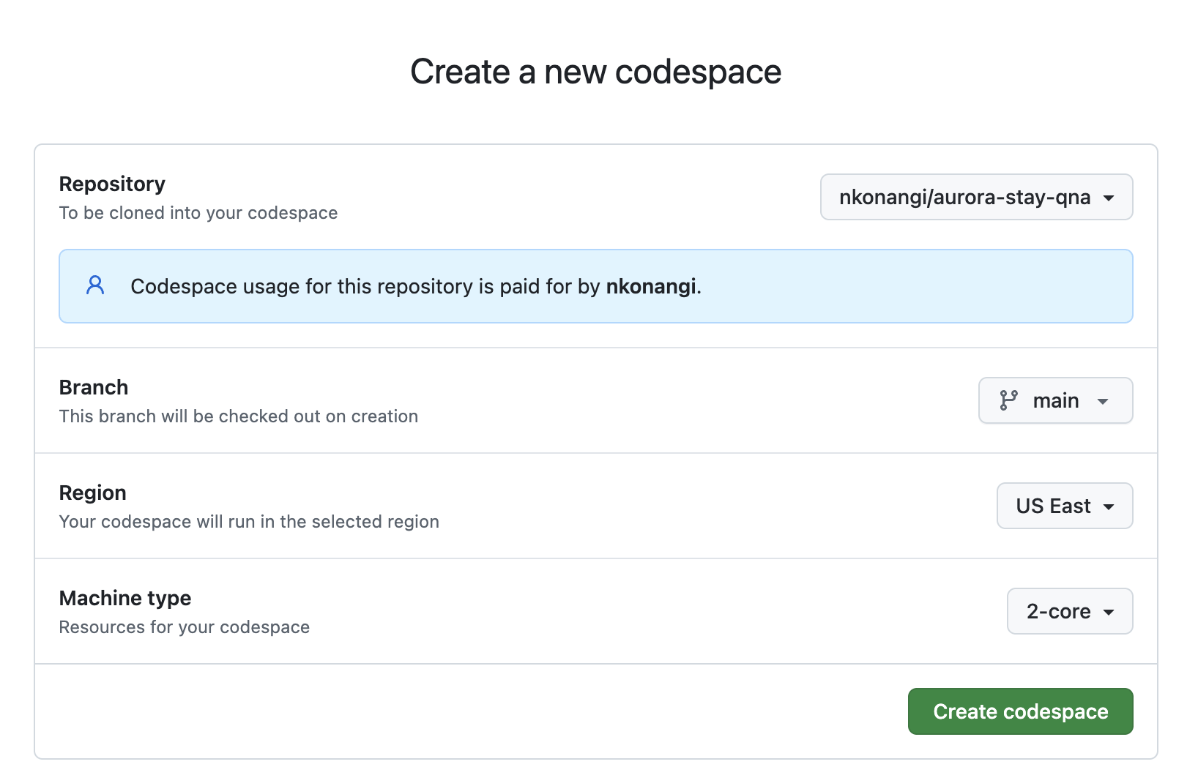
Codespaces : Create

Slide 35
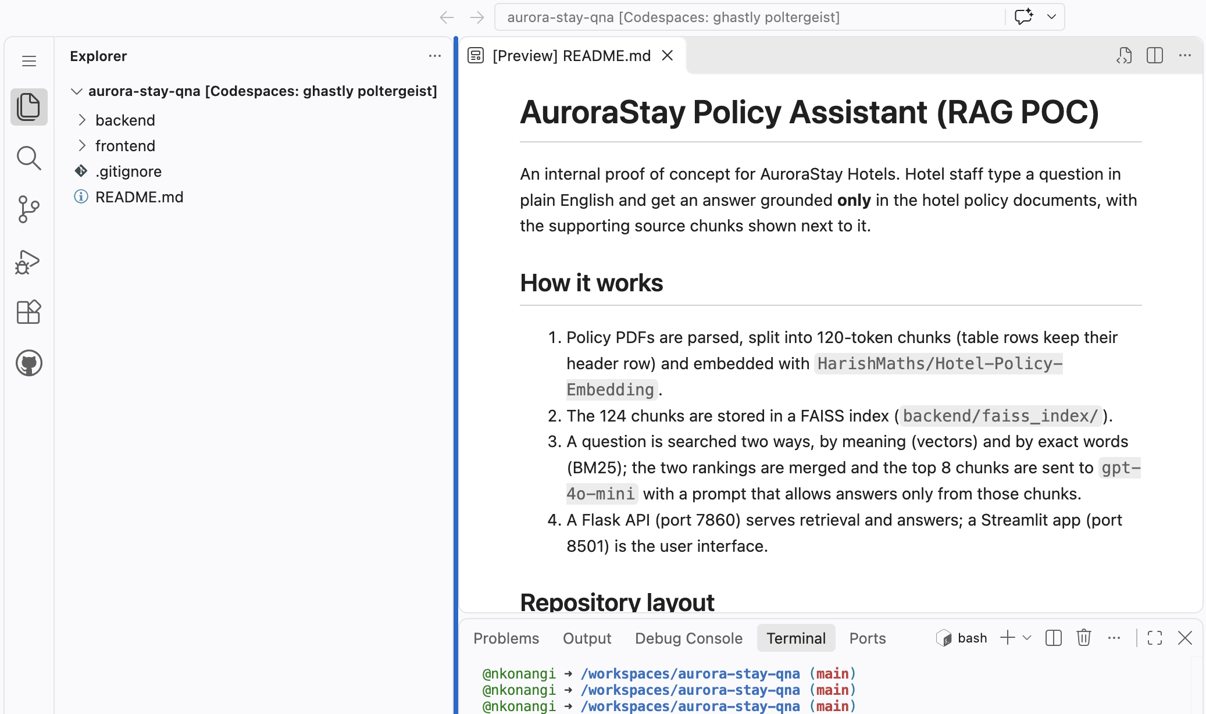
Codespaces : aurora-stay-qna

Slide 36
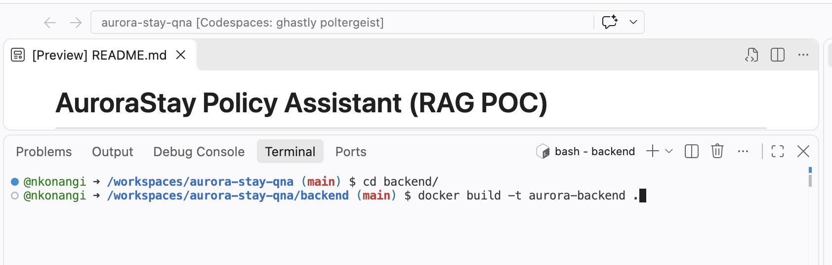
Apps Build: backend app

Slide 37
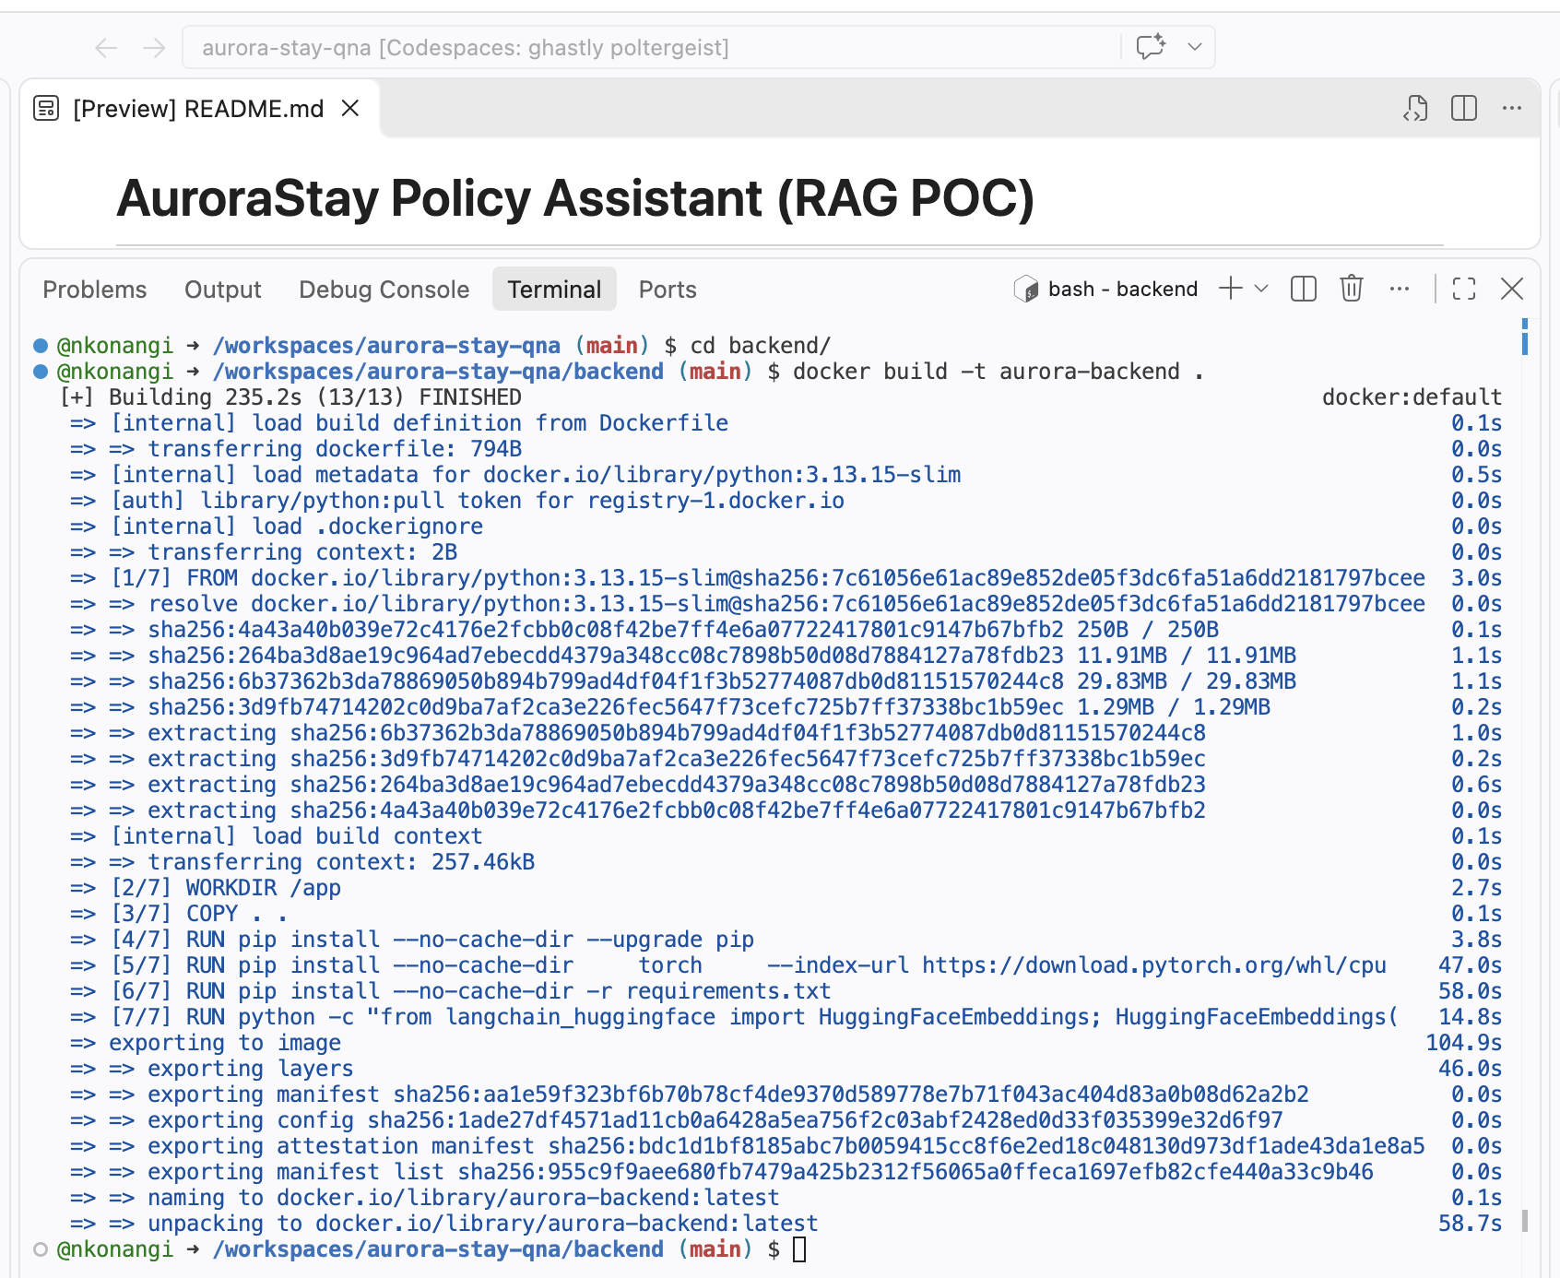
Build Backend App
Docker Image built for Backend application

Slide 38
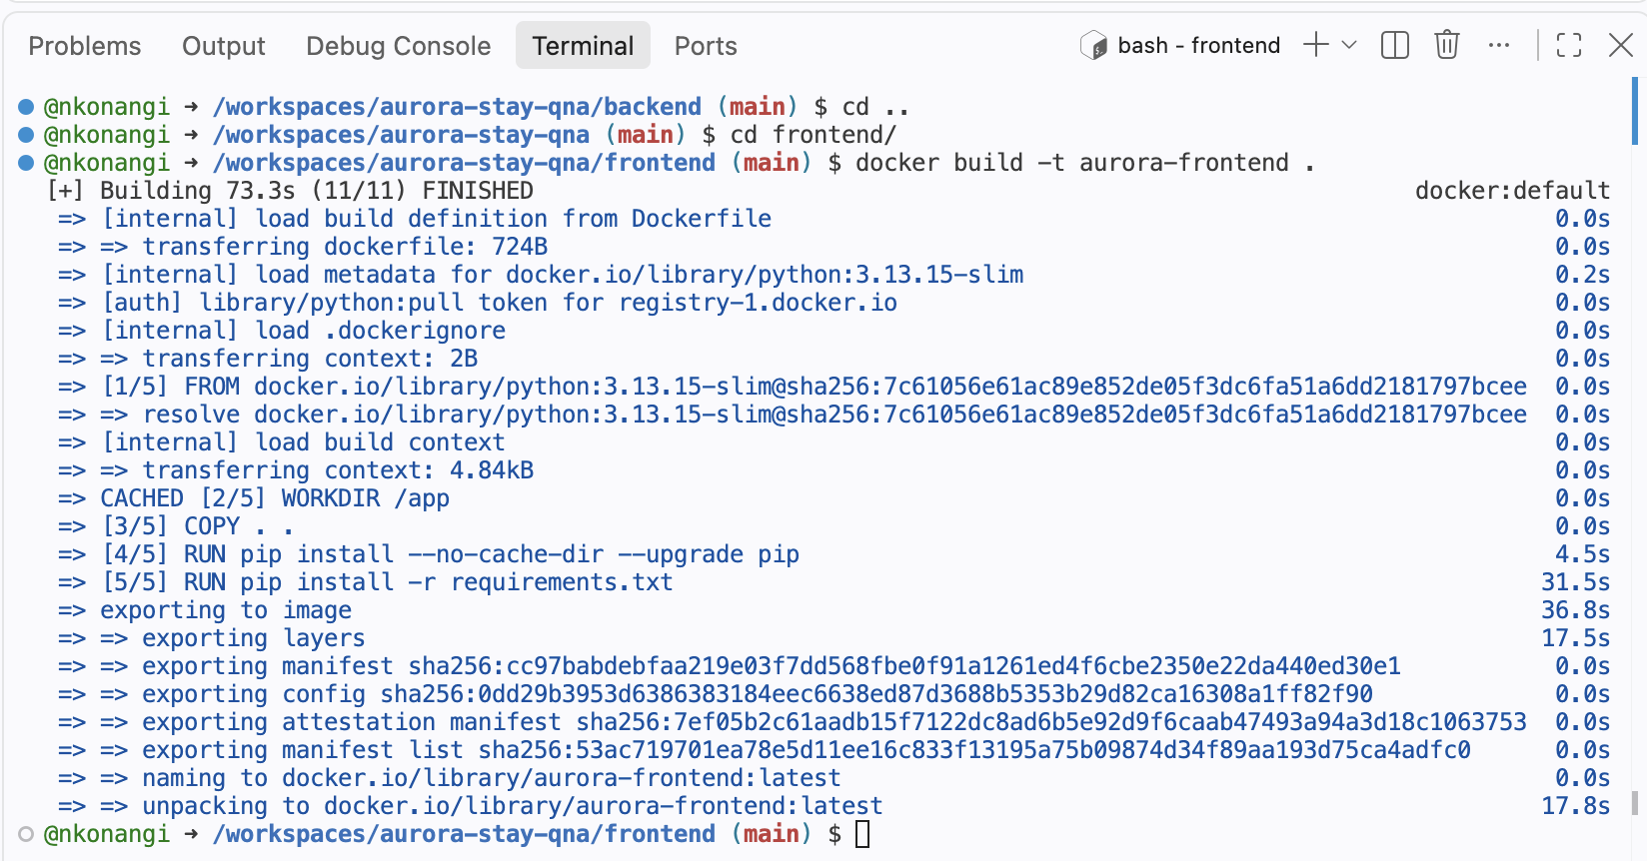
Build Frontend App
Docker Image built for Frontend application

Slide 39
Deployment:
docker run --name backend --network host -e OPENAI_API_KEY="$OPENAI_API_KEY" –e OPENAI_API_BASE="$OPENAI_API_BASE" aurora-backend

Slide 40
Deployment:

Slide 41
Deployment:

Slide 42
Deployment:

Slide 43
Deployment:

Slide 44
Deployment:

Slide 45
Deployment: Backend – Serialize the Vector Database
Saved with vectorstore.save_local("backend_files/faiss_index"), producing a folder with two files:
index.faiss (≈146 KB): the 95 chunk vectors.
index.pkl (≈48 KB): the chunk text and source metadata.
Why: The API loads the index at start-up instead of re-parsing PDFs and re-embedding (about 5 minutes of work), so the container starts quickly.
Note: Loading uses allow_dangerous_deserialization=True because the .pkl is a Python pickle. This is safe only because we build the file ourselves; never load an index from an untrusted source.

Slide 46
Deployment: Backend – Define the Flask Application
Flask app (backend_files/app.py) loads the embedding model and FAISS index once at start-up, then serves on port 7860 via gunicorn.
Endpoint | Method | Purpose
/ | GET | Health check: returns a welcome message.
/v1/relevant_chunks | POST | Input: query, k. Returns the k most relevant chunks only (no LLM call).
/v1/answer_with_relevant_chunks | POST | Input: query, k, model_name, temperature, top_p, max_tokens. Returns the answer plus the chunks used. This is what the UI calls.
/v1/answer | POST | Same inputs; returns the answer only.
Design: Retrieval and generation logic lives in rag_utils.py (same functions as the notebook); the API key is read from environment secrets, not stored in code.

Slide 47
Deployment: Backend – Define the Dependencies
backend_files/requirements.txt (Flask + gunicorn for the API; LangChain, sentence-transformers and faiss-cpu for retrieval; langchain-openai for the LLM call):
flask==3.1.3
Werkzeug==3.1.8
requests==2.34.2
gunicorn==26.2.0
uvicorn[standard]
langchain-huggingface==1.2.2
langchain-community==0.4.2
langchain-openai==1.6.1
sentence-transformers==6.1.0
faiss-cpu==1.15.0

Slide 48
Deployment: Backend – Define the Dockerfile
backend_files/Dockerfile: CPU-only PyTorch keeps the image small; the embedding model is downloaded during the build and the container then runs offline; gunicorn serves the Flask app on port 7860.
FROM python:3.13.15-slim
WORKDIR /app
COPY . .
RUN pip install --no-cache-dir --upgrade pip
RUN pip install --no-cache-dir \
torch \
--index-url https://download.pytorch.org/whl/cpu
RUN pip install --no-cache-dir -r requirements.txt
ENV HF_HOME=/app/huggingface
# Download the model at build time
RUN python -c "\
from langchain_huggingface import HuggingFaceEmbeddings; \
HuggingFaceEmbeddings( \
model_name='HarishMaths/Hotel-Policy-Embedding', \
model_kwargs={'device': 'cpu'}, \
encode_kwargs={'normalize_embeddings': True} \
)"
# Force offline mode at runtime so it uses the cached model
ENV TRANSFORMERS_OFFLINE=1
ENV HF_HUB_OFFLINE=1
CMD ["gunicorn", "-w", "1", "--timeout", "120", "-b", "0.0.0.0:7860", "app:rag_api"]

Slide 49
Deployment: Frontend – Define the Streamlit App
frontend_files/app.py: A single-page Streamlit app titled "Aurora Stays" for hotel staff.
Sidebar controls: Number of chunks (k), temperature and max tokens, so the team can test settings during the pilot.
Input: A question box and a choice of "Answer only" or "Answer + Relevant Chunks".
What happens: The app posts the question to the Flask endpoint and shows the answer; with chunks selected, each supporting chunk appears in an expandable panel, so staff can verify the source before telling a guest.
Failure handling: Clear messages if the API is unreachable or returns an error.

Slide 50
Deployment: Frontend – Define the Dockerfile
frontend_files/Dockerfile (requirements: streamlit 1.64.0 and requests 2.34.2). Runs Streamlit on port 8501 and binds to 0.0.0.0 so the Codespaces forwarded URL can reach it:
# Use a minimal base image with Python 3.13.15-slim installed
FROM python:3.13.15-slim
# Set the working directory inside the container
WORKDIR /app
# Copy all files from the current directory to the container's /app directory
COPY . .
# Upgrade pip
RUN pip install --no-cache-dir --upgrade pip
# Install Python dependencies listed in requirements.txt
RUN pip install -r requirements.txt
# Run the Streamlit application on port 8501
# 0.0.0.0 makes the application accessible outside the container
# XSRF protection is disabled for easier external access
CMD ["streamlit", "run", "app.py", "--server.port=8501", "--server.address=0.0.0.0", "--server.enableXsrfProtection=false"]

Slide 51
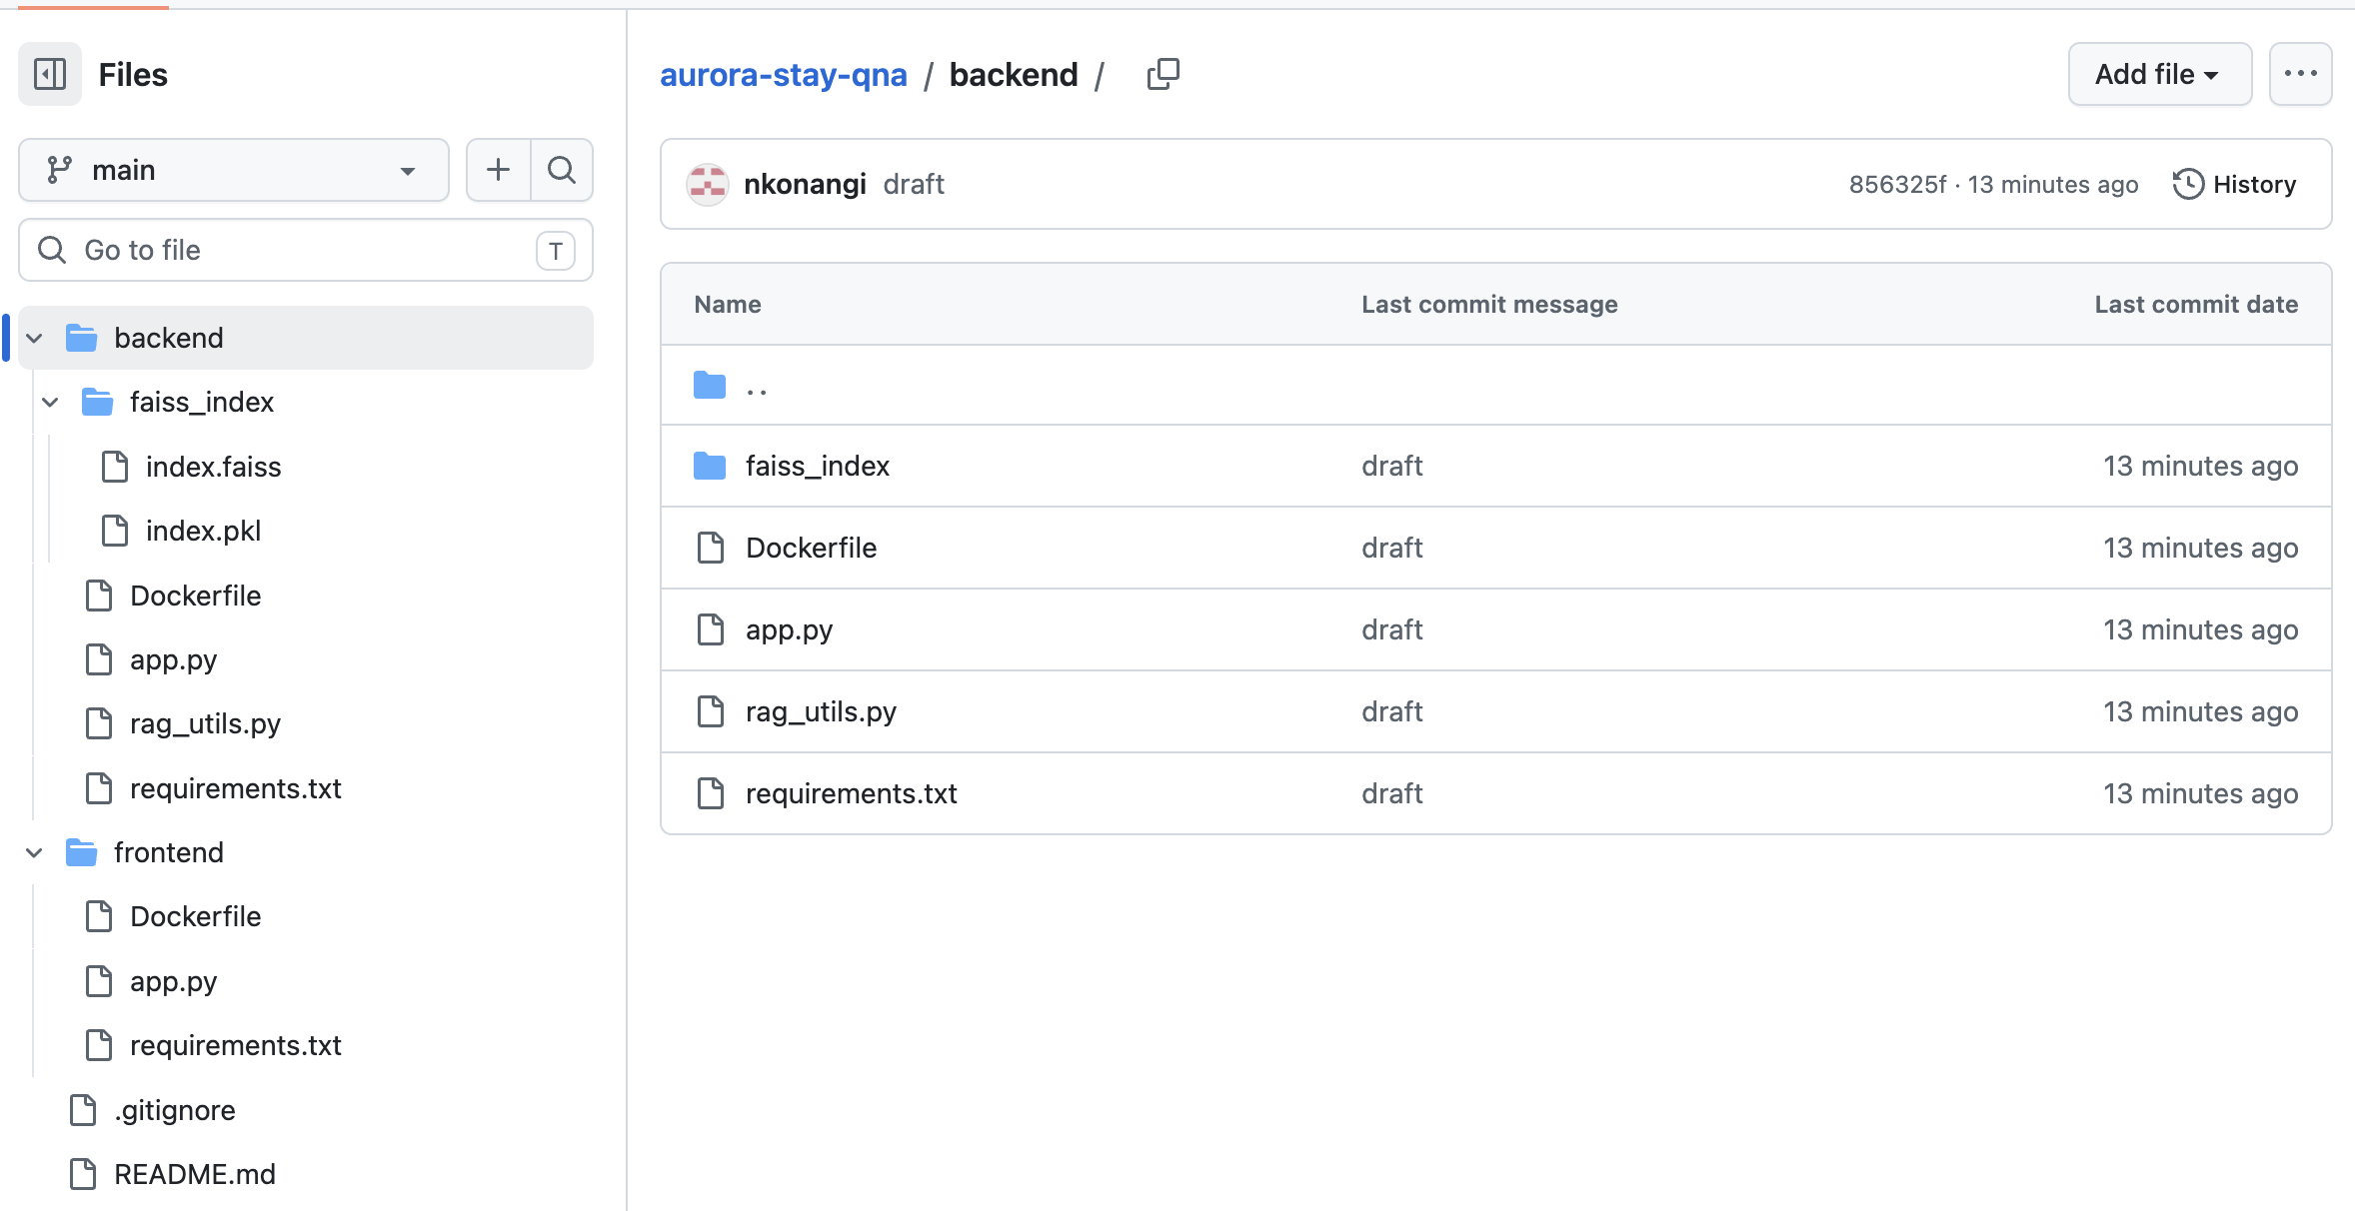
Deployment: Frontend – Push the Files to GitHub
Files prepared for the push
(GitHubrepo name aurora-stay-qna):
backend/app.py,
rag_utils.py,
requirements.txt,
Dockerfile,
faiss_index/index.faiss,
faiss_index/index.pkl;
frontend/app.py,
requirements.txt,
Dockerfile.
Not pushed: config.json (API key) is deliberately excluded.
PENDING – Repository URL: https://github.com/<your-username>/aurora-stay-qna (add after running the push cell; add a screenshot of the repo file list).

Slide 52
Deployment: Inference – Define the Forwarded URL
Plan: Deploy backend (port 7860) and frontend (port 8501) in GitHub Codespaces, make both ports public, and test through the forwarded URLs.
PENDING – Forwarded URL: https://<codespace-name>-7860.app.github.dev (no trailing slash). Add Streamlit screenshots showing the inputs tried, e.g. "What is the pet fee at ASH-CHI Loop?" and "Is breakfast free at the Miami Brickell property?".

Slide 53
Deployment: Inference – Relevant Chunks
Endpoint: POST /v1/relevant_chunks
Payload (suggested): {"query": "What is the pet fee at ASH-CHI Loop?", "k": 4}
PENDING – run the inference cells after deployment and paste the status code (200) and the returned chunks, or screenshots of all three.

Slide 54
Deployment: Inference – Answer with Relevant Chunks
Endpoint: POST /v1/answer_with_relevant_chunks
Payload (suggested): {"query": "What is the pet fee at ASH-CHI Loop?", "k": 4, "model_name": "gpt-4o-mini", "temperature": 0, "top_p": 1, "max_tokens": 512}
PENDING – run the inference cells after deployment and paste the status code (200), the generated answer and the supporting chunks.

Slide 55
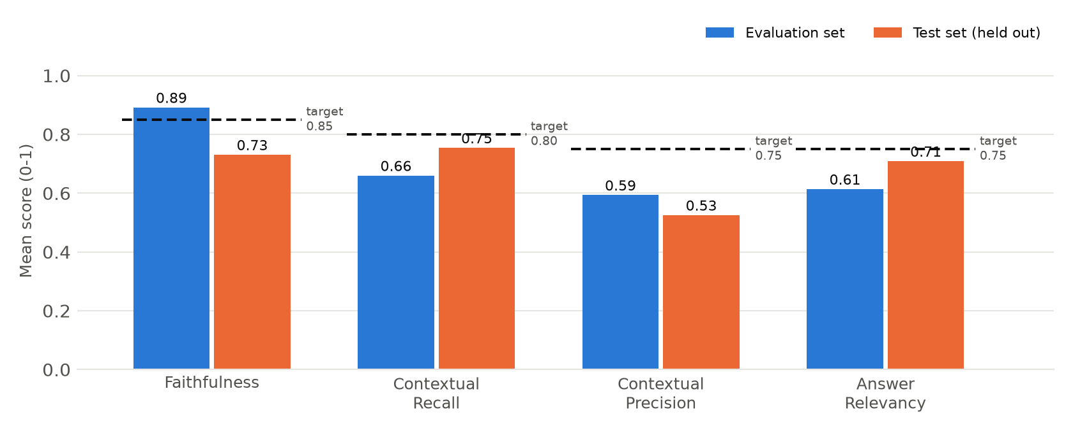
Insights: Safe But Not Yet Reliable Enough
Safe by design: Every auto-answered response scored faithfulness ≥ 0.99 in both sets; the unreliable answers were the ones routed to review. The system errs toward "look it up" rather than guessing.
Gap: Retrieval (recall and precision) is the bottleneck, not the LLM. Only Faithfulness (eval) clears its target.

Slide 56
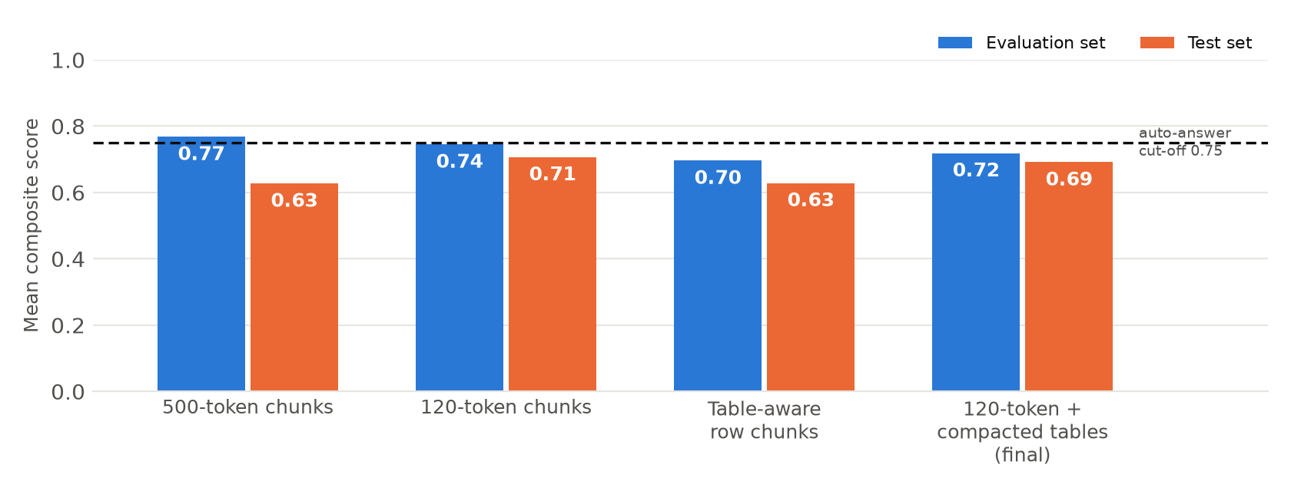
Insights: Chunking Was the Biggest Quality Lever
Four configurations tested: Averages differ by only 0.03–0.07, within judge noise, but they fail on different questions. The final choice (compacted tables) fixes property lookups such as Chicago check-in, Seattle breakfast and Denver late checkout, but weakens a few others.
Lesson: The embedder's 128-token limit and table-heavy PDFs mean document preparation matters more than prompt or model tuning.

Slide 57
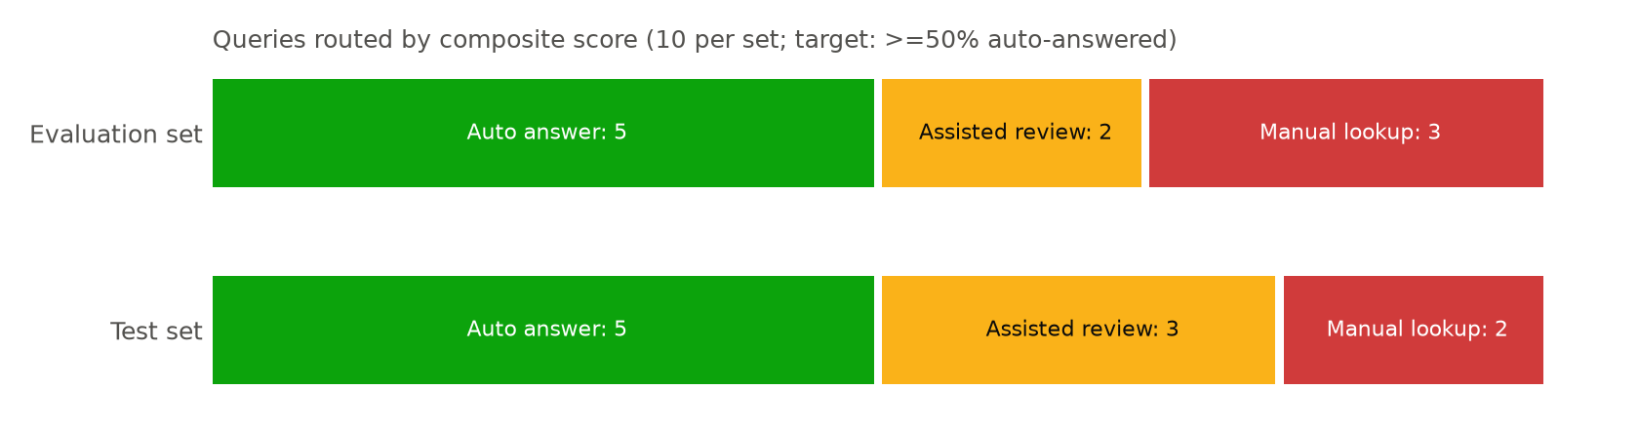
Insights: Business Impact and Routing
Target met, narrowly: 5 of 10 auto-answered in each set = 50%. If this held across ~1,200 weekly queries, about 600 would skip manual lookup, and about 240 of the ~480 complex ones (illustrative only: 10 questions per set give a very wide margin of error).
Assisted review is the key to adoption: Answers with the sources shown give staff a fast check on borderline cases instead of an 8–12 minute search.
Weakest topics: property-specific fees and times, smoking and incidental-hold questions (see tables).

Slide 58
Recommendations
1
Pilot internally (now): Release to a few properties as a staff-only tool with the three-way routing rule; log every question and track how often staff override the answer.
2
Fix property data retrieval (next 4–6 weeks): Store the property matrix once as structured data (all 18 properties, not 6), detect the property name in the question, and filter to it before searching.
3
Clean the documents: Remove the duplicated tables across PDFs, give every policy one owner, and add new properties through a single template.
4
Improve the retriever: Evaluate an embedding model with a longer window (512+ tokens), and test hybrid keyword + vector search and a re-ranker.
5
Build a bigger evaluation set: 100+ real staff questions, reviewed by operations, run on every change; set a go-live rule such as faithfulness ≥ 0.85 and ≥ 60% auto-answered.
6
Governance before wider rollout: Human review for refunds, legal, safety and escalation topics; access control; weekly review of failed queries.

Slide 59
APPENDIX

Slide 60
Appendix: Experiment Log and Caveats
Run 1, 500-token chunks, k=3: 172 chunks; eval composite 0.77, test 0.63.
Run 2, 120-token chunks, k=4: 172 chunks; eval 0.74, test 0.71 (first run to respect the 128-token limit).
Run 3, one chunk per table row: 187 chunks; eval 0.70, test 0.63. Rejected: duplicated rows across PDFs filled the top results and the embedder did not separate properties.
Run 4, 120-token + compacted tables (final): 95 chunks; eval 0.72, test 0.69; fixes the property-lookup questions.
Caveats: 10 questions per set; LLM-judge scores vary between runs; the final configuration was chosen on retrieval behaviour and root cause, not on a score gap, and the test set was also scored in each run, so test numbers are not a pristine hold-out. Three of the four runs hit intermittent API authentication errors and were rerun unchanged.

