Slide 1
Chapter 1 Introduction Linked Data and the Semantic Web
Nikolaos Konstantinou
Dimitrios-Emmanuel Spanos

Slide 2
Outline
Introduction
Preliminaries
The Linked Open Data Cloud

Slide 3
The Origin of the Semantic Web
Semantic Web
Term primarily coined by Tim Berners-Lee
For the Web to be understandable both by humans and software, it should incorporate its meaning
Its semantics
Linked Data implements the Semantic Web vision

Slide 4
Why a Semantic Web? (1)
Information management
Sharing, accessing, retrieving, consuming information
Increasingly tedious task
Search engines
Rely on Information Retrieval techniques
Keyword-based searches
Do not release the information potential
Large quantity of existing data on the web is not stored in HTML
The Deep Web

Slide 5
Why a Semantic Web? (2)
Content meaning should be taken into account
Structure to the meaningful Web page content
Enable software agents to
Roam from page to page
Carry out sophisticated tasks for users
Semantic Web
Complement, not replace current Web
Transform content into an exploitable source of knowledge

Slide 6
Why a Semantic Web? (3)
Web of Data
An emerging web of interconnected published datasets in the form of Linked Data
Implements the Semantic Web vision

Slide 7
The Need for Adding Semantics (1)
Semantics
From the Greek word σημαντικός
Pronounced si̱mantikós, means significant
Term typically used to denote the study of meaning
Using semantics
Capture the interpretation of a formal or natural language
Enables entailment, application of logical consequence
About relationships between the statements that are expressed in this language

Slide 8
The Need for Adding Semantics (2)
Syntax
The study of the principles and processes by which sentences can be formed
Also of Greek origin
συν and τάξις
Pronounced sin and taxis
Mean together and ordering, respectively

Slide 9
The Need for Adding Semantics (3)
Two statements can be syntactically different but semantically equivalent
Their meaning (semantics) is the same, the syntax is different
More than one ways to state an assumption

Slide 10
The Need for Adding Semantics (4)
Search engines rely on keyword matches
Keyword-based technologies
Have come a long way since the dawn of the internet
Will return accurate results
Based on keyword matches
Extraction and indexing of keywords contained in web pages
But
More complex queries with semantics still partially covered
Most of the information will not be queried

Slide 11
Traditional search engines
Rely on keyword matches
Low precision
Important results may not be fetched, or
Ranked low
No exact keyword matches

Slide 12
Keyword-based searches
Do not return usually the desired results
Despite the amounts of information
Typical user behavior
Change query rather than navigate beyond the first page of the search results

Slide 13
The Semantic Web (1)
Tackle these issues
By offering ways to describe of Web resources
Enrich existing information
Add semantics that specify the resources
Understandable both by humans and computers
Information easier to discover, classify and sort
Enable semantic information integration
Increase serendipitous discovery of information
Allow inference

Slide 14
The Semantic Web (2)
Example
A researcher would not have to visit every result page and distinguish the relevant from the irrelevant results
Instead, retrieve a list of more related, machine-processable information
Ideally containing links to more relevant information

Slide 15
Outline
Introduction
Preliminaries
The Linked Open Data Cloud

Slide 16
Data-Information-Knowledge (1)
Data
Information
“facts about a situation, person, event, etc.”
Smallest information particle
The bit
Replies with a yes or no (1 or 0)
Can carry data, but in the same time, it can carry the result of a process
For instance whether an experiment had a successful conclusion or not
Information, especially facts or numbers, collected to be examined and considered and used to help decision-making, or information in an electronic form that can be stored and used by a computer

Slide 17
Data-Information-Knowledge (2)
E.g. “temperature” in a relational database could be
The information produced after statistical analysis over numerous measurements
By a researcher wishing to extract the average value in a region over the years
A sensor measurement
Part of the data that will contribute in drawing conclusions regarding climate change

Slide 18
Data-Information-Knowledge (3)
Knowledge
Key term: “by experience or study”
Implies processing of the underlying information
Understanding of or information about a subject that you get by experience or study, either known by one person or by people generally

Slide 19
Data-Information-Knowledge (4)
No clear lines between them
Term that is used depends on the respective point of view
When we process collected data in order to extract meaning, we create new information
Addition of semantics
Indispensable in generating new knowledge
Semantic enrichment of the information
Makes it unambiguously understood by any interested party (by people generally)
Data → Information → Knowledge

Slide 20
Heterogeneity
Distributed data sources
Interconnected, or not
Different models and schemas
Differences in the vocabulary
Syntactic mismatch
Semantic mismatch

Slide 21
Interoperability (1)
Interoperable
Two systems in position to successfully exchange information
3 non-mutually exclusive approaches
Mapping among the concepts of each source
Intermediation in order to translate queries
Query-based
Protocols and standards (recommendations) are crucial
E.g. SOAP, WSDL, microformats

Slide 22
Interoperability (2)
Key concept: Schema
Word comes from the Greek word σχήμα
Pronounced schíma
Means the shape, the outline
Can be regarded as a common agreement regarding the interchanged data
Data schema
Defines how the data is to be structured

Slide 23
Information Integration (1)
Combine information from heterogeneous systems, sources of storage and processing
Ability to process and handle it as a whole
Global-As-View
Every element of the global schema is expressed as a query/view over the schemas of the sources
Preferable when the source schemas are not subject to frequent changes

Slide 24
Information Integration (2)
Local-As-View
Every element of the local schemas is expressed as a query/view over the global schema
P2P
Mappings among the sources exist but no common schema

Slide 25
Information Integration Architecture (1)
A source Π₁ with schema S₁
A source Π₂ with a schema S₂
…
A source Π_{ν} with source S_{ν}
A global schema S in which the higher level queries are posed

Slide 26
Information Integration Architecture (2)
The goal in the information integration problem
Submit queries to the global schema S
Receive answers from S₁, S₂, …, S_{ν}
Without having to deal with or even being aware of the heterogeneity in the information sources

Slide 27
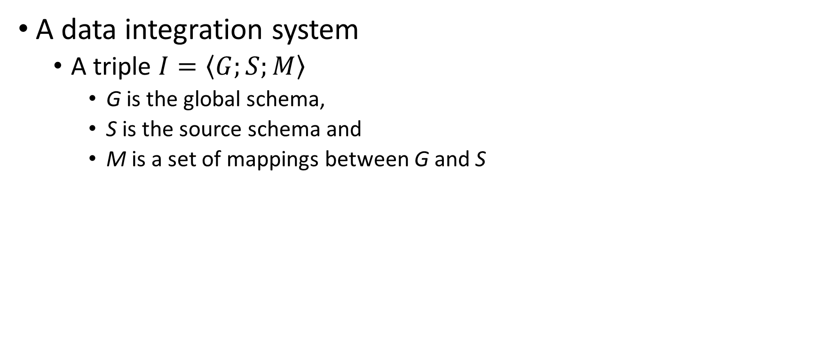
Data Integration (1)
A data integration system
A triple $I=〈G;S;M〉$
G is the global schema,
S is the source schema and
M is a set of mappings between G and S

Slide 28
Data Integration (2)
Local-As-View
Each declaration in M maps an element from the source schema S to a query (a view) over the global schema G
Global-As-View
Each declaration in M maps an element of the global schema G to a query (a view) over the source schema S
The global schema G is a unified view over the heterogeneous set of data sources

Slide 29
Data Integration (3)
Same goal
Unifying the data sources under the same common schema
Semantic information integration
Addition of its semantics in the resulting integration scheme

Slide 30
Mapping
Using the definition of data integration systems, we can define the concept of mapping
A mapping m (member of M) from a schema S to a schema T
A declaration of the form Q^{S} ⇝ Q^{T}
Q^{S} is a query over S
Q^{T} a query over T

Slide 31
Mapping vs. Merging
(Data) mapping
A mapping is the specification of a mechanism
The members of a model are transformed to members of another model
The meta-model that can be the same, or different
A mapping can be declared as a set of relationships, constraints, rules, templates or parameters
Defined during the mapping process, or through other forms that have not yet been defined
Merging
Implies unifying the information at the implementation/storage layer

Slide 32
Annotation (1)
Addition of metadata to the data
Data can be encoded in any standard
Especially important in cases when data is not human-understandable in its primary form
E.g. multimedia

Slide 33
Annotation (2)
(Simple) annotation
Uses keywords or other ad hoc serialization
Impedes further processing of the metadata
Semantic annotation
Describe the data using a common, established way
Addition of the semantics in the annotation (i.e. the metadata)
In a way that the annotation will be machine-processable
In order to be able to infer additional knowledge

Slide 34
Problems with (Semantic) Annotation
Time-consuming
Users simply do not have enough time or do not consider it important enough in order to invest time to annotate their content
Familiarity required with both the conceptual and technical parts of the annotation
User performing the annotation must be familiar with both the technical as well as the conceptual part
Outdated annotations
A risk, especially in rapidly changing environments with lack of automation in the annotation process

Slide 35
Automated Annotation
Incomplete annotation is preferable to absent
E.g. in video streams
Limitations of systems performing automated annotation
Limited recall and precision (lost or inaccurate annotations)

Slide 36
Metadata (1)
Data about data
Efficient materialization with the use of ontologies
Ontologies can be used to describe Web resources
Adding descriptions about their semantics and their relations
Aims to make resources machine-understandable
Each (semantic) annotation can correspond to a piece of information
It is important to follow a common standard

Slide 37
Metadata (2)
Annotation is commonly referred to as “metadata”
Usually in a semi-structured form
Semi-structured data sources
Structure accompanies the metadata
E.g. XML, JSON
Structured data sources
Structure is stored separately
E.g. relational databases

Slide 38
Metadata (3)
Powerful languages
Practically unlimited hierarchical structure
Covers most of the description requirements that may occur
Storage in separate files allows collaboration with communication protocols
Files are independent from the environment in which they reside
Resilience to technological evolutions
Negatives
Expressivity of the description model
Limited way of structuring the information

Slide 39
Metadata (4)
Inclusion of semantics
Need for more expressive capabilities and terminology
Ontologies
Offer a richer way of describing information
E.g. defining relationships among concepts such as subclass/superclass, mutually disjoint concepts, inverse concepts, etc.
RDF can be regarded as the evolution of XML
OWL enables more comprehensive, precise and consistent description of Web Resources

Slide 40
Ontologies (1)
Additional description to an unclear model that aims to further clarify it
Conceptual description model of a domain
Describe its related concepts and their relationships
Can be understood both by human and computer
A shared conceptualization of a given specific domain
Aim at bridging and integrating multiple and heterogeneous digital content on a semantic level

Slide 41
Ontologies (2)
In Philosophy, a systematic recording of “Existence”
For a software system, something that “exists” is something that can be represented
A set of definitions that associate the names of entities in the universe of discourse with human-readable text describing the meaning of the names
A set of formal axioms that constrain the interpretation and well-formed use of these terms
The specification of a conceptualization (Gruber 1995)

Slide 42
Ontologies (3)
Can be used to model concepts regardless to how general or specific these concepts are
According to the degree of generalization
Top-level ontology
Domain ontology
Task ontology
Application ontology
Content is made suitable for machine consumption
Automated increase of the system knowledge
Logical rules to infer implicitly declared facts

Slide 43
Reasoners (1)
Software components
Validate consistency of an ontology
Perform consistency checks
Concept satisfiability and classification
Infer implicitly declared knowledge
Apply simple rules of deductive reasoning

Slide 44
Reasoners (2)
Basic reasoning procedures
Consistency checking
Concept satisfiablility
Concept subsumption
Instance checking (Realization)
Properties of special interest
Termination
Soundness
Completeness

Slide 45
Reasoners (3)
Research in Reasoning
Tradeoff between
Expressiveness of ontology definition languages
Computational complexity of the reasoning procedure
Discovery of efficient reasoning algorithms
Commercial
E.g. RacerPro
Free of charge
E.g. Pellet, FaCT++

Slide 46
Knowledge Bases
Terminological Box (TBox)
Concept descriptions
Intensional knowledge
Terminology and vocabulary
Assertional Box (ABox)
The real data
Extensional knowledge
Assertions about named individuals in terms of the TBox vocabulary
Application Programs
Rules
TBox
Description
Language
Reasoning
ABox
Knowledge Base

Slide 47
Knowledge Bases vs. Databases (1)
A naïve approach:
TBox ≡ Schema of the relational database
ABox ≡ Schema instance
However, things are more complex than that

Slide 48
Knowledge Bases vs. Databases (2)
Relational model
Supports only untyped relationships among relations
Does not provide enough features to assert complex relationships among data
Used in order to manipulate large and persistent models of relatively simple data
Ontological scheme
Allows more complex relationships
Can provide answers about the model that have not been explicitly stated to it, with the use of a reasoner
Contains fewer but more complex data

Slide 49
Closed vs. Open World Assumption (1)
Closed world assumption
Relational databases
Everything that has not been stated as true is false
What is not currently known to be true is false
A null value about a subject’s property denotes the non-existence
A NULL value in the isCapital field of a table Cities claims that the city is not a capital
The database answers with certainty
A query “select cities that are capitals” will not return a city with a null value at a supposed boolean isCapital field

Slide 50
Closed vs. Open World Assumption (2)
Open world assumption
Knowledge Bases
A query can return three types of answers
True, false, cannot tell
Information that is not explicitly declared as true is not necessarily false
It can also be unknown
Lack of knowledge does not imply falsity
A question “Is Athens a capital city?” in an appropriate schema will return “cannot tell” if the schema is not informed
A database schema would return false, in the case of a null value

Slide 51
Monotonicity
A feature present in Knowledge Bases
A system is considered monotonic when new facts do not discard existing ones
First version of SPARQL did not include update/delete functionality
Included in SPARQL 1.1
Recommendation describes that these functions should be supported
Does not describe the exact behavior

Slide 52
Outline
Introduction
Preliminaries
The Linked Open Data Cloud

Slide 53
The LOD Cloud (1)
Structured data
Open format
Available for everyone to use it
Published on the Web and connected using Web technologies
Related data that was not previously linked
Or was linked using other methods

Slide 54
The LOD Cloud (2)
Using URIs and RDF for this is goal is very convenient
Data can be interlinked
Create a large pool of data
Ability to search, combine and exploit
Navigate between different data sources, following RDF links
Browse a potentially endless Web of connected data sources

Slide 55
The LOD Cloud (3)
Applications in many cases out of the academia
Technology maturity
Open state/government data
data.gov (US)
data.gov.uk (UK)
data.gov.au (Australia)
opengov.se (Sweden)
Open does not necessarily mean Linked

Slide 56
The LOD Cloud (4)
Published datasets span several domains of human activities
Much more beyond government data
Form the LOD cloud
Constantly increasing in terms of volume

Slide 57
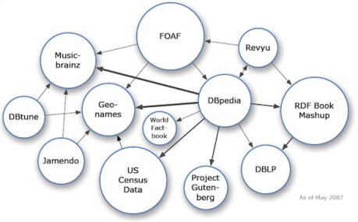
The LOD Cloud (5)
Evolution
2007
2009
2014

