Slide 1
An approach to Intelligent Information Fusion in
Sensor Saturated Urban Environments
Charalampos Doulaverakis
Centre for Research and Technology Hellas
Informatics and Telematics Institute
EISIC 2011, 12 September 2011

Slide 2
Presentation outline
Introduction
System architecture
Low-level fusion capabilities
High-level fusion capabilities
Implementation and use cases
Conclusions

Slide 3
Introduction
Today, large scale employments of sensor applications
  Urban area
    WikiCity, CitySense, Google Latitude
Materialization of concepts like
  M2M, Internet of Things

Slide 4
Introduction
Sensor applications could also be used for critical urban security surveillance
Difficulties
  Multiple distributed heterogeneous components
  Sensor processing
  Signal processing
  Automation
Other approaches
  Either do not accommodate A/V processing or are cumbersome
  Use Semantic Web but do not provide full framework

Slide 5
Urban security surveillance environments
Sensor saturated environments
  Difficult to manage and observe
Densely populated areas
  Difficult discovery of important events
Multiple processing algorithms
  Methods to manage the data they produce
Variety of sensor modalities
  Data heterogeneity

Slide 6
Our approach
Comprises a multi-level fusion system, at all JDL levels
Seamlessly blends ontologies with low-level information databases
Combines semantic web middleware with sensor networks middleware

Slide 7
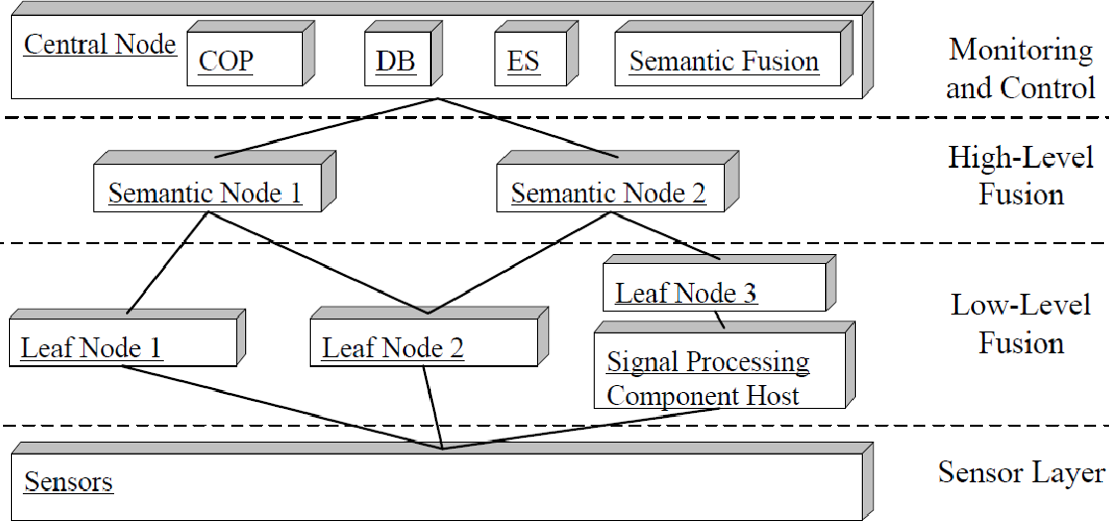
Architecture

Slide 8
Architecture
Semantic web and ontologies
  Efficiently handle heterogeneous information
  Model domain knowledge
    Class definition and relations
  Support automated reasoning
    Infer facts
Provide the backbone of intelligent sensor fusion

Slide 9
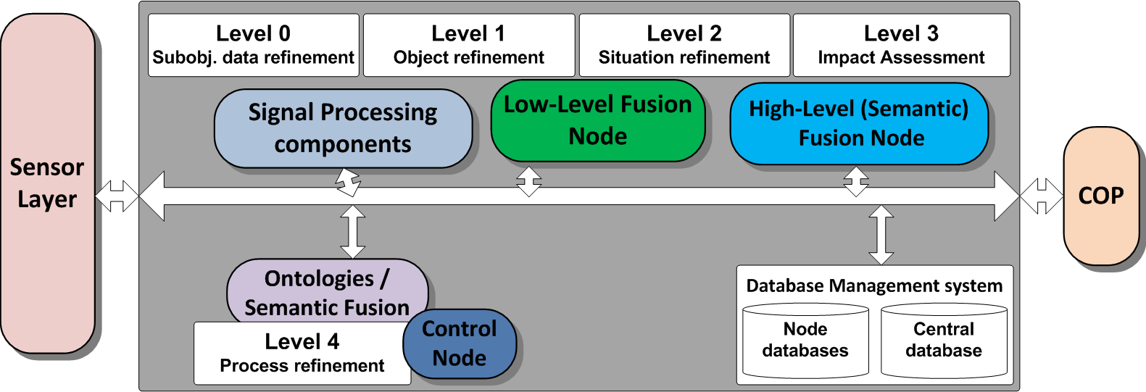
Architecture

Slide 10
Low level fusion (LLF)
Enabled through Global Sensor Network, GSN
  Java based
  Introduces “virtual sensors”
  Supports information collection and integration
Supports LLF through an SQL-like language

Slide 11

Low level fusion (LLF)
Integration challenges
  Signal processing and distributed computing have to be brought together
  Integration is non trivial
    Algorithms have to communicate with GSN servers through web services/sockets which poses overheads

Slide 12
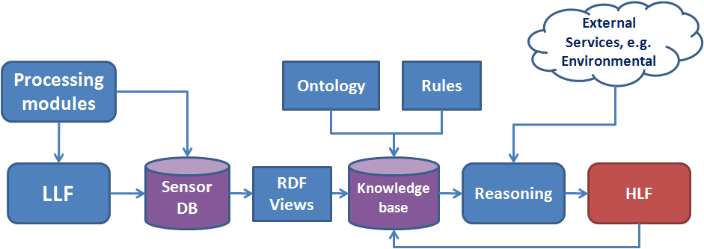
High level fusion (HLF)
Enabled by Virtuoso Universal Server

Slide 13
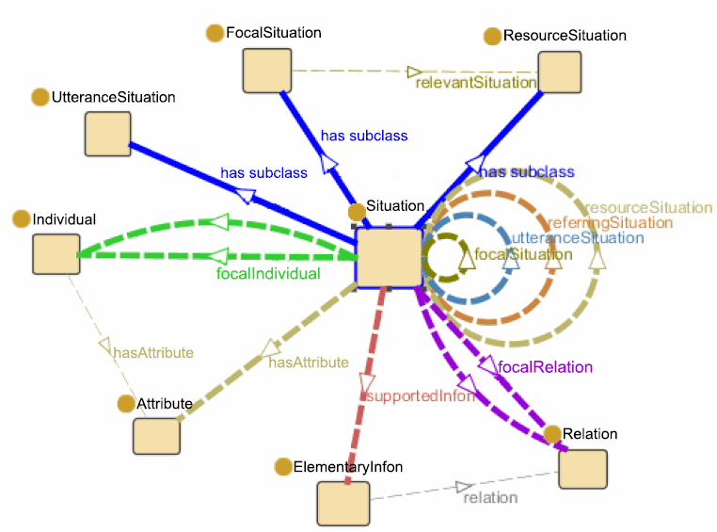

Ontology for HLF
Situation Theory Ontology
Ex. “Critical event near important infrastructure”

Slide 14
Mapping data to RDF
2 ways of mapping relational data to RDF
Push method
  Data are semantically annotated as soon as they are generated. Implemented by each virtual sensor alone
Pull method
  Data are associated to ontological entities. Implemented at a central high level node and runs through a scheduler
Additional data that come from external services are also mapped to RDF
  e.g. Environmental Service

Slide 15
Reasoning
Use of
  Class/subclass reasoning
  Owl:sameAs
  Further extended by rules
First 2 are supported by Virtuoso
Rules are supported by Jena
Both can be used on the same framework

Slide 16
Reasoning
Dataset volume issue
  Continuous sensor feeds produce large amounts of data
  Tackled through the use of time frames
    Dealing with RDF quads
In the case of integration of systems that use ontologies, ontology mapping has to be defined

Slide 17
Implementation
2 sensor processing modules are integrated
  Body tracker generates number of persons present in a scene
  Smoke detector detects smoke particles

Slide 18
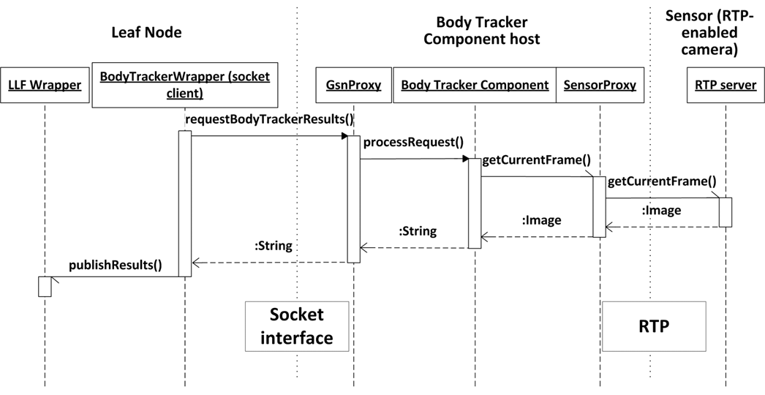
Implementation
Body tracker integration, similar for Smoke detector

Slide 19


Implementation
For LLF an event is triggered when the WHERE condition is true
For HLF in a Semantic Node the difference is that ontology and reasoning is used
  e.g. a rule or construct query would state:
  ”If smoke is detected near an object then raise an alarm”

Slide 20
Implementation, use case
Scenario where Environmental Service is deployed
  Gives data for locations, queried in real time
  Enables geospatial inference
  Data from low level processing are used for higher level decisions
Different levels of criticality
  Smoke near petrol station is a critical situation
  Smoke event related to a celebration is not critical
All above are associated with a security agenda to infer threat level

Slide 21
Implementation, use case
Process
  Sensor processing data are mapped to RDF (smoke detection, body tracker)
  Environmental Service is called real time to give location of events, cameras -> mapped to RDF
  Reasoner associates events with criticality factor

Slide 22
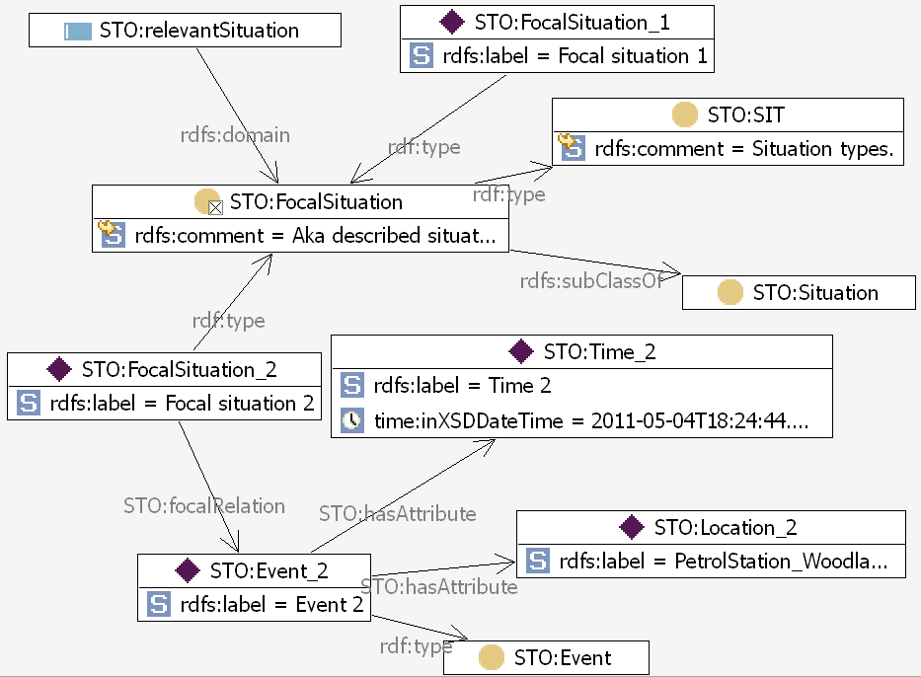
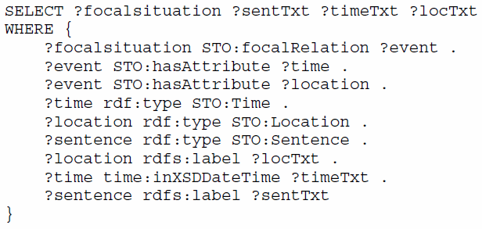
Implementation, use case

Slide 23
Conclusions
We presented a framework for intelligent information fusion in sensor networks
Deal with all aspects above sensor layer
  Perception modules integration
  Communication of the perception modules with GSN
  Low level fusion
  High level fusion with integration of semantic description of information
  Communication with external services
  Situation assessment and alert generation
Generic framework that can be applied to other domains
Future work
  Deal with probabilistic reasoning
    Resolution of conflicts and deal with missing detections

Slide 24
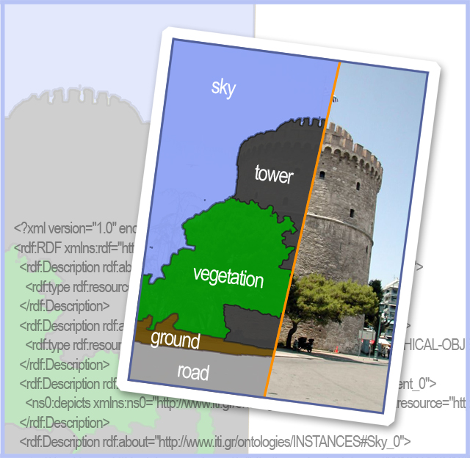
Thank you for your attention
CERTH/ITI
http://mklab.iti.gr

