Slide 1

A lightweight approach for providing Location Based Content Retrieval
Anastasios Zafeiropoulos, Emmanuel Solidakis, Stavroula Zoi, Nikolaos Konstantinou, Panagiotis Papageorgiou, Panagiotis Stathopoulos, Nikolas Mitrou
tzafeir@cn.ntua.gr
National Technical University of Athens
ECE Faculty, Computer Network Laboratory
A lightweight approach for providing Location Based Content Retrieval

Slide 2
Outline
Introduction - Location Based Services (LBS) Components
LBS Requirements – Design Criteria
Position Tracking Technologies
Proposed Architectural Approach
  Overall Architecture
  System Components
  Demonstration – E-museum Implementation
Offered Services
Deployment Scenario
Conclusions and Discussion
A lightweight approach for providing Location Based Content Retrieval

Slide 3
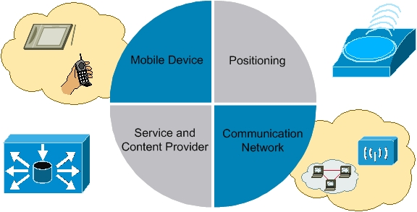
Introduction
One of the key technologies underpinning ubiquitous computing is that of Location Based Services (LBS)
LBS are information services accessible with mobile devices through a mobile network and utilizing the ability to make use of the location of the mobile device
The basic components of LBS and their connections are shown in the following figure:
A lightweight approach for providing Location Based Content Retrieval

Slide 4
LBS Requirements – Design Criteria
Requirements for a platform to provide LBS:
  Terminal independence
  Simple user interface
  Minimal communication over mobile telephone networks
  Simple integration of existing Internet services
  High availability of the services even at high loads
  Scalability – Openness (support common standards and protocols)
Design Criteria when developing location-aware indoor mobile applications
  easy navigation through web browsers
  navigation feedback and minimal graphical interaction
  orientation support in the surrounding environment and
  minimum redundancy in input commands
A lightweight approach for providing Location Based Content Retrieval

Slide 5
Position Tracking Technologies (1)
In indoor applications, three recent technologies are mainly exploited:
WLAN
    triangulation methods to the data coming from at least three access points near the user.
Bluetooth
    requires no fixed infrastructure - simple to install and set up
    can simultaneously handle both data and voice transmissions with low power
    great ability to locate neighbour devices and discover the type of services they could offer.
IrDA
    supports high data rates and requires line-of-sight contact
    rebounds over the surfaces and requires from sender and receiver to be aligned.
A lightweight approach for providing Location Based Content Retrieval

Slide 6
Position Tracking Technologies (2)
  In outdoor applications, two recent technologies are mainly exploited:
GPS
    used from the majority of LBS systems for outdoor tracking environments
    requires the current time, the position of the satellite and the measured delay of the received signal
    the position accuracy is primarily dependent on the satellite position and signal delay
  GSM LBS
    provide personalized services to the subscriber based on his current position but are less accurate and add extra cost (applied in indoor applications as well)
A lightweight approach for providing Location Based Content Retrieval

Slide 7
Our Proposed Architectural Approach
A proposed architectural approach for providing web-based and location-based multimedia content retrieval through Java enabled devices is presented.
The various system components are designed and implemented in a modular manner
  The separation of the positioning system from the content access mechanisms.
  The selection of the localization radio mechanism
  The selection of the terminal mobile device
  Independence from the underlying hardware infrastructure (the entire system is based on Web technologies, which can be deployed easily in any server)
  Independence from the content being available to the end-user
Our approach is based on open standards and open source components
A lightweight approach for providing Location Based Content Retrieval

Slide 8
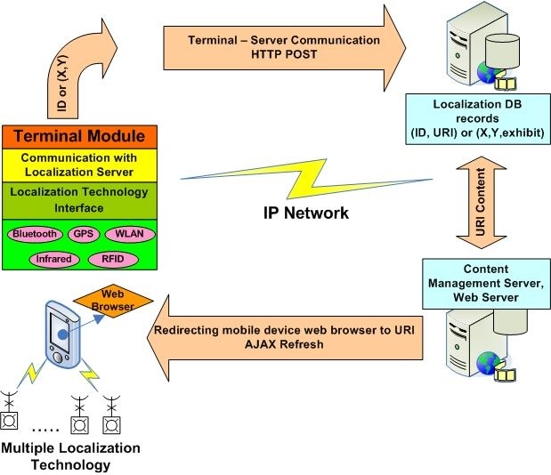
Overall Architecture
The core elements of the proposed system architecture and the way they are connected
  The main characteristics of these elements are the following:
    The Localization technologies
    The communication network which can be any IP enabled access network
    The Terminal Module, that runs on the mobile device
    The localization server for providing association between location information given by the user terminal and a specific point of interest
    The content related to each point of interest
    The redirection mechanism
A lightweight approach for providing Location Based Content Retrieval

Slide 9
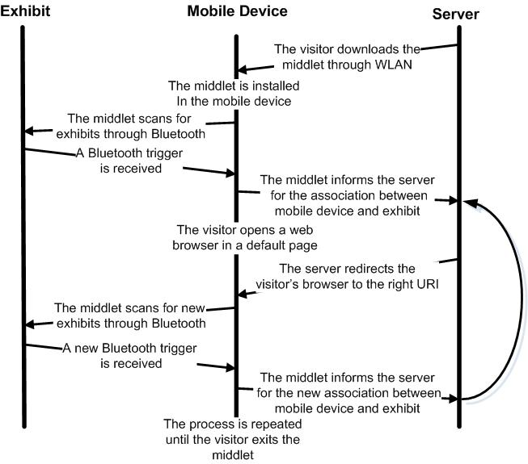
Deployment Scenario
A lightweight approach for providing Location Based Content Retrieval

Slide 10
System Components (1)
Mobile Device Software – Terminal Module
  Java middlet that can be installed easily in any mobile device
  configuration menu in the start form of the middlet, where each user can select language, audio and video options and complexity level for the application
  search for localization interest points - that exist within the scope of the terminal - and the ID's of all the detected interest points are sent to the Localization Server
  in case of tracking technologies that are based on user coordinates, the localization mechanism sends an exact geographic coordinate instead of the ID
A lightweight approach for providing Location Based Content Retrieval

Slide 11
System Components (2)
The Location to URI Database Localization Server
  The database holds information about the points of interest, the devices that executed the application and information regarding the association between them.
  Every location corresponds to a URI at the CMS server featuring some content – static or dynamically generated.
  We have defined various actors for different users in our database scheme. The knowledge level and the level of specialisation of every user are stored.
  Each time the Java middlet is started, the database is updated with the new information sent from the mobile device.
A lightweight approach for providing Location Based Content Retrieval

Slide 12
System Components (3)
The Redirection Mechanism
  The browsers of the terminals point to the web-pages describing the corresponding nearest point of interest.
  Ajax technology is used in order for the terminals to remain active.
  As soon as the middlet inserts a new entry in the database, new content is pushed to the browser by the use of Ajax.
  The web-page is refreshed asynchronously pointing to URI of the new point of interest.
  Web page's interactivity, speed, and usability are increased.
A lightweight approach for providing Location Based Content Retrieval

Slide 13
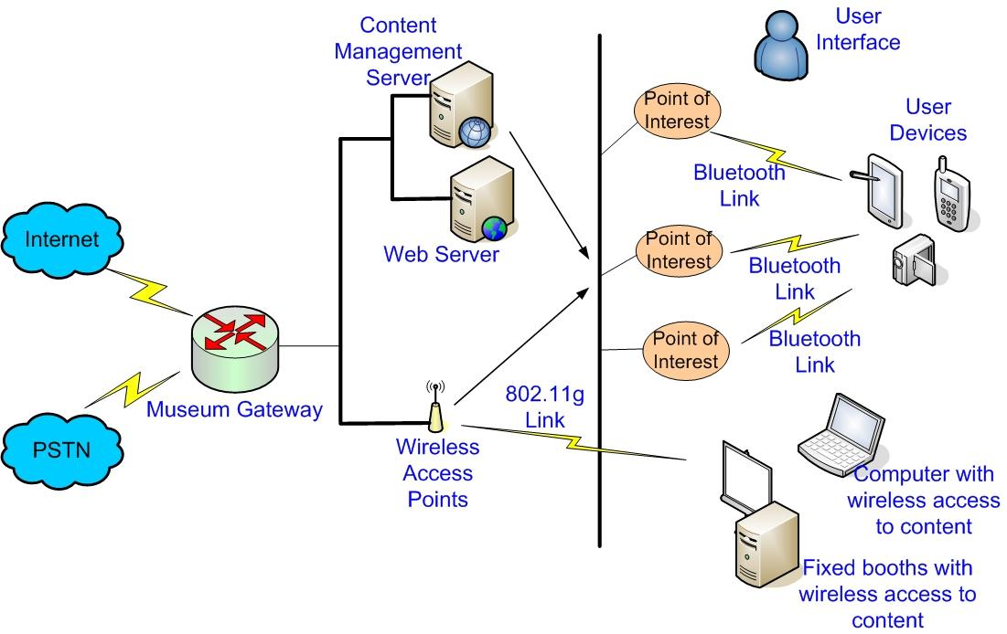
Demonstration
E-museum Implementation (1)
A museum e-guidance system application has been developed that utilizes Bluetooth localization technology for the positioning of the museum exhibits and WLAN technology for the IP network communication.
A lightweight approach for providing Location Based Content Retrieval

Slide 14
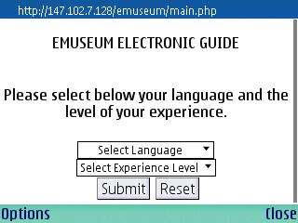
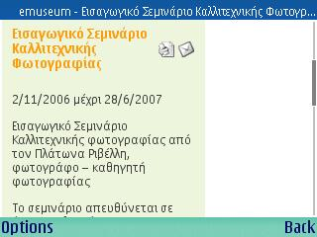
Demonstration
E-museum Implementation (2)
A lightweight approach for providing Location Based Content Retrieval

Slide 15
Offered Services
A wide range of services targeted to the needs of different user requirements are supported:
  Automatic (push) content retrieval based on visitor proximity to an exhibit or group of exhibits
  On demand (pull) content retrieval - targeted search queries
  Directional information (e.g. vector maps), indicating the user’s current location in the museum and how he can move throughout the museum
  Creation of live linear guidance
  Registration of path and content of interest for offline usage
A lightweight approach for providing Location Based Content Retrieval

Slide 16
Conclusions
An approach for providing Location Based Guidance Services is proposed, that attempts to address issues such as the selection of
  the localization technology,
  the appropriate software and hardware for the backend platform,
  the terminal mobile device
Demonstration of a user-friendly application, based on the above architecture.
Future work will include
  the support of user-transparent handover process aiming at the selection of the most suitable localization technique, in heterogeneous environments (e.g. indoor-outdoor)
  experimental work is currently underway towards evaluating the behaviour of the different localization techniques
A lightweight approach for providing Location Based Content Retrieval

