Slide 1


Biblio-transformation-engine: An open source framework and use cases in the digital libraries domain
Kostas Stamatis, Nikolaos Konstantinou, Anastasia Manta,
Christina Paschou and Nikos Houssos
National Documentation Centre / National Hellenic Research Foundation, Greece

Slide 2
Agenda
Introduction
Motivation - the recurring need for data transformations
The proposed solution
Use cases / experience reports
Summary – conclusions – future work

Slide 3
Motivation
Data transformations are needed everywhere in digital libraries / scholarly communication systems
Painful and tedious procedure
Many sub-tasks of the entire procedure reoccur and could be reused
Need for systematic framework for data transformations to accelerate the process, reduce errors and facilitate reuse

Slide 4
Analysis – basis steps in data transformations
Retrieve source data records
Apply processing:
(Optionally) Remove data records
(Optionally) Add/modify/delete field values within records
Transform data source to output format (implement the corresponding mapping)
Generate desired output
Export to a file and/or directly update databases / external systems
Need for incremental / selective data loading -> processing and output conditions may require repeated execution of the loading/processing cycle

Slide 5
Design goals
Customisable, non-intrusive, easy to use, integrate and extend (e.g. support a variety of data source types)
Separation of concerns in development – e.g. development of transformation logic independent of data sources
Example: No need to be aware of MARC to develop a function to harmonise encoding of dates
Support for recurring execution of the data loading/processing cycle according to specific criteria (e.g. useful for OAI-PMH)

Slide 6
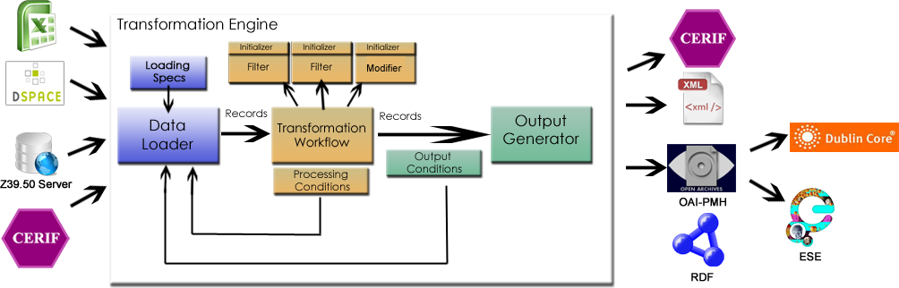
The biblio transformation engine

Slide 7
Components of the engine
Data Loader: Retrieves data from input source(s) according to DataLoading Spec
ProcessingStep: Transforms input in some way
Filters: removes records according to specific criteria
Modifier: updates records according to specific criteria
Initializer: initializes data in processing steps (e.g. load author names to Filter)
Output Generator: Creates the desired output (e.g. export file, direct update of database)
Record abstraction: simple common interface for all types of records that allows complex transformation functions

Slide 8
Processing workflow
Load data – transform input to records
If processing conditions are met, begin processing – sequential execution of Filters and Modifiers
If output conditions are met, begin output – execution of OutputGenerator(s)

Slide 9
Processing workflow
Load source data
Processing conditions OK
Modify LoadingSpec
NO
YES
Apply Filters & Modifiers
Output conditions OK
NO
Generate output
YES

Slide 10
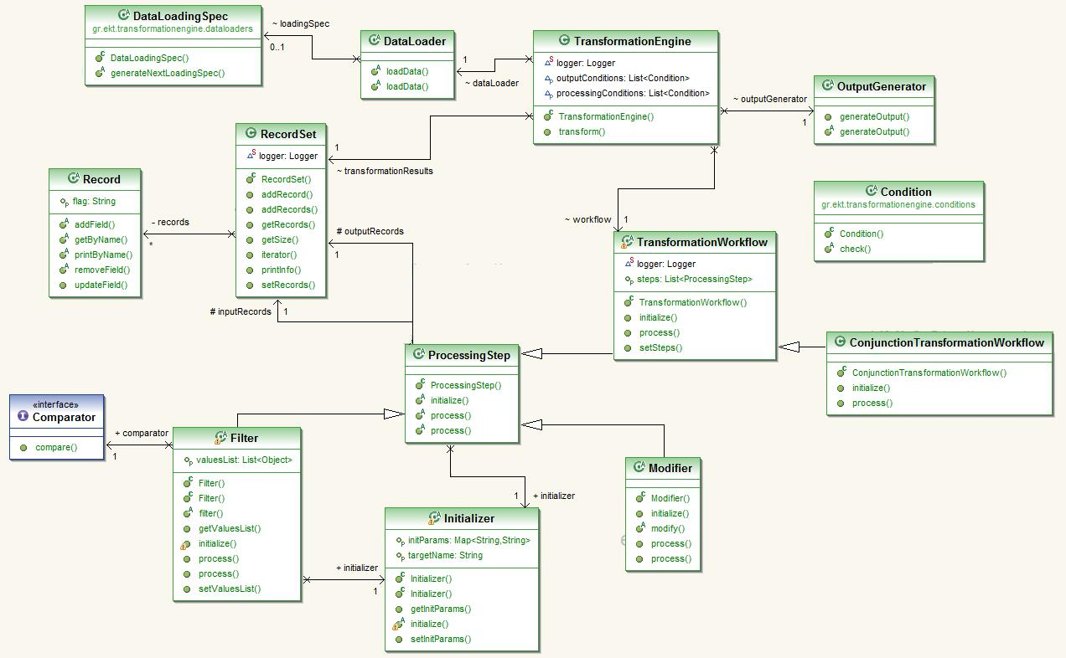
The transformation engine – data model

Slide 11
Implementation
FLOSS library developed in Java (maven used as a build tool)
Configuration outside the code - dependency injection mechanisms of the Spring framework core container
Specification of Data Loader, Processing Steps, Conditions, OutputGenerator
Mapping from source to target format (for one-to-one field mappings)

Slide 12
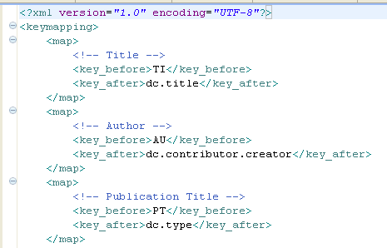
Example of mapping configuration

Slide 13
FLOSS library
Available at
http://code.google.com/p/biblio-transformation-engine/
European Union Public License
Feel free to download and use it!
Looking forward to feedback, questions,… (contributions also welcome ☺)

Slide 14
Use case 1 – Generate Linked Open Data
Sources: Repository records, legacy cultural material records, research information in CERIF
Corresponding data loaders reused
Filters/Modifiers can be totally agnostic of RDF and input formats
Use Jena RDF library to generate RDF triples
Add/generate appropriate identifiers/URI for each entity (either at the modifier or output generator level)

Slide 15
Use case 2 – Import/export data/export to/from repositories
Source record formats: EndNote, RIS, Bibtex, UNIMARC
Developed data loaders for each format, re-used output generator for DSpace
Export to different formats and reference styles based on repository records
Implemented for DSpace
For reference styles uses the citeproc-js library and the Citation Style Language (CSL)

Slide 16
Use case 3 – Feed the VOA3R aggregator
Get records of the Hellenic National Archive of Doctoral Dissertation (HEDI – didaktorika.gr) to the VOA3R aggregator (Virtual Open Access Agriculture & Aquaculture Repository)
Developed subject-based filter and injected it into an enhanced OAI-PMH server using the library.
~1070 of approximately 23.500 records, needed to apply techniques to cater for the distribution sparsity of “suitable” records combined with resumption token
Seamless on-the-fly deployment and co-existence with sets targeted to other aggregators (DART, openarchives.gr)

Slide 17
Use case 4 – Feed Europeana
Include in Europeana content from the Technical Chamber of Greece (TEE)
Records in TEE library catalog (UNIMARC), available through a Z39.50 interface
Developed Z39.50 data loader, appropriate filters and modifiers (independent of UNIMARC)
Mapping to ESE implemented through a modifier
~6800 from the TEE records sent to Europeana
Repeatable, automated procedure through an enhanced OAI-PMH server using the library

Slide 18
Future work
Support more types of data transformations (contributions welcome ☺)
Extend declarative specification of mappings to cover more sophisticated cases
Configurable support for common data model to facilitate reuse of Filter and Modifier implementations
Systematically study the user experience, identify and implement potential improvements

Slide 19
Thank you for your attention!
More info:
http://code.google.com/p/biblio-transformation-engine/
kstamatis AT ekt.gr
nkons AT ekt.gr
amanta AT ekt.gr
cpaschou AT ekt.gr
nhoussos AT ekt.gr

