Slide 1


Priamos: A Middleware Architecture for Real-time Semantic Annotation of Context Features
Nikolaos Konstantinou, Emmanuel Solidakis, Stavroula Zoi, Anastasios Zafeiropoulos, Panagiotis Stathopoulos, Nikolas Mitrou
National Technical University of Athens
ECE Faculty, Computer Network Laboratory

Slide 2
Outline
Introduction
Related Work
Priamos Architecture
Priamos Modules
Users – Hierarchy
Test Case Scenario
Performance Measurements

Slide 3
Introduction
The basic concept of the Semantic Web is content annotation
  Time-Consuming task
  Considered to be loss of resources in terms of time and money
  Reuse of information is troublesome
  Annotation easily becomes out-of-date
Context means situational information (time, location, ongoing activities)
  A system is context-aware if it can extract, interpret and use context information and adapt its functionality to the current context of use
  One of the most challenging issues of context aware applications is the inclusion of intelligence while processing the incoming information and deducting meaning

Slide 4
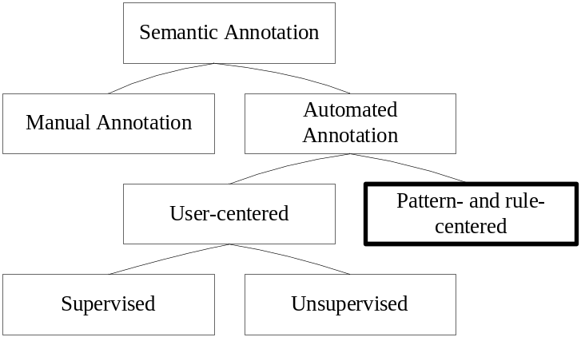
Related Work
Manual annotation (Vannotea, M-Ontomat Annotizer, COHSE, SMORE)
Supervised automated annotation (Mnm, Melita)
Unsupervised automated annotation (Armadillo, KnowItAll, SmartWeb)
Pattern-based and rule-based approaches
  Cafetiere (rule-based system for generating XML annotations )
  Ponder, Context Toolkit, HP’s CoolTown, Intelligent Room (do not use a formal model to represent context information)
  CHIL, KaOS, Rei (limited to specific ontologies)

Slide 5
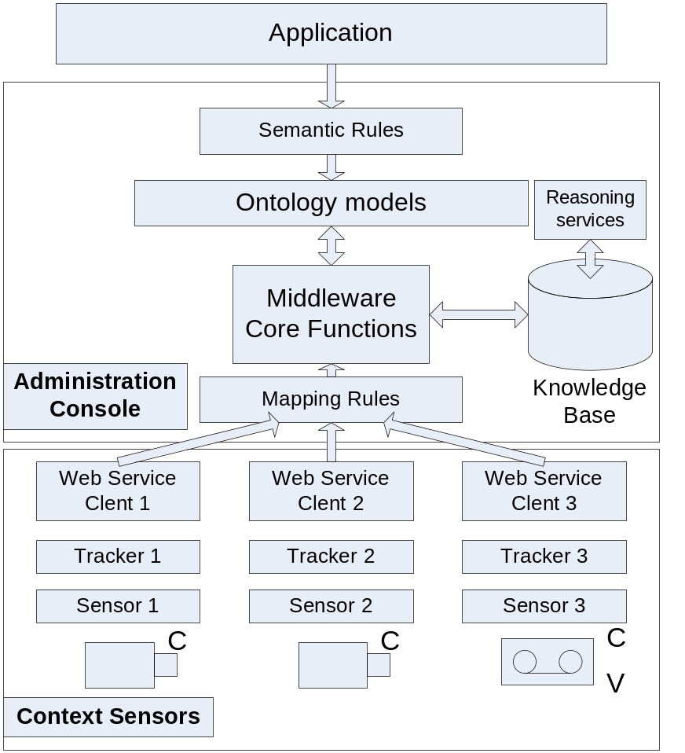
Priamos Architecture
Priamos focuses mostly in providing a middleware environment that does not restrict the users or developers to specific predefined vocabularies for a world model description or a message syntax among the various pluggable components. Emphasis is given in offering an architecture that is independent of ontologies and sensors while in the same time adopts a common formal representation of context and facilitates application development.
The Priamos middleware architecture comprises a set of core reusable distributed components for the automated, real-time annotation of
low-level context features and their mapping to high-level semantics.
The main idea is to launch a procedure that annotates contextual information upon its appearance by using specific sets of rules. The resulting Knowledge Base reflects a spherical perception of the world model.

Slide 6
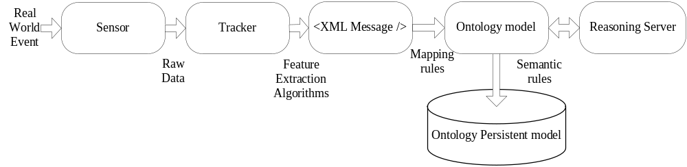
Message Processing Cycle

Slide 7
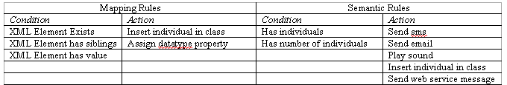
Software Modules
Web Service Interfacing Module
  Messages expressed in any arbitrary well-formed XML document
Message Templates
  The received messages can conform to any specifications we might choose
Ontology Models
  The database model is stored using Jena internal graph engine.
Rules

Slide 8
Application Description
Trackers
  They are the first ones to process raw data
  Apply special algorithms and techniques to the signal captured by the sensors
Ontology Manager
Message Template Manager
Message to Ontology Mapper
Semantic Rule Composition
Action Manager
  Send Sms
  Send Email
  Send Web Service Message
  Voice Message
  Run an external Application

Slide 9
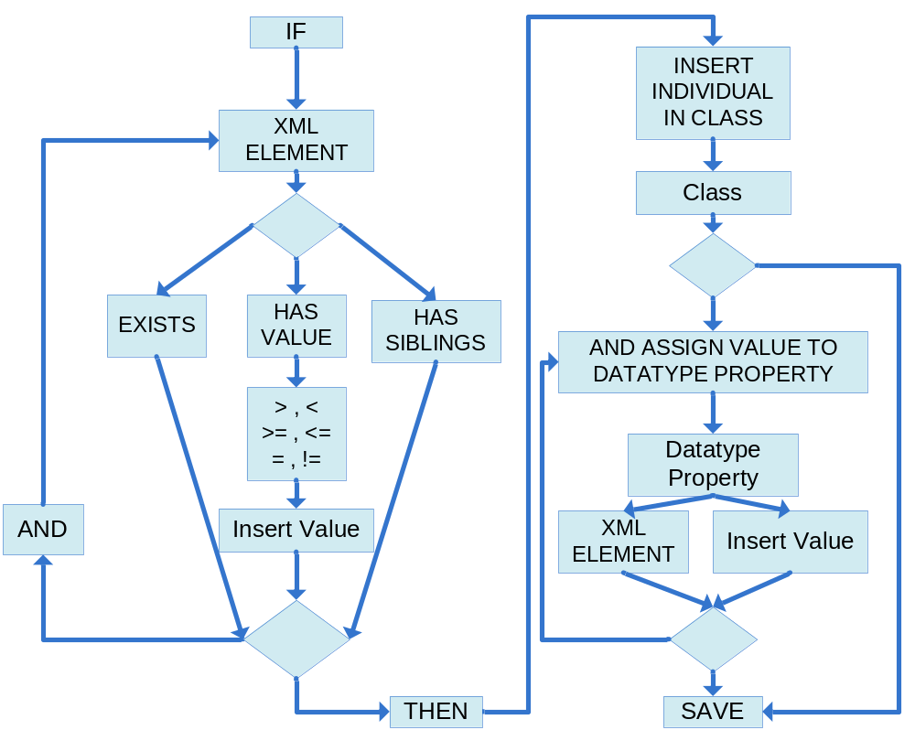
Message to Ontology Mapper

Slide 10
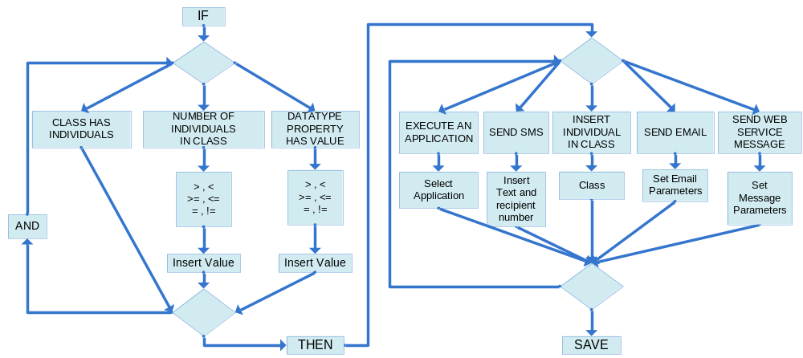
Semantic Rule Composition

Slide 11
Priamos Users
Middleware Maintainers
  Domain Expert who defines the mapping rules from the incoming messages to the ontology concepts
  Keeps in mind to fully cover the the developers’ needs
Application Developers
  Exploits the core middleware functionality
  Can plug an ontology, form semantic rules on the ontology, define the actions that can be taken
System Administrators
  Has the overall supervision of the system’s functions
  Can configure the system for different operations
  Can define features of interest to be captured (e.g. when a security alert should be triggered)
End Users
  They are not familiar with the technology
  Monitor a system operation session (e.g. a guardian in a security-surveillance scenario)
  Receive automated notifications in form of a sound, an email, a call, an alert in general (e.g. a security guard who receives alerts in his mobile)

Slide 12
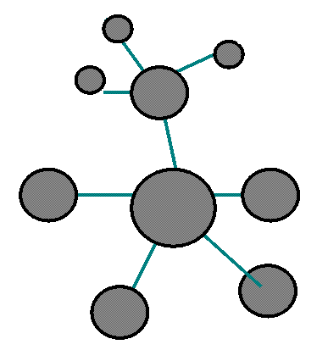



The Priamos API
Priamos Installation
Priamos
Configuration
Real-Time Decision Making
Offline Search
loadOntology
Add/remove SemanticRules
getSemanticRules
setActions
getActions
APPLICATION
DEVELOPERS
Ontology Browsing, Editing
TurnOnPriamos
Middleware
TurnOffPriamos
Middleware
SYSTEM ADMINISTRATOR
CameraZoom (Camera1)
TurnOffTracker (FaceTracker)
TurnOnTracker (FaceTracker)
SendEmail, SoundAlert, SendSMS, …
Alert!
END USERS
getActions
askOntology (Query)
Add/remove MessageTemplate
Add/remove MappingRule
getMappingRules
MIDDLEWARE
MAINTAINERS

Slide 13
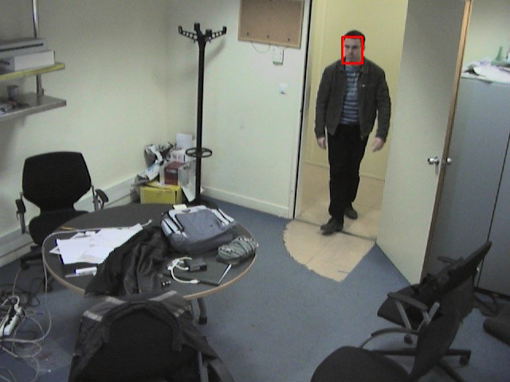
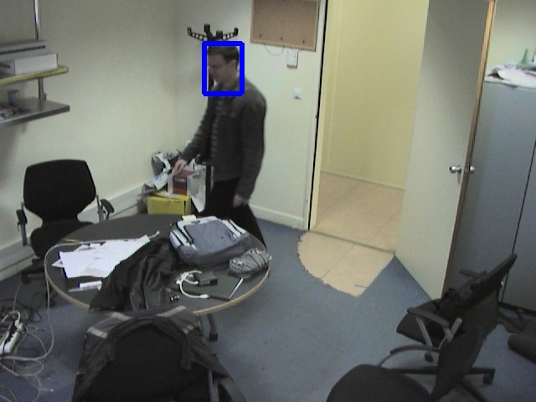
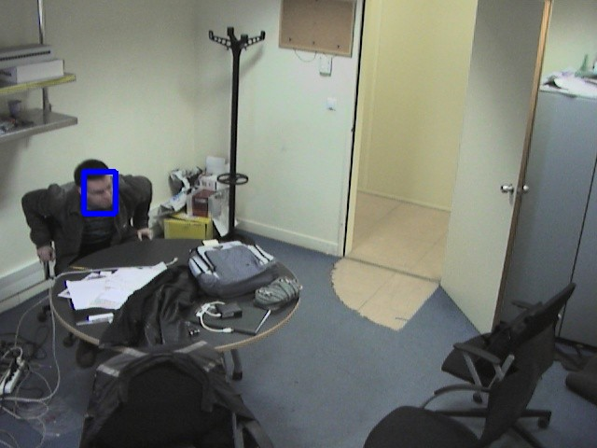
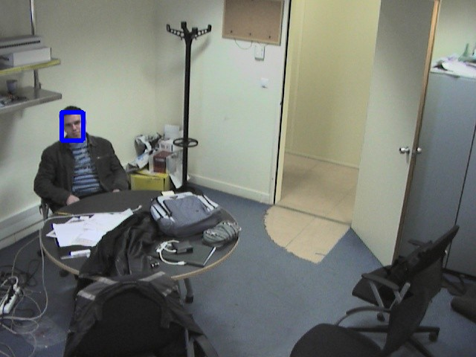
Smart Room Scenario
Lab Environment – A camera is monitoring the room
Face Tracker using 2 algorithms:
    Viola Jones for face detection
    Camsift algorithm for face tracking
Produced Message
        <Event id="5712">
        <Tracker type="FaceTracker">
        <DataSource id="3" name="CeilingCamera" url="seq_000077" />
        <person id="1" certainty="100">
        <location2d datasourceId="3" x="429" y="46" />
        </person>
        </Tracker>
        </Event>
Mapping Rule
if exists /Event/Tracker/Datasource/Person then insertIndividualIn(Persons)
Semantic Rule
if hasIndividuals(Persons) then turn on the lights / send an email

Slide 14
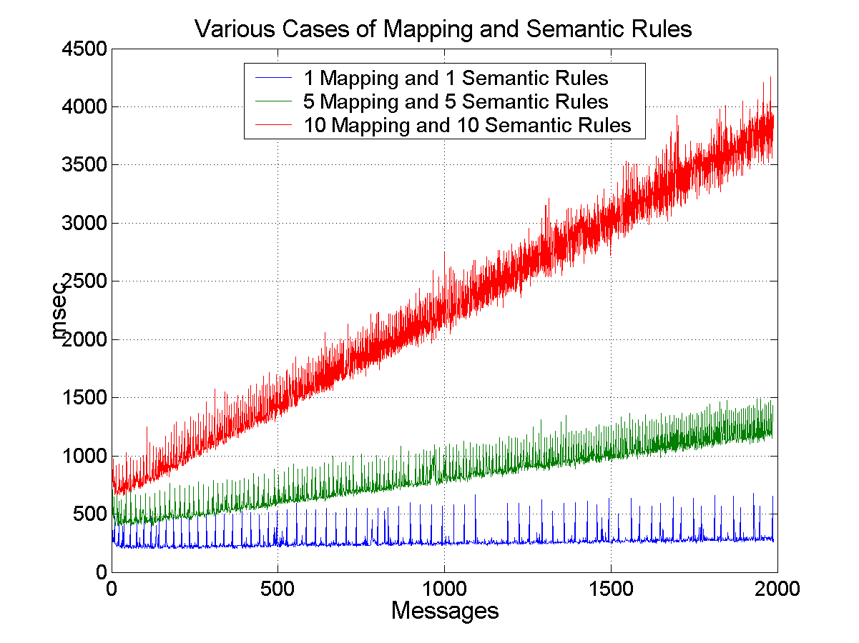
Performance Measurements

Slide 15
Future Work
  Maintenance Scheduling (Buffer Database, Replication)
  Use of Semantic Web Services
  Enhance the Semantic and Mapping Rules
  Probabilistic Processing of information
  Offline Semantic Search

