Slide 1

A Semantic-based Architecture for Sensor Data Fusion
UBICOMM ‘08
Stamatios Arkoulis, PhD Candidate
National Technical University of Athens

Slide 2
Outline
Introduction
Existing Systems & Applications
Data Transformation & Semantic Representation
Motivation
The Proposed Architecture
  Data Layer
  Processing Layer
  Semantic Layer
Conclusions
Future Work

Slide 3
Introduction
Sensor networks (wireless)
  attract a lot of attention → research → innovation
Many implementations worldwide (why?)
  Nature: smallness, price, energy-efficiency, reliability
  IPv6: no number limitations
    huge address space for networking purposes
  Improvements in resource management (battery life,
  computation & communication capabilities, memory)
What about the future?
  sensors everywhere
  accessible via the Internet

Slide 4
Introduction
Main scientific attention
  networking of distributed sensing
  But what about…
    management, analysis, understanding of collected data
Current sensor deployments
  Huge number of sensors
  Heterogeneity
  Rawness of data
    little, if any, meaning by themselves
  Enormous amounts of data stored
We have many “Data” but little “Information”

Slide 5
Introduction
The Solution ?
Proper data management (for event detection)
  Data interpretation
    considering final user requirements / needs / scope
  Data heterogeneity
    special aggregation schemas
    combination / comparison / correlation
  Data Aggregation & Processing
    render them helpful to applications
Key Technology: “The Semantic Web”

Slide 6
Introduction
The Semantic Web
  despite the heterogeneity and amount of collected data
    “meaningful” events extraction
    interoperability
“Connection of Sensory Data to their environmental features”
  “Semantic Annotation” → What?
    metadata added to any form of content
    well-defined semantics ease its use
  “Semantic Annotation” → How?
    content description languages
    query languages
    annotation frameworks

Slide 7
Existing Systems & Applications
Sensor Web Enablement(SWE) initiative [by OGC]
  Goal → Development of Standards
    discovery/exchange/processing of sensor observations
  Common encoding/transport protocol used by services
    no explicit ontological structure proposed yet
    no formal conceptual model → no interoperability
ES3N architecture
    Semantic Web technologies on top of sensor networks
    sensor observations’ ontology-based storage
      mechanisms – RDF Repository
    end-user posts semantic queries (SPARQL)
    scalability – large data volumes
      questionable performance / efficiency

Slide 8
Existing Systems & Applications
IrisNet Architecture – Software infrastructure
  data collection/storage organization (XML) → Agents
  end-user queries vast quantities of data (XPath)
  Scalable – Powerful – Efficient
    million/distributed/high bit-rate/heterogeneous sensors
  No semantics → No data reusability
SWAP 3-tier architecture (framework)
  sensory data combination (for high-level tasks)
    unified end-user view of underlying sensor network
  Sensor / Knowledge / Decision layer → Agent-based
  services semantically description to end-users
  multiple agents and ontologies → Complexity

Slide 9
Existing Systems & Applications
Priamos Middleware – Architecture
  automated
  real time
  unsupervised annotation of low-level context features
  mapping to high-level semantics
  rules composition through specific interfaces
    content annotation without need of technical expertise
    context awareness challenges easily addressed

Slide 10
Data Transformation & Semantic Representation
Specific interpretation models
  makes raw sensory data meaningful
  apps’ scope / kind of information dependent
OGC specifications → Models & XML Schema:
  O&M: sensor observations and measurements (both archived or/and real-time) encoding
  SensorML: sensor systems (i.e. location) and sensor observations’ associated processing description
  Formal semantic representation offers…
    structured knowledge (concerning a certain domain)
    specify a domain’s important concepts/relations

Slide 11
Motivation
Existing Sensory Data Management approaches
  no support for distributive sensor deployments
  inability to scale well in today increasing environment
    no applicable to large sensors network
    small amount of data can be transferred
  lack of context annotation / semantic data representation
  absence of ontological infrastructures for rules & queries
Such limitations obstruct end-users to…
  fully exploit the acquired information
  match events from different sources
  deploy smart apps able to follow semantic-oriented rules
“Solution: A completely new architecture”

Slide 12
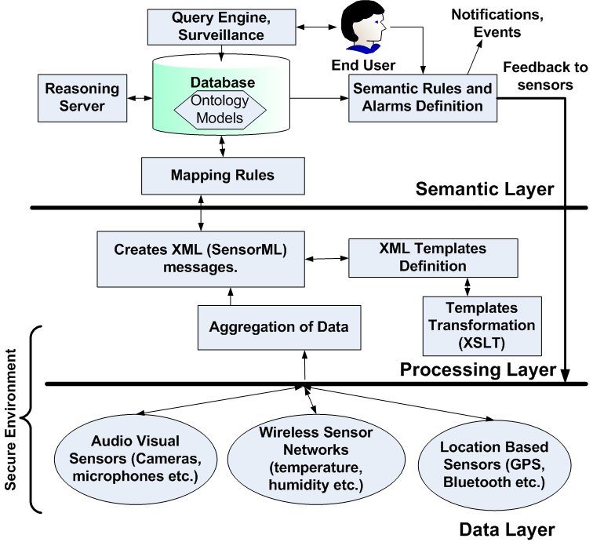
The Proposed Architecture
Data management
  Gathering
    Real-time
    Recorded
  Aggregation
    Heterogeneity
  Processing
    Meaningfulness
User defined rules
  alarms - actions
Flexibility
Modularity
Scalability

Slide 13
Data Layer
Central entities
  sensor discovery
  data acquisition (+policies)
    event-based → data sent directly
    polling-based → data periodical queried
  raw-data collection
    Location Sensors (Smart Phones, PDAs, etc.)
      positioning interfaces (Bluetooth, GPS, Wi-Fi)
      location-sensitive data
      next layer reached either directly or via special
      infrastructures
    Wireless Sensors

Slide 14
Data Layer
    Wireless Sensors (MICA2, eKo, Imote2)
      Measure and monitor environmental metrics
      Architectures, routing protocols and schemes exist
        efficient energy consumption & congestion avoidance
      Data reaches the next layer
        routed to specific nodes & forwarded to central entities
        send directly to central entities
    Audiovisual Sensors (microphones, cameras, etc.)
      rich, real-time content
      special networking requirements to be satisfied
        bandwidth (huge amount of bits to be transmitted)
        packet loss (destroyed content / wrong order)
        jitter (glitches)
  Data reaches the upper layer → Web services etc.

Slide 15
Data Layer – Security Issues
Security Requirements
  Data confidentiality/integrity/freshness/authentication
  Secure time synchronization / localization
  Anonymity (hide location of sensor-observed aspects)
  Secure transmission between Sensors-Aggregators
    Secure Web Services, SSL, X.509, PKIs, XML encryption
Obstacles to Security
  resource / computing constraints
  communication reliability
  unattended operation
Optimality: Safety – Efficiency “trade-off”
  Sensors’ type & Deployment scenario dependence

Slide 16
Processing Layer
Aggregators (due to sensors’ limited resources)
  raw data processing
  data transformation to useful (“standard”) formats
    XML generation
    dynamic system configuration through XML schemas
      sensors’ capabilities/location/interfaces formal descriptions
      specification of different data significance for users’ apps
    XML files re-transformation (XSLT Module)
  XML files forwarding to the upper layer
GSN (Open Source – Java)
  user-defined wrappers (based in a data model)
  incoming data encapsulation to the data model

Slide 17
Semantic Layer
Abstraction of received “XMLs”
Context capturing in varying conditions
“Automatically” configured context annotation
  by application specific ontologies
This layer consists of
  an exported Web Service interface
  ontology Models
  Mapping and Semantic Rules
    …and the corresponding actions / notifications
  the external Reasoning Server

Slide 18
Semantic Layer
Web Service interfacing module
  messages (from the lower layer) manipulation
    any arbitrary well-formed XML document
    knowledge is transferred
Ontology models
  Database Model → Jena internal graph engine
  Ontological Model → Triple statements
  Knowledge Base → Annotation (separate from data)
  Incoming XML files stored
    transformation in another XML template

Slide 19
Semantic Layer
Rules (syntactic and semantic homogeneity)
  Knowledge conversion into semantic information → KB
  XML Mapping Rules
    fetch data from XML message
    storing in ontology model as ontology class individuals
  Semantic Rules
    modify the ontology model
  Distinction inspired by RuleML
    RDF-only and RDF-XML-combining subsets
    common syntax
      different conditions & actions in each case
  Event-Condition-Action pattern followed
    “on event if condition then action”

Slide 20
Semantic Layer
Mapping Rule
  IF EXISTS /sensor/temperature/@value THEN INSERT INDIVIDUAL IN CLASS Temperature AND SET DATATYPE PROPERTY hasValue /sensor/temperature/@value
Consecutive Semantic Rule
  IF DATATYPE PROPERTY IN CLASS Temperature HAS VALUE GREATER THAN 40 AND DATATYPE PROPERTY IN CLASS Humidity HAS VALUE GREATER THAN 0.3 THEN Alert (”Surveillance area under unusual conditions!”)
  Trigger Alerts based on KB awareness of the world
  Semantic-based intelligence added
    reasoning procedures deduce implicit knowledge
    based on the current explicit facts

Slide 21
Semantic Layer
Reasoning server
  Knowledge Base is Ontology-Reasoner combination
    Reasoner (essential)
      OntoBroker, KAON2, Pellet etc.
      DIG interoperability / Stand alone DIG servers
        HTTP message exchanging with calling programs
      Jena supports biding of external reasoners
  “choice is up to the user”

Slide 22
Conclusions
Modular architecture for deploying WSNs
  ease end-user to take advantage of collected data
  facilitate developers
    deploy new useful applications
    exploit the Semantic Web advances
  add flexibility to the sensor world
  form associations over the raw data
  extract meaningful information and valuable results
  create specific management & notification rules
    based on the nature of applications

Slide 23
Future Work
Implementation of different scenarios
  combine aggregation/security/processing methods
Evaluation of architecture’s discrete components
  Scalability & Performance issues
Study energy efficiency trade-offs under
  proposed routing schemes
  data aggregation architectures

Slide 24
Questions?
Thank you for your attention !!
Stamatios Arkoulis
stark@cn.ntua.gr

