Slide 1
VisAVis: An Approach to an Intermediate Layer between Ontologies and Relational Database Contents
Nikolaos Konstantinou, National Technical University of Greece

Slide 2
Introduction
VisAVis Protégé Plugin
Features
  Map between RDB and Ontologies
  Execute queries expressed in RDQL

Slide 3
Motivation
The Semantic Web Vision orders that web pages need to be annotated in terms of an ontology language
What happens with Data stored in databases and is generated and retrieved automatically?

Slide 4
Definitions
An Ontology can be defined as a model of a Knowledge Base
Thus, we have the Terminological and the Assertional Box (ABox & TBox)
Simplified point of view:
  TBox <-> Schema of the RDB
  ABox <-> Instance of the actual data

Slide 5
Mapping Process
Capture Database Data
Select an Ontology Class
Validate the mapping
Modify the resulting Ontology

Slide 6
Mapping Process
Validate the mapping
  Disjoint classes cannot have mappings to common data. Common data includes data in tables with a foreign key relation
  Maintain subclass hierarchy in the database

Slide 7
Query Execution
Parse requests
Instead of returning the class resources, we check if the mapping property exists
  Yes: redirect the query to the database
  No: No changes

Slide 8
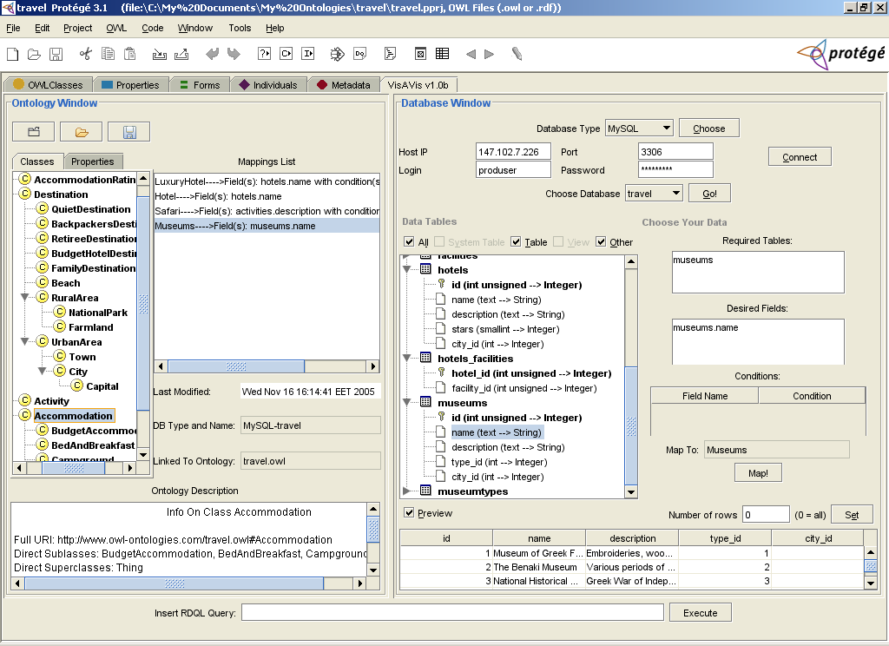
Use-Case Scenario

Slide 9
Use-Case Scenario
<owl:Class rdf:about="#Hiking">
<queryString>SELECT activities.description FROM activities, activities_types WHERE (activities.activity_type_id = activities_types.id) AND (activities_types.name = "Hiking")
</queryString>
<rdfs:subClassOf>
<owl:Class rdf:about="#Sports"/>
</rdfs:subClassOf>
</owl:Class>

Slide 10
Implementation
Java, version 1.5.0 or higher
Jena framework, tested in versions 2.2 and 2.3
Protégé, tested in 3.0, 3.1, 3.1.1, 3.2beta
MySQL and PostgreSQL, with JDBC connection

Slide 11
Future Work
Richer SQL builder
Support for more databases
Return results from both the database and the ontology

Slide 12
Questions
Thank you for your attention
VisAVis plugin available at http://www.cn.ntua.gr/~nkons/essays_en.html

