Slide 1

Open Access Scientific Content Services for the Greek Higher Education: An overview and future developments
Dimitris Kouis (dkouis@seab.gr), Nikolaos Konstantinou, Nikolaos Mitrou
Hellenic Academic Libraries Link
Iroon Polytechniou 9, 15780 Athens, Greece
http://www.seab.gr , http://www.heal-link.gr
Open Access Conference @ ΕΚΤ
Towards common European policies for innovative reuse of public sector and scientific information
October 16, 2013 - Athens, National Hellenic Research Foundation Vassileos Constantinou Avenue 48

Slide 2
HEAL-Link main objectives
to economise resources and provide improved services for supporting teaching and research within academic units;
to set a common strategy, concerning access to digital material, so that information sources are managed in the best possible way for the country;
to adopt common performance standards and indices for library services;
to coordinate the development of the collections of the member-libraries of the consortium;

Slide 3
HEAL-Link in numbers
Hellenic Academic Libraries-Link (known as HEAL-Link) was founded in 1998.
Members & Associated Members: < 50 Higher Education Institutes, Research Centers and other Public Sector Organizations
Cooperating organizations: < 30 Public and Private Sector Libraries and Organizations
Academic & Research community: < 13.000 academic staff (professors & researchers)
Students: < 350.000 under/post graduate students
On line content : < 14.000 scientific journals, 30.000 eBooks, various digital databases etc. < 4.000.000 bibliographic records
Current ongoing projects: < 13 ME funding for upgrading/creating digital services

Slide 4
Access to academic textbooks and scientific on-line sources expenditures

Slide 5
Access to academic textbooks and scientific on-line sources expenditures

Slide 6
Access to academic textbooks and scientific on-line sources expenditures

Slide 7
Access to academic textbooks and scientific on-line sources expenditures

Slide 8



HEAL-Link's current activities towards Open Access
Two co-financed projects by Greece and EU:
Advanced Central Services of HEAL-Link's Open Access Digital Libraries (2010-2015, 4.5ME)
< 30 projects executed by Academic Libraries (HEAL-Link members) with total budget exceeding 23 ME
Hellenic Academic E-books (2012-2015, 8.3ME)
Digital Libraries
eCourses
eBooks

Slide 9
Advanced Central Services of HEAL-Link's Open Access Digital Libraries
HEAL-Digital resources and Institutional Repositories service (HEAL-DIR)
Supporting and coordinating actions within the individual academic institutions in order to develop and/or upgrade their own institutional repository conforming to common standards which enable interoperability
HEAL meta
HEAL Meta-search Service

Slide 10

Advanced Central Services of HEAL-Link's Open Access Digital Libraries
AMELib (Accessible Multimodal Electronic Library)
AMELib digital repository provides books to print-disable students through a set of tools for converting printed books to audio-books as well as other forms.

Slide 11
Advanced Central Services of HEAL-Link's Open Access Digital Libraries
HEAL-Link Catalogs and Authorities/Indexing Service (HEAL-CAS)
Electronic plagiarism detection service
Electronic Authorities / Indexing Service [Greek Researchers and Research Institutes, Greek scientific journals and Greek scientific digital resources]
ILSAS (Integrated Library System as a Service)
HEAL-HelpDesk

Slide 12
Advanced Central Services of HEAL-Link's Open Access Digital Libraries
HEAL-Link Electronic Resources Management Service (HEAL ERMS)
HEAL-Link ERMS
Electronic Articles Loaning Service (EALS)
HEAL-Link Cloud Service (HEAL-Cloud)

Slide 13
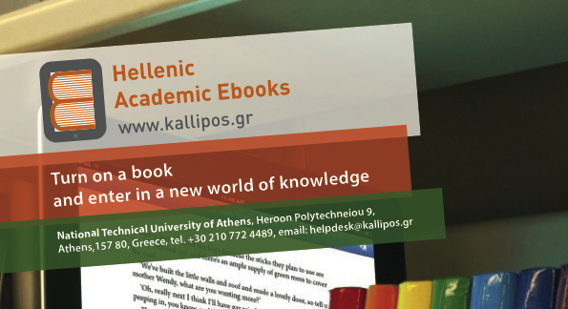
Hellenic Academic E-books
The service “Kallipos – Hellenic Academic Electronic books” aims to create and provide, in open access, a large number (more than 700) academic textbooks as e-books.

Slide 14
Hellenic Academic E-books
Main characteristics:
open access
multiple formats (pdf & ePub)
interactivity & multimedia elements (video, sound, simulations etc.)
complete metadata description
learning objects

Slide 15
Hellenic Academic E-books

Slide 16
Future .... Linked data

Slide 17
Conclusions
The support of a non-OA scientific content provision environment is not economically viable.
HEAL-Link, as the largest scientific content provider in Greece, adopts OA as the primary strategic goal for its present and future planning.
All current HEAL-Link activities support and encourage OA movement.

Slide 18
Thank you !

