Slide 1

SynthEdit: Format Transformations by Example Using Edit Operations
Alex Bogatu, Norman Paton, Alvaro Fernandes, and Nikolaos Konstantinou
21st Hellenic Database Management Symposium (HDMS 2019)
Athens, July 7-8, 2019

Slide 2
Format Transformations
Changes to the representation of textual information, with a view to reducing inconsistencies.
One of the most labor-intensive, typically manual tasks of data wrangling.
Promising results from synthesis algorithms for spreadsheet data (e.g. FlashFill*)
However: exponential in the number of examples, highly polynomial in the length of the examples.
How about a fully automated method for multiple sources, large numbers of examples?
Paper contributions: SynthEdit
A new transformation synthesis technique based on edit operations that enables efficient learning of transformation programs.
Scalable to tens or hundreds of examples
Aims at eliminating the need for user involvement.
Example: 1900s NY state Governor names and term years
Source | Target
Hugh Leo Carey (74-82) | Hugh L. Carey (1974-1982)
Jay Henry Lehman (33-42) | Jay H. Lehman (1933-1942)
* S. Gulwani. Automating String Processing in Spreadsheets Using Input- output Examples. In POPL ’11

Slide 3
Preliminaries (1)
Tokens. A string is a collection of tokens
Three types of tokens are supported:
Regular expression tokens that match a predefined regular expression pattern
Constant string tokens
Special tokens – beginning/end of a string
Regular Expression Primitives. Used to obtain the set of tokens for a string
Number. N = [0-9]+
Upper case. U = [A-Z]+
Lower case. L = [a-z]+
Alphabet. A = [A-Za-z]+
Alphanumeric. Q = [A-Za-z0-9]+
Punctuation. P = [., ; : /-_?!&$]+
White space. W = \s+

Slide 4
Preliminaries (2)
Example: 1900s NY state Governor names and term years
Transformation:
Replace "Leo", "74", and "82" from the source with "L", "1974", and "1982" from the target, respectively.
Transformation generalisation:
Replace the second A-type token, the first N-type token, and the second N-type token from the source with the first U-type token, the first N-type token, and the second N-type token from the target, respectively.
Source | Target
Hugh Leo Carey (74-82) | Hugh L. Carey (1974-1982)
Jay Henry Lehman (33-42) | Jay H. Lehman (1933-1942)
Token-type representation:
A W A W A W P N P N P

Slide 5
Transformation Language
Uniquely identify each token using its neighbour tokens.
Regex primitive r := N | U | L | A | Q | P | W
Position expression P := Pos(r₁, r₂, c)
Token t := (r, P)
String expression E := Copy(t) | Const(s) | Substr(t, i, j) | Concat(E₁, …, E_{n})
Edit operation O := INS(E) | DEL(t) | SUB(t, E)
Transformation T := O₁; O₂; ...; O_{n}
Notes:
Syntax and Sermantics

Slide 6
Transformation Example Using Edit Operations
Example: 1900s NY state Governor names and term years
Source | Target
Hugh Leo Carey (74-82) | Hugh L. Carey (1974-1982)
Jay Henry Lehman (33-42) | Jay H. Lehman (1933-1942)
SUB((A, Pos(ˆ, W, 0)), Copy((A, Pos(ˆ, W, 0))));
SUB((W, Pos(A, A, 0)), Copy((W, Pos(A, A, 0))));
SUB((A, Pos(W, W, 0)), Substr((A, Pos(W, W, 0)), 0, 1));
INS(Const(”.”));
SUB((N, Pos(P, P, 0)), Concat(Const(”19”), Copy((N, Pos(P, P, 0)))));
…
Notes:
5 operations out of 12 shown

Slide 7
Synthesis Algorithm (1)
Step 1: Tokenization.
Split source and target into tokens, search for sub-strings that match one of the regular expression primitives. Learn position expressions to uniquely identify them.
Step 2: Edit Operation Synthesis.
Given an example instance, with token-type representations of source T_{s} and target T_{t}, generate a sequence of edit operations that edits T_{s} into T_{t}
Uses an Edit Distance Algorithm based on WFSA*.
Transform:
T_{s}: A W A W A W P N P N P
Into:
T_{t}: A W U P W A W P N P N P
Example: 1900s NY state Governor names and term years
Source | Target
Hugh Leo Carey (74-82) | Hugh L. Carey (1974-1982)
Jay Henry Lehman (33-42) | Jay H. Lehman (1933-1942)
* M. Mohri. Edit-Distance of Weighted Automata. In CIAA’02

Slide 8
Synthesis Algorithm (2)
Step 3: String expression synthesis.
Objective: express each target token as a string expression applied on some source token.
Given a target token, identify and index the source token(s) whose value(s) are the closest to it (longest common sub-strings).
For each entry in the index:
Find all source tokens that are either a substring or a superstring of the target token (similar tokens).
Synthesize a string expression that uses source tokens to obtain the target token. Return Const, Copy, Substr, or Concat.
 | t_{i} | [(s_{j}, lcs(s_{j},t_{i}))] | Expression
1 | Hugh | [(Hugh, Hugh)] | Copy
2 | L | [(Leo, L)] | Substr
3 | 1974 | [(74, 74)] | Concat
Step 3 result: SUB(A^{s}₀,A^{t}₀); SUB(W^{s}₀,W^{t}₀); SUB(A^{s}₁,U^{t}₀); INS(P^{t}₀); SUB(W^{s}₁, W^{t}₁); …

Slide 9
Synthesis Algorithm (3)
Step 4: Transformation synthesis.
Replace target tokens with the corresponding string expressions learned
From
SUB(A^{s}₀,A^{t}₀); SUB(W^{s}₀,W^{t}₀); SUB(A^{s}₁,U^{t}₀); INS(P^{t}₀); SUB(W^{s}₁, W^{t}₁); …
to
SUB(A^{s}₀,Copy(A^{s}₀)); SUB(W^{s}₀,Copy(W^{s}₀)); SUB(A^{s}₁,Substr(A^{s}₁,0,1)); INS(Const(”.”)); SUB(W^{s}₁,Copy(W^{s}₀)); …
Example: 1900s NY state Governor names and term years
Transformation consistent with the example instance and applicable on new input strings, similar to the source format representation.
Source | Target
Hugh Leo Carey (74-82) | Hugh L. Carey (1974-1982)
Jay Henry Lehman (33-42) | Jay H. Lehman (1933-1942)

Slide 10
Learning from Multiple Examples
First, partition the example instances into groups with source strings that follow the same format representation.
Then, synthesize a transformation for each partition.
If more than one transformation is possible per partition, pick the one consistent with the majority of the example instances of that partition.
If a transformation is not found, input string is left unchanged.

Slide 11
Complexity
EditSynthesis (step 2) runs in O(m × n) time, where:
m is the length of the source string, and
n is the length of the target string.
Generation of an inverted index I (step 3) runs in O(k × l × u × v), where:
k is the number of source tokens,
l is the number of target tokens,
u is the source token value length, and
v is the target token value length.

Slide 12
Evaluation
Used 33 real-world datasets, each of which consists of up to 200 example instances from several domains (person names, websites, songs, etc.)*
We report the average precision, recall and synthesis time over all datasets computed using k-fold cross-validation (k = 10) and various number of examples.
For the purposes of computing precision and recall:
TP: any input string that is correctly transformed, i.e., the result of the transformation is similar to the expected output.
FP: any input string that is incorrectly transformed.
FN: any input string that is left unchanged, i.e., there is no transformation synthesized for its format representation.
*E. Zhu, Y. He, and S. Chaudhuri. Auto-join: Joining Tables by Leveraging Transformations. VLDB’17

Slide 13
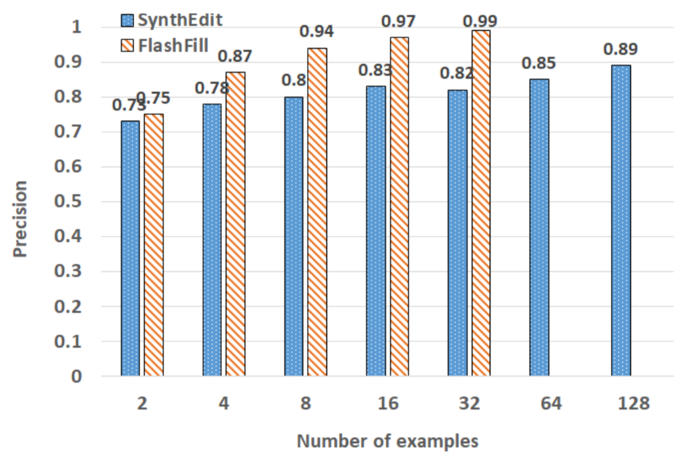
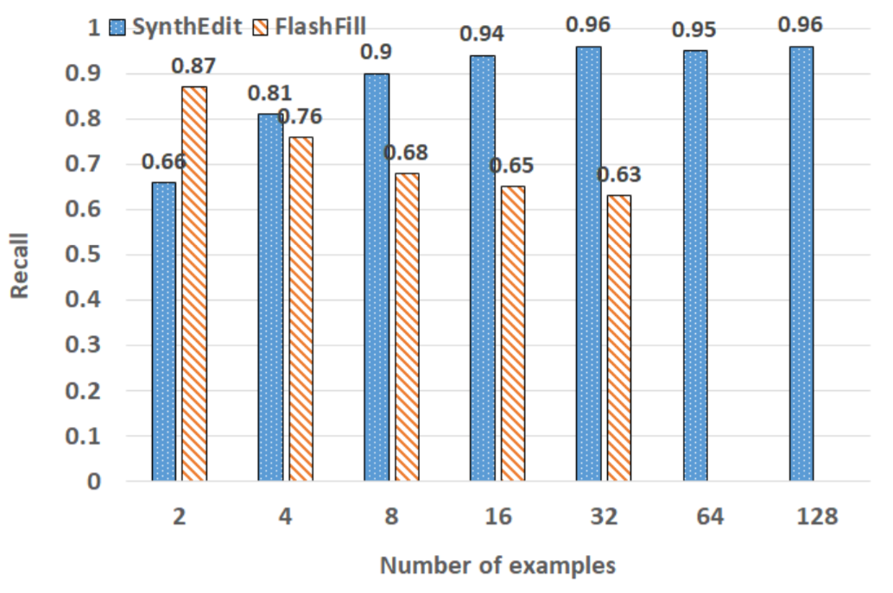
Experiments (1)
FlashFill required more RAM than what was available.

Slide 14
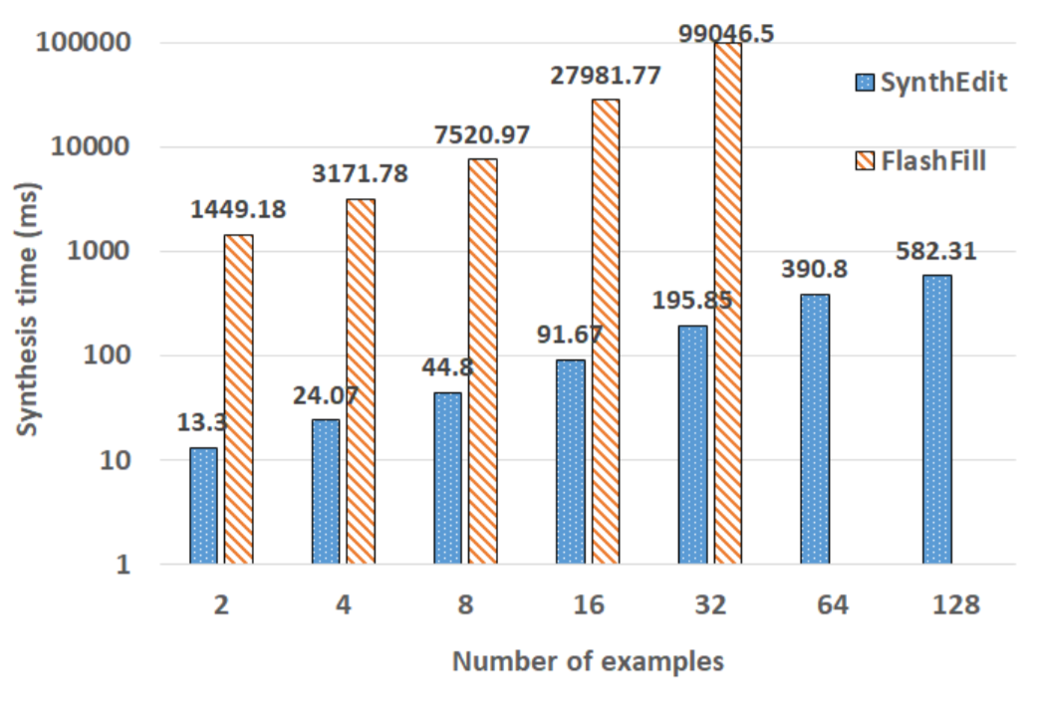
Experiments (2)

Slide 15
Conclusions
We propose:
A transformation language that uses regex primitives, edit operations, and string expressions to express format transformations.
A synthesis algorithm that, starting from a given set of input/output examples, automatically learns one or more transformations expressed using the mentioned language and consistent with the examples.
Our proposed method is more efficient than the closest antagonist, while achieving better recall, at the cost of slightly reduced precision.

Slide 16

Thank you!
Acknowledgement:
This work is funded by the UK Engineering and Physical Sciences Research Council, through the VADA Programme.

