Slide 1

JavaScript
Lecture. BOM, DOM, Event Handling.

Slide 2

Lesson Plan
BOM introduction
DOM introduction
window
document
Manipulations with DOM
Event handling

Slide 3

DOM
Document Object Model - is a tree of objects.

Slide 4
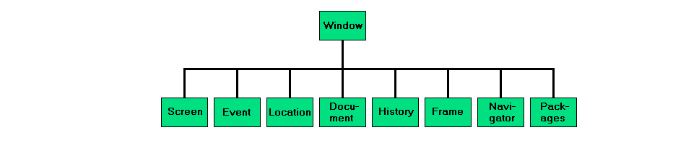
BOM
Browser Object Model

Slide 5
window
All global JavaScript objects, functions, and variables automatically become members of the window object.
Global variables are properties of the window object.
Global functions are methods of the window object.

Slide 6
window
innerHeight | Height of the browser window viewport including, if rendered, the horizontal scrollbar.
outerHeight | Height in pixels of the whole browser window.
innerWidth | Width of the browser window viewport including, if rendered, the vertical scrollbar.
outerWidth | Width in pixels of the whole browser window.

Slide 7
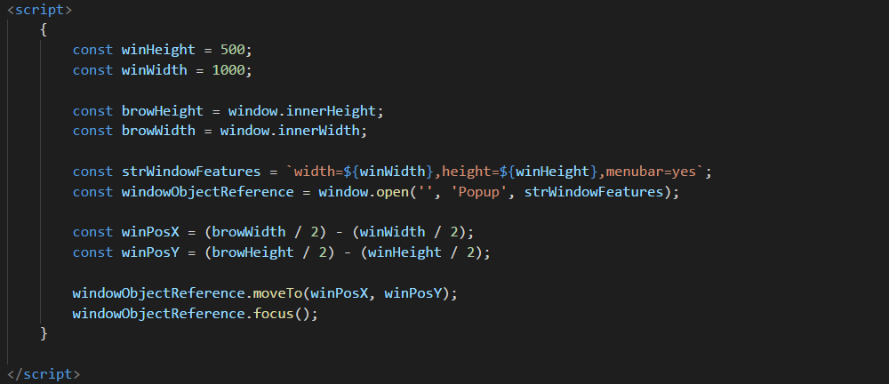
window

Slide 8
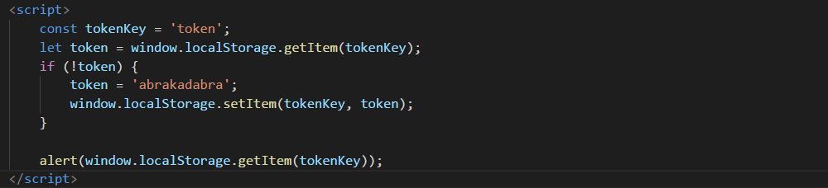
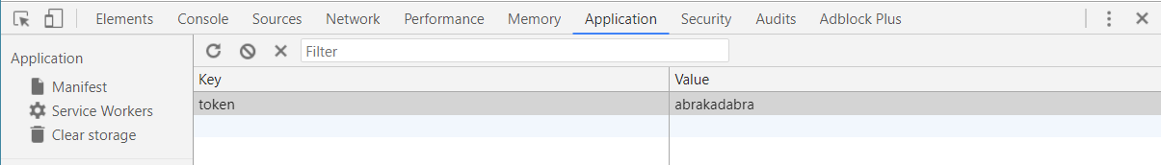
Local and Session Storages

Slide 9
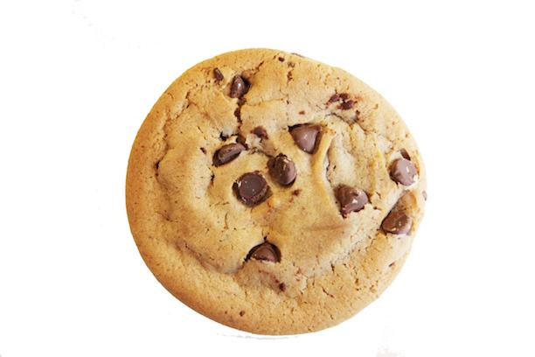
Cookies

Slide 10
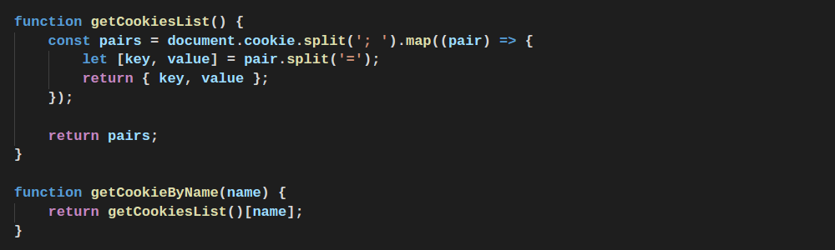
Cookies
Custom function for get cookies

Slide 11
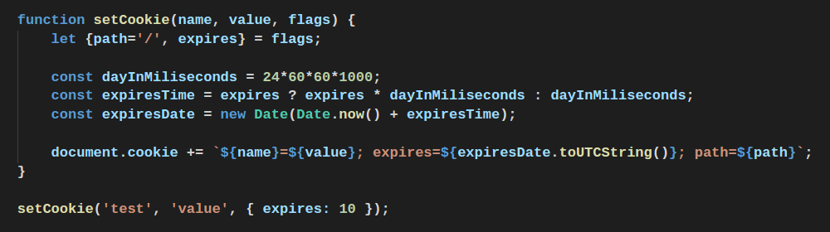
Cookies
Custom function for set cookies

Slide 12
window widespread props
history | A reference to the History object, which provides an interface for manipulating the browser session history
location | Gets/sets the location, or current URL, of the window object.
navigator | A reference to the navigator object.
screen | A reference to the screen object associated with the window.
scrollX, scrollY | The number of pixels that the document has already been scrolled horizontally or vertically.
scroll() | Scrolls the window to a particular place in the document.
focus(), blur() | Set or set away focus from the window.

Slide 13
document
The document itself is a document node
All HTML elements are element nodes
All HTML attributes are attribute nodes
Text inside HTML elements are text nodes
Comments are comment nodes

Slide 14
document
Main methods for getting dom elements
getElementById | Returns a reference to the element by its ID.
getElementsByName | Returns an array-like object of elements with the given tag name.
getElementsByClassName | Returns an array-like object of all child elements which have all of the given class names.
querySelector | Returns the first element within the document that matches the specified selector.
querySelectorAll | Returns a list of the elements within the document that match the specified group of selectors.

Slide 15
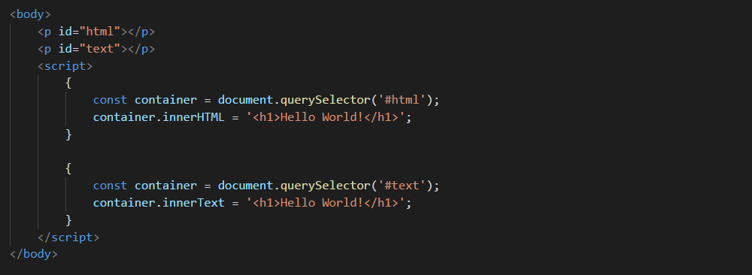
innerHTML and innerText

Slide 16
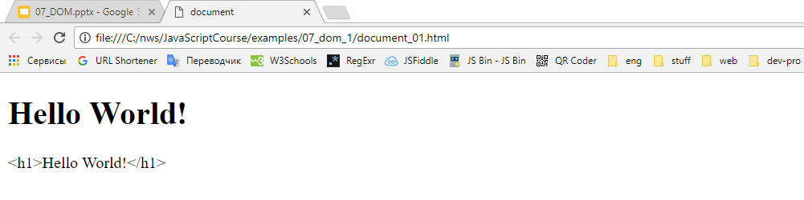
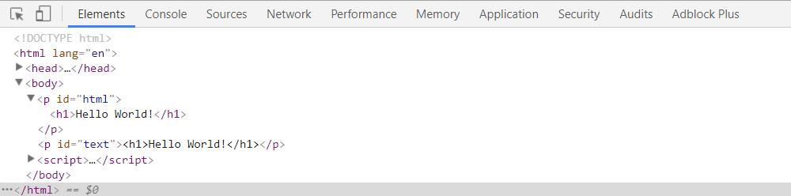
innerHTML and innerText

Slide 17
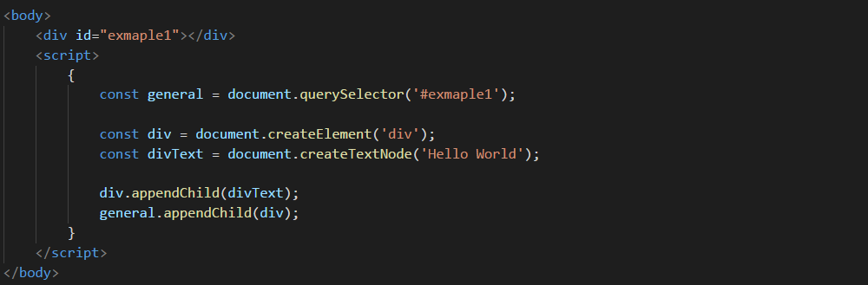
createElement and appendChild

Slide 18
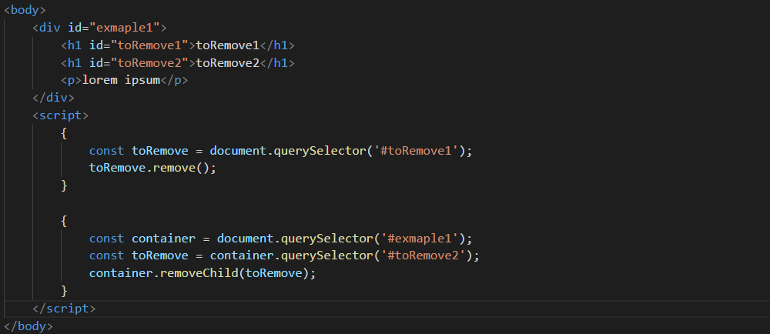
remove and removeChild

Slide 19
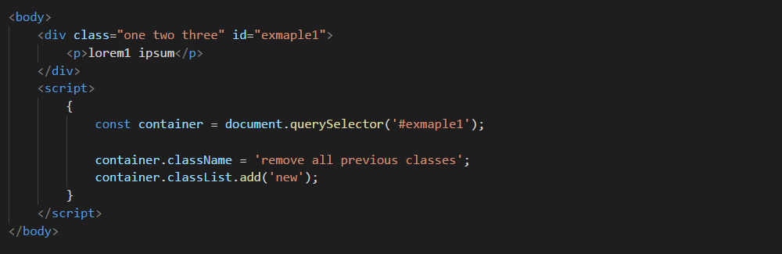
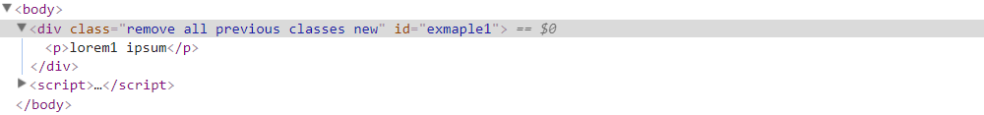
className and classList

Slide 20
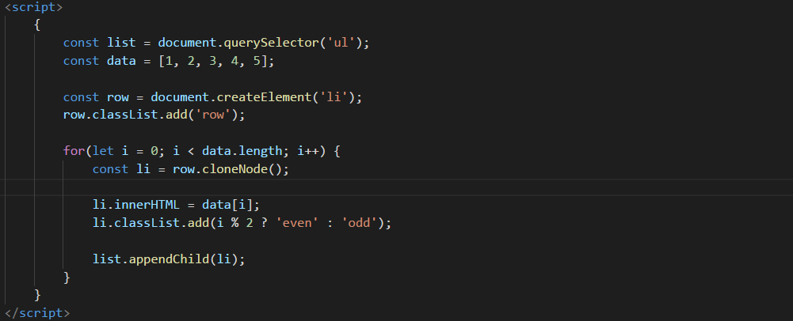
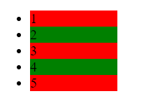
Clone Node

Slide 21
Node Properties
firstChild, firstElementChild | Returns an node/element representing the first direct child node of the node, or null if the node has no child.
lastChild, lastElementChild | Returns an element representing the last direct child node of the node, or null if the node has no child.
nextSibling, nextElementSibling | Returns the element immediately following the specified one in its parent's.
previousSibling, previousElementSibling | Returns an element representing the previous node in the tree, or null if there isn't such node.
nodeName | returns the name of the current node as a string.
nodeType | represents the type of the node.
nodeValue | returns or sets the value of the current node.

Slide 22
Node Properties
textContent | Returns / Sets the textual content of an element and all its descendants.
parentNode, parentElement | returns the DOM node's parent node/element, or null.
contains() | Indicating whether a node is a descendant of a given node or not.
insertBefore() | Inserts a Node before the reference node as a child of the current node.
isSameNode() | Indicating whether or not the two nodes are the same.
replaceChild() | Replaces one child node of the current one with the second one given in parameter.

Slide 23
Event Handling
widespread window events.
onload | Called after all resources and the DOM are fully loaded. WILL NOT get called when the page is loaded from cache, such as with back button.
onbeforeunload | An event handler property for beforeunload events on the window.
onunload | Called when the user navigates away from the page.
onclose | Called after the window is closed.

Slide 24
Event Handling
window.onload - The load event fires at the end of the document loading process. At this point, all of the objects in the document are in the DOM, and all the images, scripts, links and sub-frames have finished loading.

Slide 25
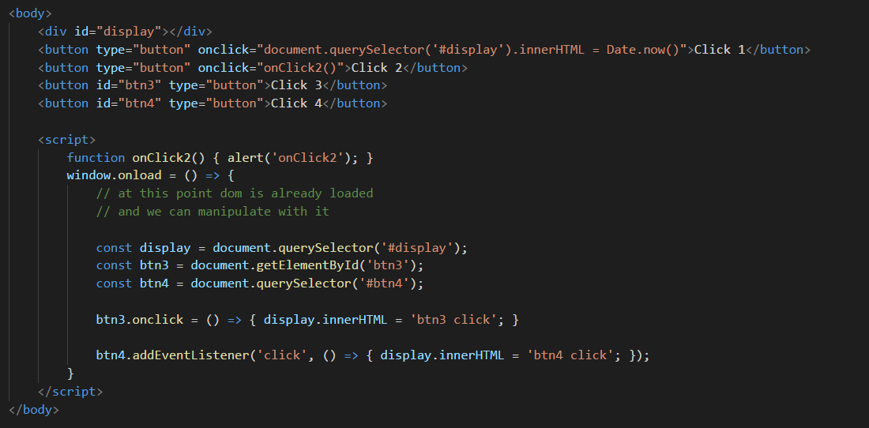
Event Handling

Slide 26
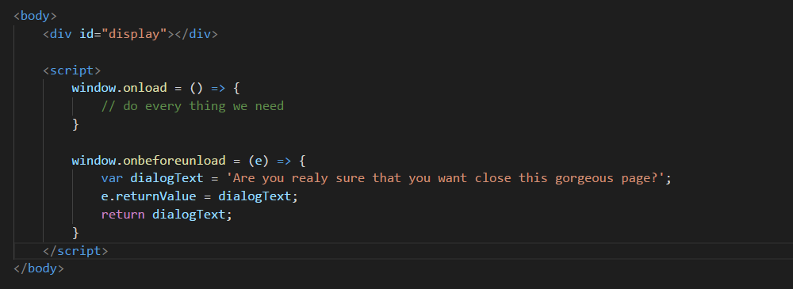
Event Handling

Slide 27
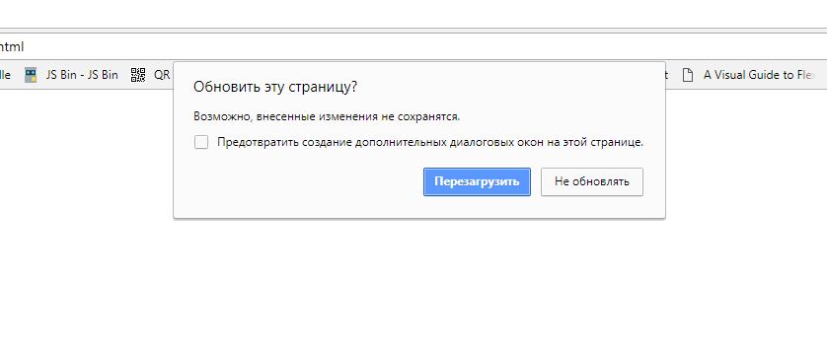
Event Handling

Slide 28
Event Handling
Widespread events.
onclick
ondblclick
onmousedown
onmouseup
onmouseenter
onmouseleave
onmouseover
onmouseout

Slide 29
Event Handling
Widespread Mouse Events.
onclick | The event occurs when the user clicks on an element.
onmousedown | The event occurs when the user presses a mouse button over an element.
onmouseup | The event occurs when the pointer is moved onto an element.
onmouseenter | The event occurs when the pointer is moved onto an element
onmouseleave | The event occurs when the pointer is moved out of an element
onmouseover | The event occurs when the pointer is moved onto an element, or onto one of its children.
onmouseout | The event occurs when a user moves the mouse pointer out of an element, or out of one of its children

Slide 30
Event Handling
Keyboard events.
onkeydown | The event occurs when the user is pressing a key.
onkeypress | The event occurs when the user presses a key.
onkeyup | The event occurs when the user releases a key.

Slide 31
Event Handling
Widespread forms events.
onblur | The event occurs when an element loses focus.
onfocus | The event occurs when an element gets focus.
onchange | The event occurs when the content of a form element, the selection, or the checked state have changed (for <input>, <keygen>, <select>, and <textarea>)
oninput | The event occurs when an element gets user input.
onsubmit | The event occurs when a form is submitted.

Slide 32
Thanks for attention

