Slide 1

JavaScript
Lecture. String, RegExp.

Slide 2

Lesson plan
String
Methods overview
Templates (new in ES6)
Escape sequences
RegExp
Introduction
Methods overview
Flags
Characters Classes
Characters Sets
Characters
Quantifiers

Slide 3
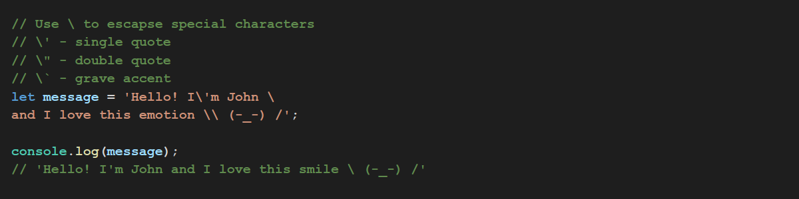
String
Escape Characters

Slide 4
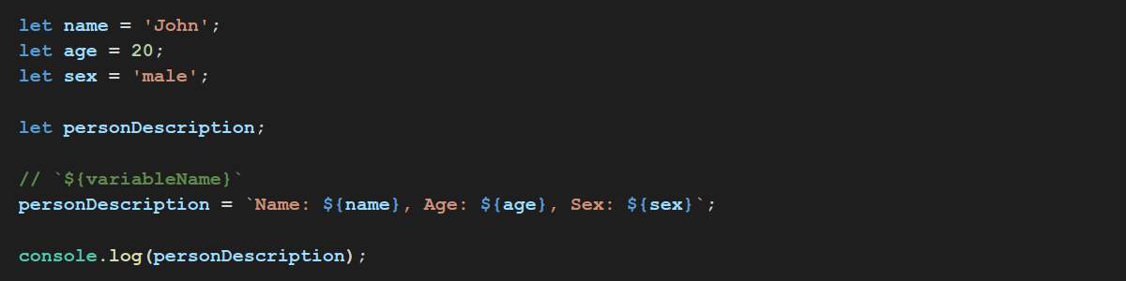
String
String templates

Slide 5
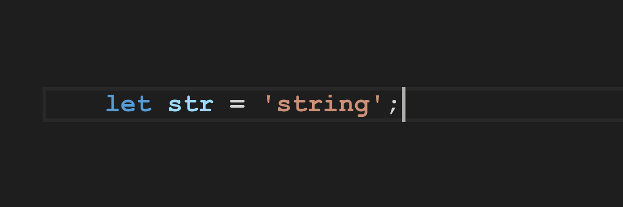
String
Let’s see some useful methods

Slide 6
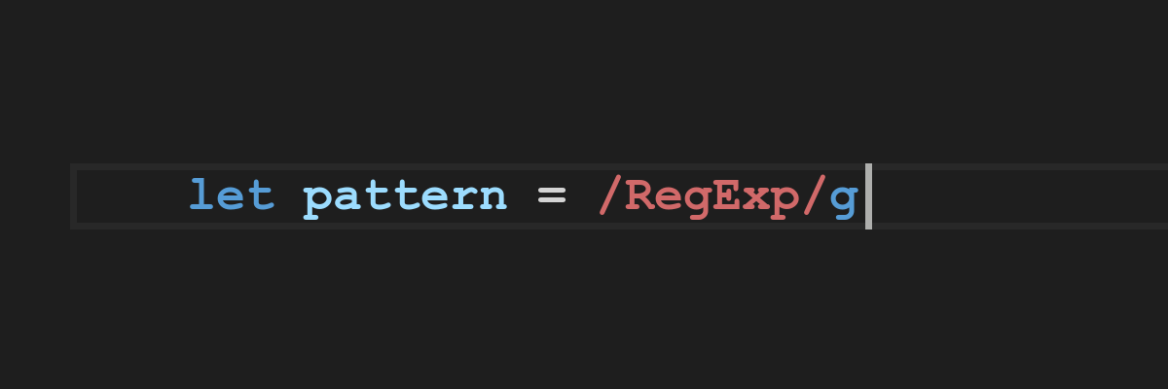
RegExp
Regular Expression - a sequence of characters that define a search pattern. Usually this pattern is then used by string searching algorithms for "find" or "find and replace" operations on strings.

Slide 7
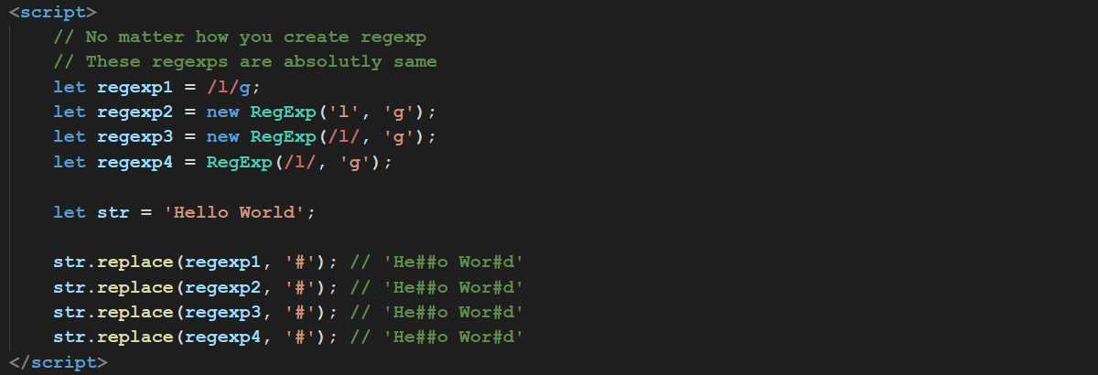
RegExp
How to create a RegExp?

Slide 8
RegExp
RegExp flags
g - global, find all matches rather than stop after the first match.
i - ignore case
m - multiline

Slide 9
RegExp
Widespread Character Classes
. (dot) - matches any single character except line terminators: \n, \r
\d - any arabic digit
\w - any alphanumeric character from the basic Latin alphabet, including the underscore
\s - matches any single whitespace character
\D - matches any character that is not a digit
\W - matches any character that is not a word character from the basic Latin alphabet
\S - Matches a single character other than whitespace

Slide 10
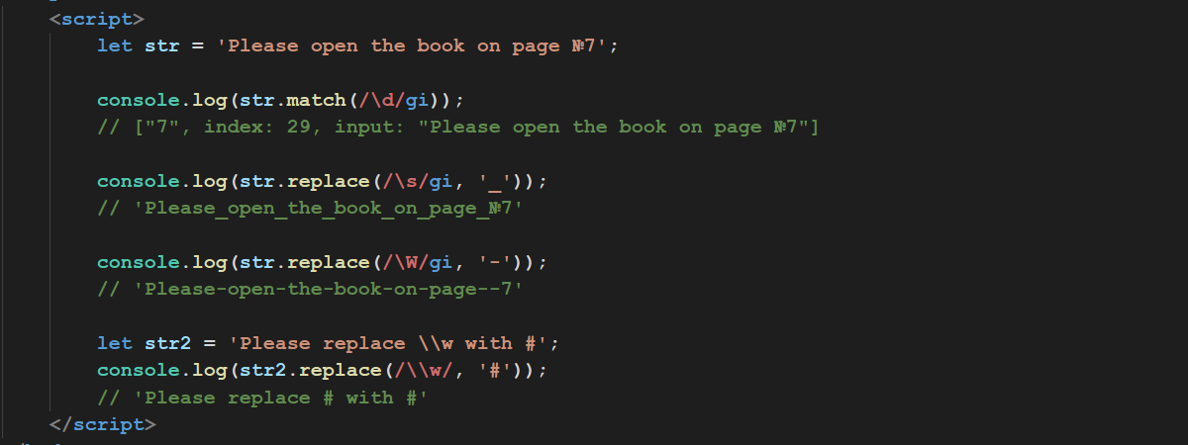
RegExp
Couple examples

Slide 11
RegExp
Character Sets
[abc] [a-z] - A character set. Matches any one of the enclosed characters.
[^abc] [^a-z] - A negated or complemented character set
a|b - Matches either a or b.
Start and end of input
^ - Matches beginning of input
$ - Matches end of input

Slide 12
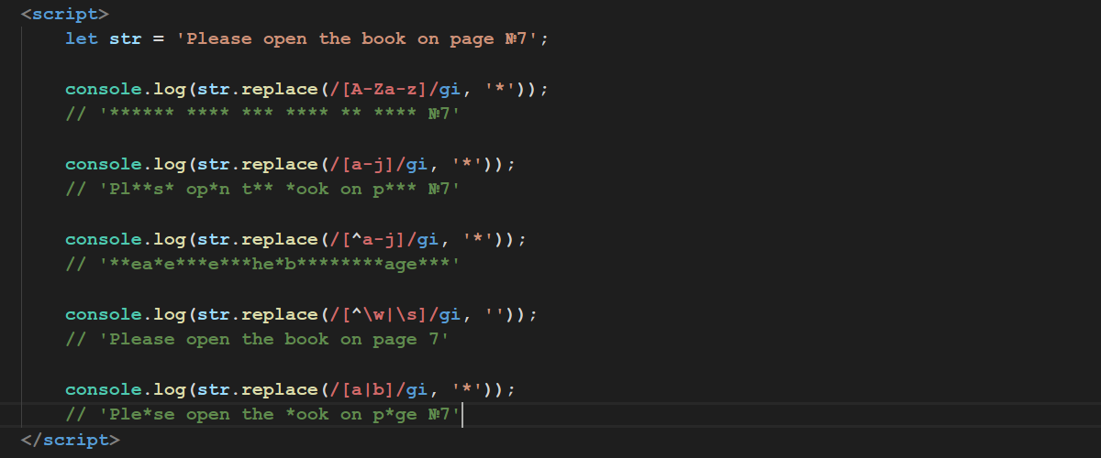
RegExp
Character Sets

Slide 13
RegExp
Quantifiers
x* - Matches the preceding item x 0 or more times.
x+ - Matches the preceding item x 1 or more times.
x? - Matches the preceding item x 0 or 1 time.
x{n} - Where n is a positive integer. Matches exactly n occurrences of the preceding item x.
x{n,} - Where n is a positive integer. Matches at least n occurrences of the preceding item x.
x{n,m} - Where n and m are positive integers. Matches at least n and at most m occurrences of the preceding item x.

Slide 14
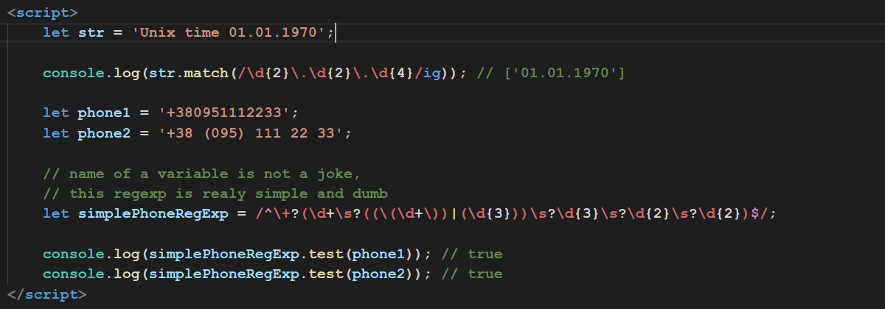
RegExp

Slide 15
Thanks for watching

