Slide 1

JavaScript
Lecture. Event Handling.

Slide 2

Lesson Plan
Event handling
Event bubbling
Event object
Event delegation
Event capturing
Event default behavior

Slide 3
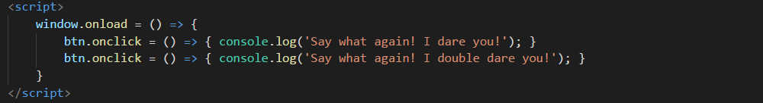
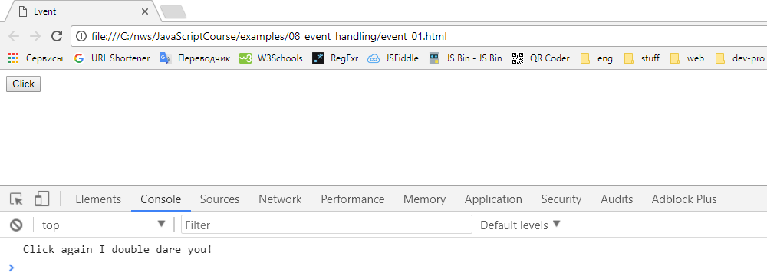
Event Handling

Slide 4
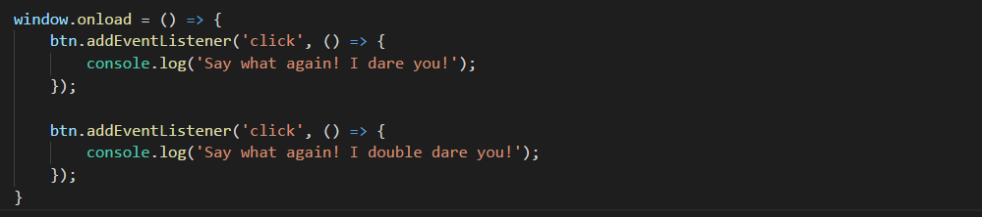
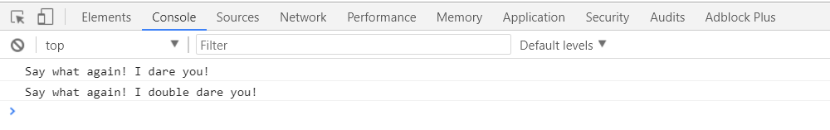
Event Handling

Slide 5
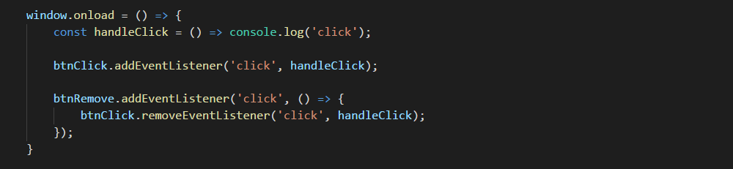
removeEventListener

Slide 6
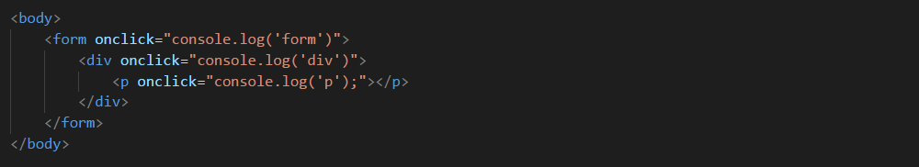
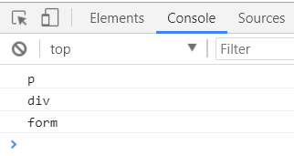
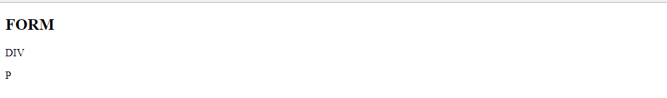
Event Bubbling

Slide 7
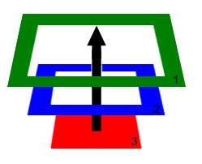
Event Bubbling
Why we get that result?

Slide 8
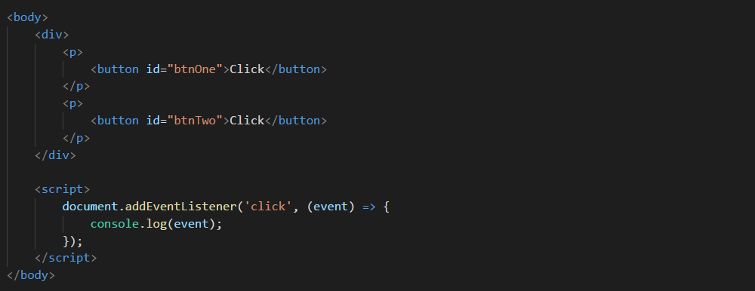
Event Object
Each event handler get event object as a parameter.

Slide 9
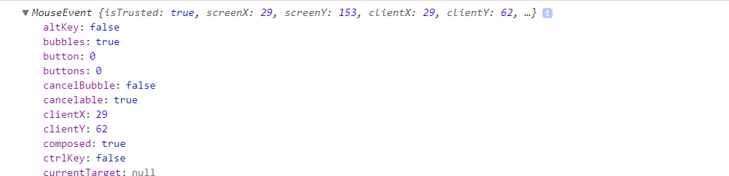
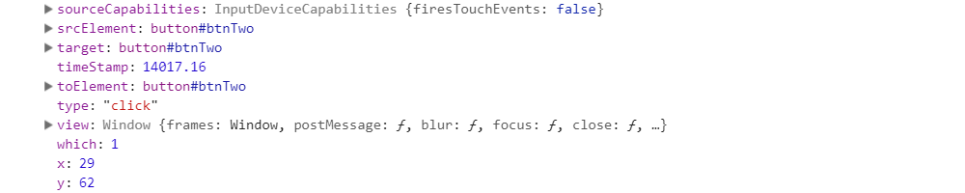
Event Object

Slide 10
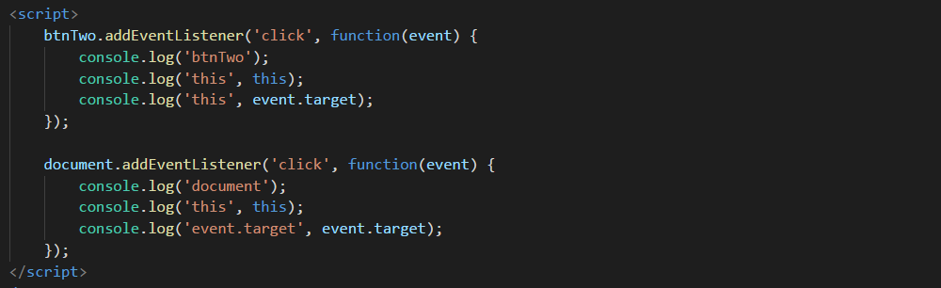
Event Object
Difference between this and event.target

Slide 11
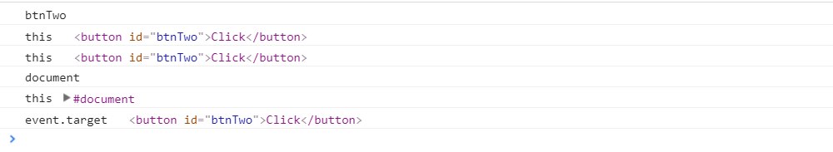
Event Object
Difference between this and event.target

Slide 12
Event Delegation
Event propagation gives us ability delegate events from elements to their parents.
Lets see some example.

Slide 13
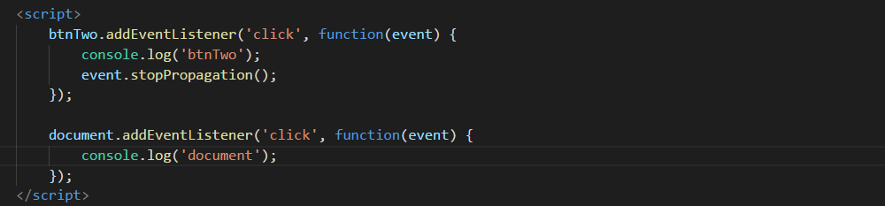
stopPropagation
Document event handler will never be executed.

Slide 14
stopPropagation
Use stopPropagation only
where it necessary

Slide 15
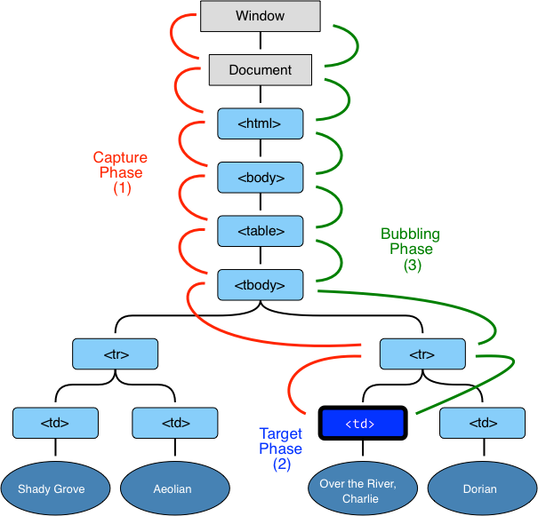
Event Capturing

Slide 16
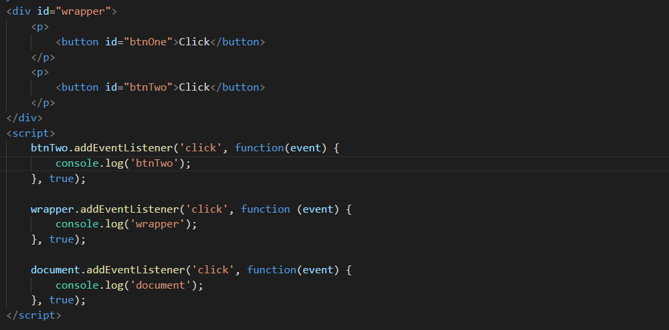
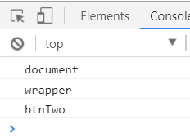
Event Capturing

Slide 17
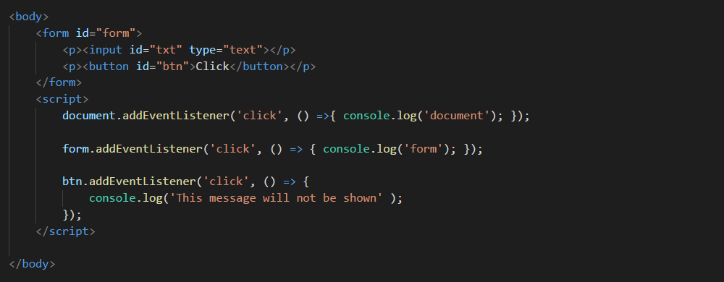
Event Default Behavior
What goes wrong? Why don’t we see messages in console?

Slide 18
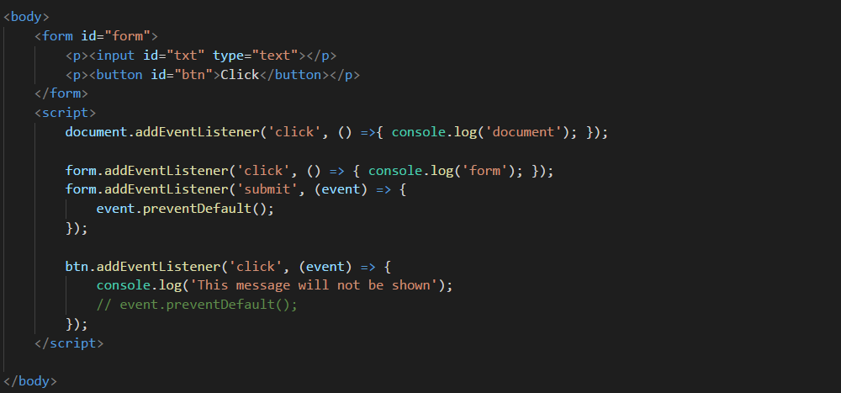
Event Default Behavior

Slide 19
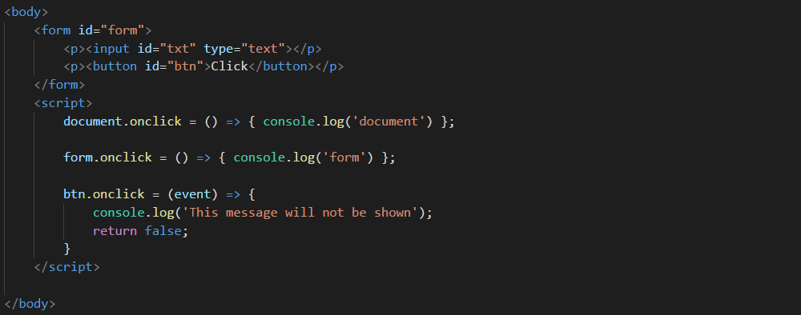
Event Default Behavior

Slide 20
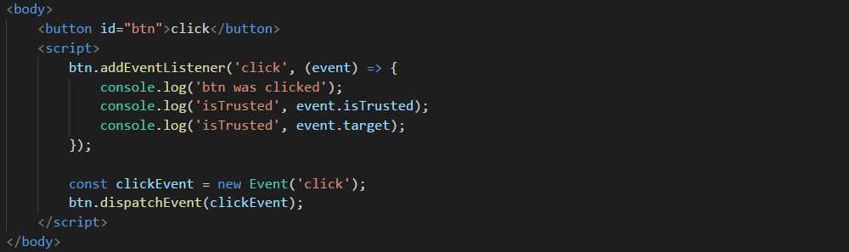
Event Dispatching

Slide 21
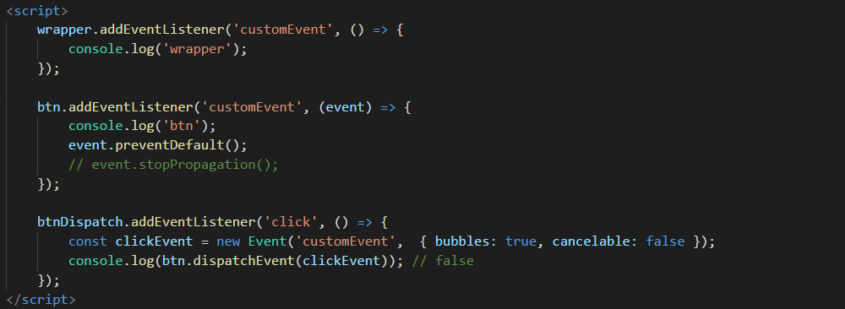
Event Dispatching

Slide 22
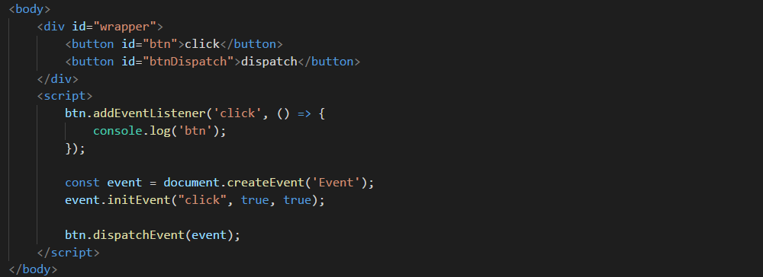
Event Dispatching

Slide 23
Event Dispatching
Standard event constructors:
UIEvent
FocusEvent
MouseEvent
WheelEvent
KeyboardEvent
CompositionEvent

Slide 24
Event Dispatching
If you need dispatch
standard event for element think twice,
do you really need this.

Slide 25
Thanks for attention

