Slide 1

JavaScript
Lecture. Asynchronous.

Slide 2

Lesson Plan
setTimeout
setInterval
Asynchronous
Callback Hell
Promise

Slide 3
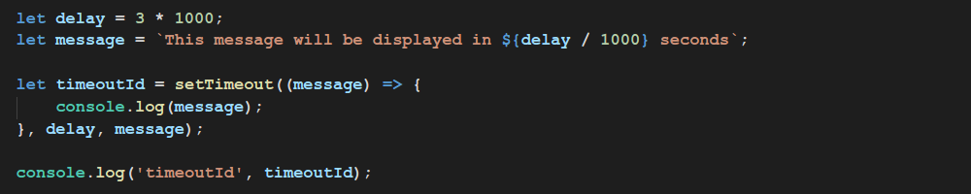
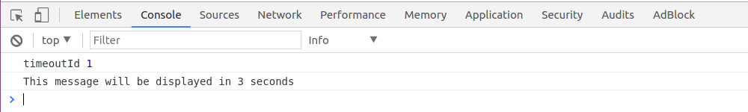
setTimeout
The setTimeout() method calls a function or evaluates an expression after a specified number of milliseconds.

Slide 4
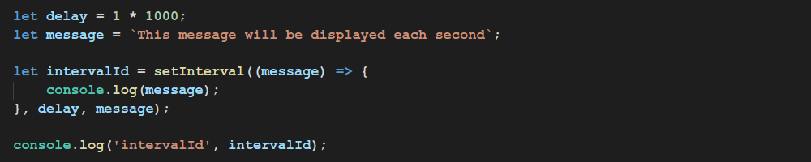
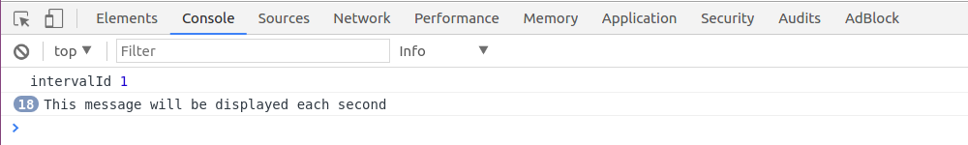
setInterval
The setInterval() method calls a function or evaluates an expression at specified intervals.

Slide 5
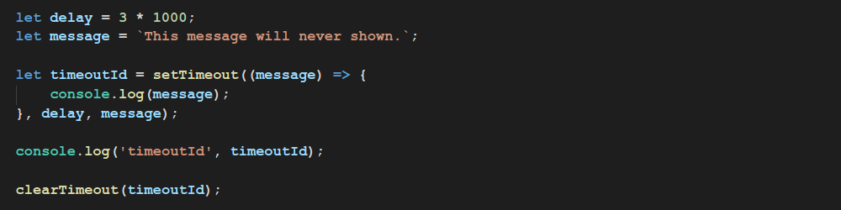
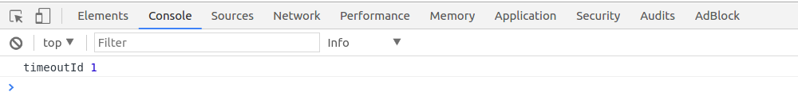
clearTimeout

Slide 6
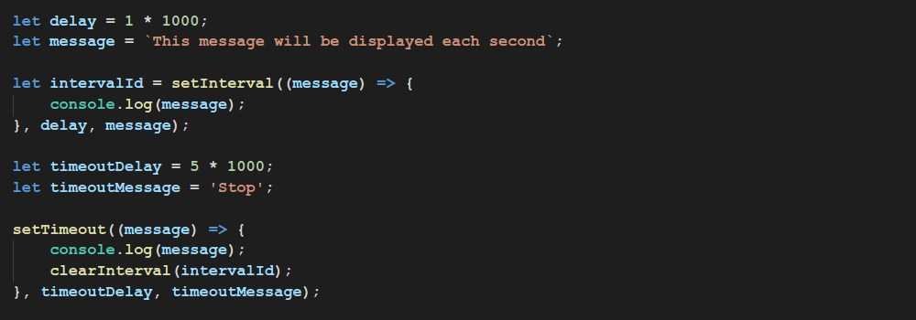
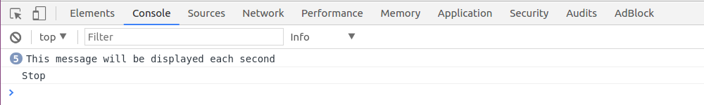
clearInterval

Slide 7
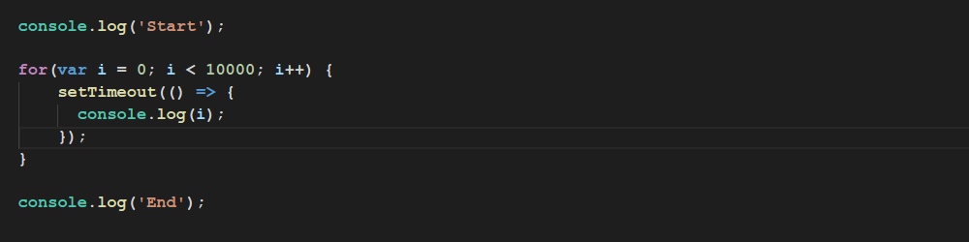
Sync and Async code

Slide 8
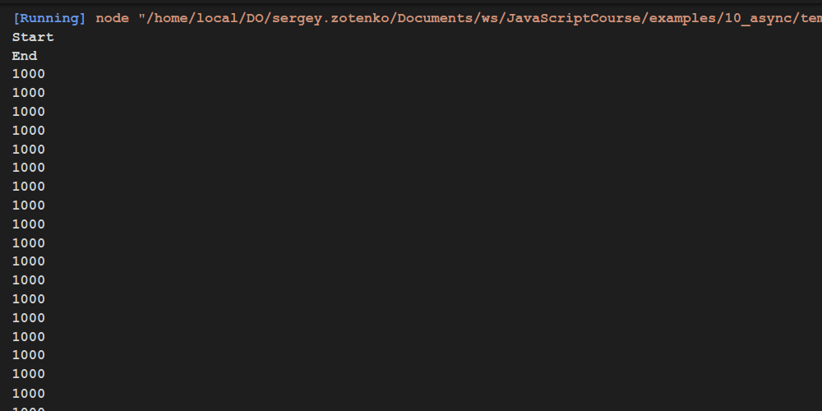
Sync and Async code
Why this displayed first
Why 1000? How can we fix this

Slide 9
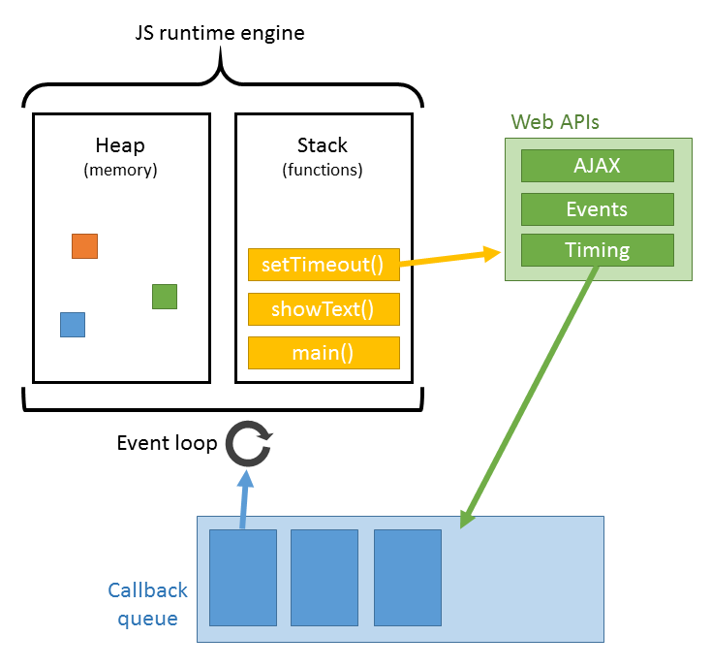
Asynchronous in JavaScript

Slide 10
Asynchronous in JavaScript
What operations are asynchronous in javascript?
DOM events
timeout
interval
XHR

Slide 11
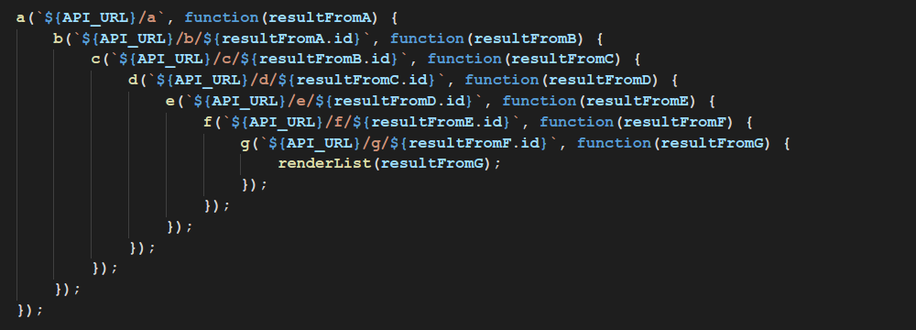
Callback Hell
What is pyramid of fate?

Slide 12
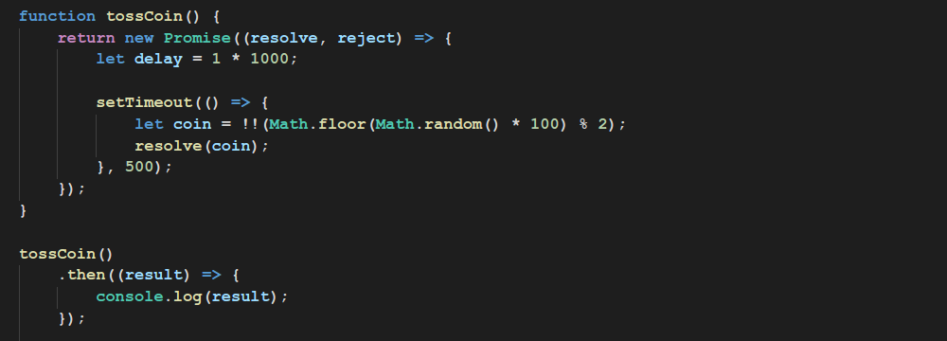
Promise

Slide 13
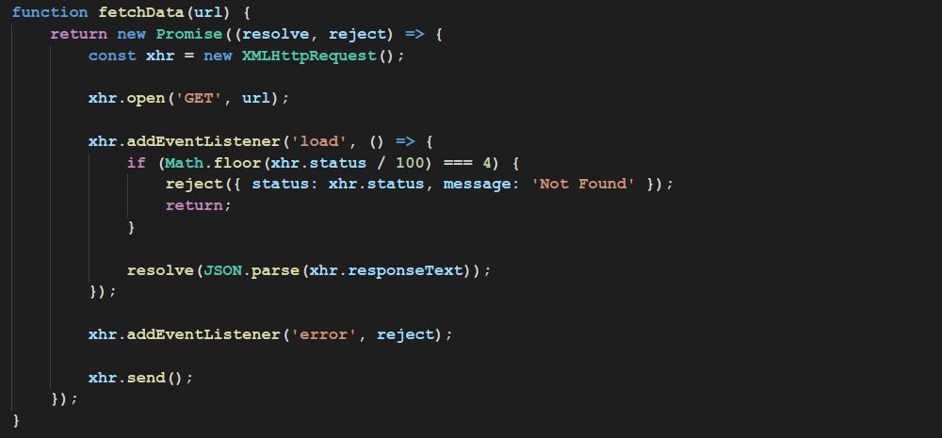
Promise

Slide 14
Promise
Promise can be in following states:
Pending
Fulfilled
Rejected

Slide 15
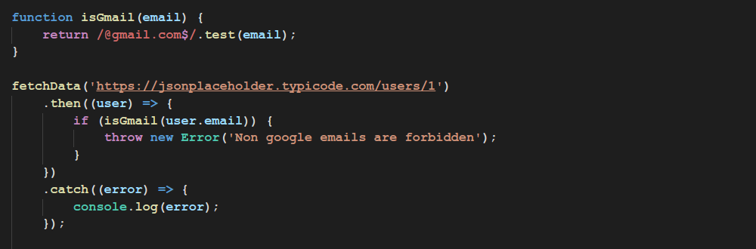
Promise
throw in then

Slide 16
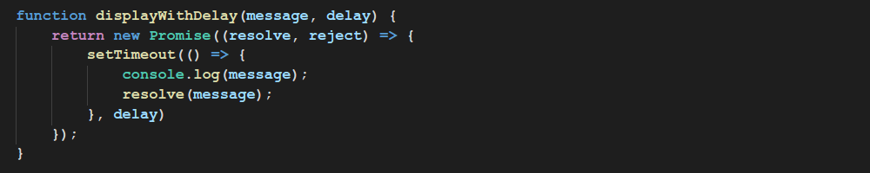
Promise
Chaining

Slide 17
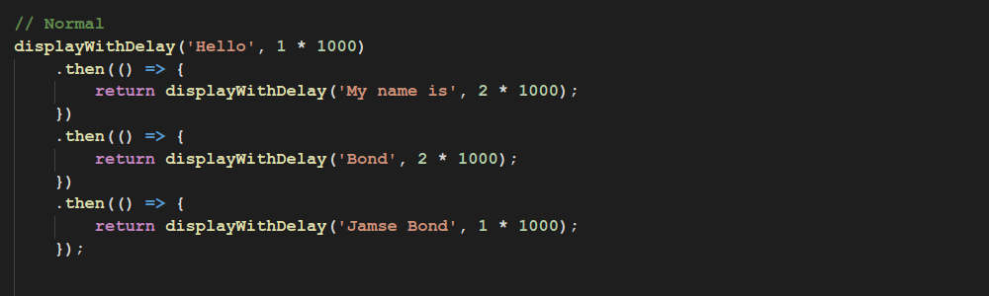
Promise
Chaining

Slide 18
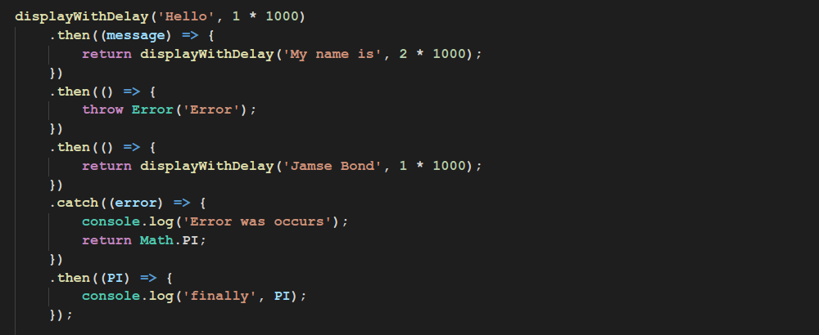
Promise
Catch in Chaining

Slide 19
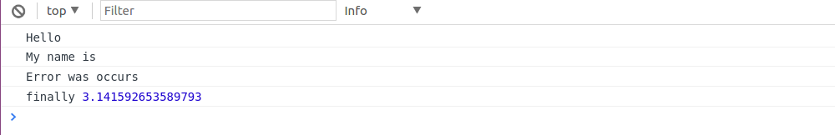
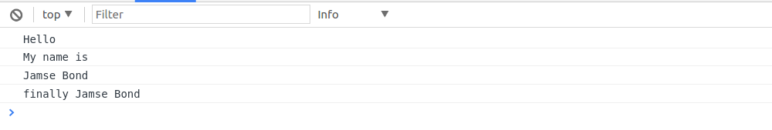
Promise
With throw
Without throw

Slide 20
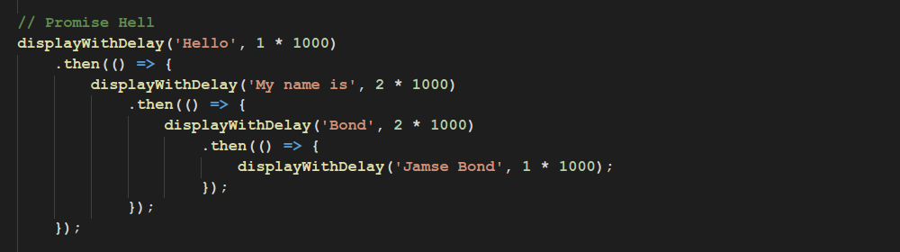
Promise
Promise Hell

Slide 21
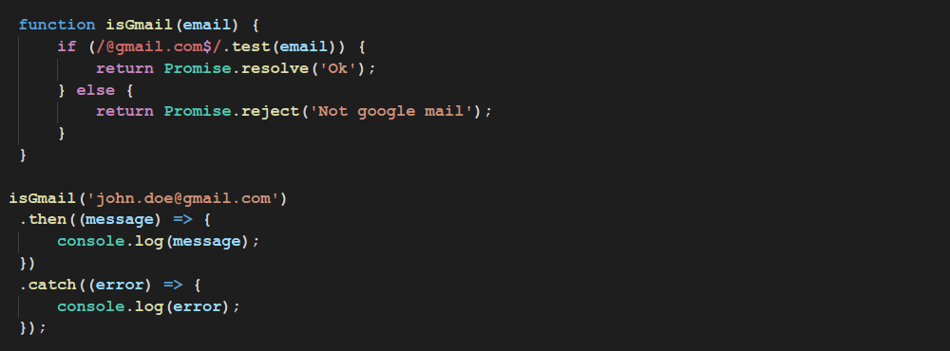
Promise
Promise.resolve() and Promise.reject()

Slide 22
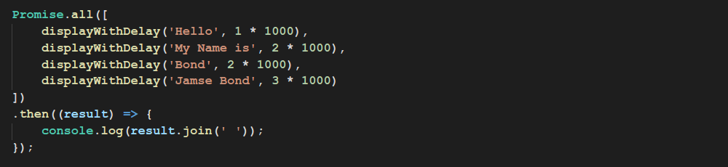
Promise
Promise.all()

Slide 23
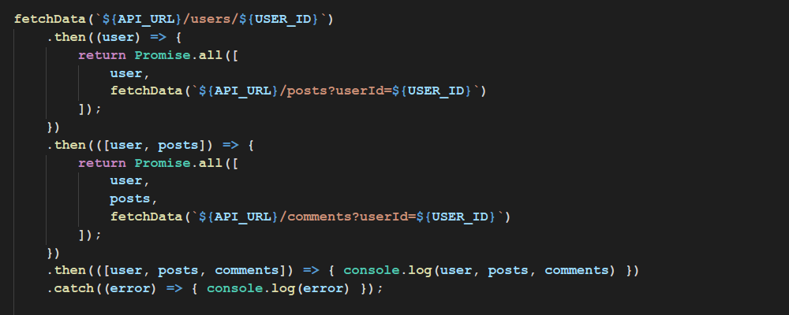
Promise
Promise.all()

Slide 24
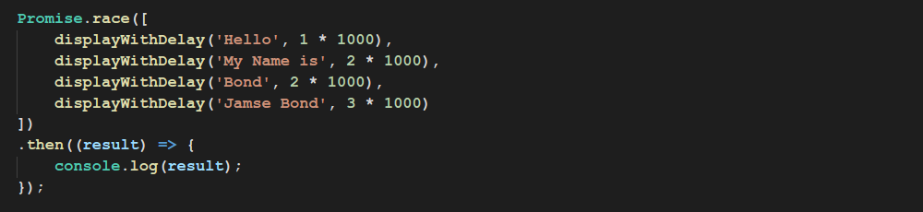
Promise
Promise.race()

Slide 25
Thanks for attention

