Slide 1

JavaScript
Lecture. OOP.

Slide 2

Lesson Plan
What is OOP
Main principles
Classes
Functional Style
Private and Public interfaces

Slide 3
Object-Oriented Programming
WHAT IS IT?

Slide 4
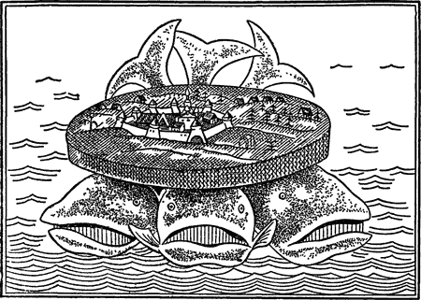
Object-Oriented Programming
Encapsulation
Polymorphism
Inheritance

Slide 5
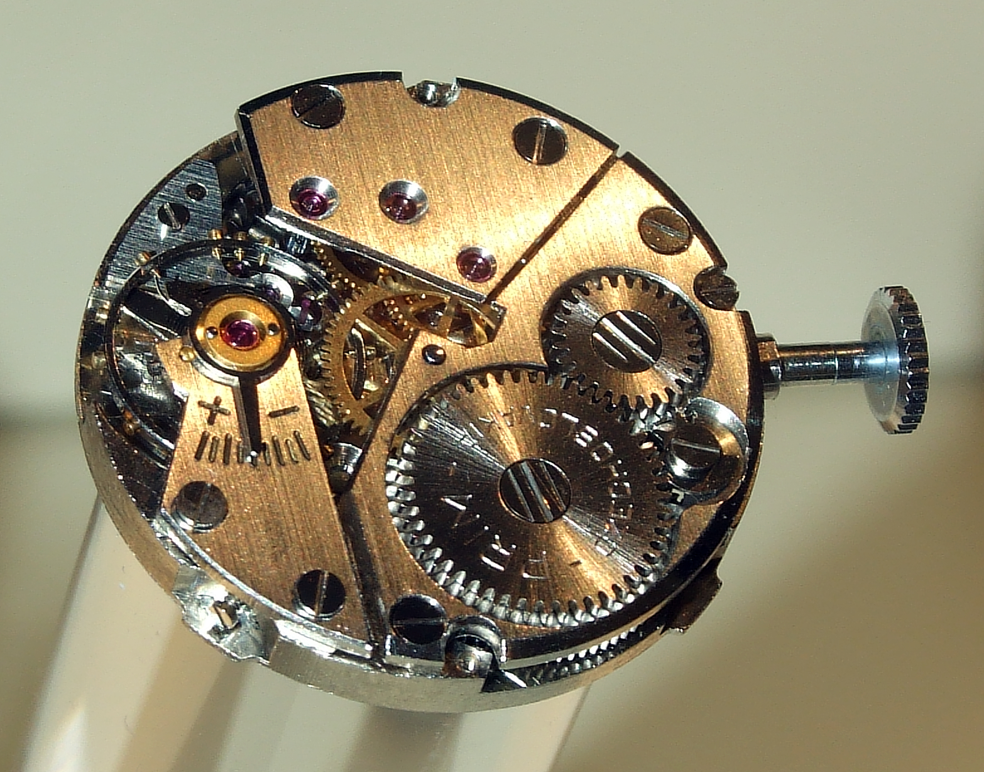
Encapsulation

Slide 6

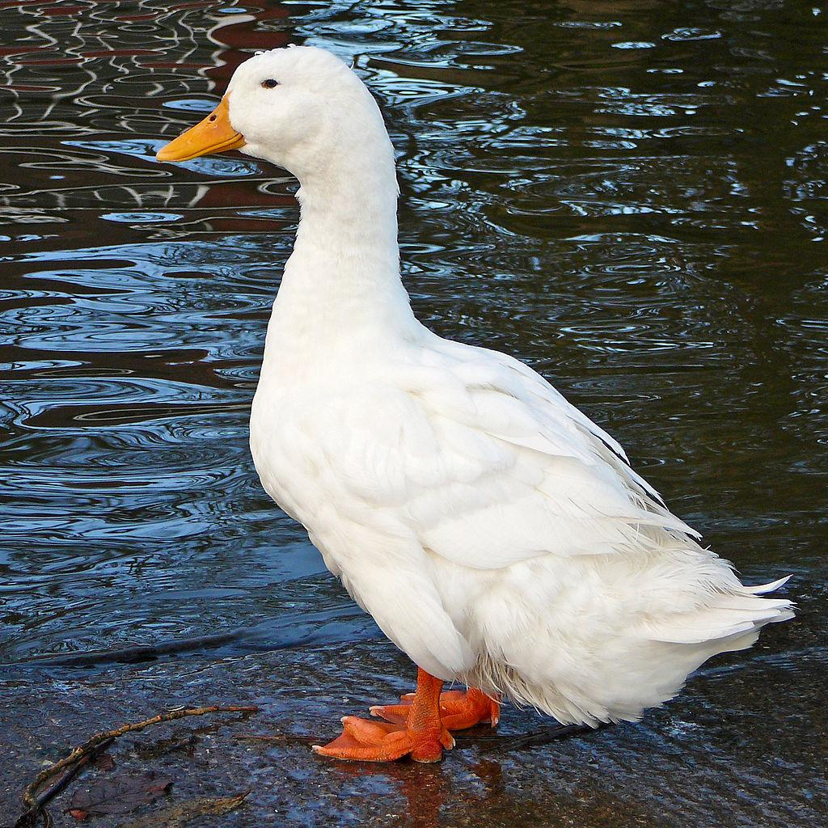
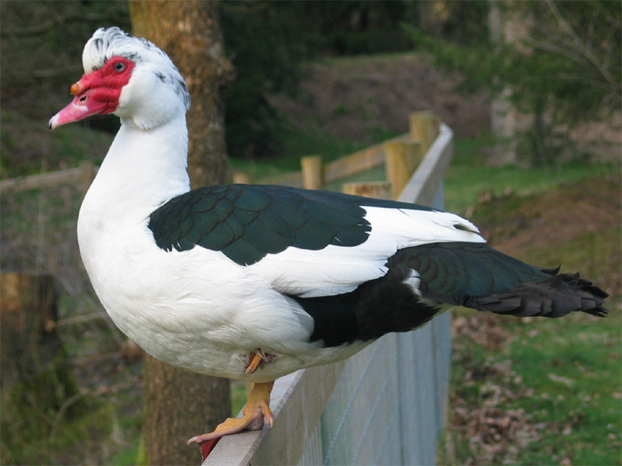
Inheritance
DUCK

Slide 7
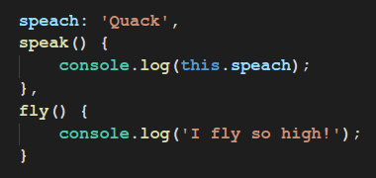
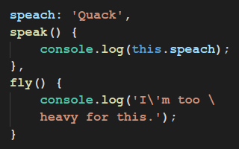
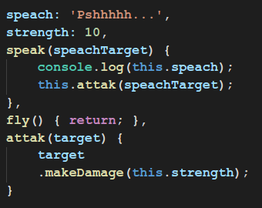
Polymorphism

Slide 8
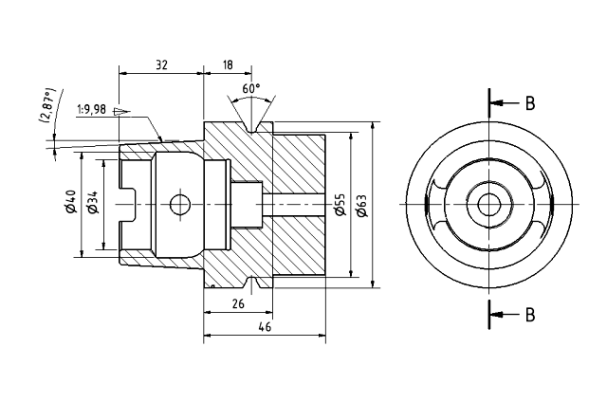
Class
Class is a blueprint

Slide 9
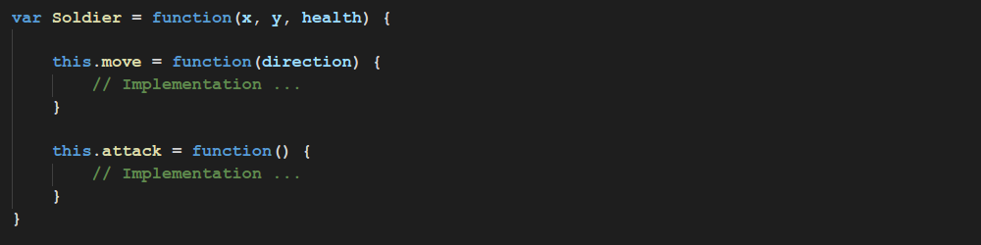
Classes and Instances
Soldier is a class

Slide 10
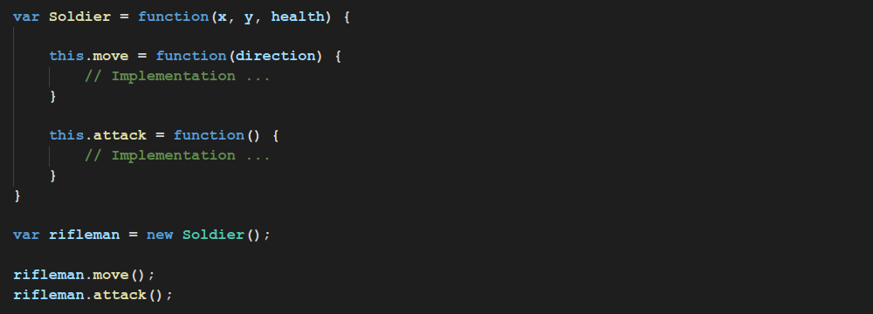
Classes and Instances
Rifleman is an instance of a Soldier

Slide 11
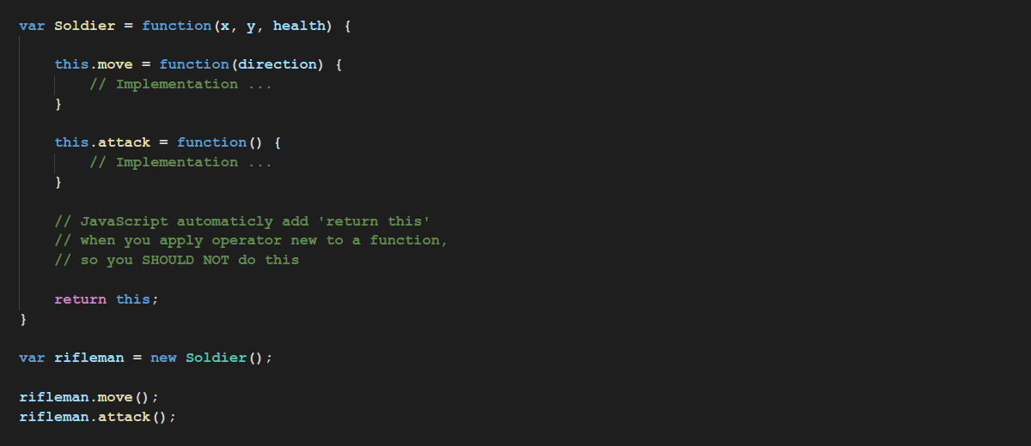
Classes in JavaScript
JavaScript supports OOP via Constructor Functions

Slide 12
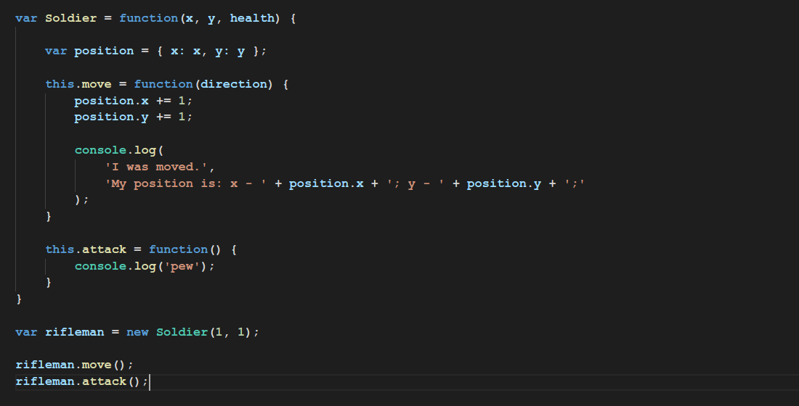

Functional Style

Slide 13
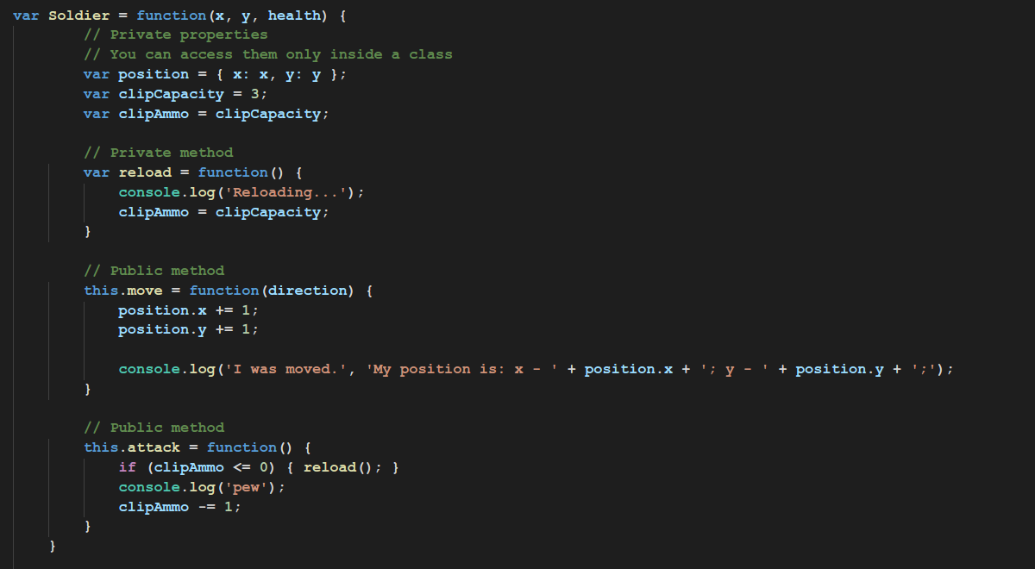
Public and Private Interfaces

Slide 14
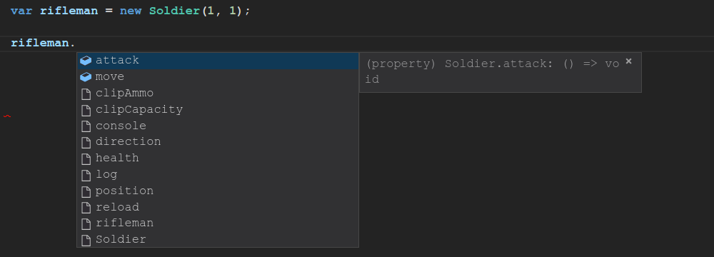
Public and Private Interfaces
This is what encapsulation is

Slide 15
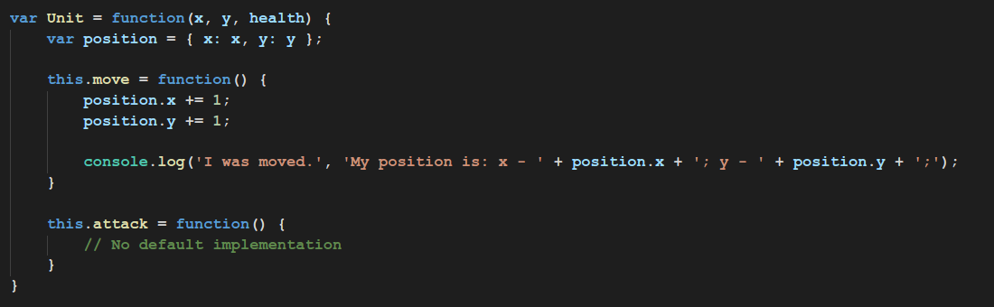
Inheritance Example
Unit is a base class

Slide 16
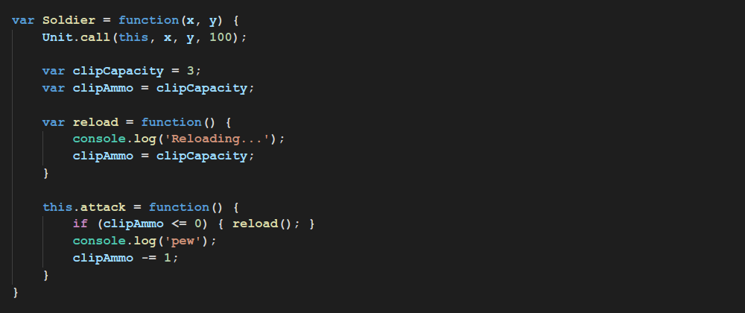
Inheritance Example
Soldier

Slide 17
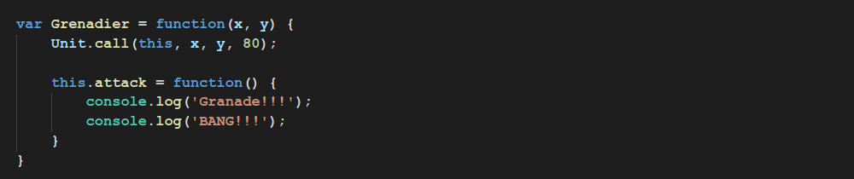
Inheritance Example
Grenadier

Slide 18
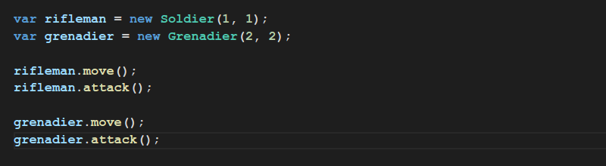
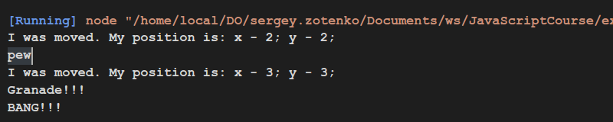
Inheritance Example
Usage

Slide 19
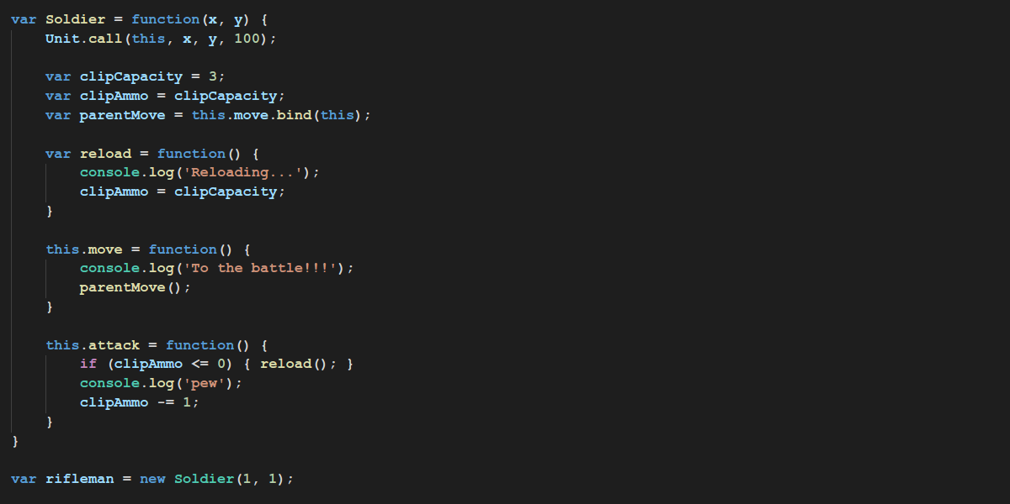
Inheritance Example

Slide 20
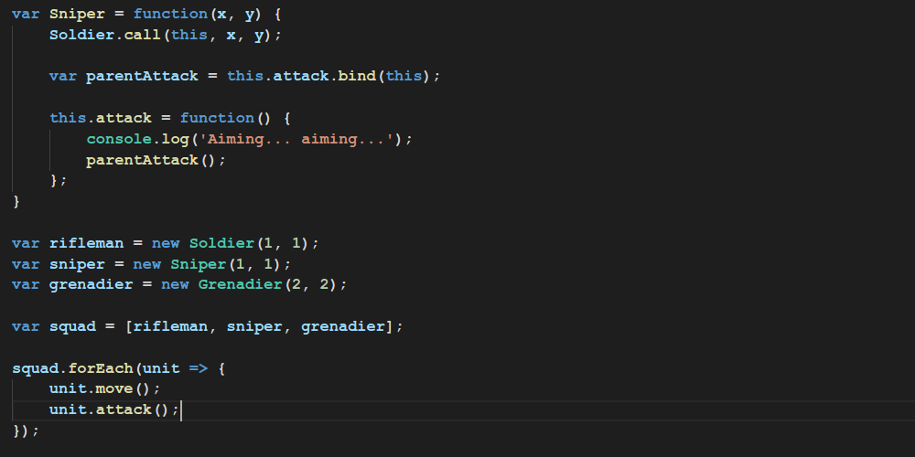
Polymorphism Example

Slide 21
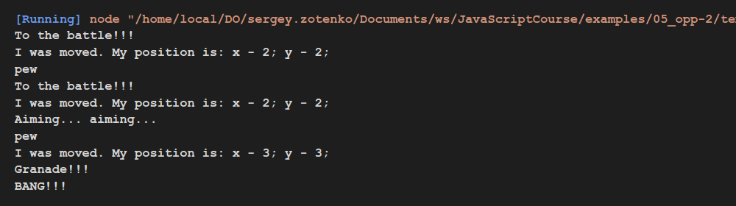
Polymorphism Example
They all are units but they attack in different way

Slide 22
Thanks for attention

