Slide 1

JavaScript
Lecture. OOP.

Slide 2

Lesson Plan
[[Prototype]]
Prototype Chaining
Object.create
Object.defineProperty
Prototype
Prototype Inheritance
OOP in ES6 style

Slide 3
[[Prototype]]
__proto__ is the actual object that is used in the lookup chain to resolve methods. It is a property that all objects have.

Slide 4
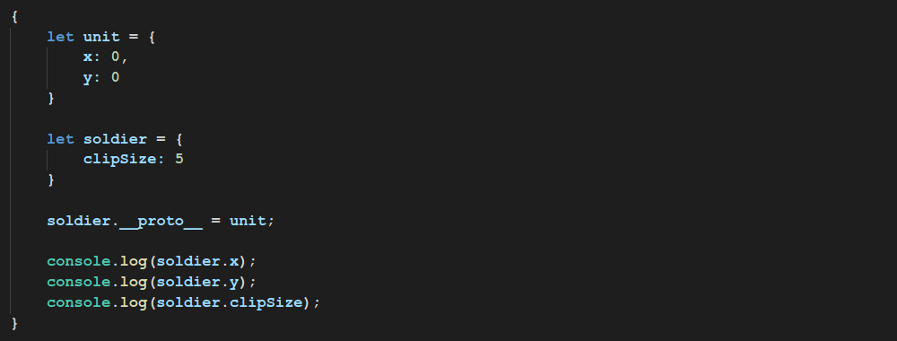

[[Prototype]]

Slide 5
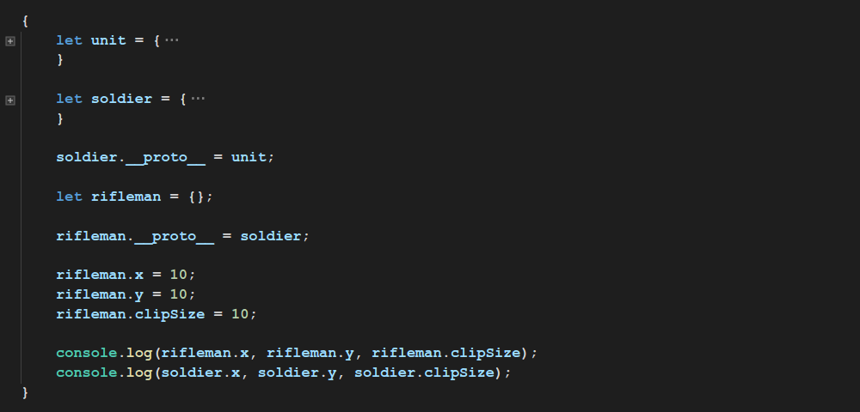

[[Prototype]]

Slide 6
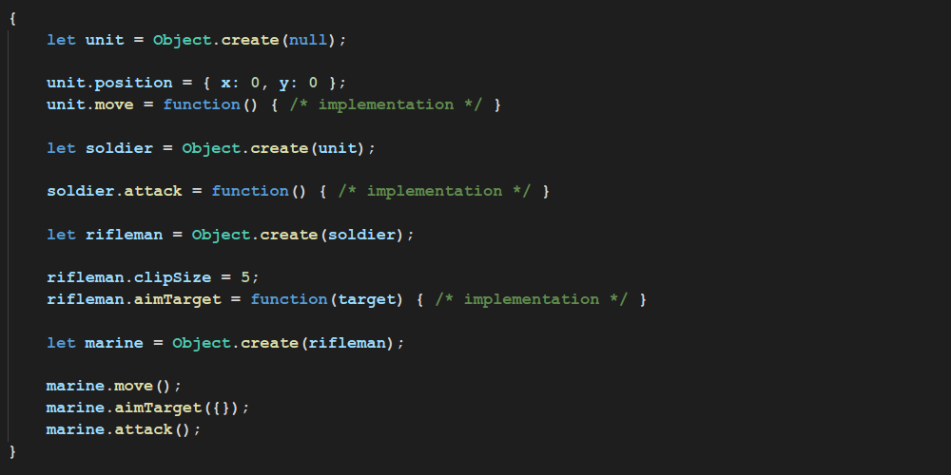
Prototype Chaining

Slide 7
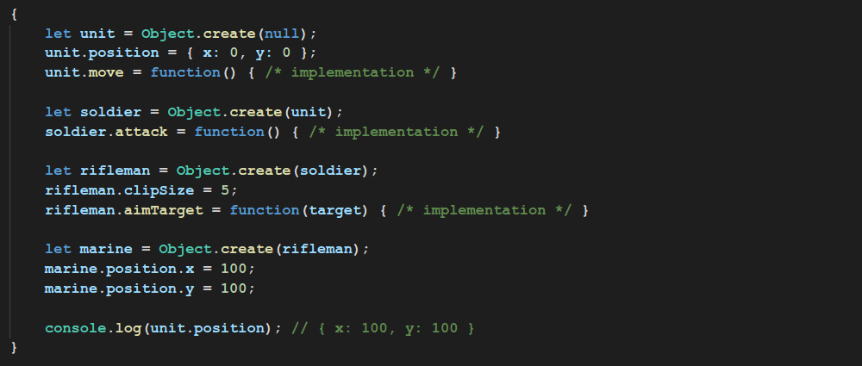
Prototype Chaining

Slide 8
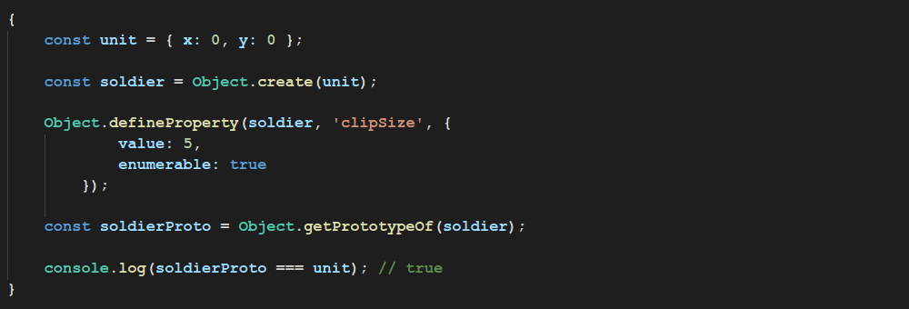
Object.getPrototypeOf
Never use __proto__ directly!

Slide 9
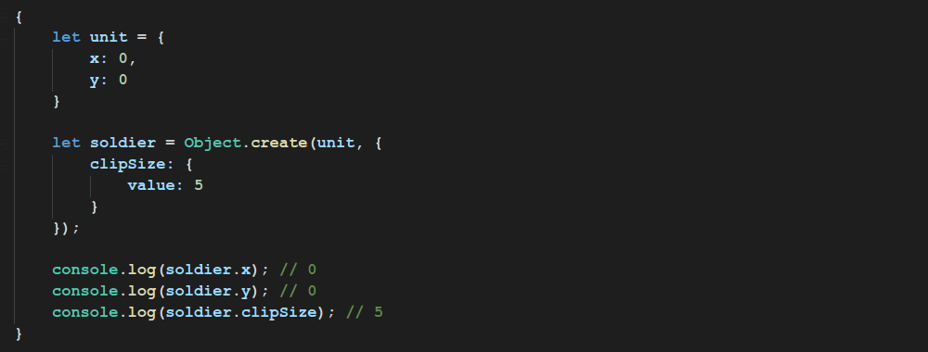
Object.create

Slide 10
Object.defineProperty
configurable | true if and only if the type of this property descriptor may be changed and if the property may be deleted from the corresponding object.
enumerable | true if and only if this property shows up during enumeration of the properties on the corresponding object.
value | The value associated with the property. Can be any valid JavaScript value
writable | true if and only if the value associated with the property may be changed with an assignment operator.
get | A function which serves as a getter for the property, or undefined if there is no getter. The function return will be used as the value of the property.
set | A function which serves as a setter for the property, or undefined if there is no setter. The function will receive as only argument the new value being assigned to the property.

Slide 11
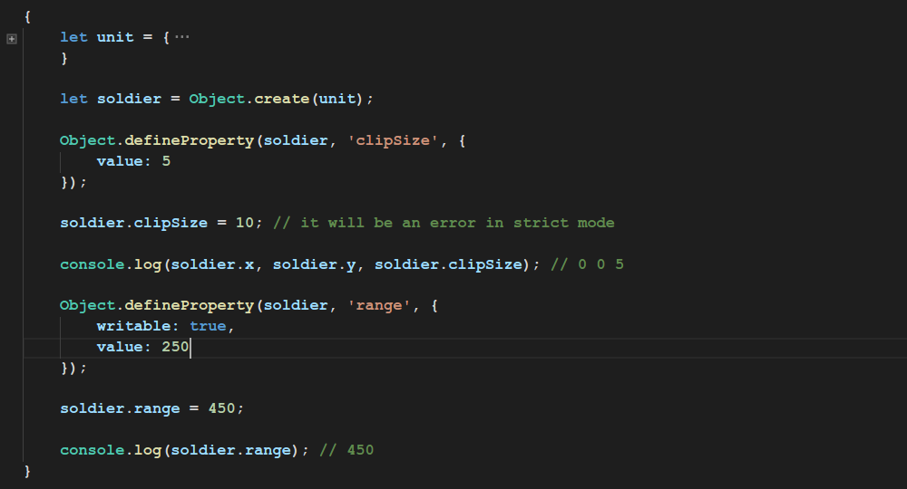
Object.defineProperty

Slide 12
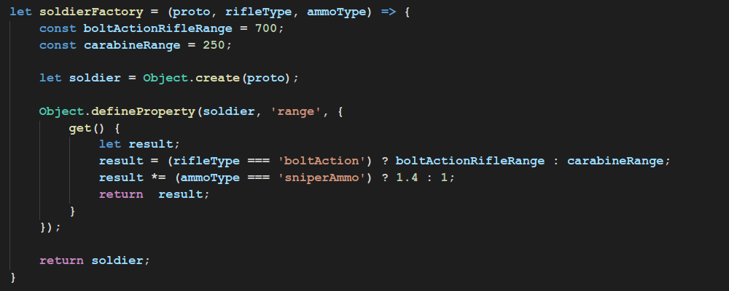
Object.defineProperty

Slide 13
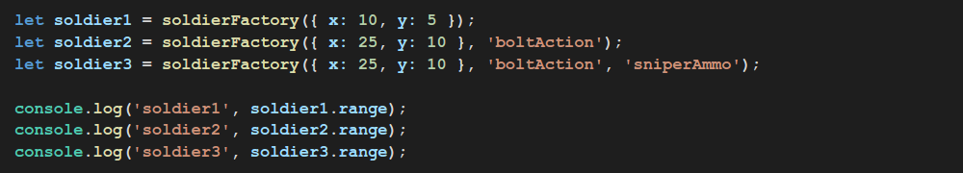
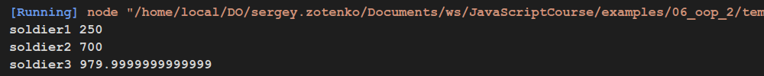
Object.defineProperty

Slide 14
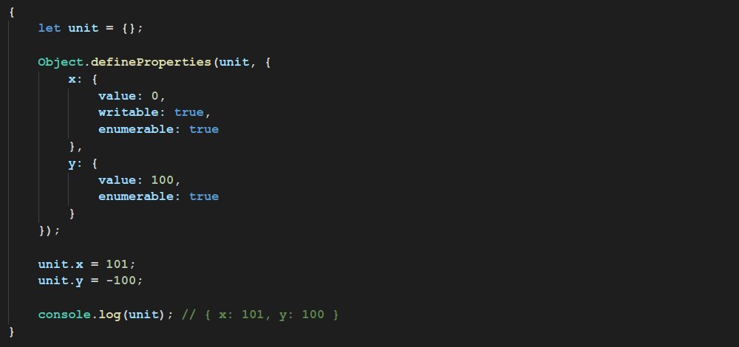
Object.defineProperties

Slide 15
Prototype
prototype is a property belonging only to functions. It is used to build __proto__ when the function happens to be used as a constructor with the new keyword.

Slide 16
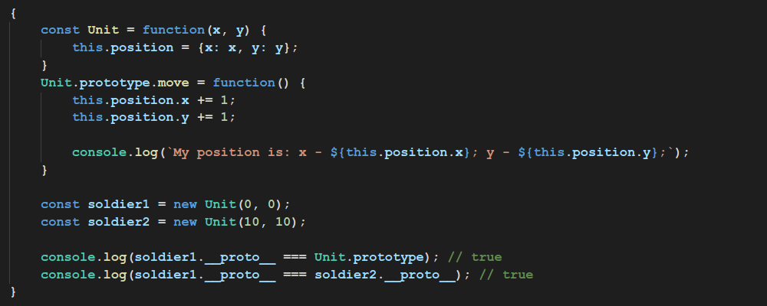
Prototype

Slide 17
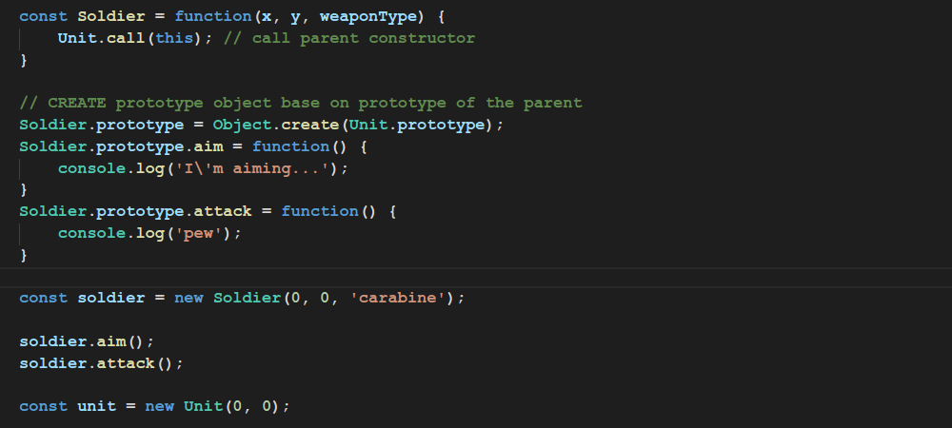
Prototype Inheritance

Slide 18
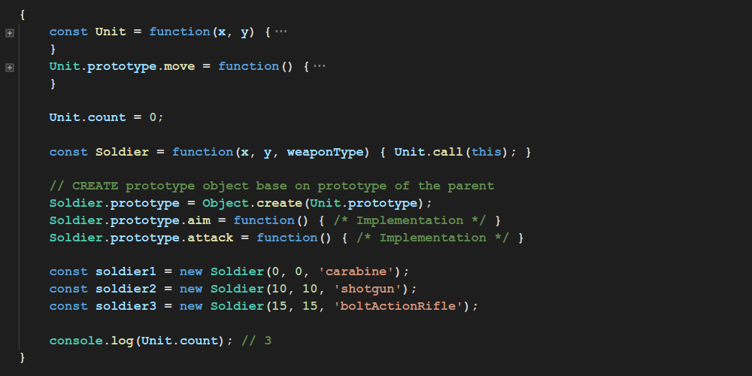
Static members

Slide 19
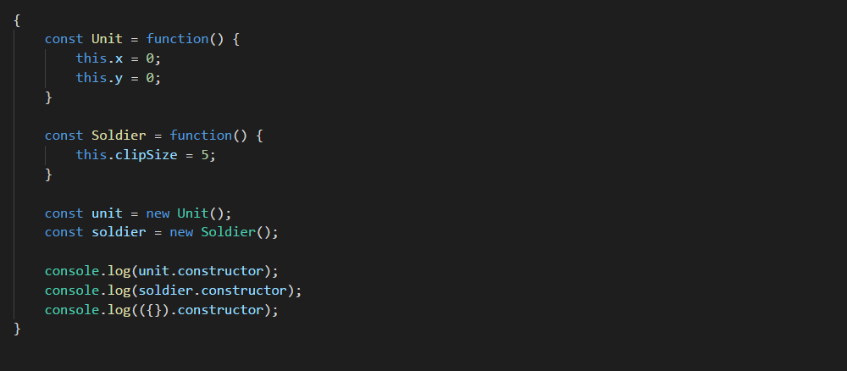

constructor

Slide 20
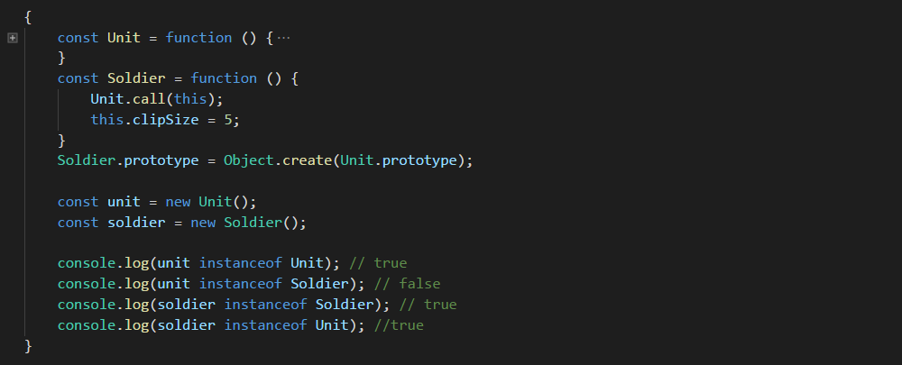
instanceof

Slide 21
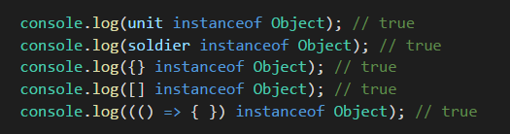
instanceof

Slide 22
OOP in ES6 style
New keywords:
class
constructor
extends
static
super

Slide 23
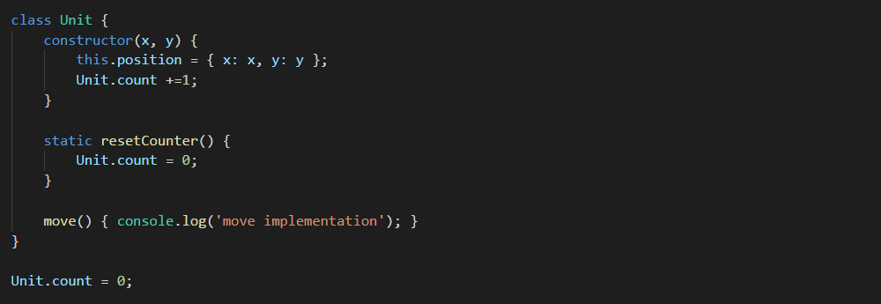
OOP in ES6 style
Base class Unit in ES6 style

Slide 24
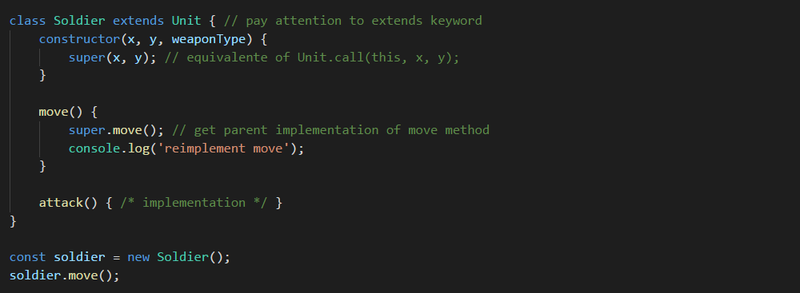
OOP in ES6 style
Child class Soldier in ES6 style

Slide 25
Thanks for attention

