Slide 1

JavaScript
Lecture. Forms.

Slide 2

Lesson Plan
Page forms
Focus event nuances
Page and element scroll
AXIOS
Drag And Drop

Slide 3
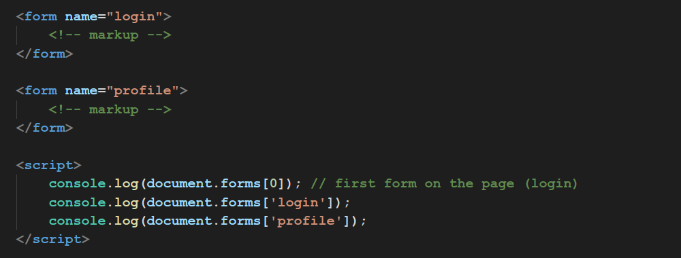
document.forms
Array-like property forms contains all forms from the page

Slide 4
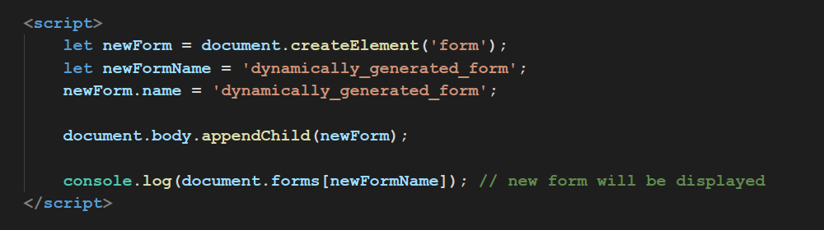
document.forms
Dynamically generated forms will be also in object forms.

Slide 5
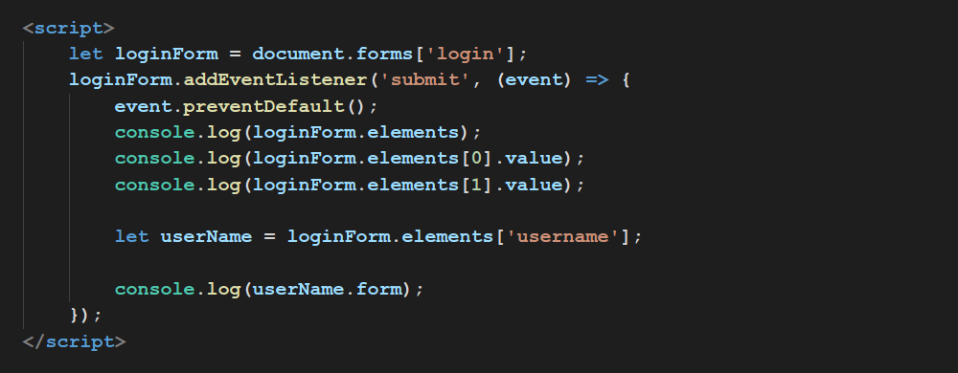
form.elements
Each form has array-like property elements which contains all form-elements and vice versa.

Slide 6
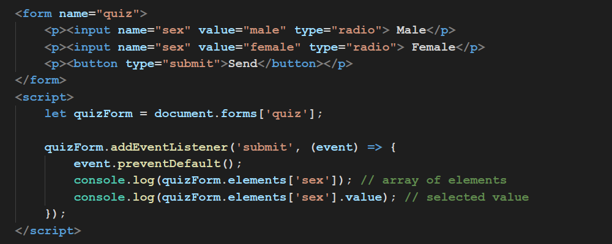
form.elements
If form contains elements with same name, will be returned array of elements with that name.

Slide 7
form.elements
form
elements[0]
elements[1]
elements[2]

Slide 8
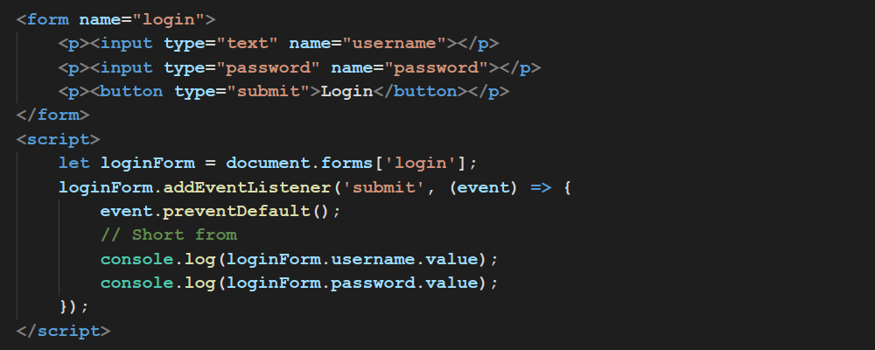
form.elements
There exists short way to access form elements.

Slide 9
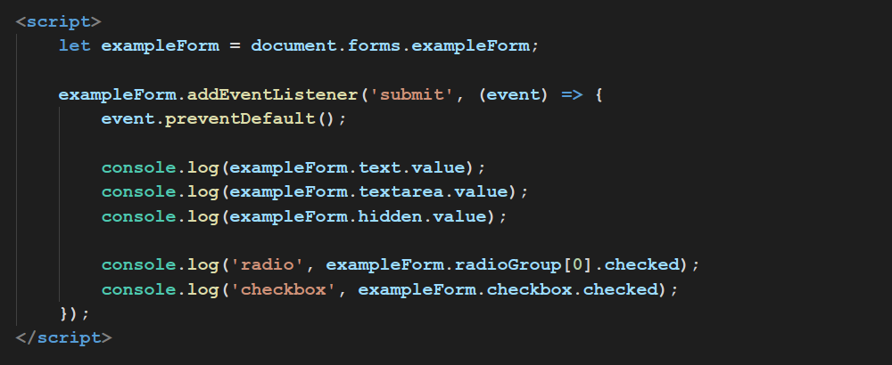
Input and Textarea
Checkbox and radiobutton returns their state via property checked.

Slide 10
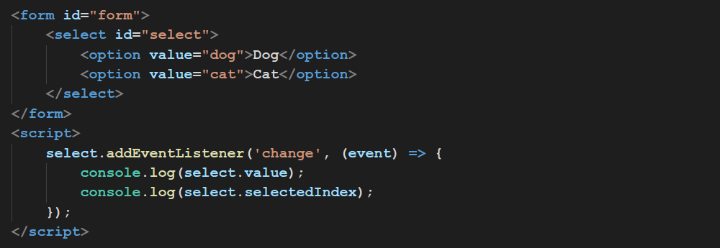
Select and Option
Get selected value

Slide 11
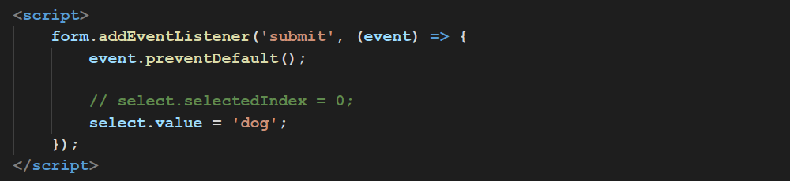
Select and Option
You can set value for select via value or index.
Negative index will cleanup selection.

Slide 12
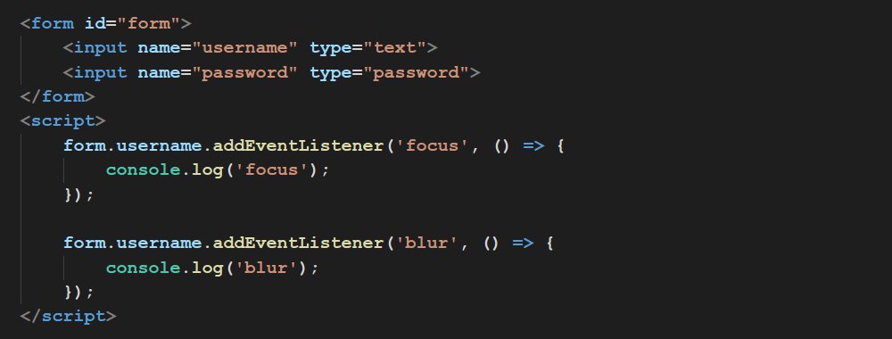
Focus Events
Fires when form-element get or lost focus

Slide 13
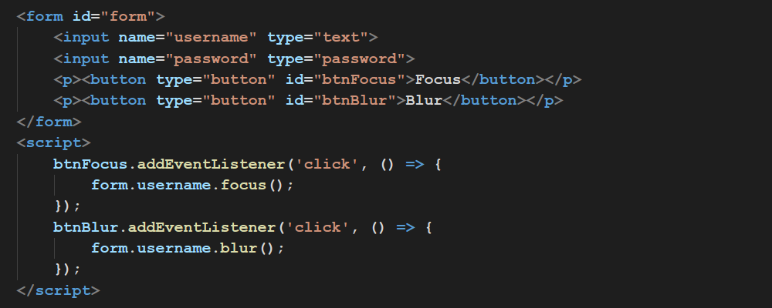
Focus Events
.focus(); .blur(); methods

Slide 14
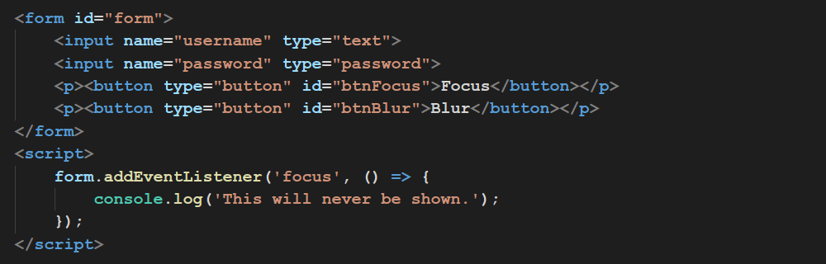
Focus Events
Events focus and blur doesn’t propagate.

Slide 15
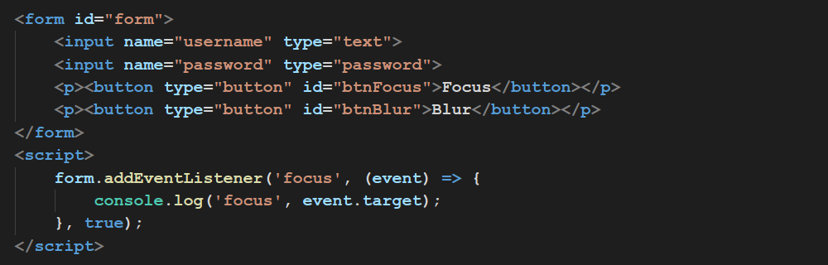
Focus Events
Event capturing in help.

Slide 16
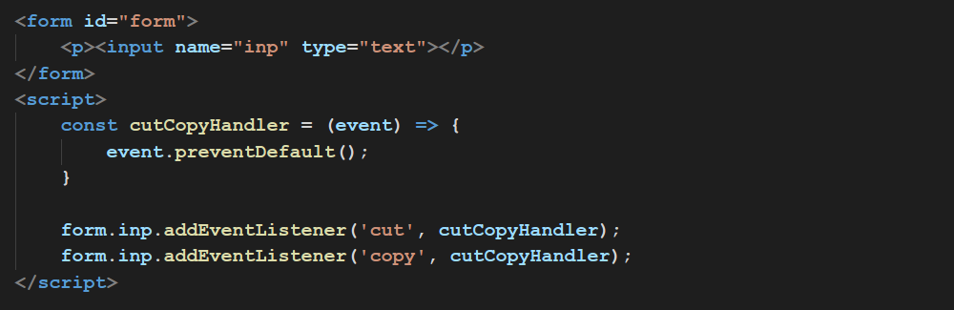
Cut/Copy Events
Prevent cut or copy for input

Slide 17
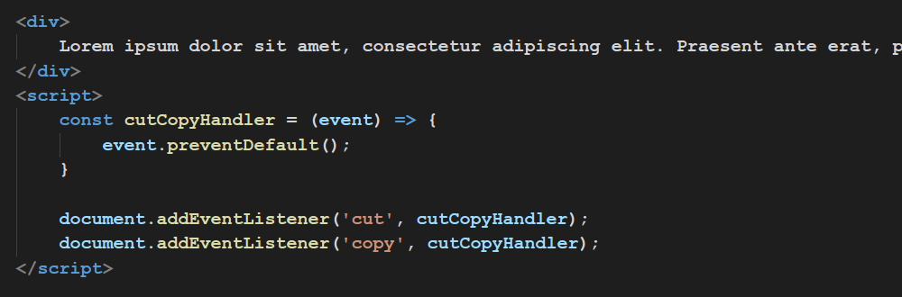
Cut/Copy Events
Prevent cut or copy for whole page.

Slide 18
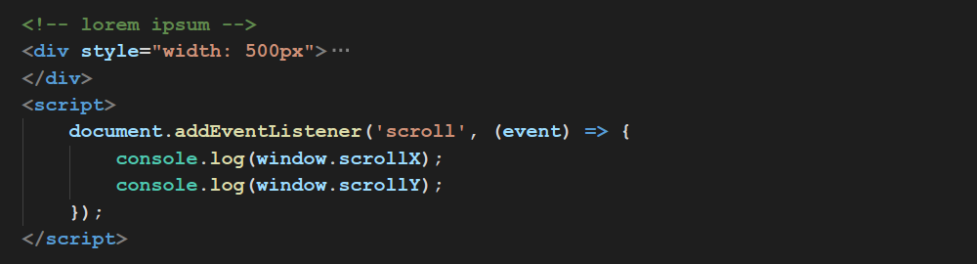
Scroll
window.scrollX and window.scrollY are read only properties, which contains current scroll position.

Slide 19
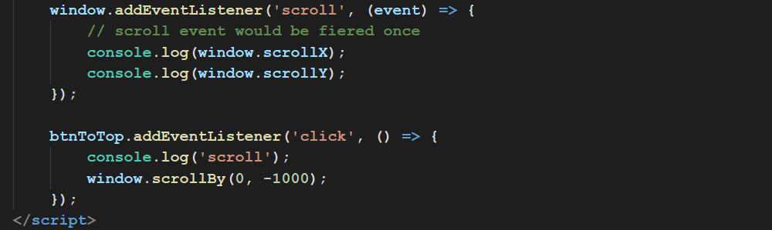
Scroll
scrollBy scrolls the document in the window by the given amount. window.scrollBy(X, Y); Where x is the offset in pixels to scroll horizontally and y is the offset in pixels to scroll vertically.

Slide 20
Scroll
scrollTo scrolls to a particular set of coordinates in the document, window.scrollTo(x-coord, y-coord); Where x-coord is the pixel along the horizontal axis of the document that you want displayed in the upper left and y-coord is the pixel along the vertical axis of the document that you want displayed in the upper left.

Slide 21
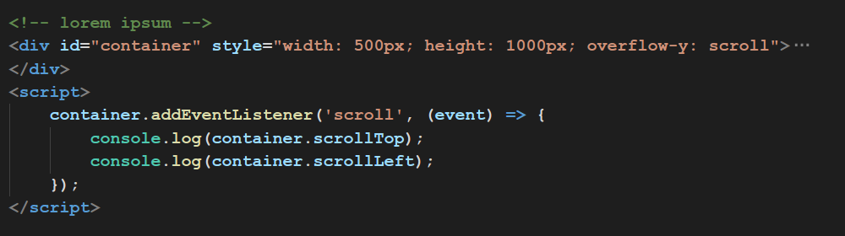
Scroll
element.scrollTop and element.scrollLeft are property which contains element scroll position and could be set.

Slide 22
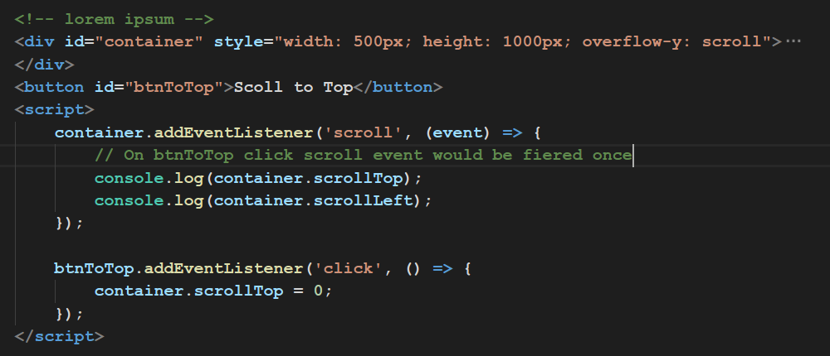
Scroll
We are able to scroll element via scrollTop and scrollLeft properties.

Slide 23
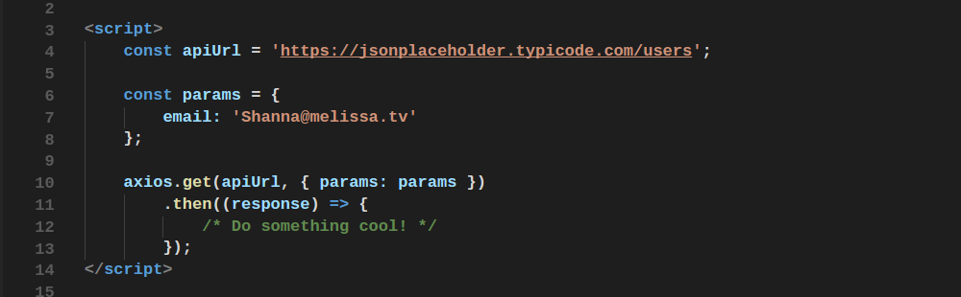
AXIOS
Promise based HTTP client for the browser and node.js

Slide 24
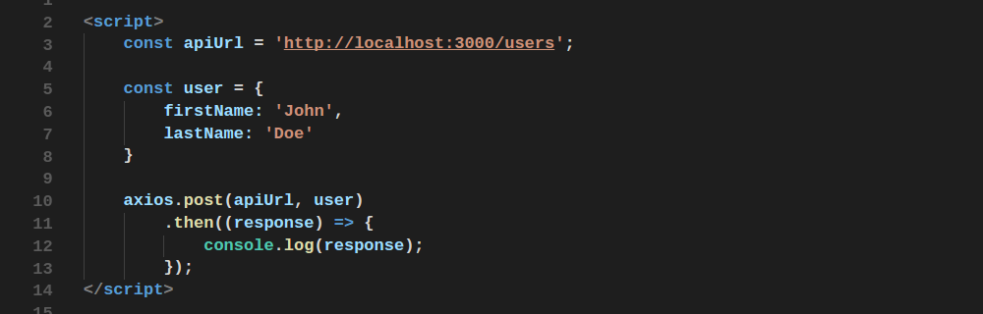
AXIOS
POST request

Slide 25
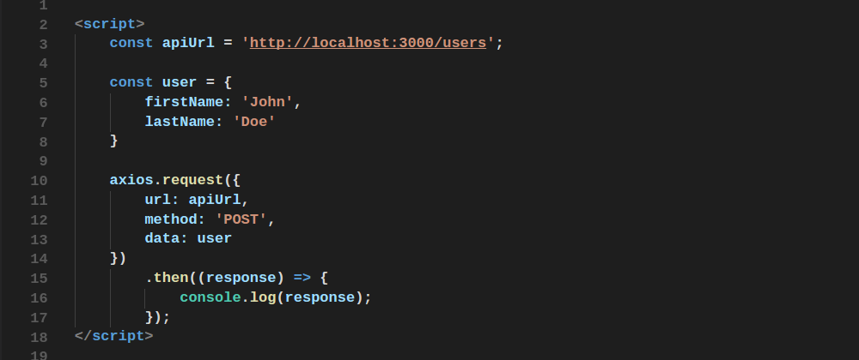
AXIOS
You are able setup a request via config object.

Slide 26
Drag’n’Drop
Let’s implement drag and drop

Slide 27
Thanks for attention

