Slide 1

JavaScript
Lecture. Design Patterns

Slide 2

Lesson Plan
Introduction to the patterns
Module
Singleton
Facade
Flyweight
Observer

Slide 3

JavaScript Good Parts

Slide 4

Design Patterns

Slide 5
Design Patterns
Problems | Solutions
On and Off Traffic for Highways | Cloverleaf Interchanges
Pedestrian Traffic | Sidewalks
Entry and Exit for Public Buildings | Revolving Doors

Slide 6

Design Patterns

Slide 7
What Constitutes Pattern
It solves a problem
It is a proven concept
The solution is not obvious

Slide 8
Type of Patterns
Creational | Structural | Behavioral
Constructor | Decorator | Command
Module | Facade | Mediator
Factory | Flyweight | Observer
Singleton | Adapter | Pub/Sub

Slide 9
Creational Design Patterns
Deal with object creation mechanisms, trying to create objects in a manner suitable to the situation.

Slide 10

Module
Simple way to encapsulate methods.
Create a “toolbox” of functions use.

Slide 11
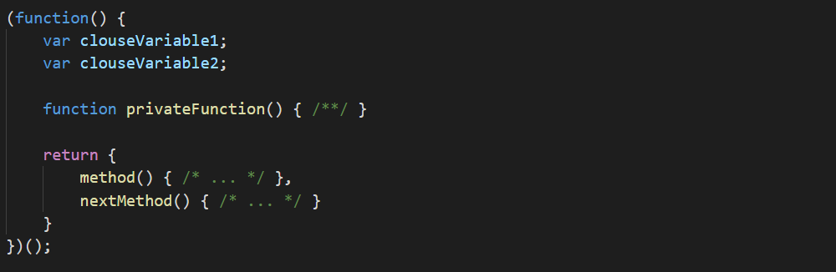
Module

Slide 12

Factory
Pattern used for simplify object creation

Slide 13
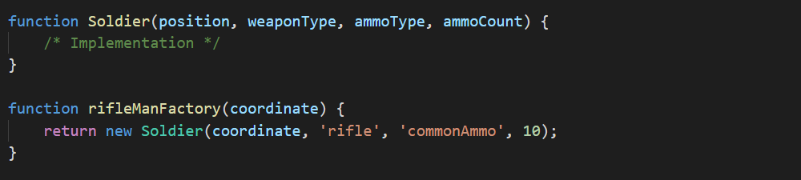
Factory

Slide 14
Singleton
Used to restrict an object to one instance of that object across the application

Slide 15
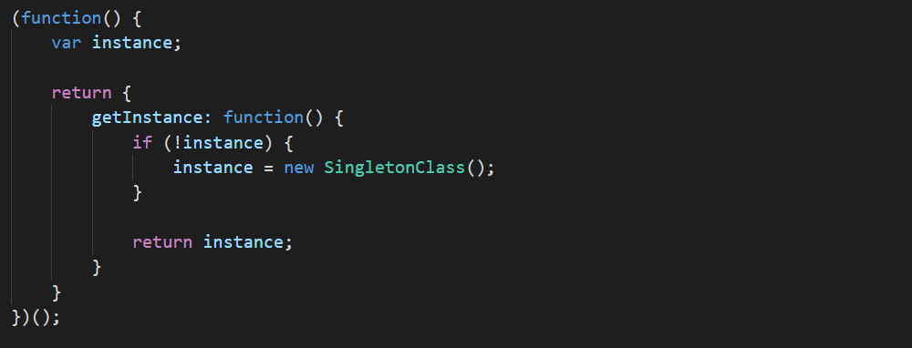
Singleton

Slide 16
Structural Design Patterns
Concerned with how objects are made up and simplify relationships between objects

Slide 17

Facade
Used to provide a simplified interface to a complicated system.

Slide 18
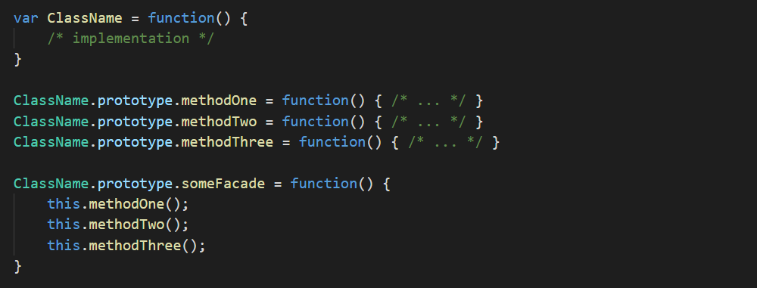
Facade

Slide 19
Flyweight
Conserves memory by sharing
portions of an object between objects.

Slide 20
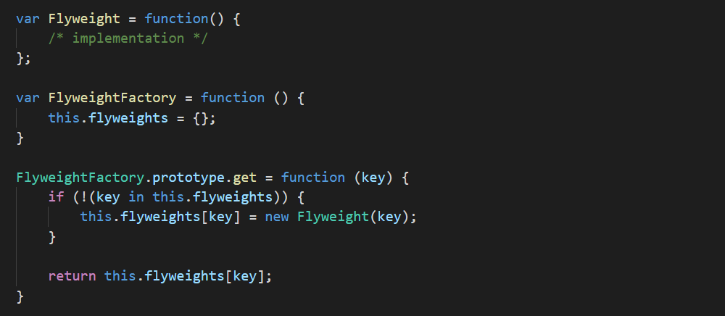
Flyweight

Slide 21
Behavioral Design Patterns
Identify common communication patterns between objects and realize these patterns

Slide 22
Observer
Allows a collection of objects to watch
an object and be notified of changes.

Slide 23
Observer
Logging
Task
Notification
handlerList []
dispatch()
Auditing

Slide 24
Thanks for attention

