Slide 1
Why version control is important ?

Slide 2
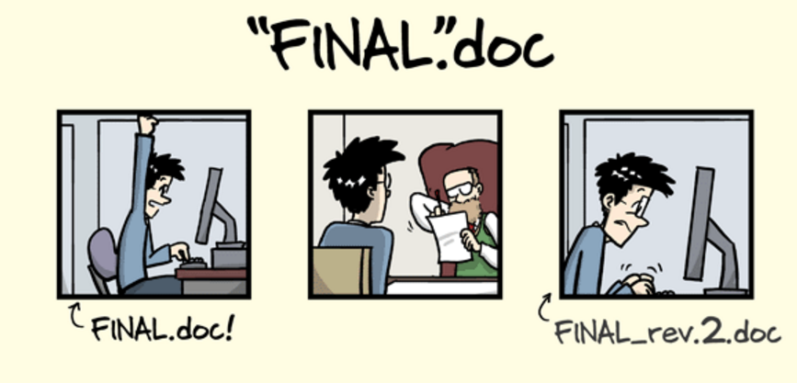
A typical scenario (curtesy of PHDCOMICS.com)

Slide 3
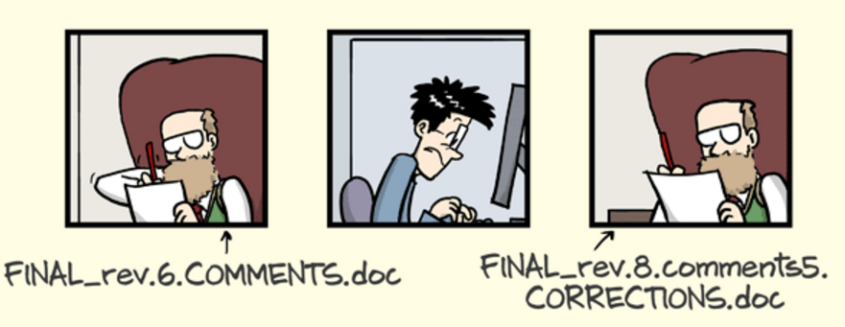
it goes…

Slide 4
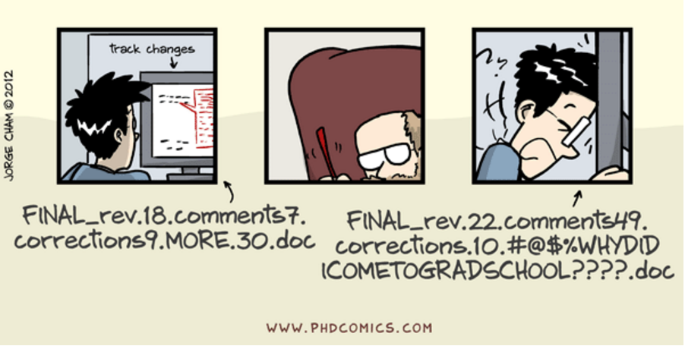
And it goes..

