Slide 1



Introduction

Slide 2
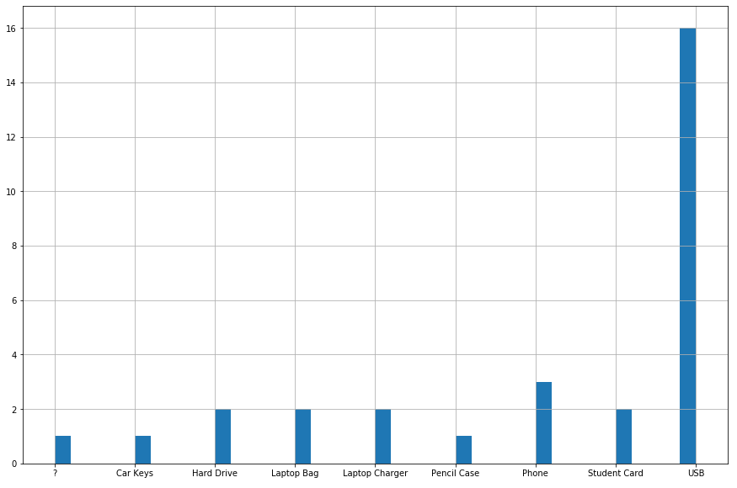
ICT 2017 Lost Items report

Slide 3
ICT 2017 Lost Items report
USB Flash Drive
Microcontroller
Flash Memory
Microcomputer e.g. Ardiuno or STM32 – F4
Microcontroller
Flash Memory
USB Controller
STM32 – F4

