Slide 1
Metadata exhibition struct fields exposure

Slide 2
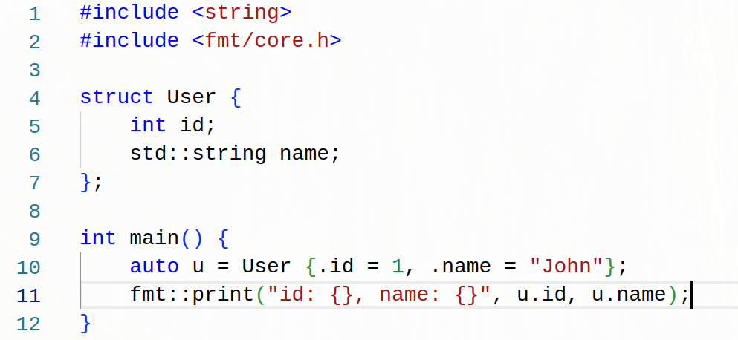
Struct

Slide 3
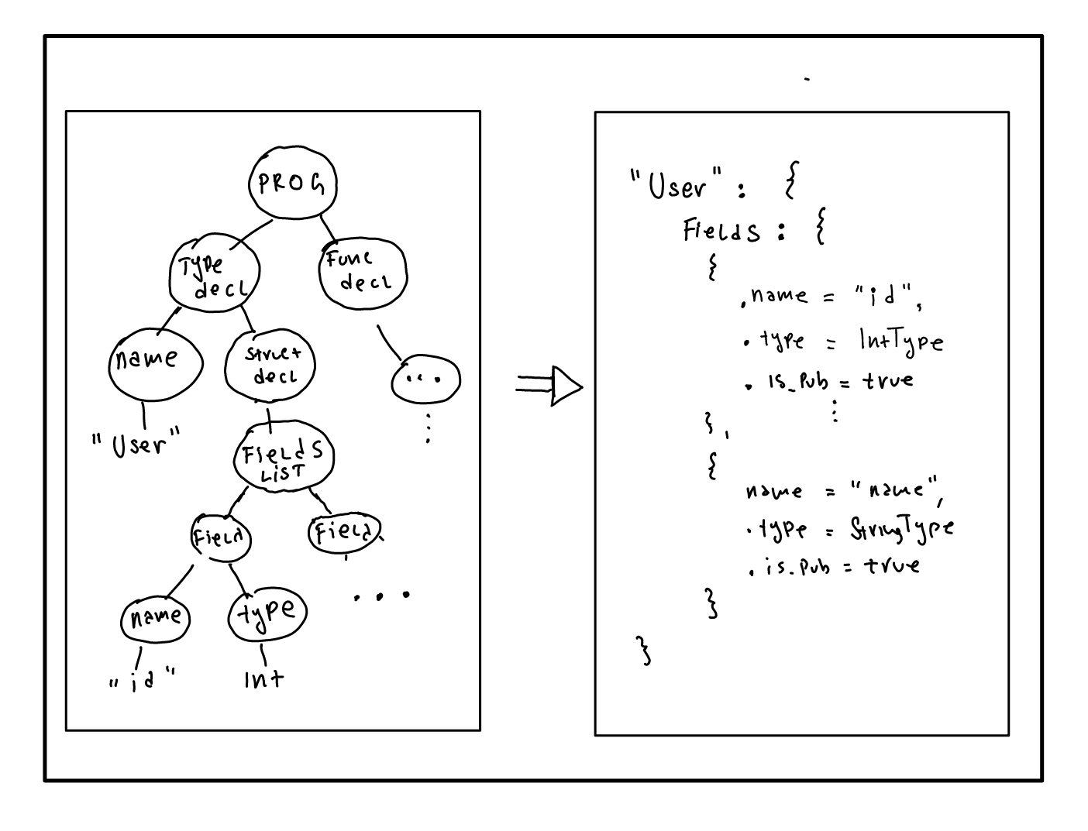
Struct
Compiler

Slide 4


Slide 5
Right?
Well ….
  Exposing compiler internals to the user can be very handy

Slide 6
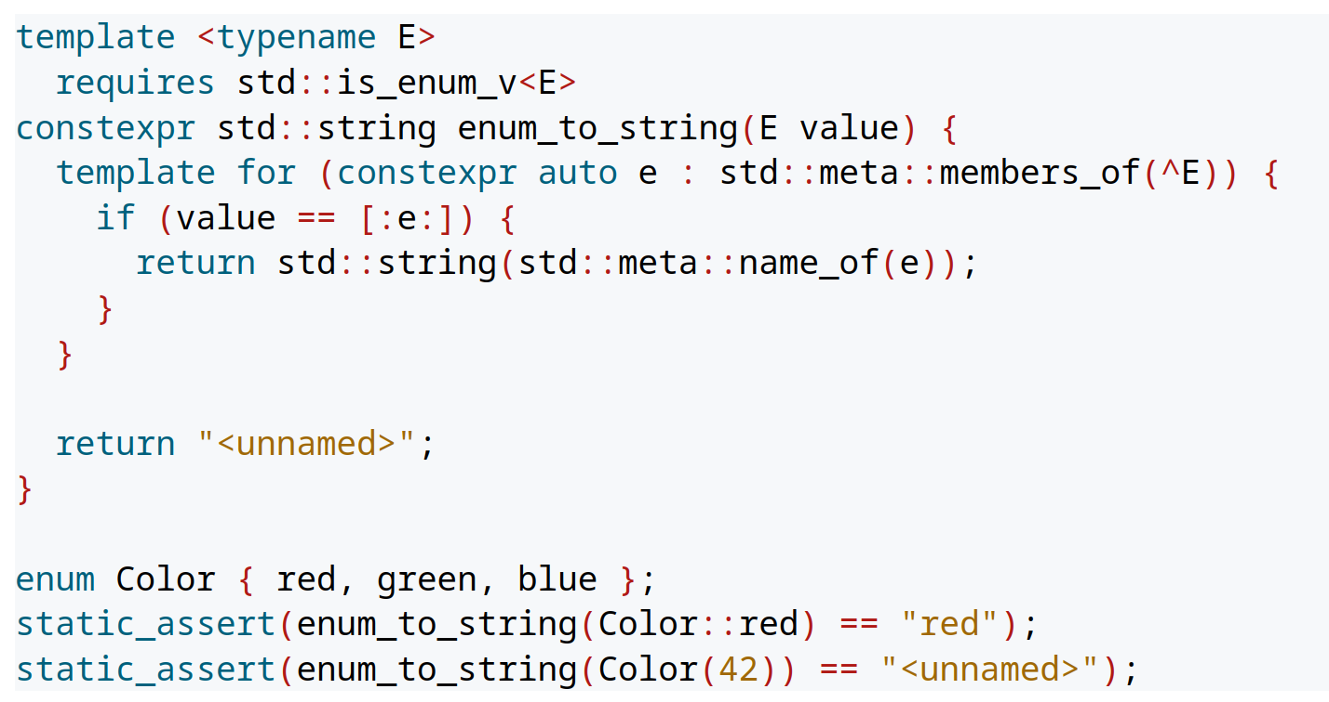
Example: Enum to string

Slide 7
Struct metadata

Slide 8
OK, but why??
Reduce boilerplate code (code generation)
Powerful plug-n-play libraries
  (de)Seriallization (JSON, YAML, protobuf, ...)
  Domain-specific apstractions (SQL, html, ...)
API design and documentation (ex. Web)
Type level programming (TMP, Zig, Haskell)

Slide 9
Fetch struct “metadata”
Approaches:
  Reflection: Go, Zig, cpp2, c++26?..
  Macros (AST interception): Rust, Lisp, Nim
  Custom reflection system (library): C++, ….

Slide 10
Reflection
Reflection is a mechanism composed of two techniques:
  Introspection - The ability for a program to examine itself
  Intercession - The ability for a program to modify itself (his behaviour or his state)
Talk by Dusan Jovanovic: (Serbian audience only)
Object serialization in C++
https://youtu.be/Feu49_CmbDs

Slide 11
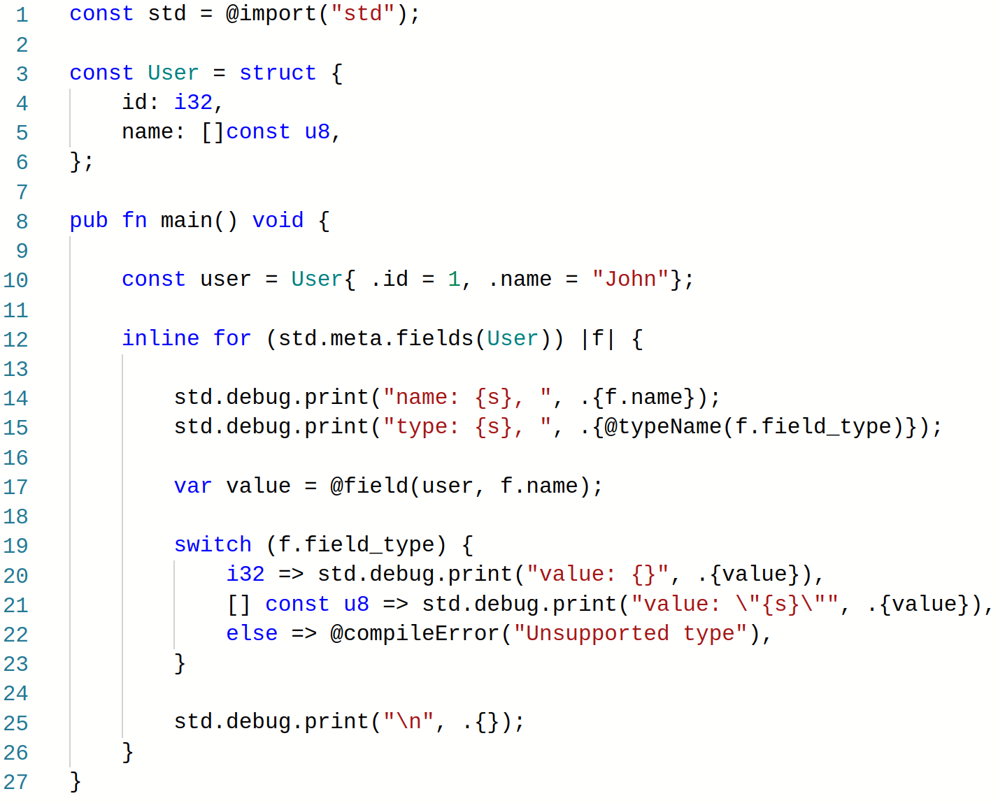
Reflection (Zig)
Output:
name: id, type: i32, value: 1
name: name, type: []const u8, value: "John"

Slide 12
Reflection (Zig)
Compiler

Slide 13
Demo time
Golang

Slide 14
Macros
What macros are?
Macros are reusable code snippets or transformations, allowing developers to write more concise, flexible, and maintainable code.
Expansion of a macro occurs during compilation or preprocessing to generate the corresponding code.

Slide 15
Rust macros
Declarative Macros (macro_rules!)
Procedural Macros
  Function-like proc macro
  Derive proc macro
  Attribute-like proc macro

Slide 16
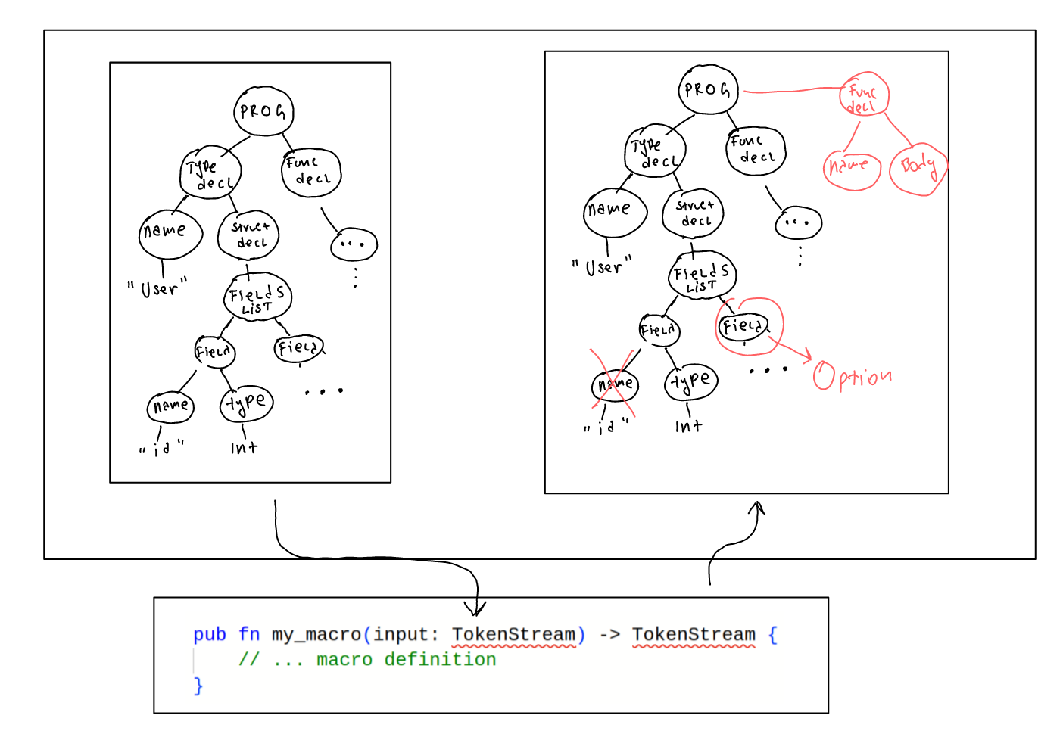
Rust (behind scene)

Slide 17
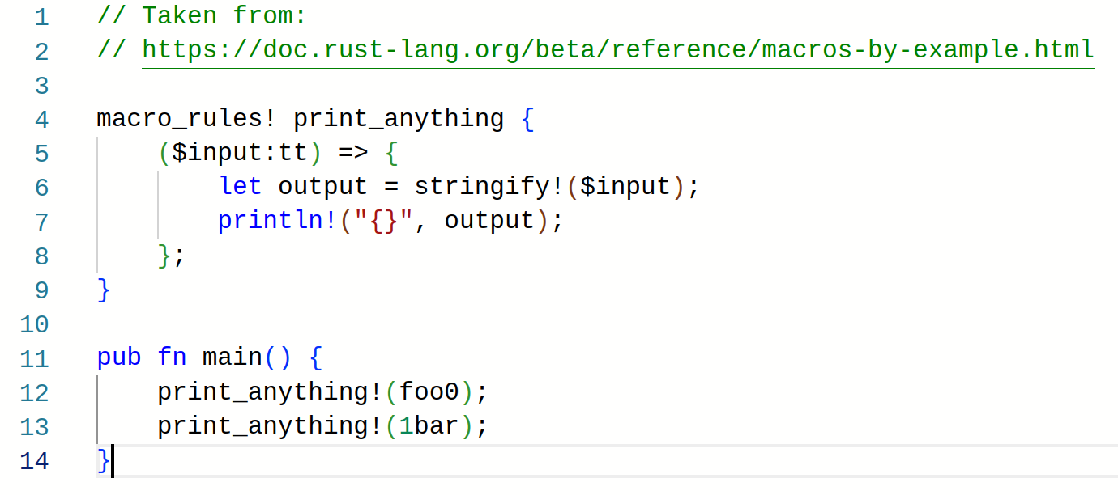
Rust: declarative macro

Slide 18
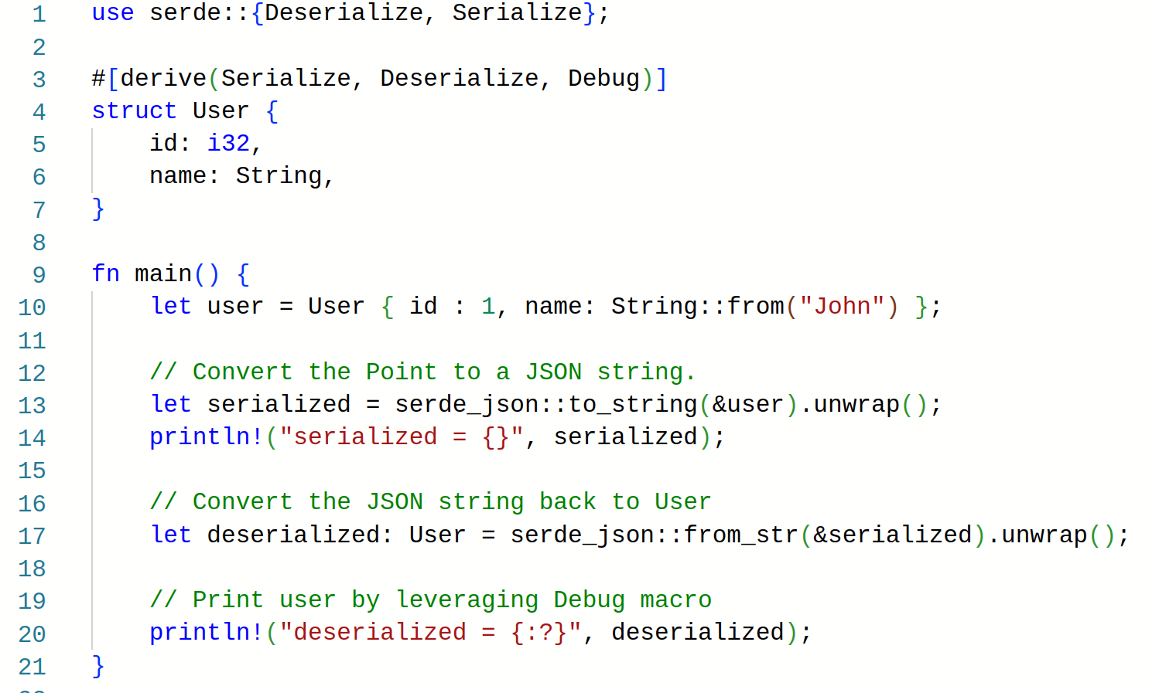
Rust: Procedural macros

Slide 19
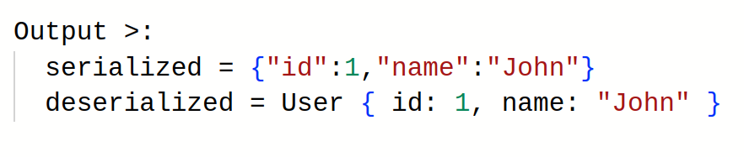
Rust: Procedural macros

Slide 20
CPP

Slide 21
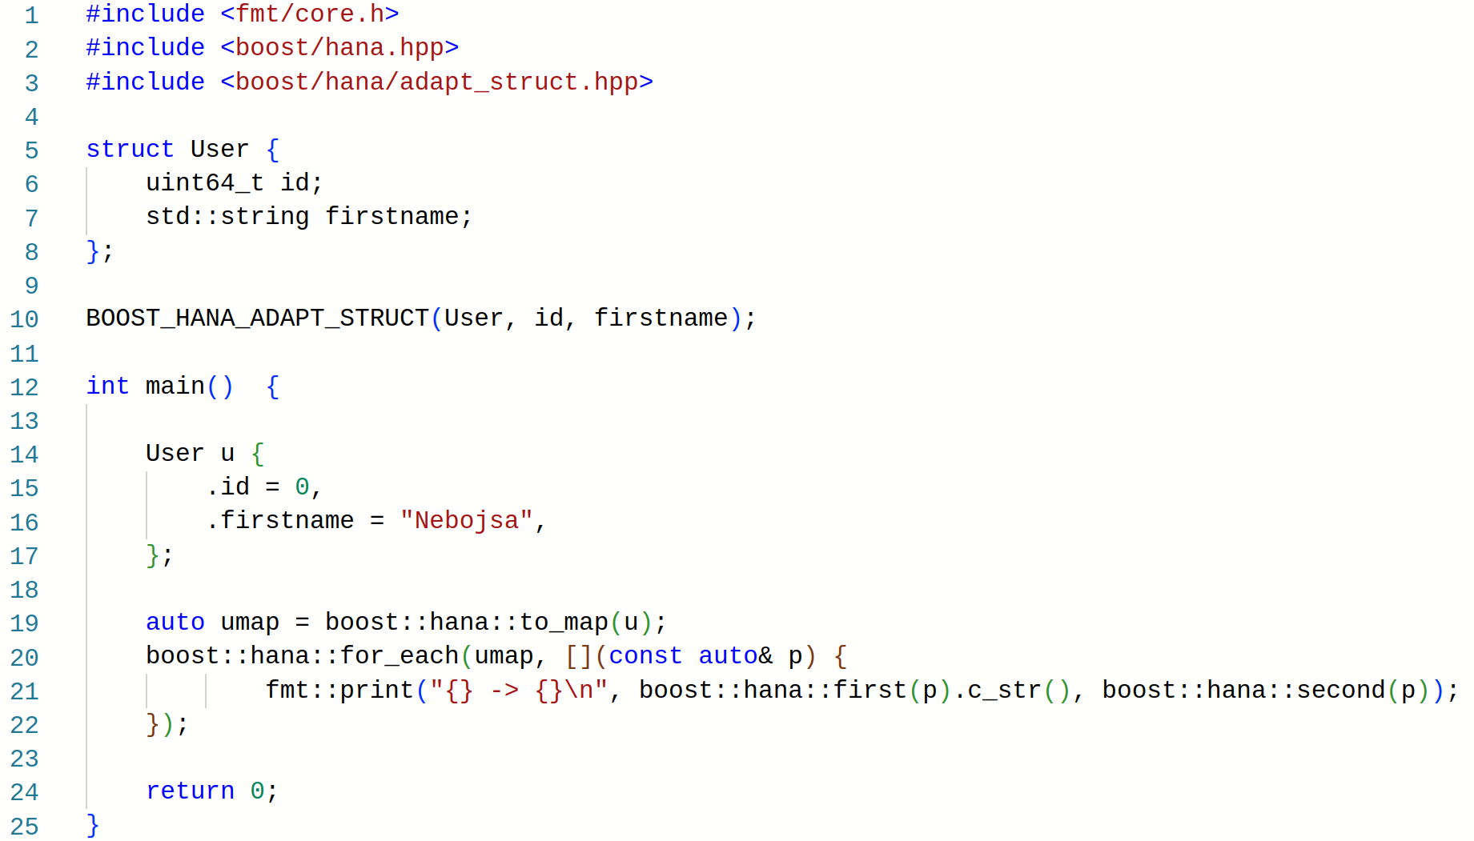
C++ (with boost::hana)

Slide 22
The End

