Slide 1
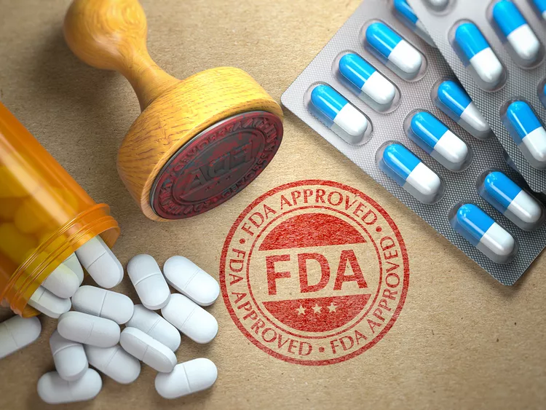
Drug Safety
Signal Detection
An end-to-end pharmacovigilance data pipeline on openFDA FAERS data
Nastaran Kouhdareh
August 2026
OpenFDA Drug Safety Signal Pipeline
1

Slide 2
THE PROBLEM
Three things stand between the data and an answer
Fragmented sources
— FAERS reports, deeply nested
— Labels, NDC products
— No shared drug identifier
Messy drug names
— One substance, many written forms
— Brand, generic and dose text mixed
— Distinct drug signatures
Review does not scale
— Many drug-reaction pairs
— No ranking and no visible support
— An analyst cannot read them by hand
OpenFDA Drug Safety Signal Pipeline
2

Slide 3
THE QUESTION
What I set out to answer
Which drug-reaction pairs are reported far more often than chance would explain — and can I rank them so an expert can triage the top of the list?
THE USER
A drug-safety analyst
— Needs candidates to investigate, not raw reports
— Ranked by strength, with the counts behind them shown
— Uses it to decide what deserves a human look
The answer has to be a ranked candidate list, never an automatic verdict.
OpenFDA Drug Safety Signal Pipeline
3

Slide 4
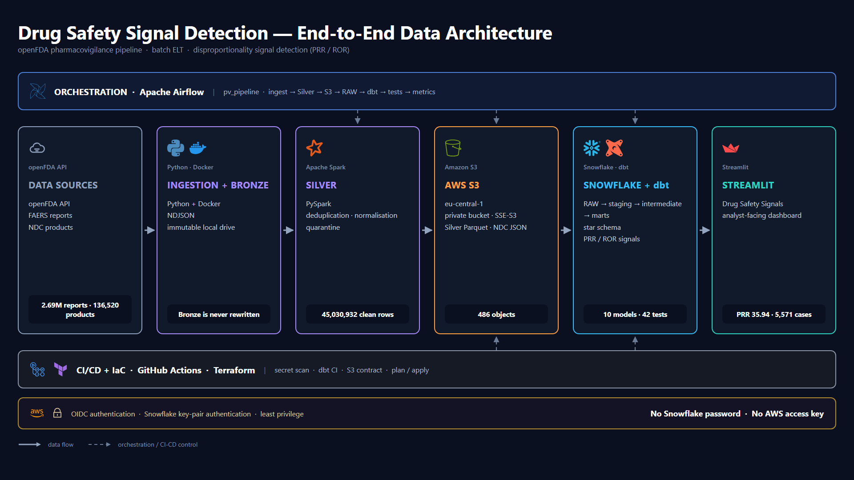
End-to-end architecture
solid = data flow · dashed = control
OpenFDA Drug Safety Signal Pipeline
4

Slide 5
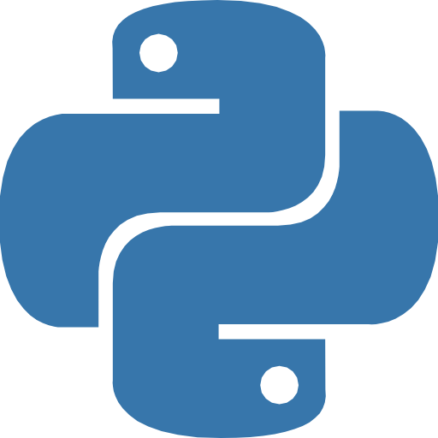
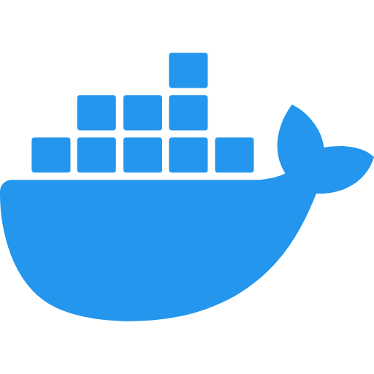
THE DATA
Three openFDA sources, one immutable Bronze layer
2,687,675
FAERS drug-event reports, 2023-2024
136,520
NDC directory products
261,258
Drug labels
64 GB
Bronze on local disk, immutable NDJSON
Python ingestion in Docker · Bronze is never rewritten
OpenFDA Drug Safety Signal Pipeline
5

Slide 6

SILVER · PYSPARK
Flatten to a defined grain, then clean
93,366,638
Flattened atomic rows
The grain
One row = one case, one resolved drug, one drug characterisation, one reaction.
45,030,932
Clean Silver rows
431,760
Quarantined, not deleted
Why deduplicate after flattening
A repeat only becomes visible at the atomic grain — one report lists the same drug on several dosage lines, and those must count once.
0
Null reactions remaining
The quarantined rows come mostly from 3 broken mega-reports.
Drug names resolved in Silver: 78.46%
OpenFDA Drug Safety Signal Pipeline
6

Slide 7


WAREHOUSE · SNOWFLAKE + DBT
Four layers, one definition of every metric
STAGING
Clean views over RAW
stg_drug_event
stg_drug_ndc
INTERMEDIATE
Exact drug resolution
int_drug_resolution
86.7% of rows resolved
MARTS
Star schema
dim_drug
dim_reaction
dim_reporter
dim_date
fct_report_drug_reaction
SIGNAL METRICS
PRR / ROR per pair
fct_signal_metrics (monthly)
sem_signal_metrics (all-time)
10 models · 42 tests passing · dbt build PASS=53, WARN=0, ERROR=0
OpenFDA Drug Safety Signal Pipeline
7

Slide 8
Live Demo dbt
OpenFDA Drug Safety Signal Pipeline
8

Slide 9
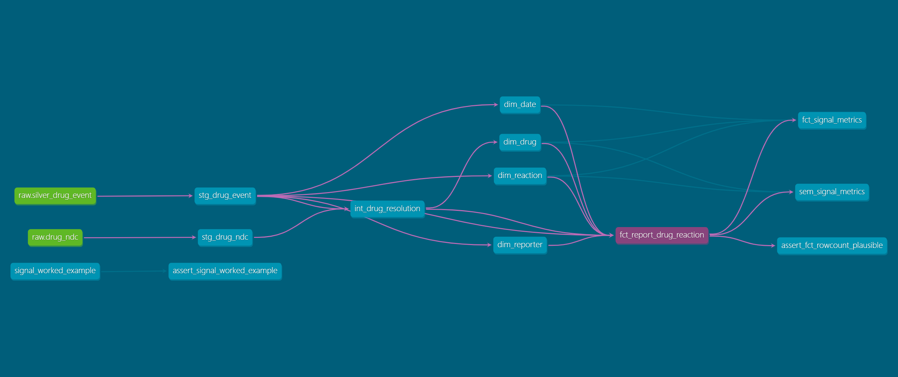

Slide 10

ORCHESTRATION · AIRFLOW 2.10.5
One trigger runs the whole chain
ingest_
ndc
ingest_
faers
build_
silver
upload_
s3
load_
raw
dbt_
build
dbt_
test
publish_
metrics
Full 24-month run, 15 August 2026 — success in 3 h 57 m 23 s, 8/8 green in dependency order
TASK
DURATION
RESULT
build_silver
3 h 47 m 27 s
24 months of Silver rebuilt
upload_s3
5 m 28 s
486 objects mirrored
load_raw
2 m 43 s
45,030,932 rows into RAW
dbt_build
1 m 08 s
PASS=53, WARN=0, ERROR=0
dbt_test
9.7 s
PASS=42
publish_metrics
15.7 s
headline numbers logged
3 Docker stacks, 8 containers. Airflow triggers Spark and dbt in their own containers — it never processes the 45M rows itself.
OpenFDA Drug Safety Signal Pipeline
9

Slide 11
THE METRIC
Disproportionality from four counts
This reaction
Other reactions
PRR
( a / (a+b) ) ÷ ( c / (c+d) )
35.94
a
5,571 cases
b
This drug
ROR
( a × d ) ÷ ( b × c )
46.76
c
d
ROR-CI lower
pessimistic edge of the ROR interval
45.21
All other drugs
Counted over every report in the warehouse, for one drug and one reaction.
chi-square
Yates-corrected, from the same four counts
142,896
Computed once in the dbt macros. The dashboard reads them and computes nothing, so one definition runs from warehouse to screen.
OpenFDA Drug Safety Signal Pipeline
10

Slide 12
Live Demo Streamlit
OpenFDA Drug Safety Signal Pipeline
11

Slide 13

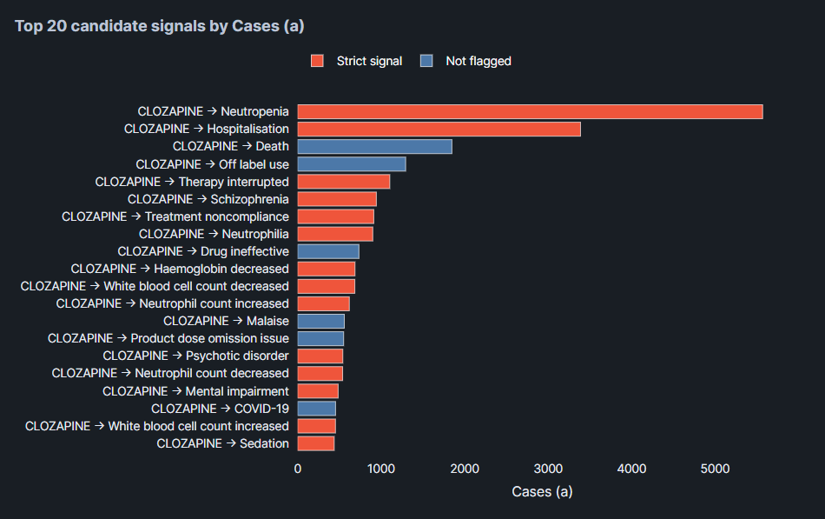
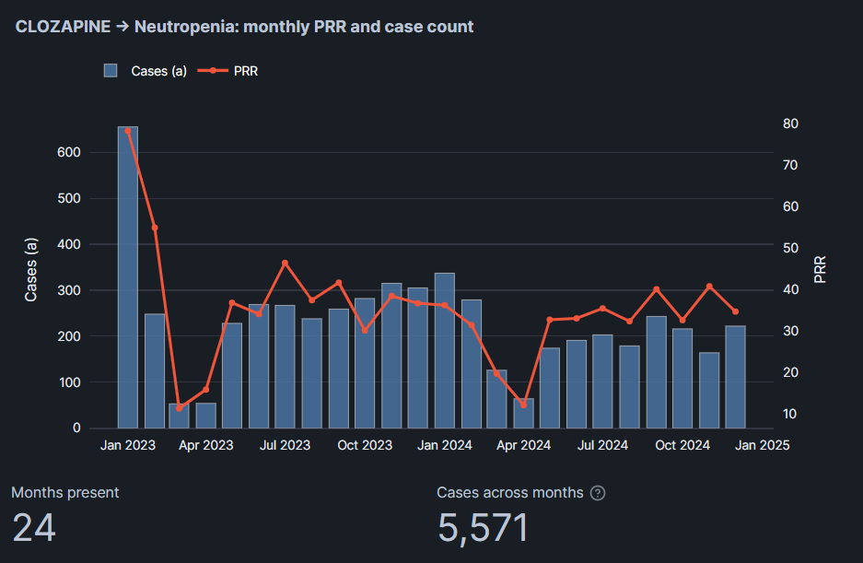
SERVING · STREAMLIT
Hosted in Snowflake — the demo is a URL
Runs as DE_CAPSTONE_DBT_ROLE and computes nothing — every metric comes from the dbt macros.
Ranked candidates for one drug. Red bars are strict signals, blue bars are not flagged — the colour is a label, not a score.
Present in all 24 months. December 2024 alone gives PRR 34.78 on 222 cases, so the signal is not one reporting spike.
OpenFDA Drug Safety Signal Pipeline
11

Slide 14
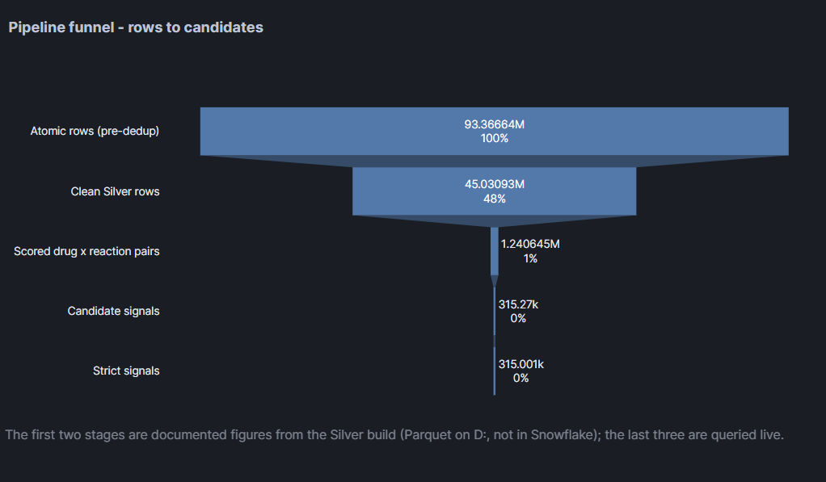
OpenFDA Drug Safety Signal Pipeline

Slide 15
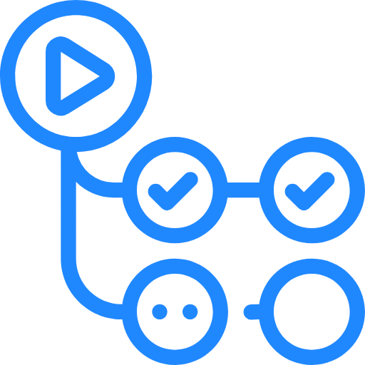

CI/CD · GITHUB ACTIONS
Four workflows, eight checks
ci.yml
• ruff and dbt parse
• python syntax 3.11 + 3.12
• secret scan
• pytest, 21 tests
dbt-ci.yml
• dbt build into DBT_CI
• PASS=53 in 1 m 17 s
• clean machine, same result
s3-contract.yml
• 486 objects
• 3,913,635,942 bytes
• read-only, cannot alter it
terraform.yml
• plan on every pull request
• manual apply
• imported, never recreated
Secret scan went red in 7 seconds
A planted SNOWFLAKE_PASSWORD failed the build, printing only the file and the line — never the value.
S3 contract went red on 2,698 bytes
The object count matched exactly, which is why the check asserts both numbers and not just the count.
A green tick shows the workflow ran. Each gate was made to refuse something on purpose, which is what shows it works.
OpenFDA Drug Safety Signal Pipeline
12

Slide 16

COST
What it actually cost to build and run
$0.25
Money actually paid
AWS S3, eu-central-1
$42
Snowflake credit consumed
of a $400 free trial
$0
dbt, Airflow, Spark, Docker
Terraform and GitHub Actions
WHERE THE MONEY WOULD GO AT 10×
— Only about 8 GB is in the cloud — the 64 GB of Bronze never left the laptop.
— At 10× the data, S3 would still cost under $1 per month.
— The ceiling is laptop disk and Spark runtime, not money.
OpenFDA Drug Safety Signal Pipeline
13

Slide 17


CLOSING
What this project delivers
BUILT
— An 8-task Airflow DAG, run end to end
— PySpark Silver at a defined grain, 45,030,932 rows
— A dbt star schema, 10 models
VERIFIED
— 42 dbt tests and 21 Python tests passing
— 4 workflows, 8 checks
— Every gate proven by making it fail
DELIVERED
— 1,240,645 drug-reaction pairs scored
— 315,270 candidate signals ranked
— A hosted dashboard built for triage
Thank you
LinkedIn
GitHub
OpenFDA Drug Safety Signal Pipeline
14

