Slide 1
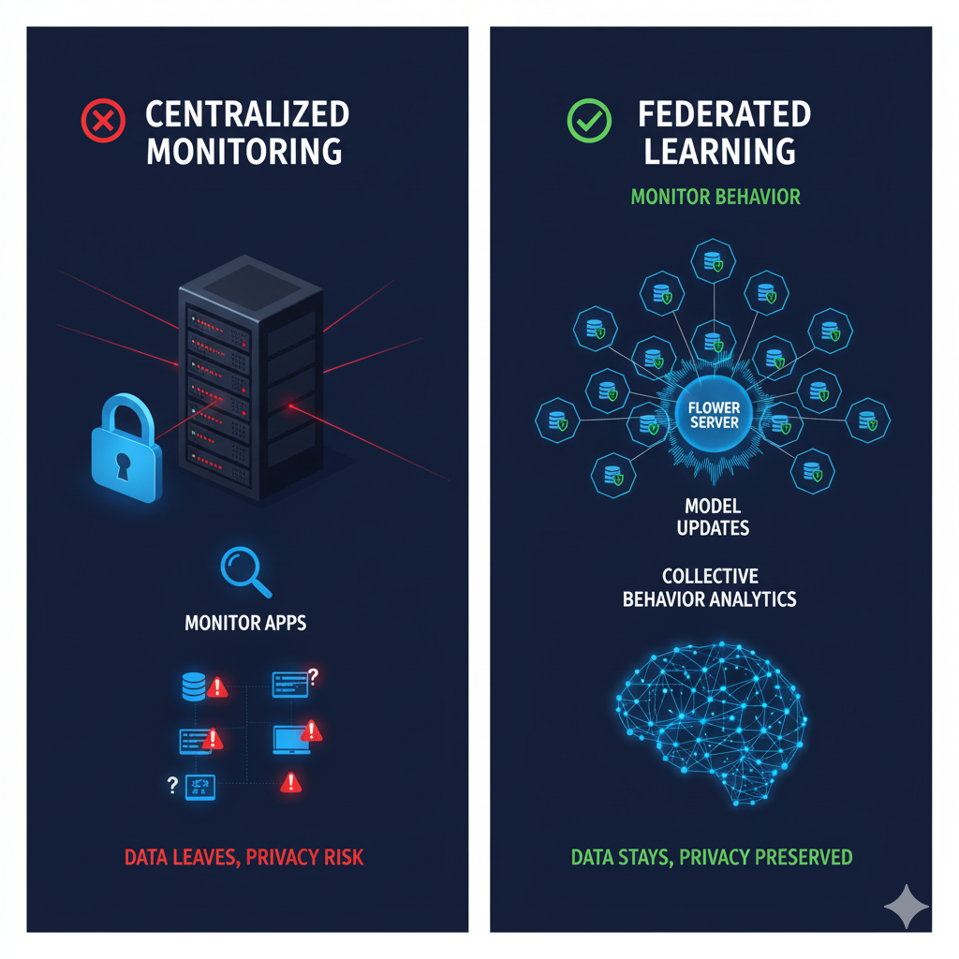
Stop Monitoring Apps; Start Monitoring Behavior
The Problem:
A subtle memory leak ➔ slow DB queries ➔ HTTP 500 errors.
i.e. 'unknown unknowns’!
The Data:
A mix of all raw server logs (syslog, auth, Nginx, DB)
  Creates a high-dimensional 'data-fingerprint' of a healthy server.
  No need for log parsing (=loss of information)
  Model: A transformer-based model learns the "language" of a healthy server
Federated vs Centralized (Why?):
  Saves huge amounts of bandwidth (weights vs. logs).
  The global model learns from a massive, diverse baseline of "normal" behavior.
  Privacy: No raw, sensitive logs are ever shared.
Stack: Flower, PyTorch, Exalsius.
Data: 3 public datasets (~1GB each).
  Datasets are mixed, and distributed between clients using flower simulation
Federated Log Anomaly Detection for "Unknown Unknowns"
Team “LateBloomers”
Notes:
Stop monitoring apps; start monitoring behavior. Using Flower to train a federated autoencoder on server logs. Learns 'normal rhythm' of healthy servers. High reconstruction error signals anomalies. Federated learning provides massive baseline for sensitivity.

