Slide 1
COE 1530 Presentation
Pic Chat

Slide 2
Who are We?
Team 9
Blaise Clair (blaiseclair)- Product Owner
Andrew Harper (graphitezeppelin) – Software Developer
Neel Kowdley (nkowdley) - Software Developer
Dom Grigore (domgrigore) - Quality Assurance Manager

Slide 3
What is our Project?
Creating a map-centric social media platform.
The content will then be place on a map, so that other users can view activities and posts at a specific location.
Look at our beautiful code:
https://github.com/nkowdley/CS1530-Team9

Slide 4
Process
Before we assigned tasks for each sprint, we met with the client to show them our progress and repriortize the backlog.
We then met as a group and selected backlog items for the current sprint, and then divided them up.
Each Sprint, we assigned tasks and ensured that we could work on them fairly independently.

Slide 5
Process
After we completed our tasks, we met up and did in person code reviews.
We also ran our tests again to ensure nothing major broke between sprints.

Slide 6
How did we do?
11 defects
  Scope Based
  Security Based
11 user stories
  Out of 23 user stories
  Cut for quality reasons
  Prioritized and completed the larger user stories
Client Satisfaction

Slide 7
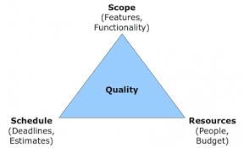
Major Challenges
1)Technical Debt
  a)PHP
  b)JS
  c)Maps API
  d)MySQL
Scope was too large to be completed in the right amount of time. In most cases we cut down on scope to increase quality.
Local Host/API keys
Testing
  File I/O
  PHPUnit Tests
  Testing an API

