Slide 1
AWS Overview Quiz

Slide 2
Which of the following describes a physical location around the world where AWS clusters data centers?
A. Endpoint B. Collection C. Fleet D. Region

Slide 3
Which of the following describes a physical location around the world where AWS clusters data centers?
A. Endpoint B. Collection C. Fleet D. Region

Slide 4
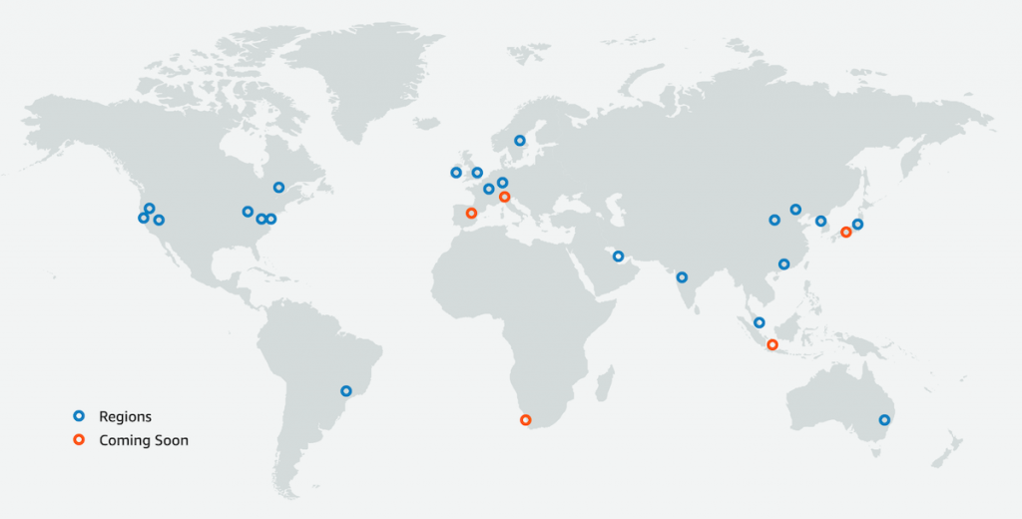
D. Region

Slide 5
Each AWS region is composed of two or more locations that offer organizations the ability to operate production systems that are more highly available, fault tolerant, and scalable than would be possible using a single data center. What are these locations called?
A. Availability Zones B. Replication areas C. Geographic districts D. Compute centers

Slide 6
Each AWS region is composed of two or more locations that offer organizations the ability to operate production systems that are more highly available, fault tolerant, and scalable than would be possible using a single data center. What are these locations called?
A. Availability Zones B. Replication areas C. Geographic districts D. Compute centers

Slide 7
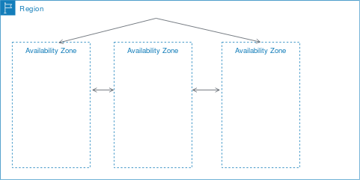
A. Availability Zones

Slide 8
What is the deployment term for an environment that extends an existing on-premises infrastructure into the cloud to connect cloud resources to internal systems?
A. All-in deployment B. Hybrid deployment C. On-premises deployment D. Scatter deployment

Slide 9
What is the deployment term for an environment that extends an existing on-premises infrastructure into the cloud to connect cloud resources to internal systems?
A. All-in deployment B. Hybrid deployment C. On-premises deployment D. Scatter deployment

Slide 10
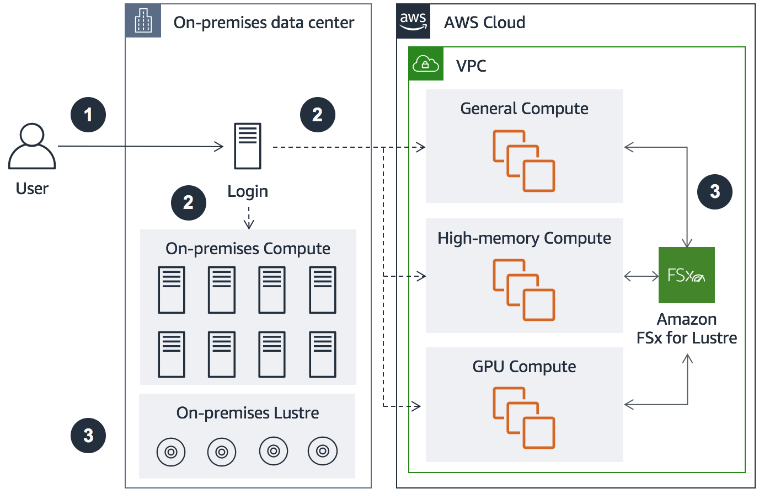
B. Hybrid deployment

Slide 11
Which AWS Cloud service allows organizations to gain system-wide visibility into resource utilization, application performance, and operational health?
A. AWS Identity and Access Management (IAM) B. Amazon Simple Notification Service (Amazon SNS) C. Amazon CloudWatch D. AWS CloudFormation

Slide 12
Which AWS Cloud service allows organizations to gain system-wide visibility into resource utilization, application performance, and operational health?
A. AWS Identity and Access Management (IAM) B. Amazon Simple Notification Service (Amazon SNS) C. Amazon CloudWatch D. AWS CloudFormation

Slide 13
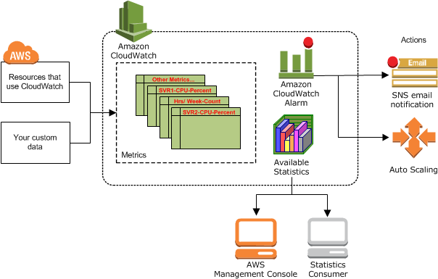
C. Amazon CloudWatch

Slide 14
Which of the following AWS Cloud services is a fully managed NoSQL database service?
A. Amazon Simple Queue Service (Amazon SQS) B. Amazon DynamoDB C. Amazon ElastiCache D. Amazon Relational Database Service (Amazon RDS)

Slide 15
Which of the following AWS Cloud services is a fully managed NoSQL database service?
A. Amazon Simple Queue Service (Amazon SQS) B. Amazon DynamoDB C. Amazon ElastiCache D. Amazon Relational Database Service (Amazon RDS)

Slide 16
B. Amazon DynamoDB
Amazon DynamoDB is a fully managed, serverless, key-value NoSQL database designed to run high-performance applications at any scale

Slide 17
Your company experiences fluctuations in traffic patterns to their e-commerce website based on flash sales. What service can help your company dynamically match the required compute capacity to the spike in traffic during flash sales?
A. Auto Scaling B. Amazon Glacier C. Amazon Simple Notification Service (Amazon SNS) D. Amazon Virtual Private Cloud (Amazon VPC)

Slide 18
Your company experiences fluctuations in traffic patterns to their e-commerce website based on flash sales. What service can help your company dynamically match the required compute capacity to the spike in traffic during flash sales?
A. Auto Scaling B. Amazon Glacier C. Amazon Simple Notification Service (Amazon SNS) D. Amazon Virtual Private Cloud (Amazon VPC)

Slide 19
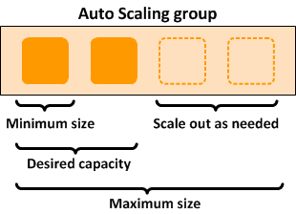
A. Auto Scaling

Slide 20
Your company provides an online photo sharing service. The development team is looking for ways to deliver image files with the lowest latency to end users so the website content is delivered with the best possible performance. What service can help speed up distribution of these image files to end users around the world?
A. Amazon Elastic Compute Cloud (Amazon EC2) B. Amazon Route 53 C. AWS Storage Gateway D. Amazon CloudFront

Slide 21
Your company provides an online photo sharing service. The development team is looking for ways to deliver image files with the lowest latency to end users so the website content is delivered with the best possible performance. What service can help speed up distribution of these image files to end users around the world?
A. Amazon Elastic Compute Cloud (Amazon EC2) B. Amazon Route 53 C. AWS Storage Gateway D. Amazon CloudFront

Slide 22
D. Amazon CloudFront
Amazon CloudFront is a content delivery network (CDN) that helps deliver static and dynamic web content to users faster than just serving it out of an AWS Region.
It improves delivery of data to end users by storing content in edge locations around the world.

Slide 23
What AWS Cloud service provides a logically isolated section of the AWS Cloud where organizations can launch AWS resources in a virtual network that they define?
A. Amazon Simple Workflow Service (Amazon SWF) B. Amazon Route 53 C. Amazon Virtual Private Cloud (Amazon VPC) D. AWS CloudFormation

Slide 24
What AWS Cloud service provides a logically isolated section of the AWS Cloud where organizations can launch AWS resources in a virtual network that they define?
A. Amazon Simple Workflow Service (Amazon SWF) B. Amazon Route 53 C. Amazon Virtual Private Cloud (Amazon VPC) D. AWS CloudFormation

Slide 25
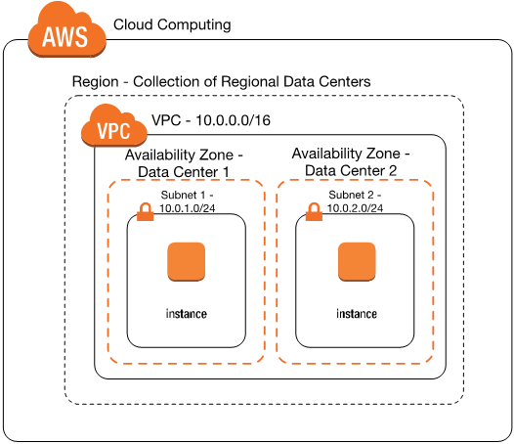
Amazon Virtual Private Cloud (VPC) is a service that lets you launch AWS resources in a logically isolated virtual network that you define

Slide 26
Your company provides a mobile voting application for a popular TV show, and 5 to 25 million viewers all vote in a 15-second timespan. What mechanism can you use to decouple the voting application from your back-end services that tally the votes?
A. AWS CloudTrail B. Amazon Simple Queue Service (Amazon SQS) C. Amazon Redshift D. Amazon Simple Notification Service (Amazon SNS)

Slide 27
Your company provides a mobile voting application for a popular TV show, and 5 to 25 million viewers all vote in a 15-second timespan. What mechanism can you use to decouple the voting application from your back-end services that tally the votes?
A. AWS CloudTrail B. Amazon Simple Queue Service (Amazon SQS) C. Amazon Redshift D. Amazon Simple Notification Service (Amazon SNS)

