Slide 1
EC2 Elastic Block Storage
EC2 Elastic Block Storage – EBS Overview
EBS Volume Example
EBS Volume Types
EBS vs Instance Store
IOPS Performance Instance Store vs. EBS
EBS Encryption
EBS Encryption Support
EBS Snapshot
How incremental snapshots work
EBS Snapshot creation
EBS Snapshot Encryption Create/Attach/Detach/Delete EBS volumes

Slide 2
EC2 Elastic Block Storage – EBS Overview
An EBS (Elastic Block Store) Volume is a network drive you can attach to your instances while they run
Amazon EBS provides highly available, reliable, durable, block-level storage volumes that can be attached to a running instance
It’s a network drive (i.e. not a physical drive)
It uses the aws network to communicate the instance, which means there might be a bit of latency
It can be detached from an EC2 instance and attached to another one quickly
It’s locked to an Availability Zone (AZ)
An EBS Volume in us-east-1a cannot be attached to us-east-1b
To move a volume across, you first need to snapshot it
Have a provisioned capacity (size in GBs, and IOPS)
You get billed for all the provisioned capacity
You can increase the capacity of the drive over time

Slide 3
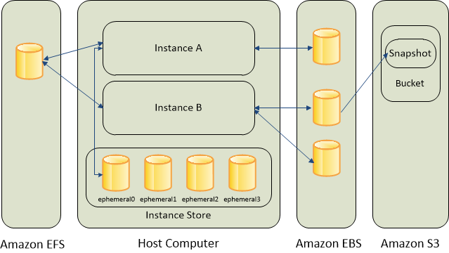
EBS Volume Example

Slide 4
EBS Volume Types
https://docs.aws.amazon.com/AWSEC2/latest/UserGuide/ebs-volume-types.html
Solid state drives (SSD)
Purpose SSD (gp3, gp2)
Provides a balance of price and performance.
Recommend these volumes for most workloads.
Provisioned IOPS SSD (io2, io1)
Provides high performance for mission-critical, low-latency, or high-throughput workloads.
Hard disk drives (HDD)
Throughput Optimized HDD (st1)
A low-cost HDD designed for frequently accessed, throughput-intensive workloads.
Cold HDD (sc1)
The lowest-cost HDD design for less frequently accessed workloads.
Previous generation volume types
Magnetic (standard)
Workloads where data is infrequently accessed

Slide 5
EBS vs Instance Store
Some instance do not come with Root EBS volumes
Instead, they come with “Instance Store” (= ephemeral storage)
Instance store is physically attached to the machine (EBS is a network drive)
Pros:
Better I/O performance (EBS gp2 has an max IOPS of 16000, io1 of 64000)
Good for buffer / cache / scratch data / temporary content
Data survives reboots
Cons:
On stop or termination, the instance store is lost
You can’t resize the instance store
Backups must be operated by the user

Slide 6
IOPS Performance Instance Store vs. EBS
Use Instance Store instead of EBS if very high IOPS rate is required
Instance store, although can not provide for data persistence, but it can provide for much higher IOPS compared to, network attached, EBS storage

Slide 7
EBS Encryption
You can encrypt both the boot and data volumes of an EC2 instance
When you create an encrypted EBS volume and attach it to a supported instance type, the following types of data are encrypted:
Data at rest inside the volume
All data moving between the volume and the instance
All snapshots created from the volume
All volumes created from those snapshots

Slide 8
EBS Encryption Support
Supported volume types
All EBS volume types.
Supported instance types
Amazon EBS encryption is available on
All current generation instance types
Previous generation instance types: A1, C3, cr1.8xlarge, G2, I2, M3, and R3.
Demo

Slide 9
EBS Snapshot
EBS provides the ability to create snapshots (backups) of any EBS volume and write a copy of the data in the volume to S3, where it is stored redundantly in multiple Availability Zones
Snapshots can be used to create new volumes, increase the size of the volumes or replicate data across Availability Zones
Snapshots are incremental backups and store only the data that was changed from the time the last snapshot was taken.
Snapshots size can probably be smaller then the volume size as the data is compressed before being saved to S3
Even though snapshots are saved incrementally, the snapshot deletion process is designed so that you need to retain only the most recent snapshot in order to restore the volume.
EBS Snapshots can be used to migrate or create EBS Volumes in different AZs or regions.

Slide 10
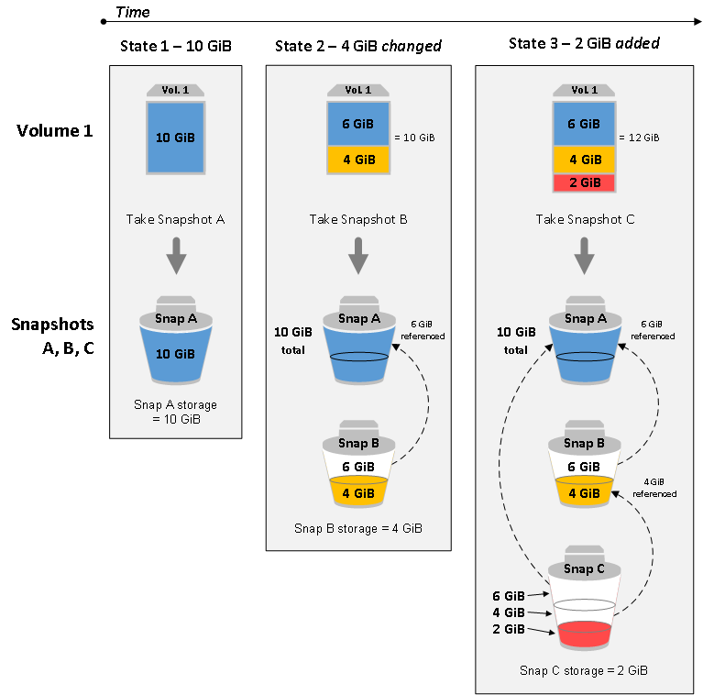
How incremental snapshots work

Slide 11
EBS Snapshot creation
Snapshots can be created from EBS volumes periodically and are point-in-time snapshots.
Snapshots are incremental and only store the blocks on the device that changed since the last snapshot was taken
Snapshots occur asynchronously; the point-in-time snapshot is created immediately while it takes time to upload the modified blocks to S3
Recommended ways to create a Snapshot from an EBS volume are
Pause all file writes to the volume
Unmount the Volume -> Take Snapshot -> Remount the Volume
Stop the instance – Take Snapshot (for root EBS volumes)

Slide 12
EBS Snapshot Encryption
EBS snapshots fully support EBS encryption.
Snapshots of encrypted volumes are automatically encrypted
Volumes created from encrypted snapshots are automatically encrypted
All data in flight between the instance and the volume is encrypted
Unencrypted snapshot you own, can be encrypted during the copy process
Encrypted snapshot that you own or have access to, can be encrypted with a different key during the copy process.

Slide 13
Create/Attach/Detach/Delete EBS volumes (Demo)
Methods of creating a volume
Create and attach EBS volumes when you launch instances by specifying a block device mapping.
Create an empty EBS volume and attach it to a running instance.
Create an EBS volume from a previously created snapshot and attach it to a running instance.
Detach an Amazon EBS volume from an instance
Delete an Amazon EBS volume

