Slide 1
Virtual Private Cloud
AWS Virtual Private Cloud
VPC Components
VPC Types
Implied Router
Route Tables
VPC IP Addressing
Internet Gateway
Public Subnet vs. Private Subnet
Elastic IP addresses
Security Groups
Network Access Control Lists
NAT Instance
NAT Gateway
VPC Flow Logs
VPC Peering
Transit Gateway
Virtual Private Gateways
Customer Gateways
Virtual Private Networks
AWS Direct Connect

Slide 2
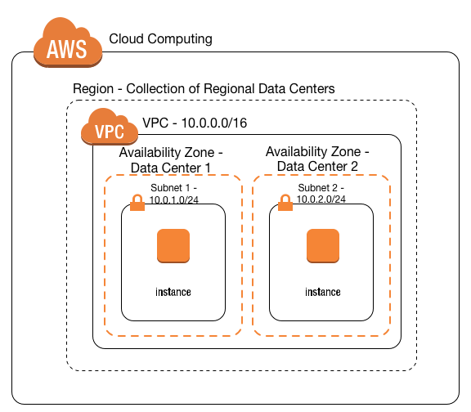
AWS Virtual Private Cloud (VPC) https://docs.aws.amazon.com/vpc/latest/userguide/vpc-ug.pdf
Is a virtual network or data center inside AWS for one client, or a department in an enterprise
The AWS client has full control over resources & virtual compute instances (virtual servers) hosted inside that VPC
Is similar to having your own data center inside AWS
Logically isolated from other VPCs on AWS
You can have one or more IP address subnets inside a VPC
A VPC is confined to an AWS region and does not extend between regions

Slide 3
VPC Components
CIDR and IP address subnets
Implied Router
Route tables
Internet gateway
Security Groups
Network Access Control Lists (N. ACLs)

Slide 4
VPC Types
A Default VPC
– Created in each AWS region when an AWS account is created
– Has default CIDR, Security Group, N ACL, and route table Settings
– Has an Internet Gateway by default
A Custom VPC
– Is a VPC an AWS account owner creates
– AWS user creating the custom VPC can decide the VPC CIDR block
– Has its own default security group, N ACL, and Route tables
– Does not have an Internet Gateway by default, one needs to be created if needed

Slide 5
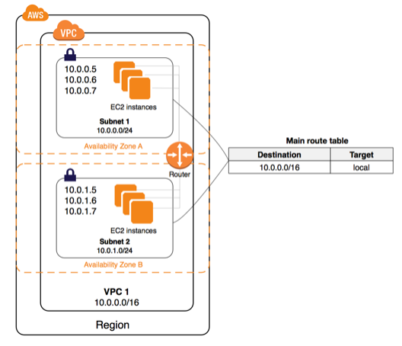
Implied Router
It is the central VPC routing function
It connects the different AZ’s together and connects the VPC to the Internet Gateway (and Virtual Private Gateway when configured)
Each subnet will have a route table that the router uses to forward traffic within the VPC
The route tables can also have entries to external destinations

Slide 6
Route Tables
Each Subnet MUST be associated with only one route table at any given time
If you do not specify a subnet-to-route-table association, the subnet (when created) will be associated with the main (default) VPC route table. You can change the subnet association to another route table when/as needed
You can also edit the main (default) route table if you need, but you can NOT delete the Main (default) route table
However, you can make a custom route table manually become the main route table, then you can delete the former main, as it is no longer a main route table
Every route table in a VPC comes with a default rule that allows all VPC subnets to communicate with one another
You can NOT modify or delete this rule

Slide 7
VPC IP Addressing
The CIDR block is the range of IP addresses that you choose for the VPC when you create it
Once the VPC is created, you can NOT change its main CIDR block range
– But you can expand the VPC CIDR block by adding additional CIDR blocks
– Some restrictions apply
If you need a different main CIDR block range, create a new VPC
The different subnets within a VPC can NOT overlap (basic TCP/IP rule)

Slide 8
AWS Reserved IP’s in each subnet
First 4 IP addresses in each subnet and the last one is reserved by AWS
– Ex. If the subnet is 10.0.0.0/24
10.0.0.0 is the base network
10.0.0.1 VPC router
10.0.0.2 DNS related
10.0.0.3 Reserved for future use
10.0.0.255 last IP
RFC 1918 range | Example CIDR block
10.0.0.0 - 10.255.255.255 (10/8 prefix) | 10.0.0.0/16
172.16.0.0 - 172.31.255.255 (172.16/12 prefix) | 172.31.0.0/16
192.168.0.0 - 192.168.255.255 (192.168/16 prefix) | 192.168.0.0/20

Slide 9
Internet Gateway
Is the gateway through which your VPC communicates with the internet, and with other AWS services
Is a horizontally scaled, redundant, and highly available VPC component
It performs NAT (static one-to-one) between your Private IPv4 addresses in your VPC and the allocated Public (or Elastic) IPv4 addresses
It supports both IPv4 and IPv6
You can not SSH or connect to it, it is fully managed by AWS

Slide 10
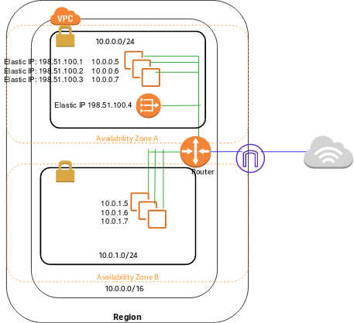

Slide 11
Public Subnet vs. Private Subnet
– Public Subnet means:
Its VPC has an Internet gateway attached to it
It is associated with a route table that has an entry for a default route pointing at the VPC’s Internet gateway
Destination 0.0.0.0/0 Target: igw-1234
– Private subnet means, it is not accessible from the Internet since it has no Public Internet IP addresses configured.
Destination | Target
10.0.0.0/16 | local
0.0.0.0/0 | igw-id
Destination | Target
10.0.0.0/16 | local
0.0.0.0/0 | nat-gateway-id

Slide 12
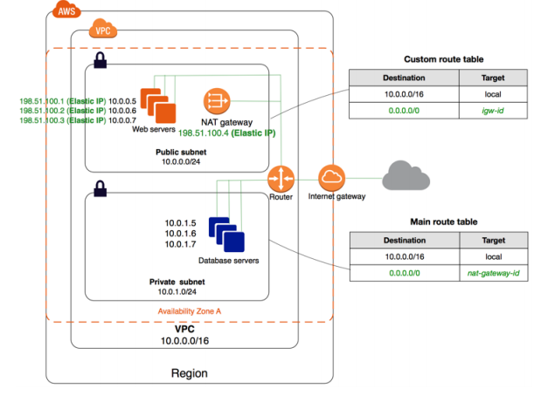
VPC with public and private subnets (NAT)

Slide 13
Elastic IP addresses
Elastic IPs are Internet routable IP addresses that you can have allocated to your VPC, and will continue being allocated to your VPC until you decide to release them back to AWS
Some AWS services (example NAT gateway) require an Elastic IP address to function
You have 5 Elastic IP addresses per region (Soft limit that you can change by contacting AWS)
Public IPv4 addresses on the other hand, are DHCP based (dynamically allocated) to your Compute, and are released back to AWS if you stop your compute instance.

Slide 14
Security Groups
A security group is a virtual firewall
It controls traffic at the virtual server (EC2 Instance) level
– Specifically at the virtual Network Interface level
Up to 16 (5 is the default) security groups per EC2 instance interface can be applied
Stateful, return traffic, of allowed inbound traffic, is allowed, even if there are no rules to allow it
Can only have permit rules, can NOT have deny rules
Implicit deny rule at the end
All rules are evaluated to find a permit rule

Slide 15
Security Groups
You can use Security Group names as the source or destination in other security group rules
You can use the security group name as the source in its own inbound security group rules
Any Virtual Server Instance(EC2) created without specifying a security group for it (during its creation), will be assigned the VPC default security group
Each VPC created will have a default Security Group created for it, you can NOT delete a default Security group
Security groups are VPC resources, hence, different EC2 instances, in different Availability Zones, belonging to the same VPC, can have the same security group applied to them
Changes to security groups take effect immediately

Slide 16
Default and non-Default Security Groups
A default security group
– Is the one created by AWS when the default VPC is created, or when you create your own Custom VPC and it will have (by default)
Inbound rules allowing Instances assigned the same security group to talk to one another
All outbound traffic is allowed
A Custom (non-default) security group
– Is the one you create under a default or non-default VPC, and by default it will have
No inbound rules – basically all inbound traffic is denied by default
All outbound traffic is allowed by default

Slide 17
Network Access Control Lists (N.ACLs)
It is a function performed on the implied router (The implied VPC router hosts the Network ACL function)
It functions at the Subnet Level
N. ACLs are “Stateless”. Outbound traffic for an allowed inbound traffic, must be “explicitly” allowed too
You can have “permit” and “deny” rules in a NACL
NACL is a set of rules, each has a number
NACL rules are checked for a “permit” from lower numbered rules until either a permit is found, or an explicit/implicit deny is reached
You can insert rules (based on the configured rule number spacing) between existing rules, hence, it is recommended to leave a number range between any two rules to allow for edits later.
N. ACLs end with an explicit deny any, which you can NOT delete
A subnet must be associated with a N. ACL, if you do not specify the N. ACL, the subnet will get associated with the default N. ACL automatically

Slide 18
Network Access Control Lists (N.ACLs)
You can create your own custom N. ACL, you do not have to use the default one
A default N.ACL allows all traffic inbound and outbound
A custom (non-default) N. ACL blocks/denies all traffic inbound and outbound by default.
For NACLs:
Inbound in NACL means coming from outside the subnet destined to the subnet.
Outbound means going out of the subnet.
For Security Groups
Inbound for security group means inbound from outside the instance destined to the instance.
Outbound means going out of the instance’s ENI.
If you are facing any issues regarding communication between EC2 instances in a VPC, always look for the security setting of security groups and N ACLs relevant to the communication path (Source instance on which subnet and to Destination instance on which subnet).

Slide 19
NAT Instance
NAT instance is required to enable the private subnet EC2 Instances to get to the internet
– Hence, the NAT instance MUST be configured in a public subnet
– EC2 instances with Public/Elastic IP addresses do not need to go through NAT instances to access the Internet
NAT instance need to be assigned a security group
No traffic initiated from the Internet can access the private subnet through the NAT instance
– Only responses to traffic initiated from the private subnets are allowed through NAT instances
Only admin SSH traffic can be allowed to the NAT instance (or RDP if Windows)

Slide 20
NAT Gateway
Is an AWS managed service (Highly available, redundant..etc)
– Customer does not need to worry about patching or OS updates
Can not be assigned a security group
AWS is responsible for its security/patching…etc
Can scale to 10s of Gbps throughput
Works only with an Elastic IP, can Not use a Public IP to do its function
– NAT instances can work with Public and Elastic IP addresses

Slide 21
VPC Flow Logs
VPC Flow Logs enables you to capture information about the IP traffic going to and from network interfaces in your VPC.
Flow log data can be published to Amazon CloudWatch Logs or Amazon S3.
Flow logs can help you with a number of tasks, such as:
Diagnosing overly restrictive security group rules
Monitoring the traffic that is reaching your instance
Determining the direction of the traffic to and from the network interfaces

Slide 22
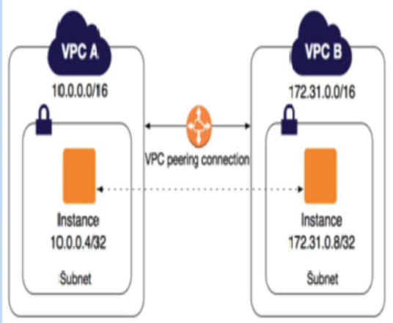
VPC Peering
By default VPCs can not communicate with each other.
To allow VPC to communicate each other, we need to setup a vpc peering connection.
You can create a VPC peering connection between your own VPCs, or with a VPC in another AWS account
The VPCs can be in different regions

Slide 23
VPC Peering
Peering connections are created through a request/accept protocol.
If the peer Amazon VPC is within the same account, it is identified by its VPC ID.
If the peer VPC is within a different account, it is identified by Account ID and VPC ID.
The owner of the peer Amazon VPC has one week to accept or reject the request.
Routing, SG/NACL need to be updated according to communicate the traffic.

Slide 24
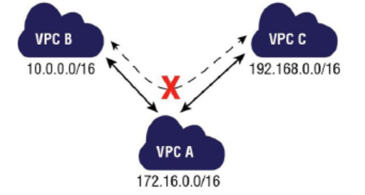
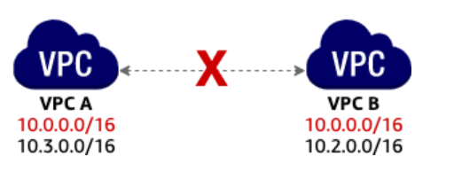
VPC Peering
An Amazon VPC may have multiple peering connections, and peering is a one-to-one relationship between Amazon VPCs.
Peering connections do not support transitive routing.
You cannot create a peering connection between Amazon VPCs that have matching or overlapping CIDR blocks.

Slide 25
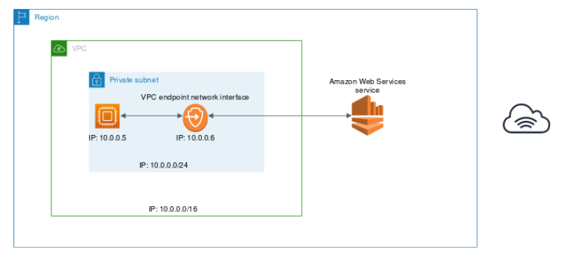
VPC endpoints
A VPC endpoint enables you to securely connect your VPC to another supported AWS services.
Traffic between your VPC and the other service does not leave the Amazon network.
A VPC endpoint does not require an internet gateway, virtual private gateway, NAT device, VPN connection, or AWS Direct Connect connection.
Instances in your VPC do not require public IP addresses to communicate with resources in the service.

Slide 26
Virtual Private Gateways (VPGs), Customer Gateways (CGWs) and Virtual Private Networks (VPNs)
You can connect an existing data center to Amazon VPC using either hardware or software VPN connections.
Virtual Private Gateway (VPG) are VPN concentrator on AWS side of the VPN connection between the two networks.
Customer Gateway (CGW) represents a physical device or a software application on the customer’s side of the VPN connection.
After these two elements of VPC have been created, it is last step to create VPN tunnel
VPN tunnel is established after traffic is generated from customer’s side of VPN connection.

Slide 27
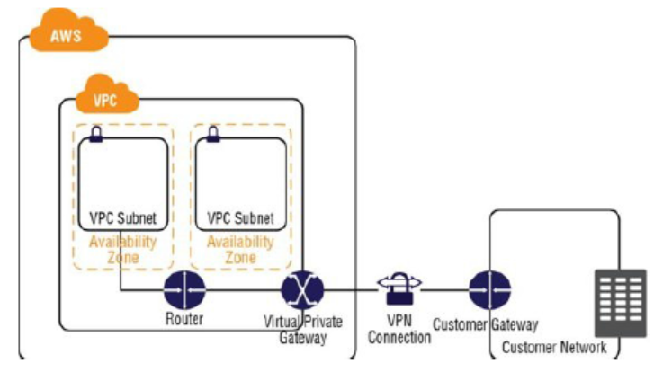
VPN
Following are the important points to understand about VPGs, CGWs, and VPNs
The VPG is the AWS end of the VPN tunnel.
The CGW is a hardware or software application on the customer’s side of the VPN tunnel.
You must initiate the VPN tunnel from the CGW to the VPG.
VPGs support both dynamic routing with BGP and static routing.
The VPN connection consists of two tunnels for higher availability to the VPC.

Slide 28
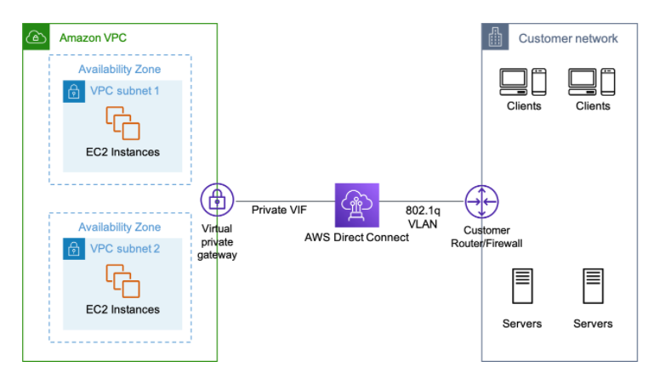
AWS Direct Connect
AWS Direct Connect is a cloud service solution to establish a dedicated network connection from your premises to AWS.
Establish a private connection between AWS and your datacenter.
Speed up to 100 Gbps.

