Slide 1
AWS CloudFormation
Infrastructure as Code

Slide 2
Infrastructure as Code
Infrastructure as Code (IaC) is a way to provision and manage your infrastructure through code instead of through manual processes
With IaC, you can create configuration files that contain your infrastructure specifications, which makes it easier to edit and distribute configurations.
You provision the same environment every time in other account or region
That code would be deployed and create/update/delete our infrastructure
Version control is an important part of IaC, and your configuration files should be under source control just like any other software source code file.

Slide 3
What is CloudFormation
You can use AWS CloudFormation to create AWS resources in an orderly and predictable fashion.
Resources are written in text files using JSON or YAML format.
The templates require a specific syntax and structure that depends on the types of resources being created and managed.
A CloudFormation template is deployed into the AWS environment as a stack
For example, within a CloudFormation template, you can create a set of:
One security group
Two EC2 instance using this security group
One S3 bucket
One load balancer (ELB) in front of these EC2

Slide 4
CloudFormation Concept
When you use AWS CloudFormation, you work with templates and stacks
Topics
Templates
Stacks
Change sets
Templates
A CloudFormation template is a JSON or YAML formatted text file
CloudFormation uses these templates as blueprints for building your AWS resources

Slide 5
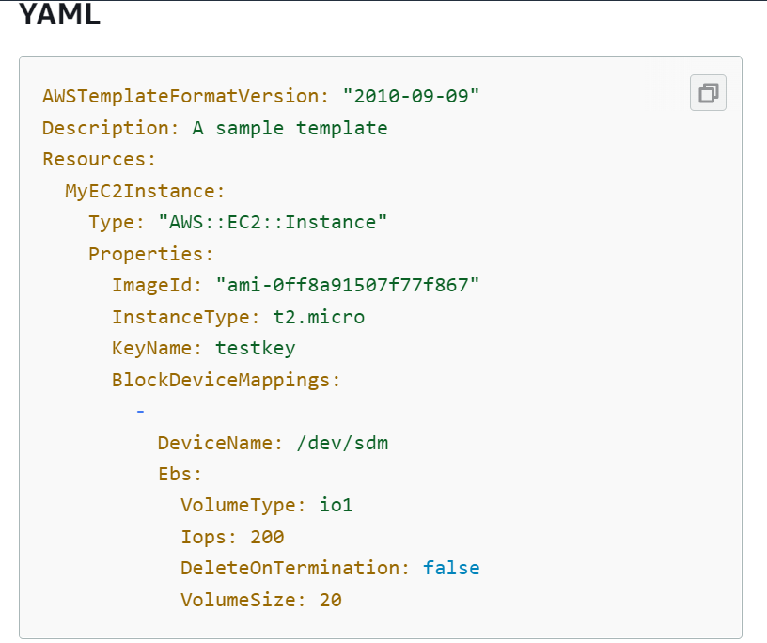

Slide 6
CloudFormation Concept
Stacks
When you use CloudFormation, you manage related resources as a single unit called a stack.
You create, update, and delete a collection of resources by creating, updating, and deleting stacks.
Change sets
If you need to make changes to the running resources in a stack, you update the stack.
Before making changes to your resources, you can generate a change set, which is a summary of your proposed changes.
Change sets allow you to see how your changes might impact your running resources, especially for critical resources, before implementing them.

Slide 7
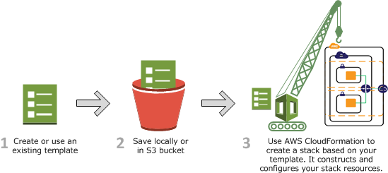
How AWS CloudFormation work
When creating a stack, AWS CloudFormation calls to AWS to provision and configure your resources.
CloudFormation can only perform actions that you have IAM permission to do.
The calls that CloudFormation makes are all declared by your template.

Slide 8
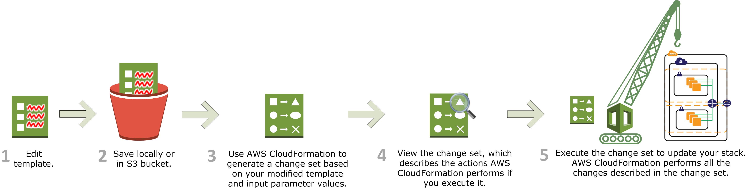
Updating a stack with change sets
You can modify the stack's template.
Create a change set by submitting a modified version of the original template
CloudFormation compares the modified template with the original template and generates a change set.
The change set lists the proposed changes.

Slide 9
Deploying CloudFormation templates
Manual way:
Editing templates in the CloudFormation Designer
Using the console to input parameters, etc
Automated way:
Editing templates in a YAML file
Using the AWS CLI (Command Line Interface) to deploy the templates
Recommended way when you fully want to automate your flow
DEMO

Slide 10
CloudFormation Template Component
Resources: AWS resources declared in the template (MANDATORY)
Parameters: Dynamic inputs for your template
Mappings: Static variables for your template
Outputs: References to what has been created
Conditionals: List of conditions to perform resource creation
Metadata
Helper
References
Functions

Slide 11
AWS Resources
Resources are the core of your CloudFormation template
They represent the different AWS Components that will be created and configured
Resources are declared and can reference each other
CloudFormation service take cares of creation, updates and deletes of resources.
Resource types identifiers are of the form:
AWS::aws-product-name::data-type-name
Ex: AWS::EC2::Instance

