Slide 1
Amazon DynamoDB

Slide 2
What is NoSQL
NoSQL databases are non-tabular databases and store data differently than relational tables
NoSQL databases store data in documents (ex: json) rather than relational tables
NoSQL databases do not support join
NoSQL databases scale horizontally
Benefits of NoSQL Databases
Flexible data models
Horizontal scaling
Faster queries
Easy to work

Slide 3
NoSQL Database
Most-popular types of NoSQL database
Document databases
Key-value stores
Wide-column databases
Graph databases
Popular NoSQL Databases
MongoDB
Couchbase
Redis
Amazon DynamoDB
IBM Cloudant
RavenDB
Cassandra
HBase
Azure Cosmos DB

Slide 4
Amazon DynamoDB
Amazon DynamoDB is a fully managed, serverless, key-value NoSQL database designed to run high-performance applications at any scale.
Single-digit millisecond performance at any scale
Millions of requests per seconds, trillions of row, 100s of TB of storage
Each table has a primary key
Each table can have an infinite number of items
Maximum size of a item is 400KB
Data types supported are:
Scalar Types: String, Number, Binary, Boolean, Null
Document Types: List, Map
Set Types: String Set, Number Set, Binary Set

Slide 5
Components of Amazon DynamoDB
The core components of DynamoDB are tables, items, and attributes
A table is a collection of items, and each item is a collection of attributes.
DynamoDB uses primary keys to uniquely identify each item in a table and secondary indexes to provide more querying flexibility.
Tables: A table is a collection of data. DynamoDB stores data in tables.
Items: Each table contains zero or more items. An item is a group of attributes that is uniquely identifiable among all of the other items.
Attributes: Each item is composed of one or more attributes. An attribute is a fundamental data element, something that does not need to be broken down any further.

Slide 6
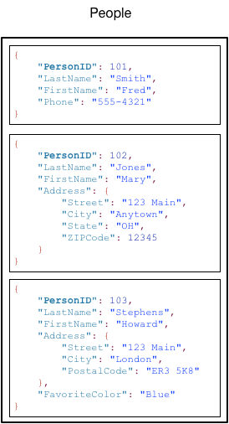
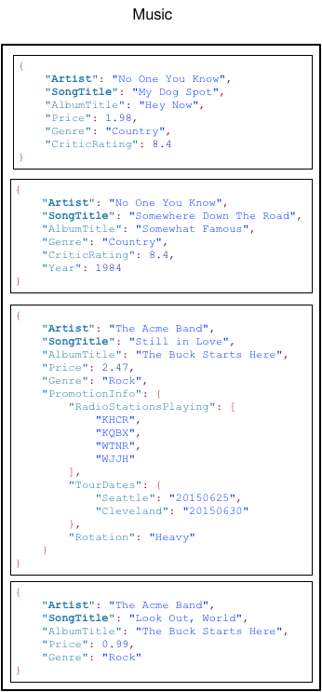

Slide 7
DynamoDB – Primary Keys
When you create a table, table name and the primary key will be given.
The primary key uniquely identifies each item in the table, so that no two items can have the same key
DynamoDB supports 2 types of primary keys
Partition key
A simple primary key, composed of one attribute known as the partition key
Partition key and sort key
A composite primary key, composed of two attributes. partition key and sort key.
The combination must be unique

Slide 8
DynamoDB – Provisioned Throughput
Table must have provisioned read and write capacity units
Read Capacity Units (RCU): throughput for reads
Write Capacity Units (WCU): throughput for writes
Option to setup auto-scaling of throughput to meet demand
ReadCapacityUnits
The maximum number of strongly consistent reads consumed per second
WriteCapacityUnits
The maximum number of writes consumed per second

Slide 9
DynamoDB – Write Capacity Units
One write capacity unit represents one write per second for an item up to 1 KB in size.
If the items are larger than 1 KB, more WCU are consumed
Example 1: we write 10 objects per seconds of 2 KB each.
We need 2 * 10 = 20 WCU
Example 2: we write 6 objects per second of 4.5 KB each
We need 6 * 5 = 30 WCU (4.5 gets rounded to the upper KB)
Example 3: we write 120 objects per minute of 2 KB each
We need 120 / 60 * 2 = 4 WCU

Slide 10
DynamoDB – Read Capacity Units
One read capacity unit represents one strongly consistent read per second, or two eventually consistent reads per second, for an item up to 4 KB in size.
If the items are larger than 4 KB, more RCU are consumed
Example 1: 10 strongly consistent reads per seconds of 4 KB each
We need 10 * 4 KB / 4 KB = 10 RCU
Example 2: 16 eventually consistent reads per seconds of 12 KB each
We need (16 / 2) * ( 12 / 4 ) = 24 RCU
Example 3: 10 strongly consistent reads per seconds of 6 KB each
We need 10 * 8 KB / 4 = 20 RCU (we have to round up 6 KB to 8 KB)

Slide 11
DynamoDB – Write, Delete Data
PutItem - Write data to DynamoDB
UpdateItem – Update data in DynamoDB
DeleteItem
Delete an individual row
Ability to perform a conditional delete
DeleteTable
Delete a whole table and all its items
Much quicker deletion than calling DeleteItem on all items

Slide 12
DynamoDB – Batching Writes
BatchWriteItem
Up to 25 PutItem and / or DeleteItem in one call
Up to 16 MB of data written
Up to 400 KB of data per item
Batching allows you to save in latency by reducing the number of API calls done against DynamoDB
Operations are done in parallel for better efficiency

Slide 13
DynamoDB – Reading Data
GetItem:
Read based on Primary key
Primary Key = HASH or HASH-RANGE
Eventually consistent read by default
Option to use strongly consistent reads (more RCU - might take longer)
ProjectionExpression can be specified to include only certain attributes
BatchGetItem:
Up to 100 items
Up to 16 MB of data
Items are retrieved in parallel to minimize latency

Slide 14
Amazon DynamoDB Accelerator (DAX)
It is a fully managed, highly available, in-memory cache for Amazon DynamoDB that delivers up to a 10 times performance improvement—from milliseconds to microseconds—even at millions of requests per second.
DAX does all the heavy lifting required to add in-memory acceleration to your DynamoDB tables, without requiring developers to manage cache invalidation, data population, or cluster management.

