Slide 1
Amazon Elastic Container Service
Docker Introduction
Usage of Docker
Docker architecture

Slide 2
Docker Introduction
Docker is a software that performs OS level virtualization, also known as “containerization”
Docker is not a virtual machine
It is a popular tool to build, deploy and run applications using containers
Apps are packaged in containers that can be run on any OS
Dockers benefits include
Works in any machine
No compatibility issues
Predictable behavior
Deploy in seconds
Easier to maintain and deploy
Works with any language, any OS, any technology.

Slide 3
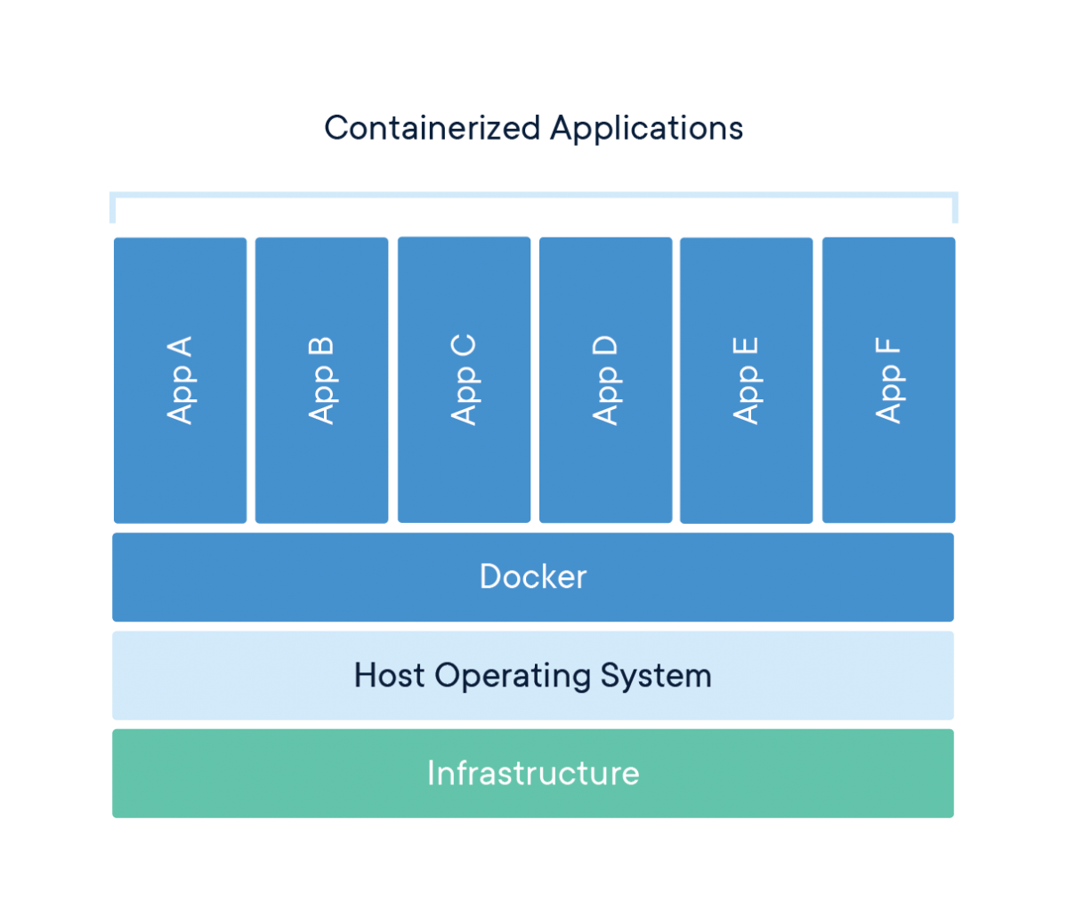

Slide 4
Usage of Docker
Fast, consistent delivery of your applications
Containers are great for continuous integration and continuous delivery (CI/CD) workflows
Responsive deployment and scaling
Docker’s container-based platform allows for highly portable workloads.
Docker containers can run on a
Developer’s local machine
On physical or virtual machines
On cloud providers
On a mixture of environments
Running more workloads on the same hardware

Slide 5
Docker Architecture
Docker uses a client-server architecture.
The Docker client talks to the Docker daemon, which does building, running, and distributing your Docker containers.
The Docker client and daemon can run on the same system, or you can connect a Docker client to a remote Docker daemon.
The Docker client and daemon communicate using a REST API, over UNIX sockets or a network interface.

Slide 6
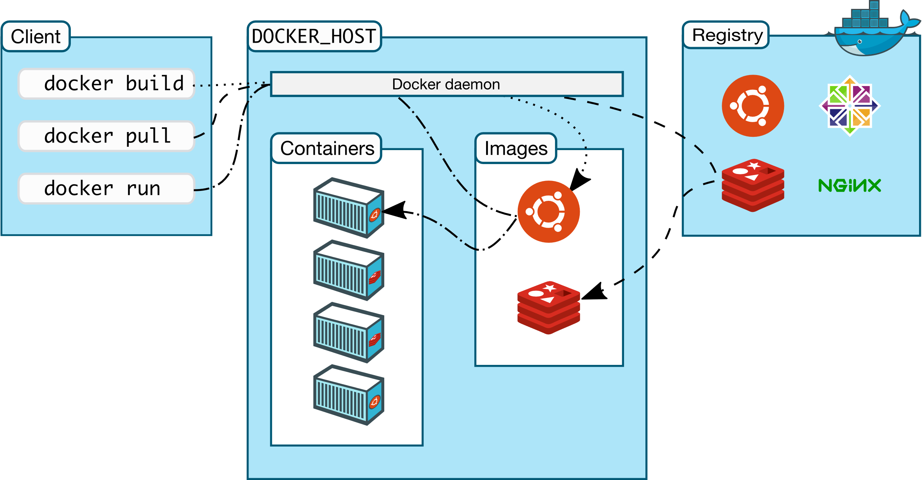

Slide 7
Docker Terminologies
The Docker Daemon
It listens for Docker API requests and manages Docker objects such as images, containers, networks, and volumes.
The Docker Client
It is the primary way that many Docker users interact with Docker. The Docker client can communicate with more than one daemon.
Docker Registries
It stores Docker images.
Docker Hub is a public registry that anyone can use.
Amazon ECR is another example

Slide 8
Docker Terminologies
Docker File
A Dockerfile is a text document that contains all the commands a user could call on the command line to assemble an image.
Docker Images
An image is a read-only template with instructions for creating a Docker container.
An image is based on another image, with some additional customization.
Docker Container
A container is a runnable instance of an image.
You can create, start, stop, move, or delete a container using the Docker API or CLI.

Slide 9
Docker Image Repository
Docker images are stored in Docker Repositories
Public Repo: Docker Hub https://hub.docker.com/
Find base images for many technologies or OS:
Ubuntu
MySQL
NodeJS, Java…
Private Repo:
Amazon ECR (Elastic Container Registry)
JFrog
Nexus

Slide 10
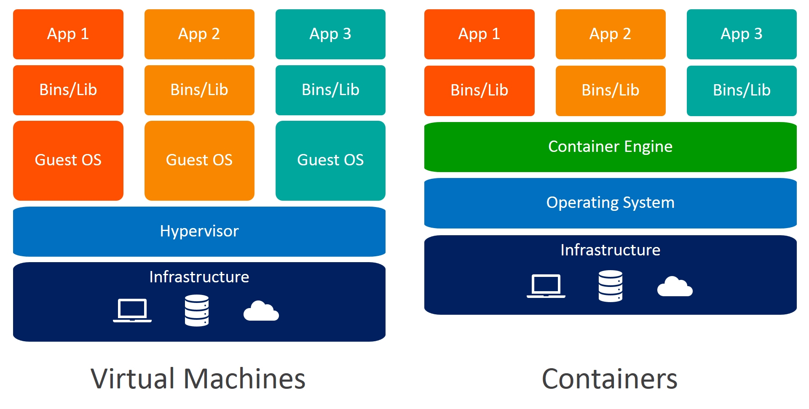
Docker versus Virtual Machines

Slide 11
AWS Docker Containers Management
Amazon Elastic Container Service (ECS): Amazon’s platform
Fargate: Amazon’s own Serverless Platform
Elastic Kubernetes Service: Amazon’s managed Kubernetes (open source)

Slide 12
Amazon Elastic Container Service
Amazon Elastic Container Service is a highly scalable, fast container management service.
Amazon ECS enables you to launch and stop your container-based applications by using simple API calls
Regional service.
Amazon ECS clusters created within a new or existing VPC.
You can create task definitions that define which container images run across your clusters.
Your task definitions are used to run tasks or create services.
Container images are stored in container registries, for example, the Amazon Elastic Container Registry.

Slide 13
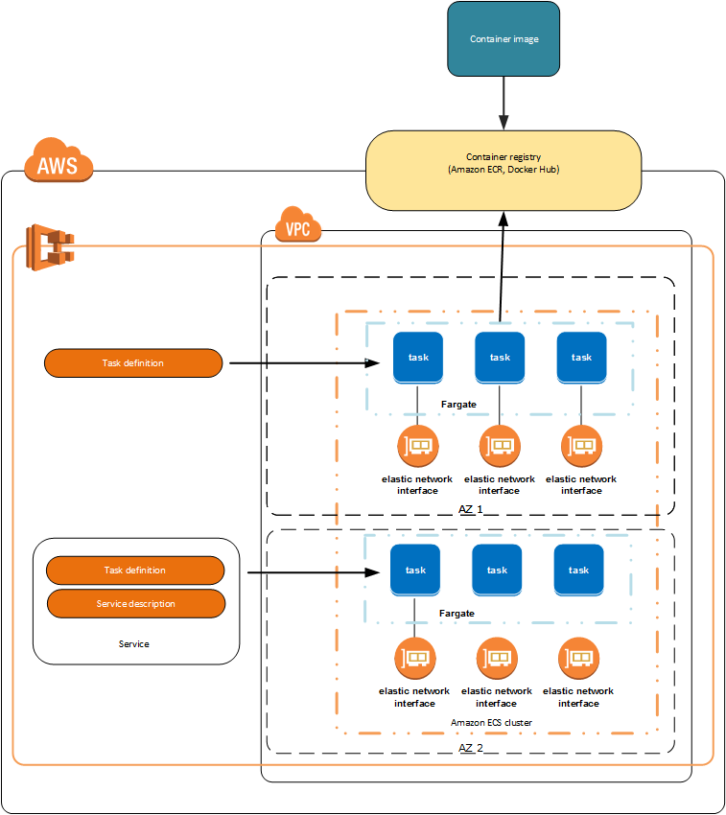

Slide 14
ECS Clusters Overview
ECS Clusters are logical grouping of EC2 instances
EC2 instances run the ECS agent (Docker container)
The ECS agents registers the instance to the ECS cluster
The EC2 instances run a special AMI, made specifically for ECS
Clusters are Region-specific
Type
Fargate
EC2 instance

Slide 15
ECS Task Definitions
A task definition is required to run Docker containers in Amazon ECS.
How to run a Docker Container
The Docker image details provided
Port Binding for Container and Host
Amount of CPU and memory to be used
The logging configuration to use for your tasks
Environment variables
Networking information
IAM Role configuration

Slide 16
ECS Service
ECS Services define the tasks details to be run and maintain a specified number of tasks
Maintaining the desired number of tasks in your service
If any task fail or stop for any reason, ECS service scheduler launches another tasks in the service
Demo

Slide 17
ECR - Amazon Elastic Container Registry
ECR is a private Docker image repository
Amazon ECR provides API operations to create, monitor, and delete image repositories
Access is controlled through IAM policy
AWS CLI v1 login command
aws ecr get-login --no-include-email --region ap-south-1
AWS CLI v2 login command
aws ecr get-login-password --region ap-south-1 | docker login --username AWS --
password-stdin test-acc.dkr.ecr.ap-south-1.amazonaws.com
Docker Push & Pull:
docker push test-acc.dkr.ecr.ap-south-1.amazonaws.com/test:latest
docker pull test-acc.dkr.ecr.ap-south-1.amazonaws.com/test:latest

