Slide 1
SQS (Simple Queue Service)
What is Amazon SQS

Slide 2
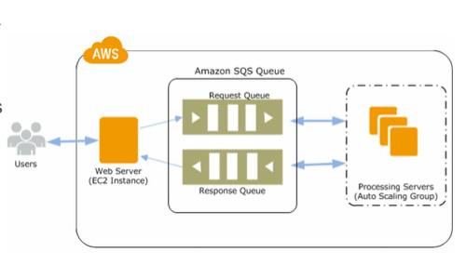
What is Amazon SQS
Amazon Simple Queue Service (Amazon SQS) is a fully managed message queuing service that makes it easy to decouple and scale microservices, distributed systems, and serverless applications.

Slide 3
Amazon SQS
It makes simple and cost effective to decouple the components of a cloud application.
You can use Amazon SQS to transmit any volume of data, at any level of throughput.
Using Amazon SQS, you can store application messages on reliable and scalable infrastructure.
An Amazon SQS queue is basically a buffer between the application components that receive data and those components that process the data in your system.
If your processing servers cannot process the work fast enough, the work is queued so that the processing servers can get to it when they are ready.

Slide 4
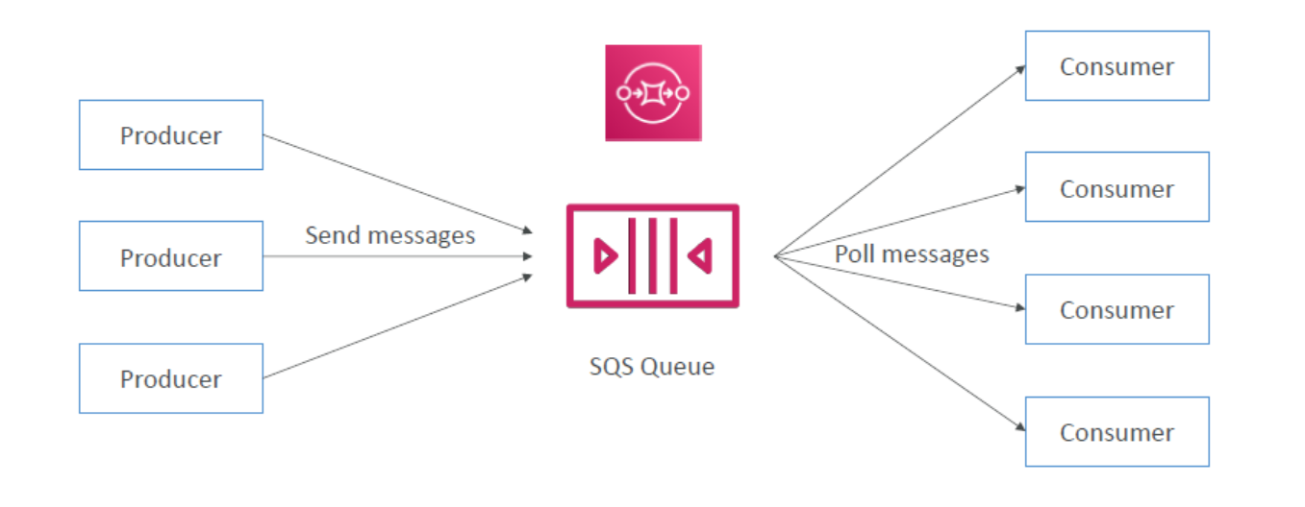

Slide 5
Amazon SQS – Standard Queue
Unlimited throughput, unlimited number of messages in queue
Default retention of messages: 4 days, maximum of 14 days
Low latency (<10 ms on publish and receive)
Limitation of 256KB per message sent
Message retention: default 4 days, up to 14 days
Can have duplicate messages (at least once delivery, occasionally)
Can have out of order messages (best effort ordering)
Poll SQS for messages
Process the messages (example: insert the message into an RDS database)
Delete the messages using the DeleteMessage API

Slide 6
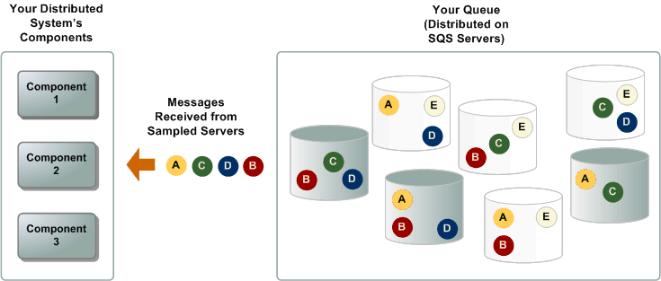

Slide 7
Amazon SQS – FIFO Queue
FIFO = First In First Out (ordering of messages in the queue)
Messages are processed in order by the consumer
Duplicates aren't introduced into the queue.

Slide 8
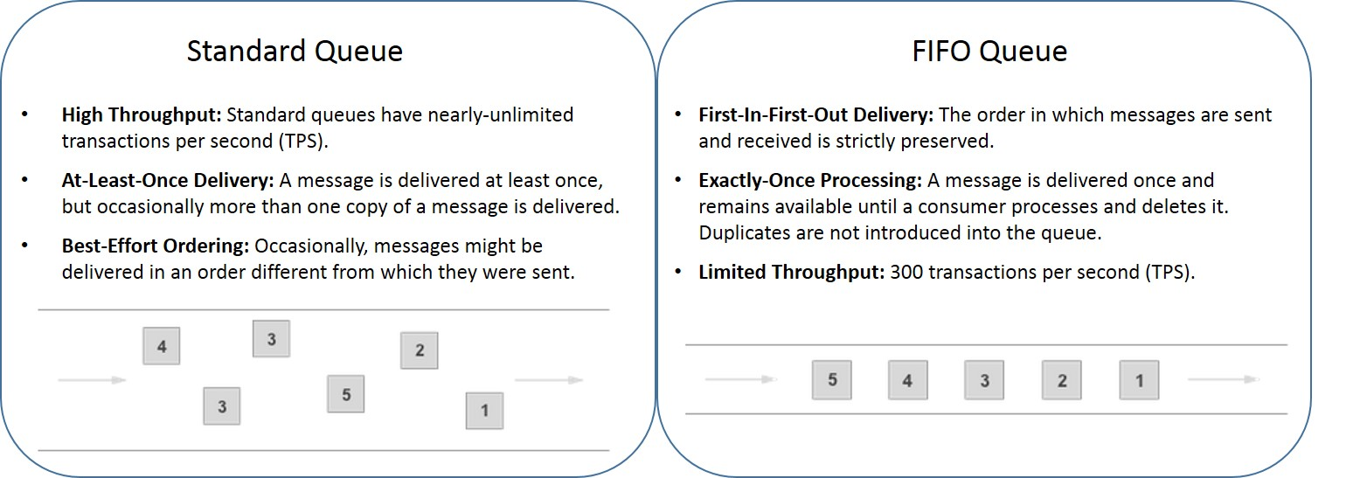

Slide 9
SQS – Message Visibility Timeout
When a consumer receives and processes a message from a queue, the message remains in the queue.
Amazon SQS doesn't automatically delete the message.
The consumer must delete the message from the queue after receiving and processing it.
To prevent other consumers from processing the message again, Amazon SQS sets a visibility timeout, a period of time during which Amazon SQS prevents other consumers from receiving and processing the message.
Default visibility timeout: 30 seconds.
Minimum is: 0 seconds
Maximum is: 12 hours
A consumer could call the ChangeMessageVisibility API to get more time

Slide 10
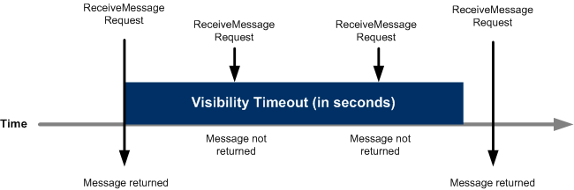

Slide 11
Dead Letter Queue
If a consumer fails to process a message within "Visibility Timeout" the message goes back to the queue.
We can set a threshold of how many times a message can go back to the queue
After the MaximumReceives threshold is exceeded, the message goes into a dead letter queue (DLQ)
Useful for debugging!
Make sure to process the messages in the DLQ before they expire

Slide 12
Amazon SQS delay queues
Delay queues let you postpone the delivery of new messages to a queue for a number of seconds
Delay a message (consumers don’t see it immediately) up to 15 minutes
Default is 0 seconds (message is available right away)
Can set a default at queue level
Can override the default on send using the DelaySeconds parameter

Slide 13
Amazon SQS - Long Polling
Amazon SQS provides polling to receive messages from a queue
Short polling – default
Amazon SQS sends the response right away
Long polling
SQS sends a response after it collects at least one available message
SQS sends an empty response only if the polling wait time expires.
LongPolling decreases the number of API calls made to SQS while increasing the efficiency and latency of your application.
The wait time can be between 1 sec to 20 sec (20 sec preferable)
Long Polling is preferable to Short Polling
Long polling can be enabled at the queue level or at the API level using WaitTimeSeconds

