Slide 1
AWS Serverless, AWS Lambda
What is a serverless architecture
Serverless Services in AWS
What is AWS Lambda

Slide 2
What is a serverless architecture
Is a way to build and run applications and services without having to manage infrastructure and scale, maintain servers.
Your application still runs on servers, but all the server management is done by AWS
AWS offers technologies for running code, managing data, and integrating applications, all without managing servers
It feature automatic scaling, built-in high availability, and a pay-for-use billing model to increase agility and optimize costs.
Serverless applications start with AWS Lambda, natively integrated with over 200 AWS services and software as a service (SaaS) applications
Serverless does not mean there are no servers. it means you just don’t manage / provision / see them.

Slide 3
Serverless Services in AWS
AWS Lambda
AWS Fargate
DynamoDB
AWS Cognito
AWS API Gateway
Amazon S3
AWS SNS & SQS
AWS Kinesis Data Firehose
Aurora Serverless
Step Functions

Slide 4
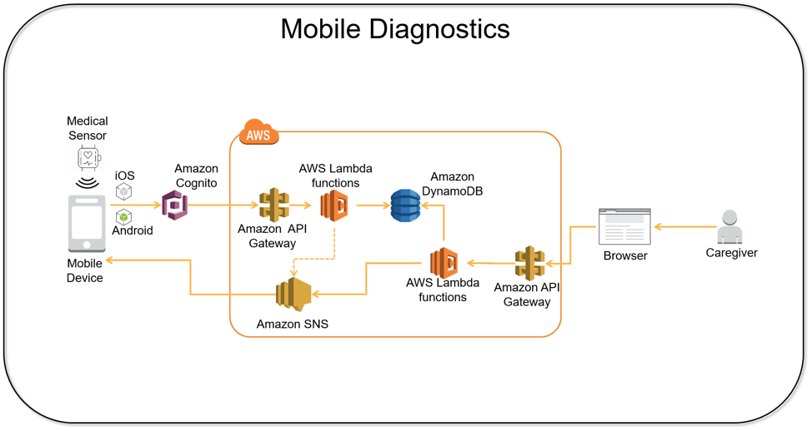

Slide 5
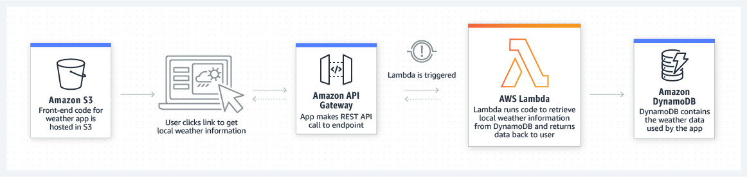

Slide 6
What is AWS Lambda
Lambda is a compute service that lets you run code without provisioning or managing servers.
Lambda runs your code on a high-availability compute infrastructure.
AWS performs all of the administration of the compute resources, including server and operating system maintenance, capacity provisioning and automatic scaling, code monitoring and logging
you can run code for virtually any type of application or backend service
AWS Lambda runs your code on a high-availability compute infrastructure
AWS Lambda executes your code only when needed and scales automatically.
You pay only for the compute time you consume – No charge when your code is not running.

Slide 7
EC2 Instance vs AWS Lambda
Virtual Servers in the Cloud
Limited by RAM and CPU
Continuously running
Scaling means: To add or remove servers
Virtual functions – no servers to manage!
Limited by time - short executions
Run on-demand
Scaling is automated!

Slide 8
Benefits of AWS Lambda
Easy Pricing
Pay per request and compute time
Free tier of 1,000,000 AWS Lambda requests and 400,000 GBs of compute time
No servers to manage
Continuous scaling
Integrated with the many AWS services
Integrated with many programming languages
Easy monitoring through AWS CloudWatch
Easy to get more resources per functions
Increasing RAM will also improve CPU and network!

Slide 9
AWS Lambda language support
Node.js
Python
Java (Java 8 compatible)
C# (.NET Core/ Powershell)
Golang
Ruby
Custom Runtime API

Slide 10
AWS Lambda Functions Configuration
IAM role (execution role)
This is the role that AWS Lambda assumes when it executes the Lambda function on your behalf.
Handler name
The handler refers to the method in your code where AWS Lambda begins execution.
AWS Lambda passes any event information, which triggered the invocation, as a parameter to the handler method.
Language Selection
Write your source code

Slide 11
AWS Lambda Demo
Create a simple lambda function, test from console, see CloudWatch logs
Run the lambda using cli
aws lambda list-functions --region ap-south-1
aws lambda invoke --function-name mylambda --cli-binary-format raw-in-base64-out --payload '{"key1": "value1", "key2": "value2", "key3": "value3" }' --region ap-south-1 response.json
Test the Lambda function using Load Balancer
Lambda with CloudWatch Events
Lambda with S3 event source

Slide 12
Lambda Function – Services it can access
Lambda functions can access
AWS Services running in AWS VPCs (Ex. Redshift , ElastiCache, RDS instances)
Non-AWS Services running on EC2 instances in an AWS VPC
Additional configuration will be required for VPC access (Security group and subnet IDs)
AWS Lambda runs your function code securely within an internal AWS VPC (not your VPC) by default.
This VPC has connectivity to AWS services and the internet.
You can configure a lambda function to connect to private subnets (DBs, Cache instances, or Internal services) in your VPC in your accounts
To enable your Lambda function to access resources inside your VPC:
Provide additional VPC-specific configuration information that includes VPC subnet IDs and security group IDs
Lambda will then create an ENI for each subnet and security group attached to the Lambda function

Slide 13
Invoking Lambda Functions
On-demand Lambda function invocation
Amazon API Gateway
Load Balancer
Web/Mobile application
Using SDKs
Scheduled events
Regular, scheduled basis.
Cron Jobs
Event Source Mapping
An event source is the AWS service or custom application that publishes events,
A Lambda function is the custom code that processes the events.
Event sources publish events that cause the Lambda function to be invoked

Slide 14
Supported AWS event sources
Amazon S3
Amazon DynamoDB
Amazon Kinesis Streams
Amazon Simple Notification Service
Amazon Simple Email Service
Amazon Cognito
AWS CloudFormation
Amazon CloudWatch Logs
Amazon CloudWatch Events
AWS CodeCommit
AWS Config
Amazon Alexa
Amazon Lex
Amazon API Gateway
AWS IoT Button
Amazon CloudFront
Amazon Kinesis Firehose
Amazon SQS

Slide 15
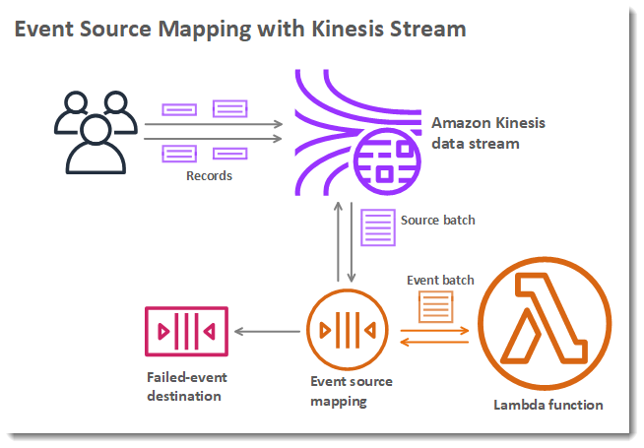

Slide 16
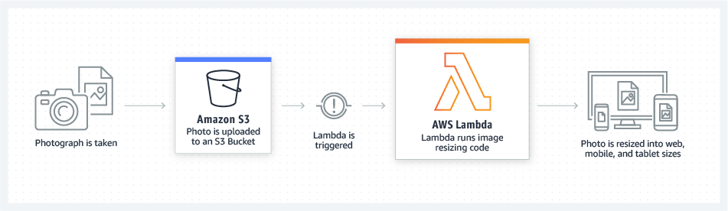
Use Cases of AWS Lambda
You have a photo sharing application. Your application upload photos, and the application stores these user photos in an Amazon S3 bucket.
Lambda function triggers for each photo upload and resize it for web. Mobile and tab size

Slide 17
AWS Lambda Limits
Execution
Memory allocation: 128 MB – 3008 MB (64 MB increments)
Maximum execution time: 900 seconds (15 minutes)
Environment variables (4 KB)
Concurrency executions: 1000 (can be increased)
Deployment
Lambda function deployment size (compressed .zip): 50 MB
Size of uncompressed deployment (code + dependencies): 250 MB
Can use the /tmp directory to load other files at startup
Size of environment variables: 4 KB

Slide 18
Monitoring and Pricing
AWS Lambda automatically monitors Lambda functions on your behalf, reporting metrics through Amazon CloudWatch
Log Captured in CloudWatch in Log Group
Pricing: https://aws.amazon.com/lambda/pricing/
Pay per calls:
First 1,000,000 requests are free
Pay per duration: (in increment of 100ms)
400,000 GB-seconds of compute time per month if FREE
== 400,000 seconds if function is 1GB RAM
== 200,000 seconds if function is 2 GB RAM

