Slide 1
CloudWatch, CloudTrail
What is CloudWatch
How Amazon CloudWatch works
Amazon CloudWatch terminology
CloudWatch Metrics
CloudWatch Custom Metrics
CloudWatch Logs
CloudWatch Logs for EC2
CloudWatch Events
CloudWatch Dashboards
CloudWatch Alarms
AWS CloudTrail
CloudTrail Events

Slide 2
CloudWatch
Amazon CloudWatch is a service that you can use to monitor your AWS resources and your applications in real time.
With Amazon CloudWatch
Metrics: Collect and track key metrics
Logs: Collect, monitor, analyze and store log files
Events: Send notifications when certain events happen in your AWS
Alarms: React in real-time to metrics / events
Amazon CloudWatch offers either basic or detailed monitoring for supported AWS products.
Basic monitoring sends data points to Amazon CloudWatch every five minutes for a limited number of preselected metrics at no charge.
Detailed monitoring sends data points to Amazon CloudWatch every minute and allows data aggregation for an additional charge. If you want to use detailed monitoring, you must enable it—basic is the default.

Slide 3
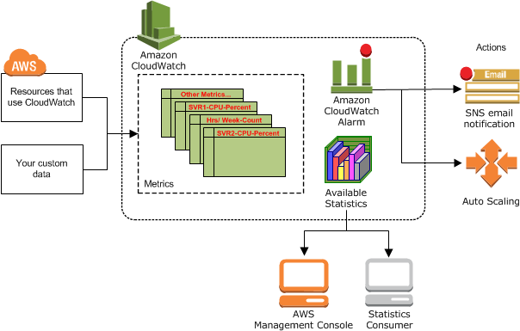
How Amazon CloudWatch works
Amazon CloudWatch is basically a metrics and logs repository.
An AWS service such as Amazon EC2, Load balancer, puts metrics into the repository, and you retrieve statistics based on those metrics.
If you put your own custom metrics into the repository, you can retrieve statistics on these metrics as well.

Slide 4
Amazon CloudWatch terminology
Namespaces: It is a container for CloudWatch metrics. Metrics in different namespaces are isolated from each other.
Metrics: It represents a time-ordered set of data points that are published to CloudWatch
Dimensions: A dimension is a name/value pair that is part of the identity of a metric. You can assign up to 10 dimensions to a metric
Statistics: Statistics are metric data aggregations over specified periods of time. CloudWatch provides statistics based on the metric data points provided.
Alarms: You can use an alarm to automatically initiate actions on your behalf. An alarm watches a single metric over a specified time period, and performs one or more specified actions, based on the value of the metric relative to a threshold over time.

Slide 5
CloudWatch Metrics
Metrics are data about the performance of your systems
CloudWatch provides metrics for every services in AWS.
Ex: CPUUtilization, NetworkIn, DiskReadBytes, NetworkPacketsOut
Metrics belong to namespaces
Dimension is an attribute of a metric (instance id, environment, etc…).
Up to 10 dimensions per metric
Metrics have timestamps
Can create CloudWatch dashboards of metrics

Slide 6
CloudWatch Custom Metrics
You can publish your own metrics to CloudWatch using the AWS CLI or an API.
You can view statistical graphs of your published metrics with the AWS Management Console.
CloudWatch stores data about a metric as a series of data points. Each data point has an associated time stamp
Use API call PutMetricData
AWS CLI
aws cloudwatch put-metric-data --metric-name Buffers --namespace MyNameSpace --unit Bytes --value 231434333 --dimensions InstanceId=1-23456789,InstanceType=m1.small

Slide 7
CloudWatch Logs
Amazon CloudWatch Logs used to monitor, store, and access log files from EC2 instances, AWS CloudTrail, Route 53, and other sources
CloudWatch can collect log from:
Elastic Beanstalk: collection of logs from application
ECS: collection from containers
AWS Lambda: collection from function logs
VPC Flow Logs: VPC specific logs
API Gateway
CloudTrail based on filter
CloudWatch log agents: for example on EC2 machines
Route53: Log DNS queries

Slide 8
CloudWatch Logs for EC2
By default, no logs from your EC2 machine will go to CloudWatch
You need to run a CloudWatch agent on EC2 to push the log files you want
Make sure IAM permissions are correct
The CloudWatch log agent can be setup on-premises too

Slide 9
Amazon CloudWatch Alarms

Slide 10
AWS CloudWatch Events
Schedule: Cron jobs
Event Pattern: Event rules to react to a service doing something
Triggers to Lambda functions, SQS/SNS/Kinesis Messages
CloudWatch Event creates a small JSON document to give information about the change
ECS Batch job

Slide 11
CloudWatch Dashboards
Amazon CloudWatch dashboards are customizable home pages in the CloudWatch console that you can use to monitor your resources in a single view.
CloudWatch dashboards is to create customized views of the metrics and alarms for your AWS resources
You can create dashboards by using the console, the AWS CLI, or the PutDashboard API.
Demo

Slide 12
AWS CloudTrail
Provides governance, compliance, and operational and risk auditing of your AWS account.
Actions taken by a user, role, or an AWS service are recorded as events in CloudTrail.
Get an Events history that include actions taken in the
AWS Management Console
AWS Command Line Interface
AWS SDKs and APIs.
When activity occurs in your AWS account, that activity is recorded in a CloudTrail event

Slide 13
AWS CloudTrail
AWS CloudTrail records user activity by recording API calls made on your account.
It records important information about each API call, including the name of the API, the identity of the caller, the time of the API call, the request parameters, and the response elements returned by the AWS service.
This information helps you to track changes made to your AWS resources and to troubleshoot operational issues.
You can create a trail with the AWS CloudTrail console, the AWS Command Line Interface (CLI), or the AWS CloudTrail API.
A trail is a configuration that enables logging of the AWS API activity and related events in your account

Slide 14
CloudTrail Events
An event in CloudTrail is the record of an activity in an AWS account
CloudTrail events provide a history of both API and non-API account activity made through
AWS Management Console
AWS SDKs
command line tools
other AWS services.
There are three types of events
Management Events
Data Events
CloudTrail Insights events

Slide 15
CloudTrail Events
Management Events
Management events provide information about management operations that are performed on resources in your AWS account. Ex:
Configuring security - IAM AttachRolePolicy
Setting up logging - CloudTrail CreateTrail
Can also include non-API events - Ex: Console login
Data Events
Data events provide information about the resource operations performed on or in a resource. Ex
Amazon S3 - GetObject, DeleteObject, and PutObject API operations
AWS Lambda function execution - Invoke API
Amazon EBS APIs - PutSnapshotBlock, GetSnapshotBlock, and ListChangedBlocks
Not logged by default
To record CloudTrail data events, you must explicitly add to a trail the supported resources
CloudTrail Insights events
CloudTrail Insights events capture unusual activity in your AWS account

