Slide 1
Amazon Simple Notification Service

Slide 2
Amazon Simple Notification Service
Amazon Simple Notification Service (Amazon SNS) is fast, flexible, managed service that provides message delivery from publishers to subscribers
Publishers communicate asynchronously with subscribers by sending messages to a topic
It a web service that coordinates and manages the delivery or sending of messages (from the AWS) to subscribing endpoints.
Messages published to an SNS topics will be delivered to the subscribers immediately

Slide 3
Amazon Simple Notification Service
Instead of including a specific destination address in each message, a publisher sends a message to the topic.
Clients can subscribe to the SNS topic and receive published messages using a supported endpoint type, such as
Amazon Kinesis Data Firehose,
Amazon SQS,
AWS Lambda,
HTTP,
email,
mobile push notifications,
mobile text messages (SMS).

Slide 4
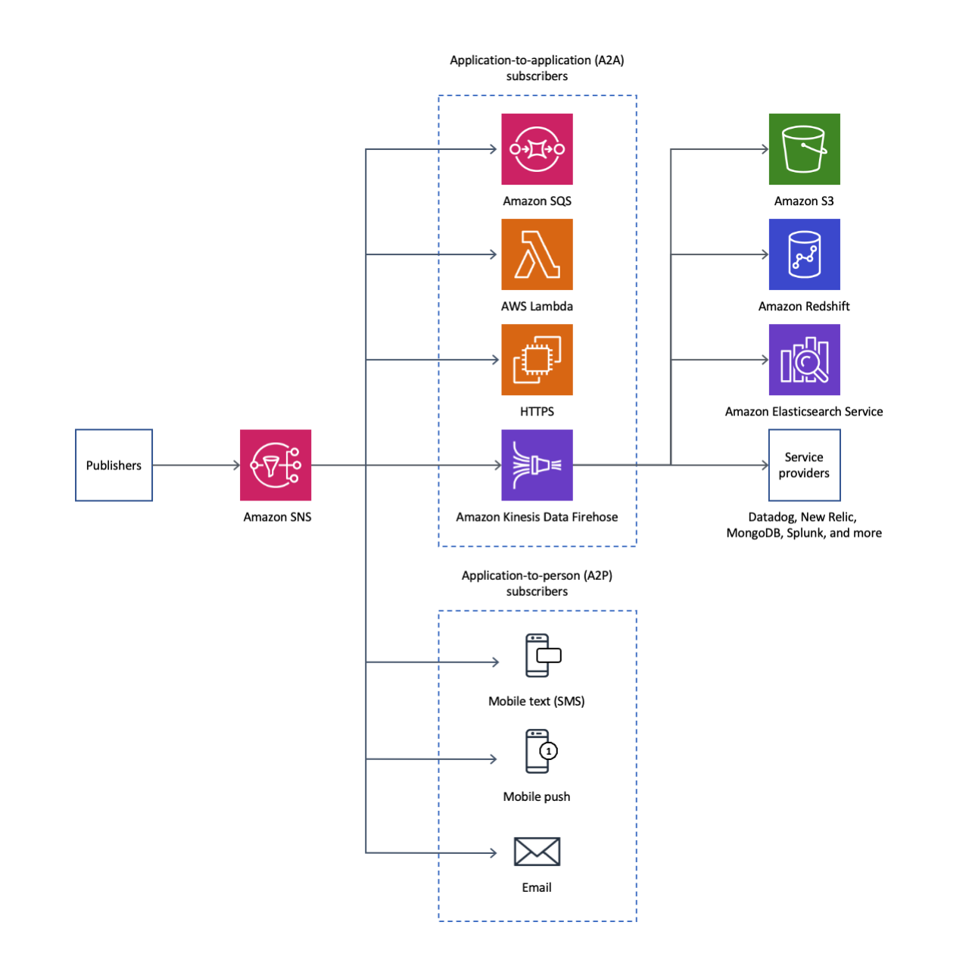

Slide 5
SNS Formats
Email: Messages are sent as text email to registered email addresse
Email – JSON : Messages/notifications are sent as JSON object to registered email addresses
SMS : Notification sent to registered phone number of the topic subscriber endpoint
HTTP/HTTPs: Subscribers specify a URL as part of their registration process. SNS notifications will be sent as “POST” to the URL
SQS : SNS will en-queue messages in the specified SQS queue as the notification endpoint
AWS Lambda

Slide 6
SNS Mobile Push Notifications
SNS Mobile Push lets you use SNS to deliver push notifications to Apple, Google, Fire OS, and Windows devices
With push notifications, an installed mobile application can notify its users immediately by popping a notification about an event, without opening the application.
Push notifications can only be sent to devices that have your app installed, and whose users have opted in to receive them.
In order to send push notifications with SNS, you must also register your app and each installed device with SNS.
When you publish a notification to a topic, SNS will send identical copies of that message to each endpoint subscribed to the topic

