Slide 1
Docker
Docker Introduction
Usage of Docker
Docker architecture
Docker Terminologies
Docker Image Repository
Virtual Machines Vs Docker Containers

Slide 2
Docker Introduction
Docker is a software that performs OS level virtualization, also known as “containerization”
Docker is not a virtual machine
It is a popular tool to build, deploy and run applications using containers
Apps are packaged in containers that can be run on any OS
Dockers benefits include
Works in any machine
No compatibility issues
Predictable behavior
Deploy in seconds
Easier to maintain and deploy
Works with any language, any OS, any technology.

Slide 3
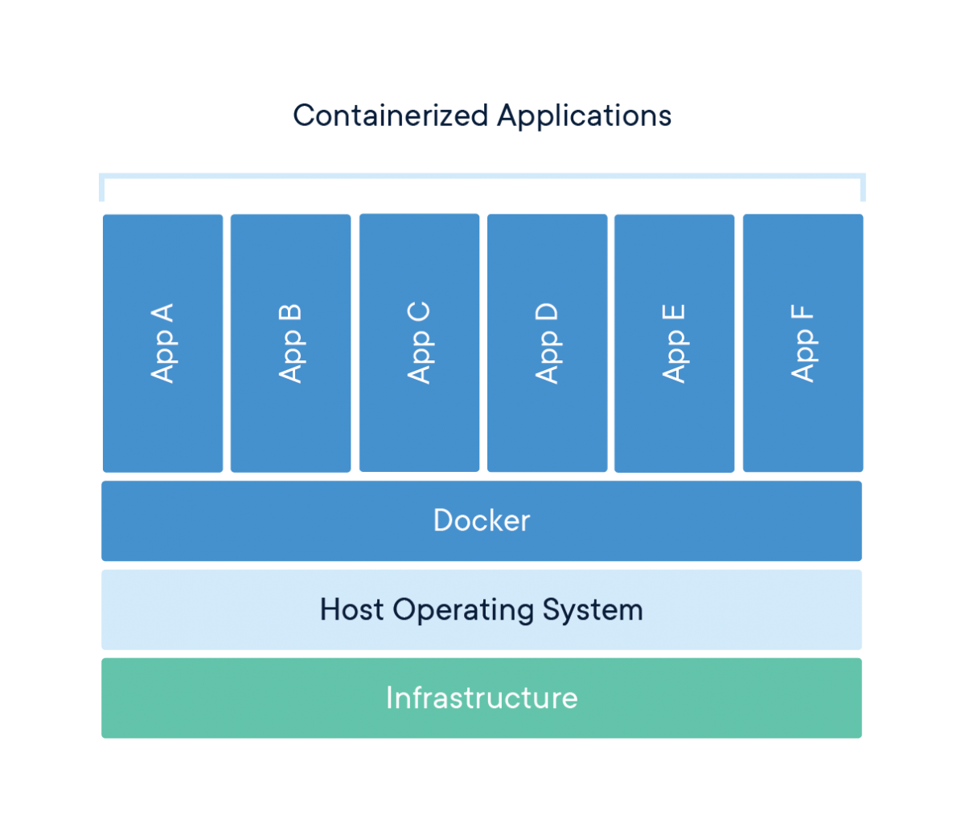

Slide 4
Usage of Docker
Fast, consistent delivery of your applications
Containers are great for continuous integration and continuous delivery (CI/CD) workflows
Responsive deployment and scaling
Docker’s container-based platform allows for highly portable workloads.
Docker containers can run on a
Developer’s local machine
On physical or virtual machines
On cloud providers
On a mixture of environments
Running more workloads on the same hardware

Slide 5
Docker Architecture
Docker uses a client-server architecture.
The Docker client talks to the Docker daemon, which does building, running, and distributing your Docker containers.
The Docker client and daemon can run on the same system, or you can connect a Docker client to a remote Docker daemon.
The Docker client and daemon communicate using a REST API, over UNIX sockets or a network interface.

Slide 6
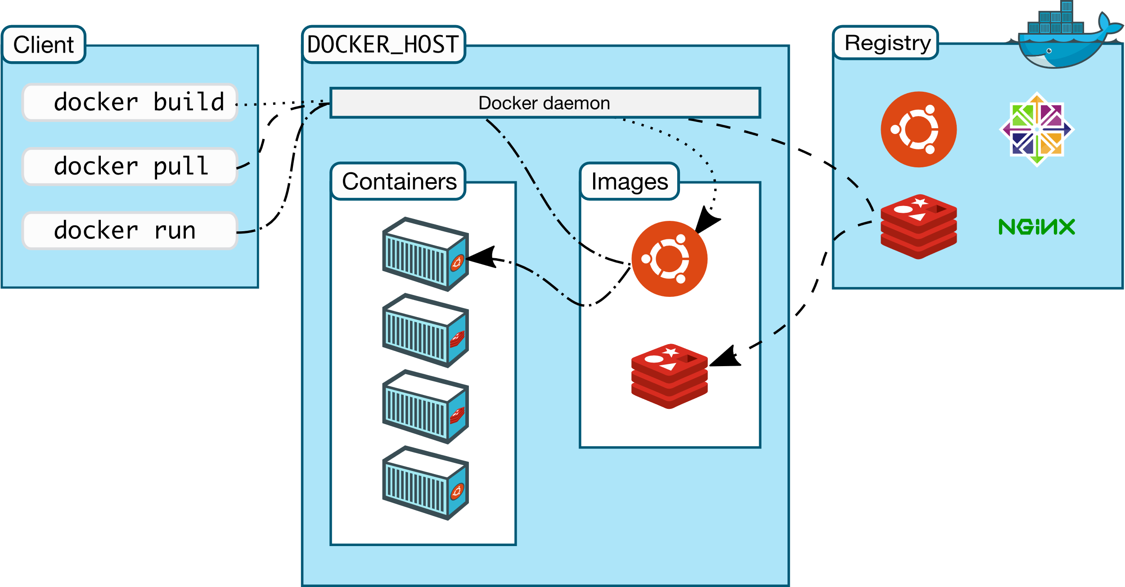

Slide 7
Docker Terminologies
The Docker Daemon
It listens for Docker API requests and manages Docker objects such as images, containers, networks, and volumes.
The Docker Client
It is the primary way that many Docker users interact with Docker. The Docker client can communicate with more than one daemon.
Docker Registries
It stores Docker images.
Docker Hub is a public registry that anyone can use.
Amazon ECR is another example

Slide 8
Docker Terminologies
Docker File
A Dockerfile is a text document that contains all the commands a user could call on the command line to assemble an image.
Docker Images
An image is a read-only template with instructions for creating a Docker container.
An image is based on another image, with some additional customization.
Docker Container
A container is a runnable instance of an image.
You can create, start, stop, move, or delete a container using the Docker API or CLI.

Slide 9
Docker Image Repository
Docker images are stored in Docker Repositories
Public Repo: Docker Hub https://hub.docker.com/
Find base images for many technologies or OS:
Ubuntu
MySQL
NodeJS, Java…
Private Repo:
Amazon ECR (Elastic Container Registry)
JFrog
Nexus

Slide 10
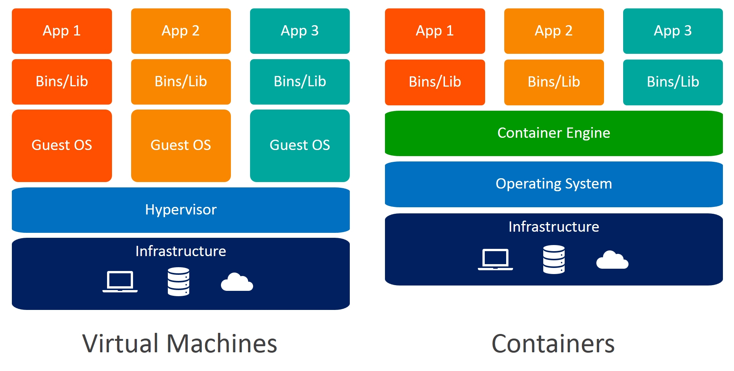
Docker versus Virtual Machines

Slide 11
Virtual Machines Vs Docker Containers
Virtual Machines
Need more resources
Process isolation is done at hardware level
Separate Operating System for each VM
VMs can be customized
Takes time to create Virtual Machine
Booting takes minutes Booting is done within seconds
Docker Containers
Less resources are used
Process Isolation is done at Operating System level
Operating System resources can be shared within Docker
Custom container setup is easy
Creation of docker is very quick
Booting is done within seconds

Slide 13
Docker containers are very easy to deploy in any cloud platform.
It can get more applications running on the same hardware when compared to other technologies
It makes it easy for developers to quickly create, ready-to-run containerized applications and it makes managing and deploying applications much easier.
There is no limitation on running Docker as the underlying infrastructure can be your laptop or else your Organization’s Public / Private cloud space

Slide 14
The purpose of Docker is to help developers and dev-ops team in becoming more productive and less error prone.
Setup and deployment of new projects becomes much more easier and time efficient with the help of Docker.

