Slide 1
Docker Architecture

Slide 2
Docker Architecture
Docker CLI
Docker Daemon
REST API

Slide 3
Docker Daemon
Docker Object
Images
Volumes
Networks
Containers
Manage
Run
Images
Volume
Network
Containerd
Manage Container
runC
Run Container

Slide 4
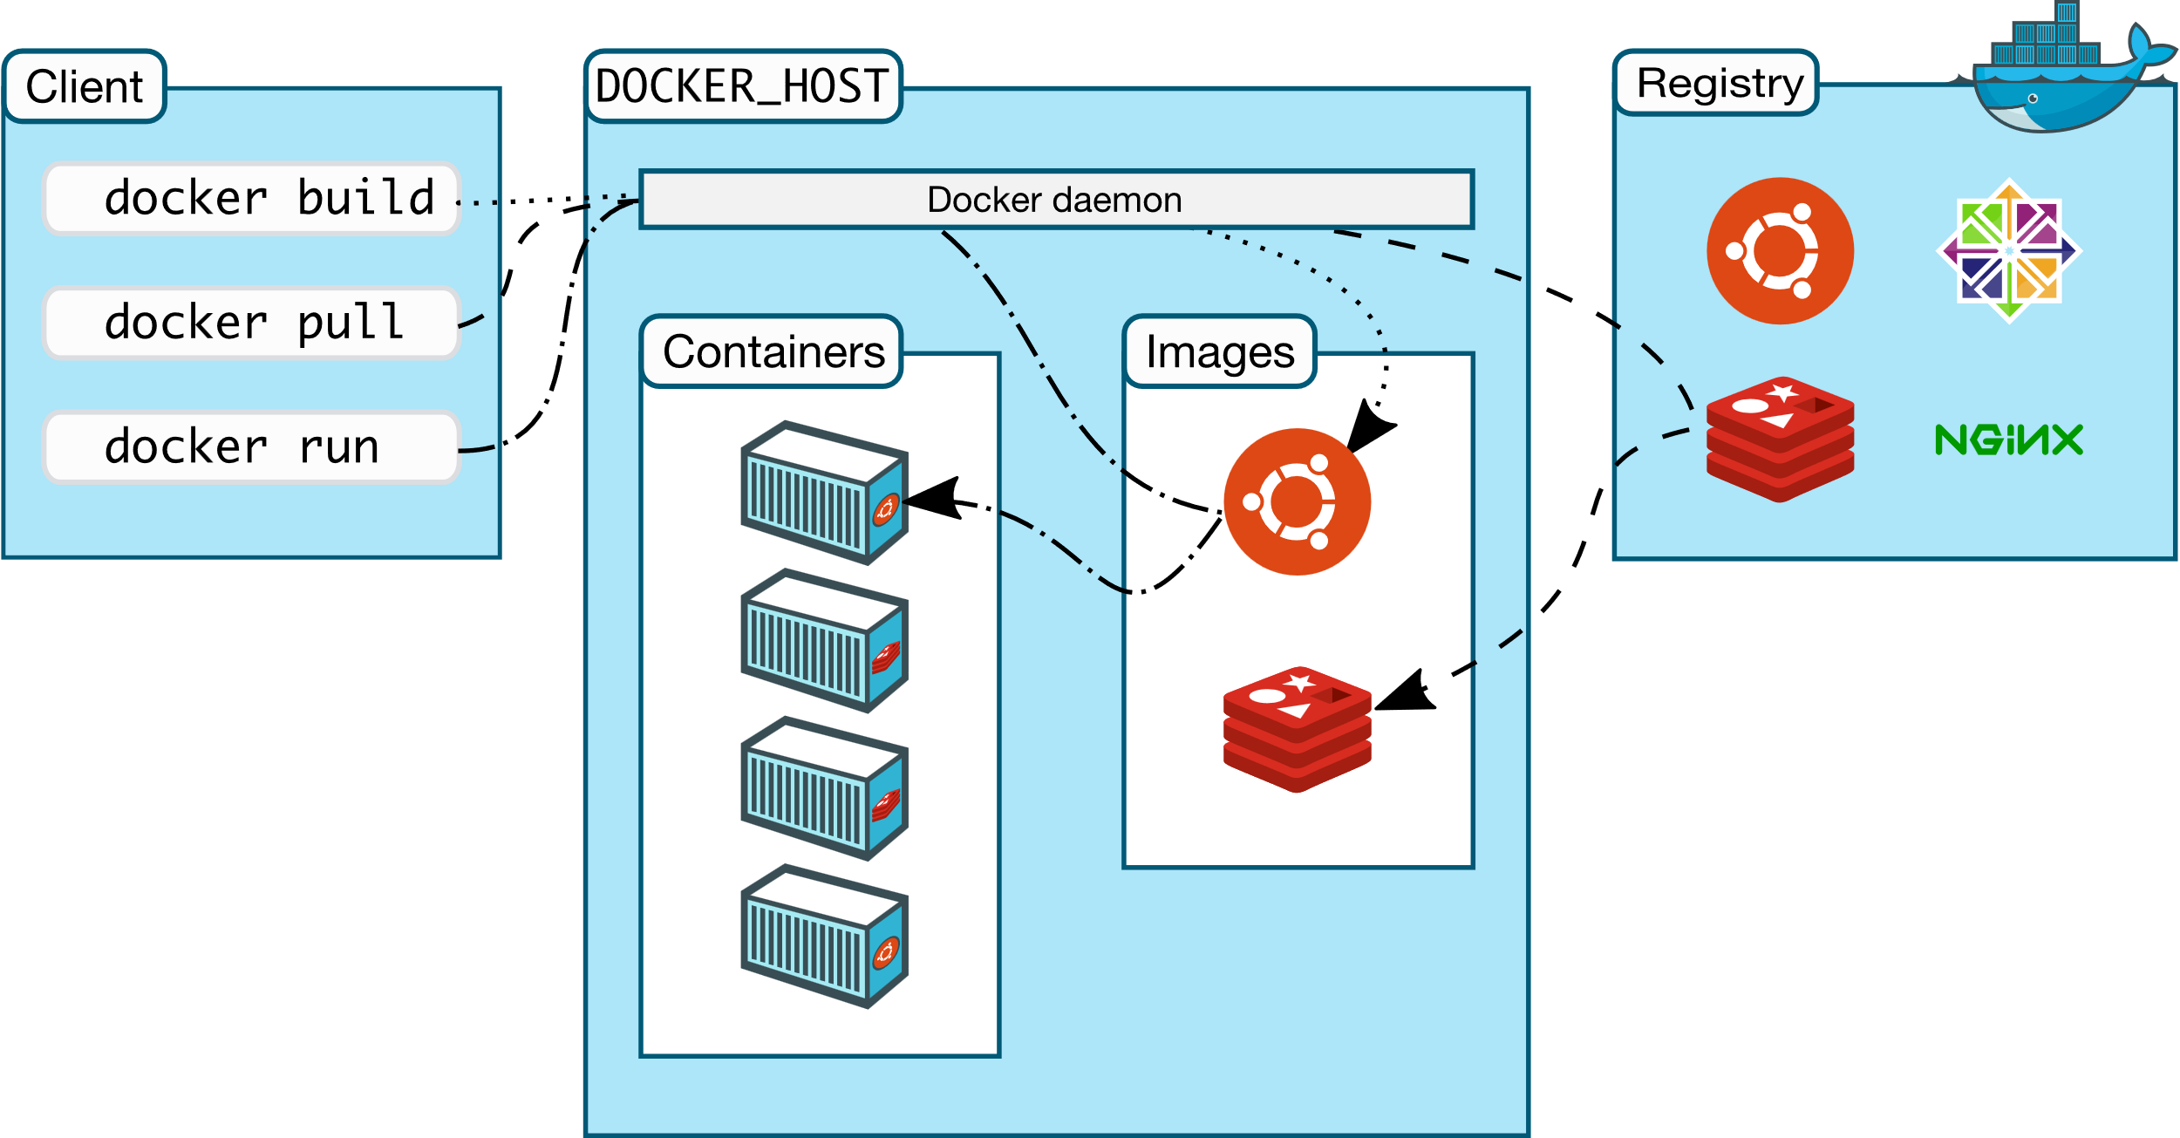

Slide 5
Docker Installation
https://docs.docker.com/engine/install/
Docker version
Docker –v
Docker system info
Docker run –p 80:80 nginx

Slide 6
Docker Command
docker <docker-object> <sub-command> [options] <Arguments/Commands>
docker image ls
docker volume ls
docker network ls
docker container ls

Slide 7
Create a New Container
Create a new container
docker container create nginx
Check the container:
cd /var/lib/docker/containers
ls –l
List the details for container
docker container ls
docker container ls -aq

Slide 8
Start A Container
Start a container which is created earlier
docker container start 104be62d7603
docker container ls

Slide 9
Create and Start a container (run)
Run a container
docker container run ubuntu
docker container ls -a
docker container run -it ubuntu (interactive)
docker container run -it --name=webapp ubuntu
Rename
docker container rename webapp mywebapp
Run in a detached mode
docker container run –d --name=webapp ubuntu
docker container attach 19cb

Slide 10
Executing Commands
docker container exec -it 56rt /bin/bash
Attach the container
docker container attach 56rt
Demo:
run container without attach
With attach using –d option
Attach existing running container using attach option

Slide 11
Container Inspect
docker container inspect webapp
Display detailed information on one or more containers

Slide 12
Container Stats
docker container stats
Display a live stream of container(s) resource usage statistics
docker stats [OPTIONS] [CONTAINER...]
docker stats webservice 67b2525d8ad1
docker stats --format "{{.Container}}: {{.CPUPerc}}“
docker stats --format "table {{.Container}}\t{{.CPUPerc}}\t{{.MemUsage}}"

Slide 13
Container Top
docker container top webapp
Display the running processes of a container

Slide 14
Container Logs
docker container logs webapp
docker container logs -f webapp

Slide 15
Stop, Pause, delete
docker container pause webapps
docker container unpause webapps
docker container stop webapps
docker container rm webapps
Stop all containers
docker container stop $(docker container ls -q)
Remove all containers
docker container rm $(docker container ls -aq)
docker container prune

Slide 16
Container host name set
docker container run –itd –name=mynginx --hostname=nginxserver Container name always unique. But multiple container have same host name

Slide 17
Container restart policy
To configure the restart policy for a container, use the --restart flag when using the docker run command.
Flag | Description
no | Do not automatically restart the container. (the default)
on-failure | Restart the container if it exits due to an error
always | Always restart the container if it stops.
unless-stopped | Similar to always, except that when the container is stopped (manually or otherwise), it is not restarted even after Docker daemon restarts.

Slide 18
Container restart policy example
docker container run -itd --name=nginx1 --restart=no nginx
If you stop the container, it will not start automatically. It’s the default option
docker container run -itd --name=nginx2 --restart=on-failure nginx
The container will start again if it fails due to an error
docker container run -itd --name=nginx3 --restart=always nginx
Always restart the container if it stops
docker container run -itd --name=nginx4 --restart=unless-stopped nginx
The container will not start again if it is stops manually. Not even container engine restarts
docker container stop nginx4
systemctl restart docker

Slide 19
Copy files in docker (docker cp)
Copy files/folders between a container and the local filesystem
Copy a local file into container
docker cp ./some_file CONTAINER:/work
Copy files from container to local path
docker cp CONTAINER:/var/logs/ /tmp/app_logs
Ex:
docker container cp index.html myhttpd:/var/www/http

Slide 20
Docker port mapping
By default, when you create or run a container using docker create or docker run, it does not publish any of its ports to the outside world.
To make a port available to services outside of Docker
use the --publish or -p flag.
Flag value | Description
-p 8080:80 | Map TCP port 80 in the container to port 8080 on the Docker host.
-p 192.168.1.100:8080:80 | Map TCP port 80 in the container to port 8080 on the Docker host for connections to host IP 192.168.1.100.
-p 8080:80/udp | Map UDP port 80 in the container to port 8080 on the Docker host.
-p 8080:80/tcp -p 8080:80/udp | Map TCP port 80 in the container to TCP port 8080 on the Docker host, and map UDP port 80 in the container to UDP port 8080 on the Docker host.

Slide 21
Docker port mapping
docker container run -itd --name=mynginx --p 8080:80 nginx
Host port: 8080
Container port: 80

Slide 22
Free Disk Space on Host
df –h
docker container prune
docker image prune

Slide 23
We deployed a container called webapp. Inspect this container to get the restart policy.
docker container inspect webapp | grep restart
docker container top webapp | grep restart
docker container run webapp | grep restart
docker container logs webapp | grep restart

Slide 24
We deployed a container called webapp. Inspect this container to get the restart policy.
docker container inspect webapp | grep restart
docker container top webapp | grep restart
docker container run webapp | grep restart
docker container logs webapp | grep restart

Slide 25
Which command is used to get the stream logs of the webapp container so that you can view the logs live?
docker container log webapp
docker container log -f webapp
docker container logs webapp
docker container logs -f webapp

Slide 26
Which command is used to get the stream logs of the webapp container so that you can view the logs live?
docker container log webapp
docker container log -f webapp
docker container logs webapp
docker container logs -f webapp

