Slide 1
Docker volume

Slide 2
Docker Volume
The data doesn’t persist when the container no longer exists
A container’s writable layer is tightly coupled to the host machine where the container is running.
Writing into a container’s writable layer requires a storage driver to manage the filesystem.
Docker has two options for containers to store files on the host machine, so that the files are persisted even after the container stops:
volumes
bind mounts.

Slide 3
Volume mount
Volumes are stored in a part of the host filesystem which is managed by Docker (/var/lib/docker/volumes/ on Linux).
Non-Docker processes should not modify this part of the filesystem.
Volumes are the best way to persist data in Docker.
Bind mounts may be stored anywhere on the host system.
They may even be important system files or directories.
Non-Docker processes on the Docker host or a Docker container can modify them at any time.

Slide 4
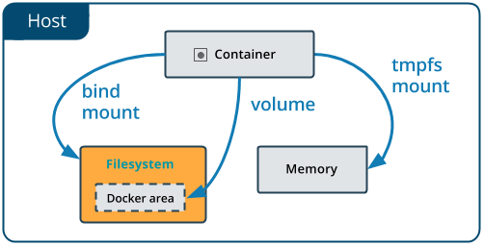

Slide 5
Docker volume commands
Create a volume:
docker volume create my-vol
List volumes:
docker volume ls
Inspect a volume:
docker volume inspect my-vol
Remove a volume:
docker volume rm my-vol
docker volume prune

Slide 6
Container with volume
Start a container with a volume
docker run -d --name devtest --mount source=myvol2,target=/app nginx:latest
docker run -d --name devtest -v myvol2:/app nginx:latest
docker inspect devtest

Slide 7
Bind mounts
When you use a bind mount, a file or directory on the host machine is mounted into a container.
docker run -d -it --name devtest --mount type=bind,source=/tmp,target=/app nginx:latest
docker run -d -it --name devtest -v /tmp:/app nginx:latest
docker inspect devtest

